Slide 1
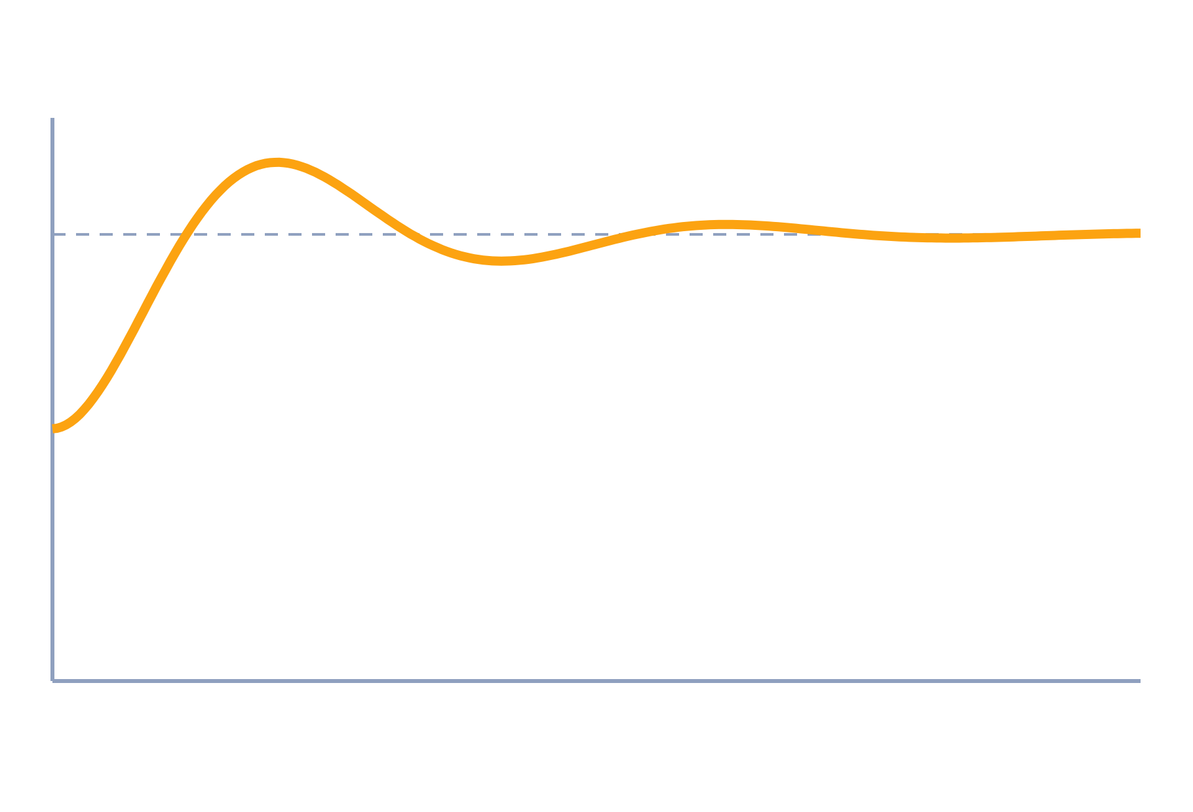
Control Systems and Transfer Functions
Control Systems (22EEG53)
Unit 1: Mathematical Modelling of Physical Systems
Topic: Open/closed loop systems, components, transfer functions of mechanical and electrical systems
Prof. Mitesh Astik
Notes:
Welcome everyone. Today's topic is Open/closed loop systems, components, transfer functions of mechanical and electrical systems. It belongs to Unit 1: Mathematical Modelling of Physical Systems. By the end of this session you will be able to use it in numerical problems. Keep your notebooks ready because we will solve two examples.

Slide 2

Learning Outcomes
Distinguish open-loop and closed-loop systems with examples.
Name the components of a feedback control system.
Write transfer functions of mechanical and electrical systems.
Use the force–voltage analogy between the two.
Linked to CO1
Model dynamical systems by transfer functions; deduce mechanical–electrical analogy.
Notes:
Read the outcomes aloud. They map to CO1 of the syllabus. Tell students that these are examinable and that the two solved examples follow the same pattern. Ask them to tick off each outcome at the end of the lecture.

Slide 3
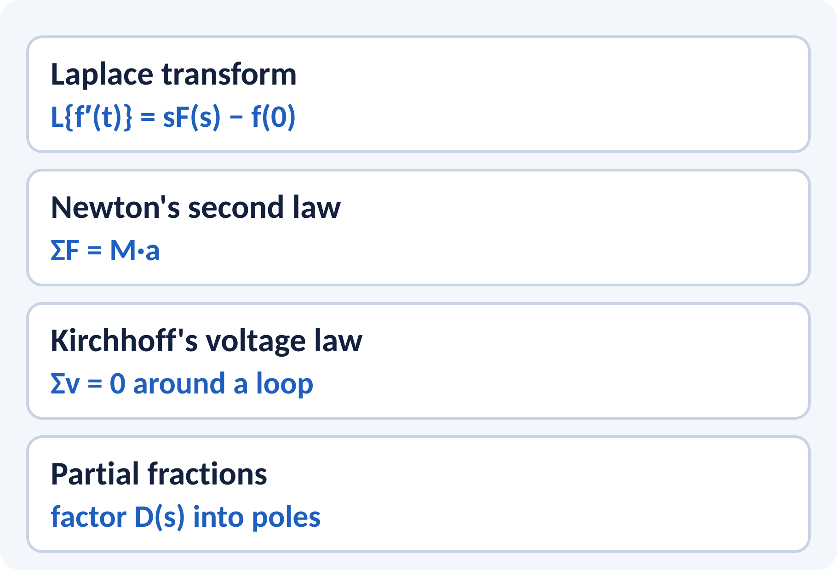
Recap: What You Already Know
Laplace transform turns differential equations into algebra.
Newton's law links force, mass and acceleration.
Kirchhoff's laws give circuit equations.
Poles are roots of the denominator.
Zero initial conditions: L{dx/dt} = sX(s), L{d²x/dt²} = s²X(s)
X(s) Laplace transform of x(t), s complex frequency (1/s)
Notes:
Ask students to recall the Laplace transform of a derivative with zero initial conditions. That single rule is used in every model we derive today. Newton's law and Kirchhoff's voltage law are the two sources of equations. Revise partial fractions at home because we need them for time response in the next unit.

Slide 4
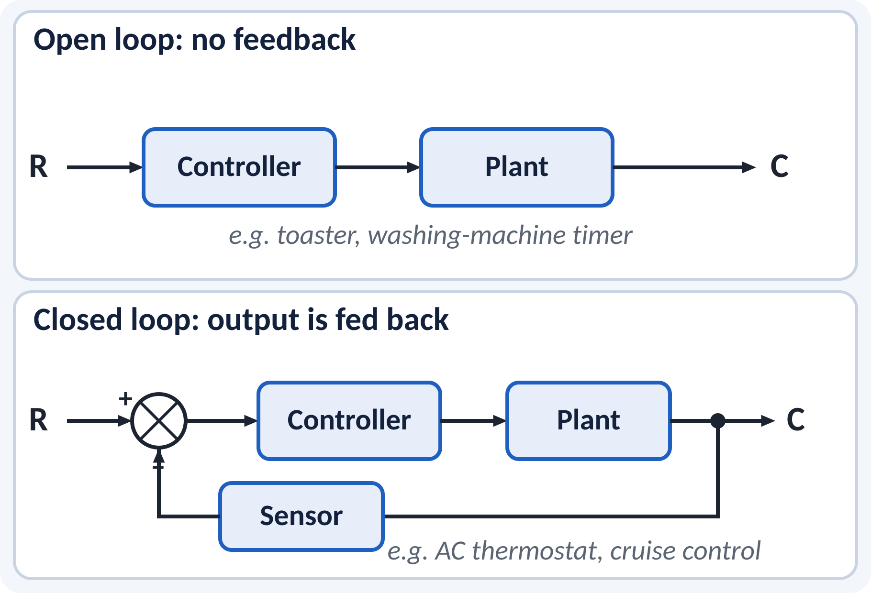
Motivation: Why Feedback?
Cruise control keeps speed on a hill.
Home AC keeps room temperature near set value.
Robot arm must reach the commanded position.
Feedback corrects errors caused by disturbances.
Control aim: make the output follow the reference despite disturbances
Notes:
A toaster runs for a fixed time regardless of the bread colour, which is open-loop. A thermostat measures the room and switches the compressor, which is closed-loop. Feedback lets the system correct itself when conditions change. This is the central idea of the whole course.

Slide 5
Open Loop and Closed Loop
Open loop: output has no effect on control action.
Closed loop: output is measured and fed back.
Open loop: simple, cheap, but sensitive to disturbance.
Closed loop: accurate, but more complex; can become unstable.
Closed loop: e = r − b, b = H·c
r reference, c output, b feedback signal, e error
Notes:
Compare the two diagrams. The only difference is the feedback path and the summing junction. Open-loop systems are accurate only if the plant is well known and there is no disturbance. Closed-loop systems reduce the effect of disturbance and parameter changes, but poorly chosen feedback can cause oscillation, which we study under stability.

Slide 6
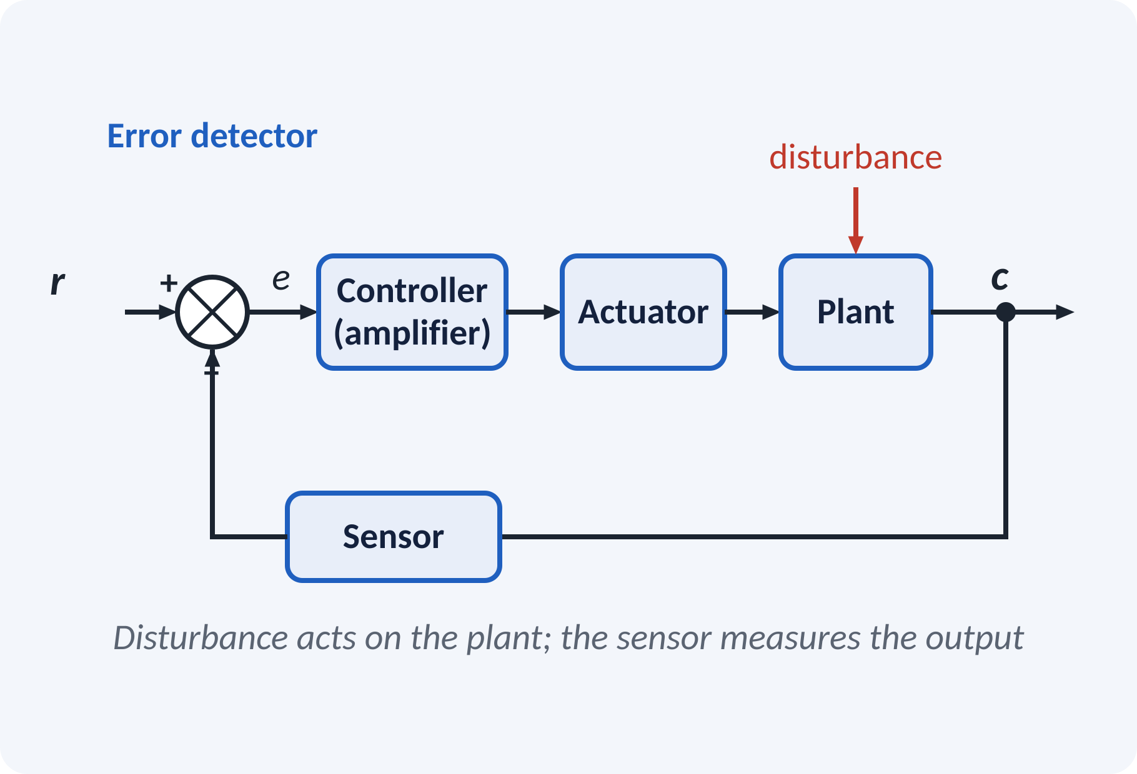
Components of a Control System
Error detector: compares reference with feedback.
Controller or amplifier: processes the error signal.
Actuator: motor or valve that drives the plant.
Plant: the process being controlled.
Sensor: measures output, e.g. tachometer or synchro.
Examples: potentiometer, synchro pair, tachogenerator, DC servo motor
Notes:
Walk through the chain from left to right. The error detector subtracts the measured value from the reference. The controller shapes the signal and the actuator supplies power to the plant. The sensor closes the loop. In the lab you will use a synchro pair as an error detector and a DC motor as the actuator.

Slide 7
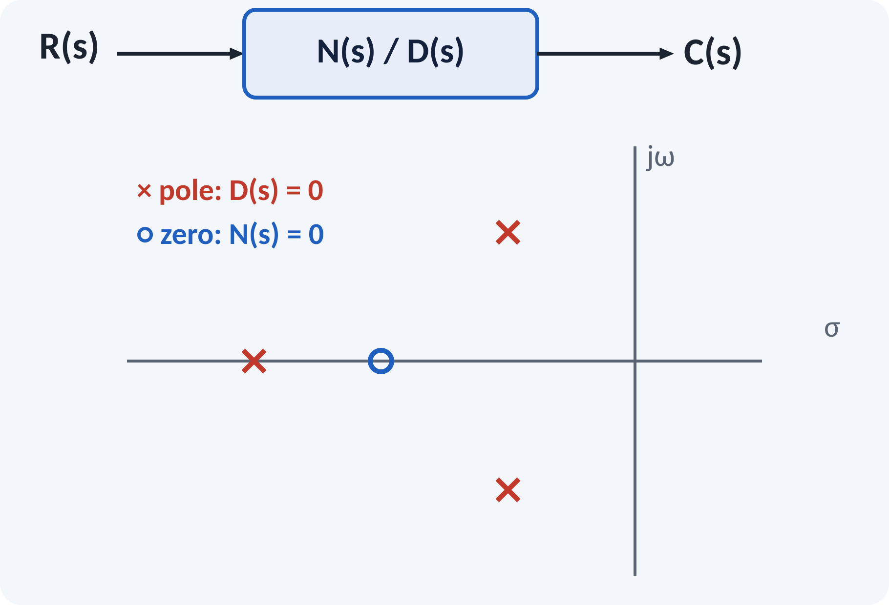
Transfer Function
Ratio of output to input in Laplace domain.
Initial conditions are taken as zero.
Valid for linear time-invariant systems.
Roots of D(s) are poles; roots of N(s) are zeros.
G(s) = C(s)/R(s) = N(s)/D(s)
D(s) = 0 is the characteristic equation of the system
Notes:
The transfer function is the output over the input after taking Laplace transforms with zero initial conditions. It depends only on the system and not on the input signal. The poles decide how the system behaves in time, so we study their locations carefully. It is defined only for linear time-invariant systems.

Slide 8
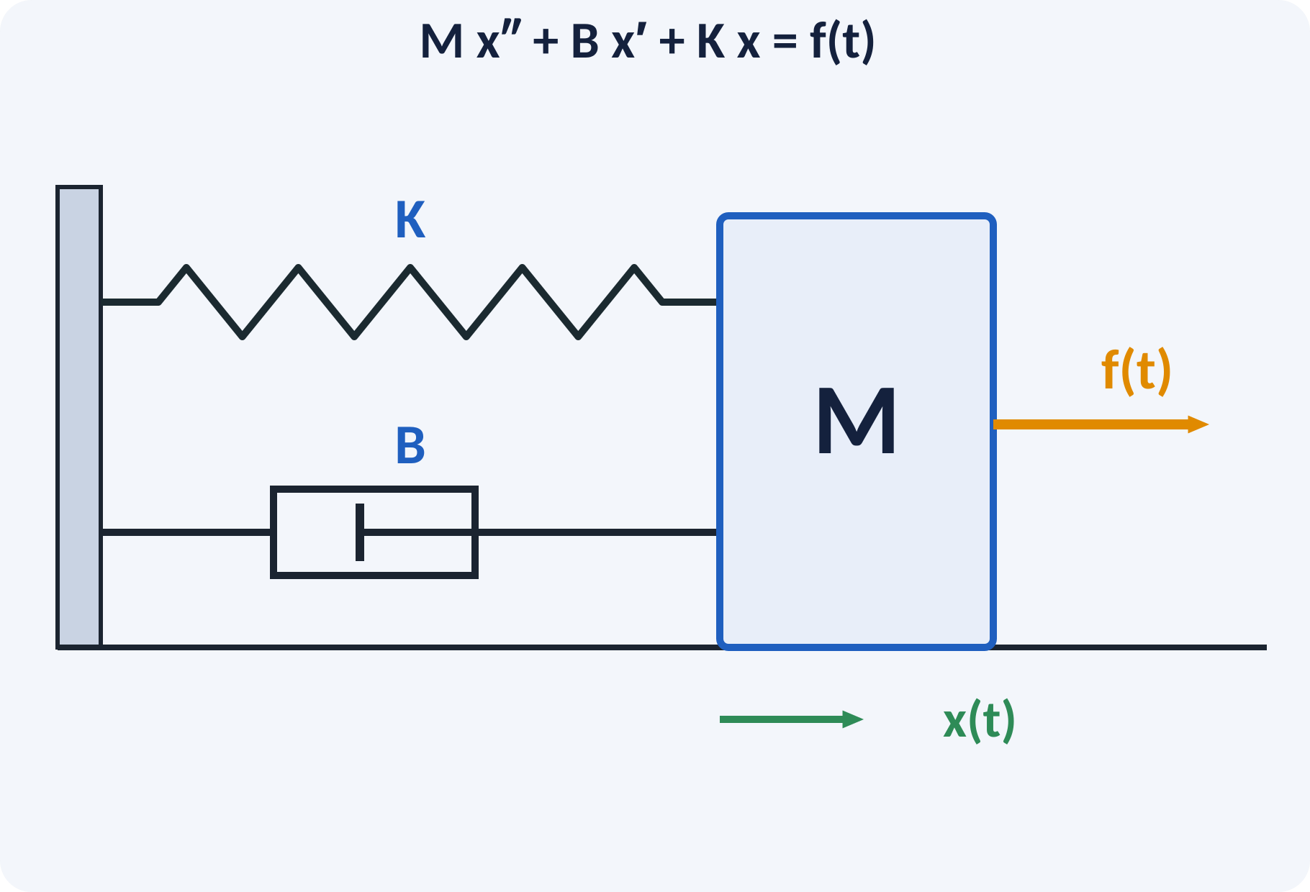
Translational Mechanical Systems
Mass M: opposes acceleration, force = M·x″.
Damper B: opposes velocity, force = B·x′.
Spring K: opposes displacement, force = K·x.
Apply Newton's law to the mass.
Take the Laplace transform and divide.
M x″ + B x′ + K x = f(t) → X(s)/F(s) = 1/(M s² + B s + K)
M kg, B N·s/m, K N/m, x m, f N
Notes:
Draw the free body diagram of the mass. The spring and damper forces act against the motion, and the applied force acts along it. Newton's law gives the second-order equation. After Laplace transform with zero initial conditions we get one over M s squared plus B s plus K. Notice the standard second-order form from the previous lecture.

Slide 9
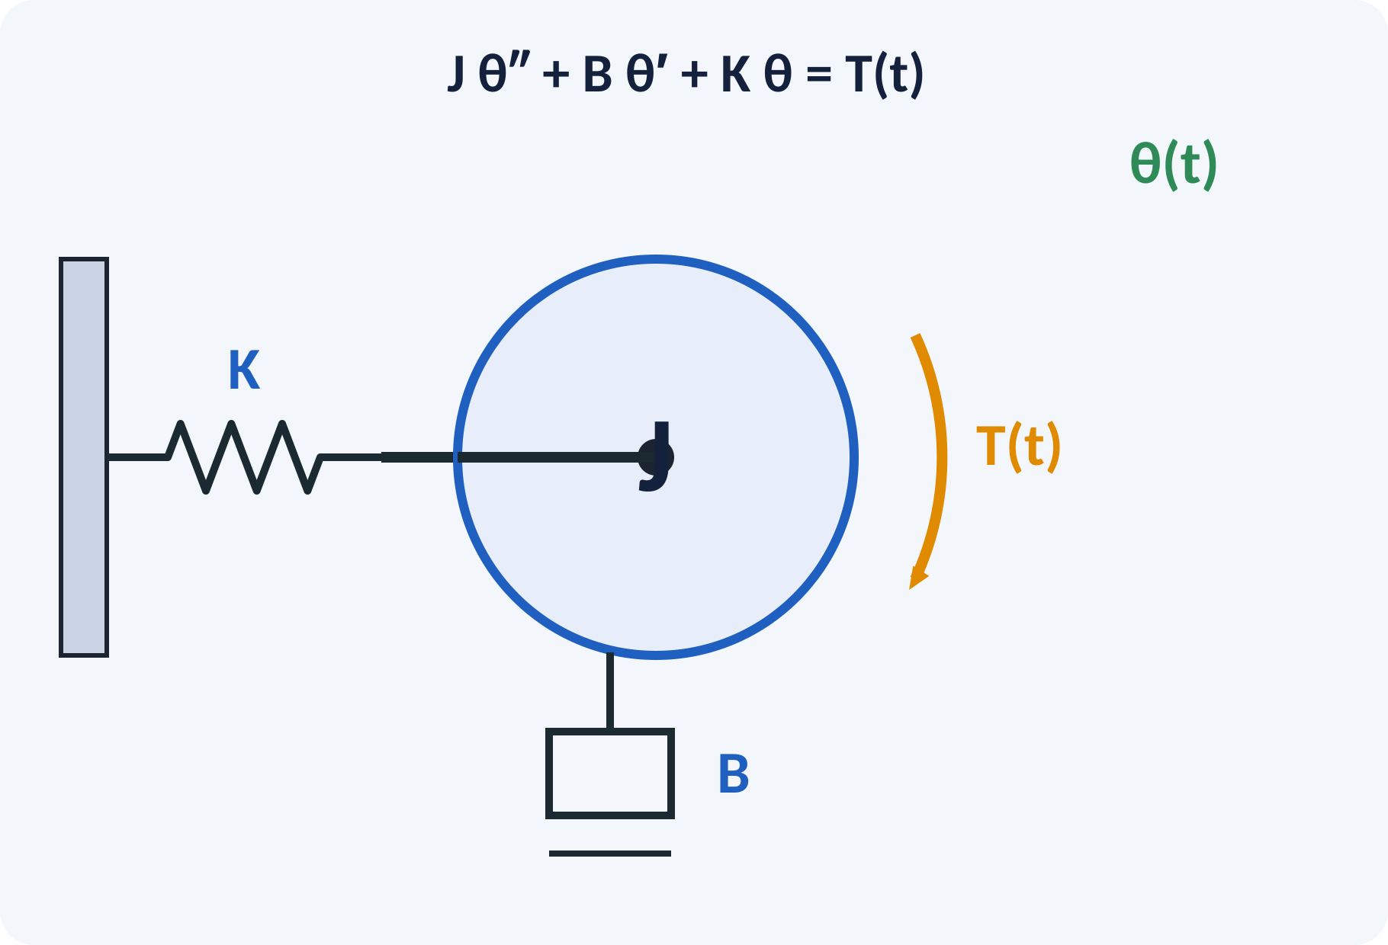
Rotational Mechanical Systems
Inertia J: torque = J·θ″.
Viscous friction B: torque = B·θ′.
Torsional spring K: torque = K·θ.
Same steps: torque balance, Laplace, divide.
J θ″ + B θ′ + K θ = T(t) → Θ(s)/T(s) = 1/(J s² + B s + K)
J kg·m², B N·m·s/rad, K N·m/rad, θ rad, T N·m
Notes:
Rotational systems follow the same pattern with torque instead of force and angle instead of displacement. J plays the role of mass, B of viscous friction and K of the torsional spring. Use SI units throughout, for example kg·m² for inertia. A servo motor driving a load is the common example.

Slide 10
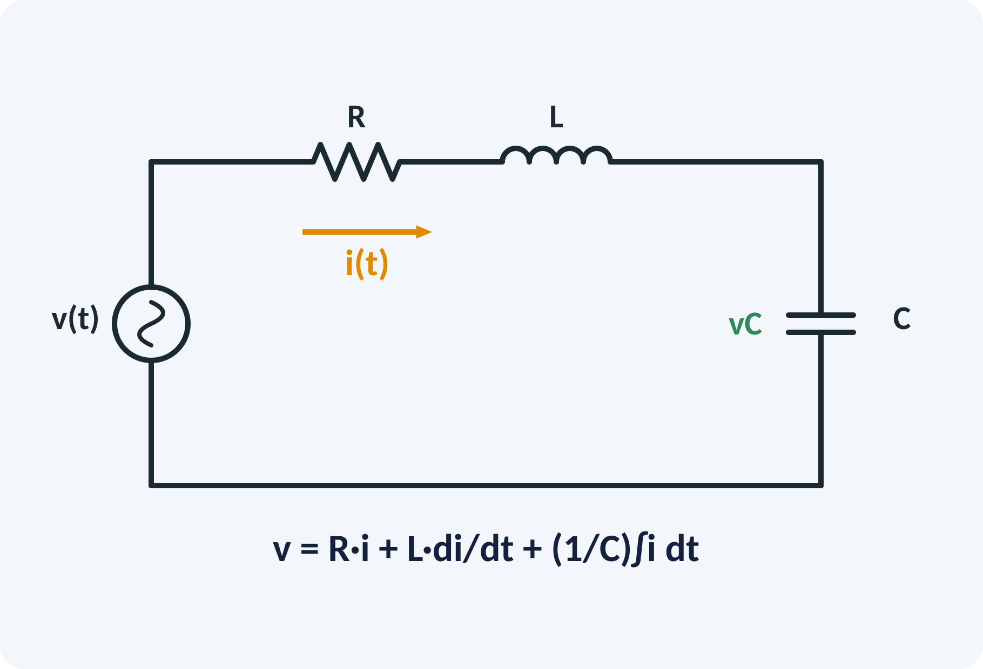
Electrical Systems
Resistor: v = R·i.
Inductor: v = L·di/dt.
Capacitor: v = (1/C)∫i dt.
Apply KVL, then Laplace transform.
Choose the output, e.g. voltage across C.
VC(s)/V(s) = 1/(L C s² + R C s + 1)
R Ω, L H, C F, i A, v V
Notes:
For the series RLC circuit, Kirchhoff's voltage law gives the sum of the three drops equal to the source. The current is C times the derivative of the capacitor voltage, so we can write everything in terms of vC. Taking the Laplace transform gives one over L C s squared plus R C s plus one. This is again a second-order system.

Slide 11
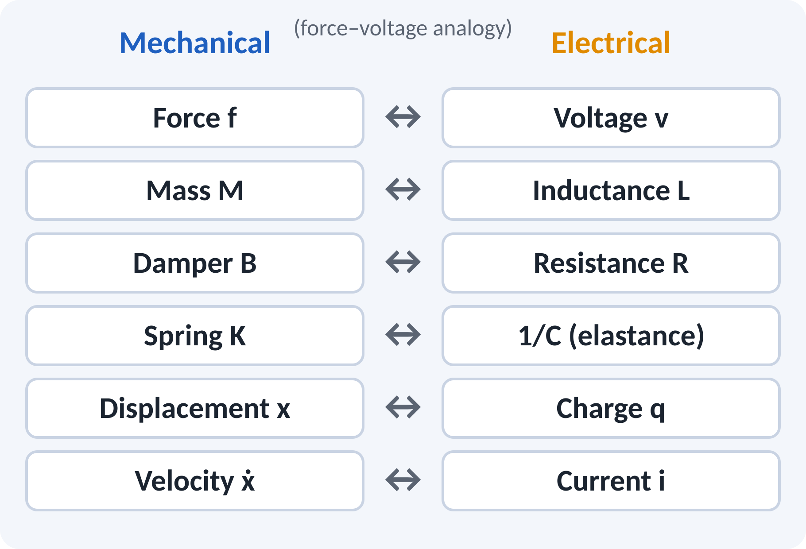
Analogous Systems
Same differential equation, different physical quantities.
Force–voltage analogy: M↔L, B↔R, K↔1/C.
Force–current analogy: M↔C, B↔1/R, K↔1/L.
Lets us study a mechanical system with a circuit.
M x″ + B x′ + K x = f ⇔ L q″ + R q′ + (1/C) q = v
x ↔ q, ẋ ↔ i
Notes:
Compare the two differential equations term by term. Mass corresponds to inductance, damper to resistance and spring to the reciprocal of capacitance. This is the force–voltage analogy. The force–current analogy exists too, with a different mapping. The practical value is that a circuit is easy to build and measure.

Slide 12
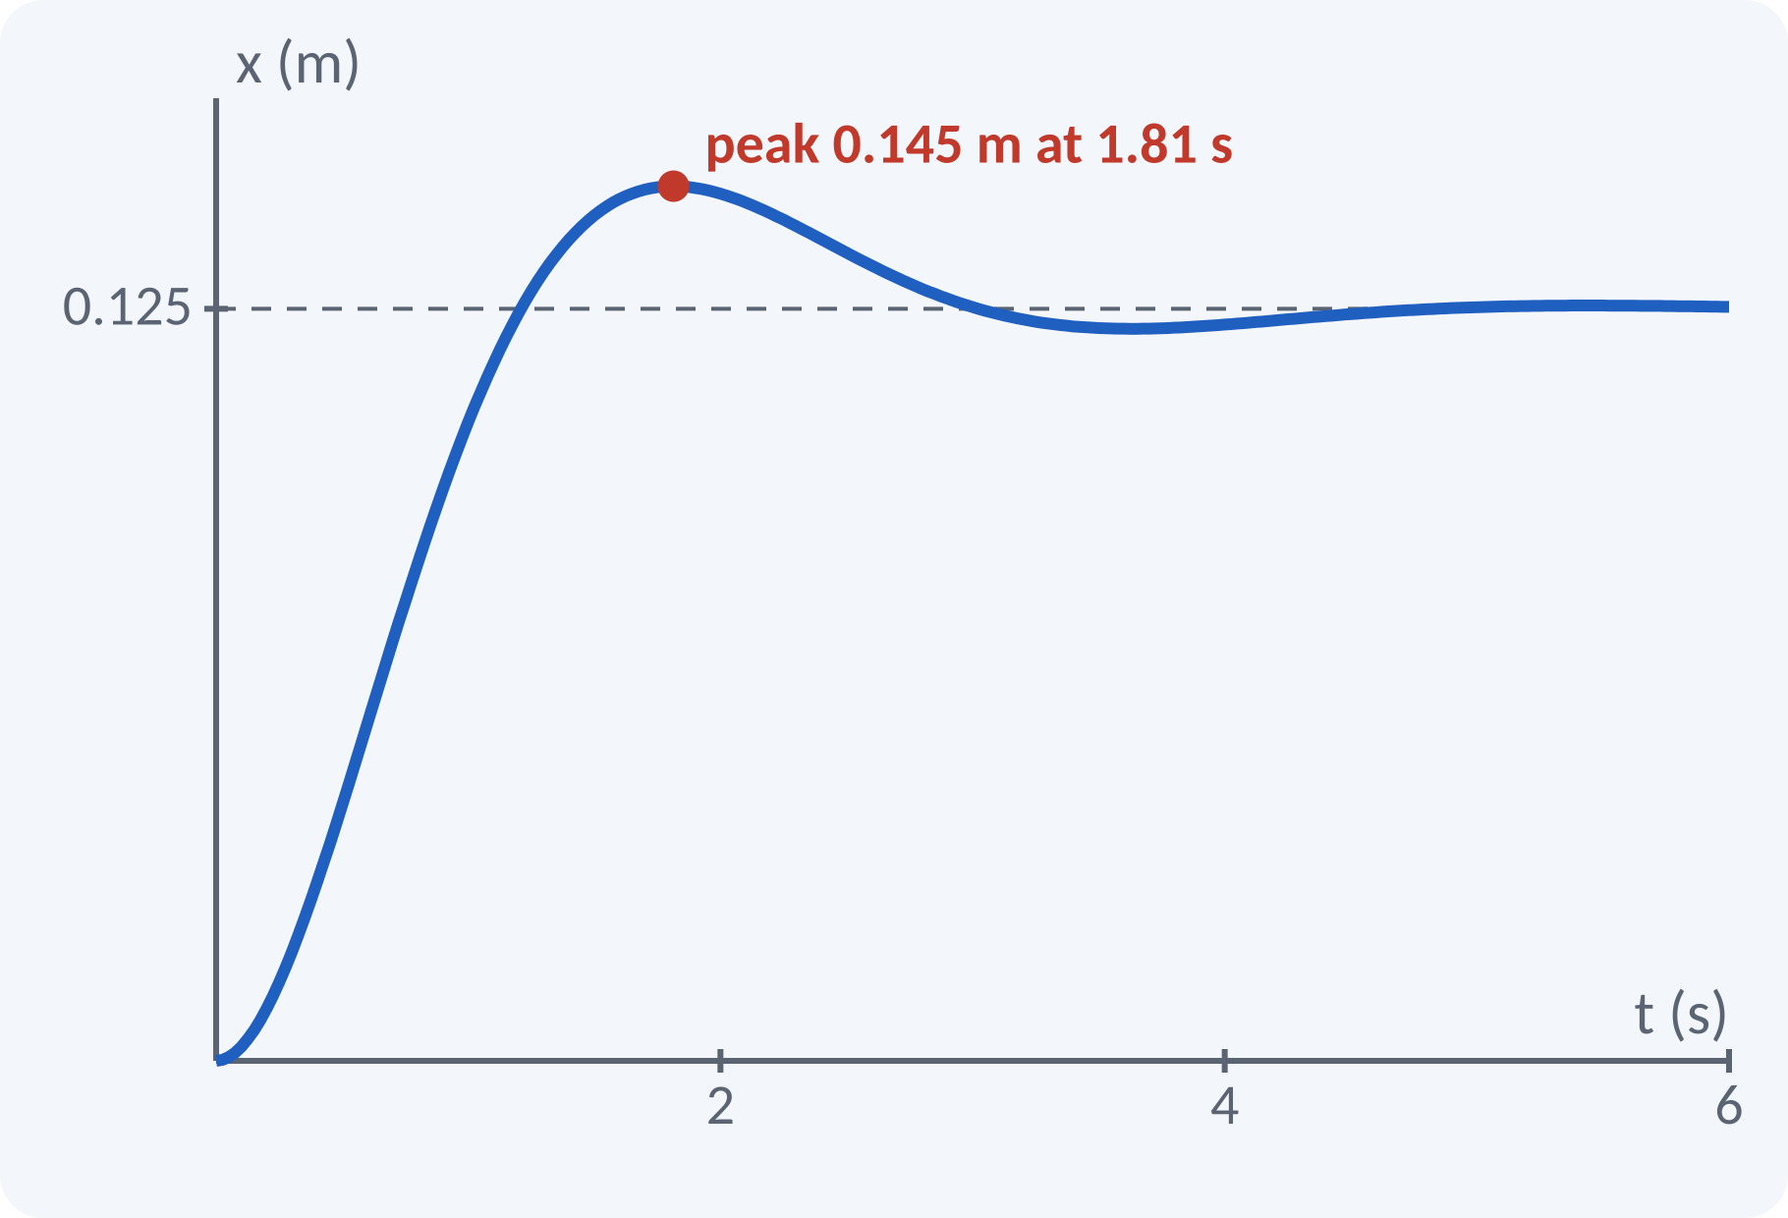
Solved Example 1: Mass–Spring–Damper
Given M = 2 kg, B = 4 N·s/m, K = 8 N/m. Find X(s)/F(s), ωn, ζ and final value for a 1 N step.
1. X/F = 1/(2s² + 4s + 8).
2. ωn = √(K/M) = √4 = 2 rad/s.
3. ζ = B/(2√(KM)) = 4/(2√16) = 0.5.
4. Final x = F/K = 1/8 = 0.125 m.
5. Mp = e^(−π·0.5/√0.75) = 16.3 %; peak = 0.125 × 1.163 = 0.145 m.
Answer: ωn = 2 rad/s, ζ = 0.5 (underdamped), x(∞) = 0.125 m
Notes:
Write the transfer function first, then compare with the standard form by dividing numerator and denominator by M. The natural frequency is the square root of K over M and the damping ratio is B over twice the square root of K M. The final value theorem or simply F over K gives the steady displacement. Because zeta is 0.5 the response overshoots by about 16 per cent.

Slide 13
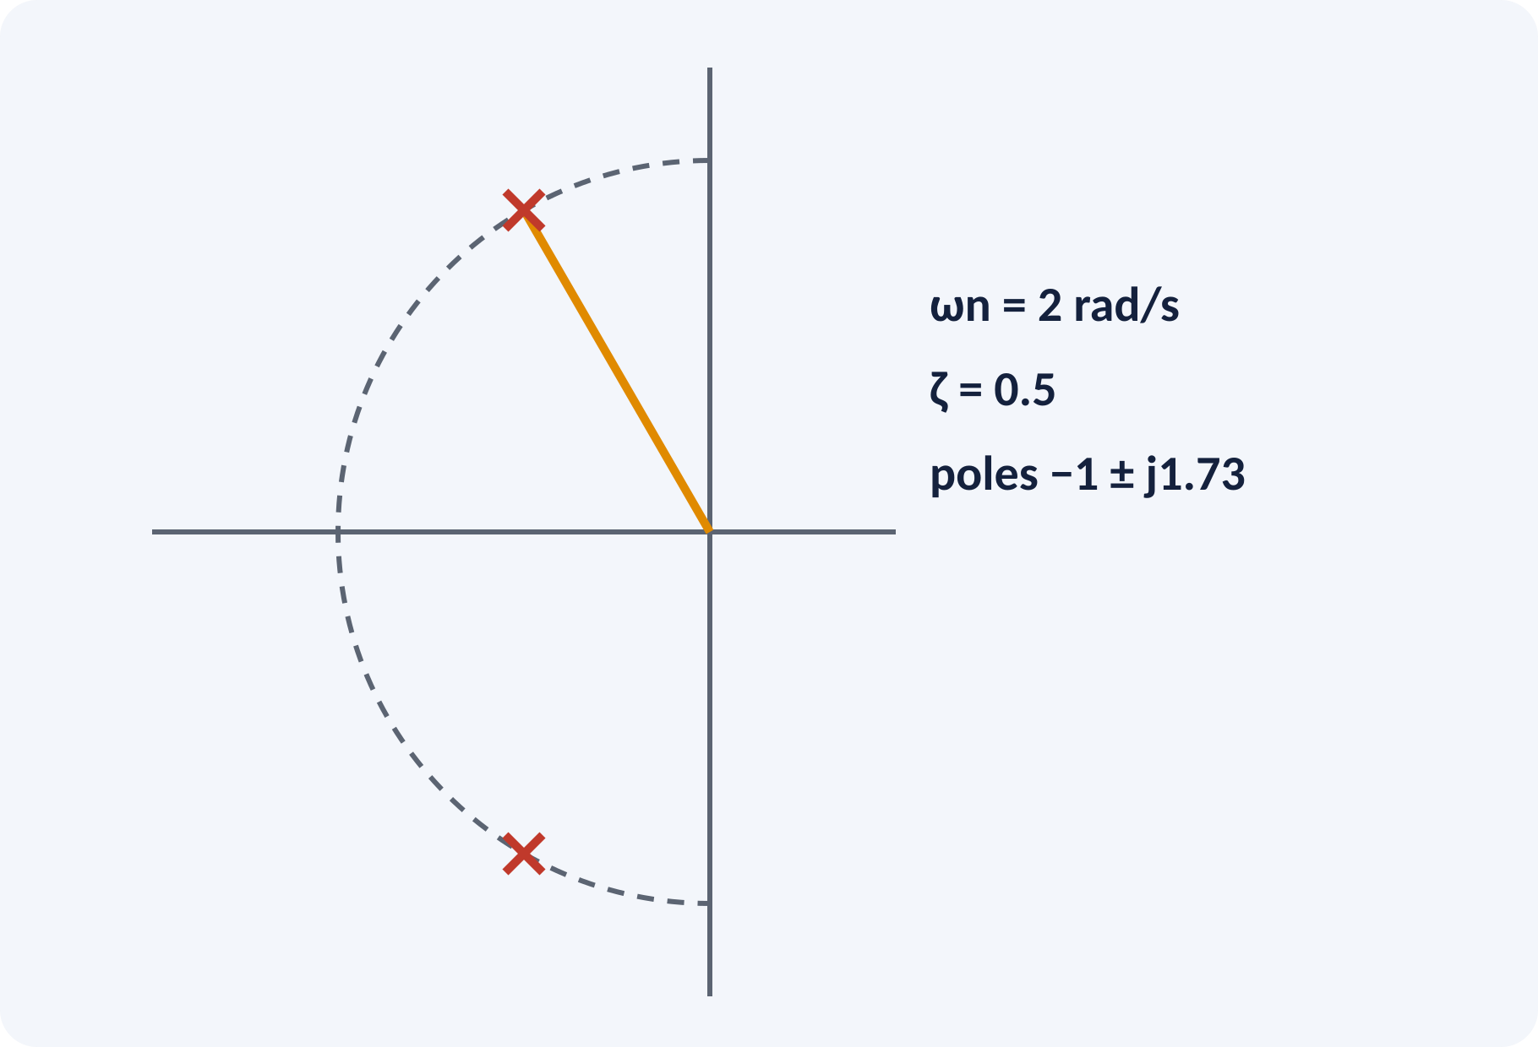
Solved Example 2: Series RLC and Analogy
Given R = 2 Ω, L = 1 H, C = 0.25 F. Find VC/V, ωn, ζ and the mechanical analogue.
1. VC/V = 1/(0.25s² + 0.5s + 1) = 4/(s² + 2s + 4).
2. ωn = 2 rad/s.
3. 2ζωn = 2, so ζ = 0.5.
4. Poles: s = −1 ± j1.73.
5. Analogue: M = L = 1 kg, B = R = 2 N·s/m, K = 1/C = 4 N/m.
Answer: ωn = 2 rad/s, ζ = 0.5; analogous M = 1 kg, B = 2, K = 4
Notes:
Multiply out the denominator, L C is 0.25 and R C is 0.5, then divide by 0.25 to reach the standard form. The result has the same ωn and ζ as Example 1, which shows that two different physical systems can behave identically. Using the force–voltage analogy we read off mass, damper and spring values directly from L, R and one over C. Always check units when using the analogy.

Slide 14
Common Mistakes and Exam Tips
✕
Common mistakes
✓
Exam tips
Forgetting zero initial conditions in G(s).
Using the wrong sign for the feedback summing junction.
Mixing up the force–voltage and force–current analogies.
Using grams or cm instead of SI units.
Treating a nonlinear system as if G(s) exists.
Draw the free body diagram first.
Write the equation, then Laplace transform.
Compare with 1/(M s² + B s + K) to check.
State units with every parameter.
Notes:
These are the points where marks are lost most often in transfer functions. Give one quick example for each mistake. Remind students that writing the formula, substitution and the unit earns method marks even if the arithmetic slips. Encourage them to check the answer for reasonableness.

Slide 15
Summary
Closed loop feeds the output back to reduce error.
Components: error detector, controller, actuator, plant, sensor.
G(s) = C(s)/R(s) with zero initial conditions.
Mechanical: 1/(M s² + B s + K); same form for J, B, K.
Series RLC: 1/(L C s² + R C s + 1); M↔L, B↔R, K↔1/C.
G(s) = N(s)/D(s): poles from D(s), zeros from N(s)
Notes:
Recap in one minute. Say each point and ask the class to recall the formula for it. If they remember these ideas, most numerical problems on transfer functions are within reach. Next lecture: block diagram reduction and signal flow graphs. Revise the two solved examples tonight.

Slide 16
Quick Quiz
Q1. A thermostat-controlled room heater is:
(a) open loop (b) closed loop (c) nonlinear only (d) digital only
Ans: (b)
Q2. X(s)/F(s) for M, B, K system is:
(a) 1/(Ms²+Bs+K) (b) Ms²+Bs+K (c) 1/(Ms+B) (d) K/(Ms²+B)
Ans: (a)
Q3. In the force–voltage analogy, mass corresponds to:
(a) resistance (b) capacitance (c) inductance (d) charge
Ans: (c)
Q4. Poles of G(s) are the roots of:
(a) numerator (b) denominator (c) input (d) output
Ans: (b)
Q5. For M = 2 kg, K = 8 N/m, ωn is:
(a) 1 rad/s (b) 2 rad/s (c) 4 rad/s (d) 16 rad/s
Ans: (b)
Notes:
Give about one minute per question and take a show of hands. Discuss why the wrong options are tempting, especially the one that uses a wrong formula. Use the quiz as a quick check on modelling before leaving.

Slide 17
References
1
I. J. Nagrath and M. Gopal, Control Systems Engineering
5th Ed., New Age International (P) Ltd., 2008 (Units 1, 2 textbook)
2
K. Ogata, Modern Control Engineering
5th Ed., Pearson Education Asia / PHI, 2009 (reference)
3
P. S. Satyanarayana, Concepts of Control Systems
2nd Ed., Dynaram Publishers, Bangalore, 2001 (reference)
Next lecture: block diagram reduction and signal flow graphs (Mason's gain formula)
Notes:
Point students to the textbooks listed in the syllabus for modelling. Ask them to solve at least three textbook problems on this topic before the next class. Thank the class and preview the next lecture.

