Slide 1
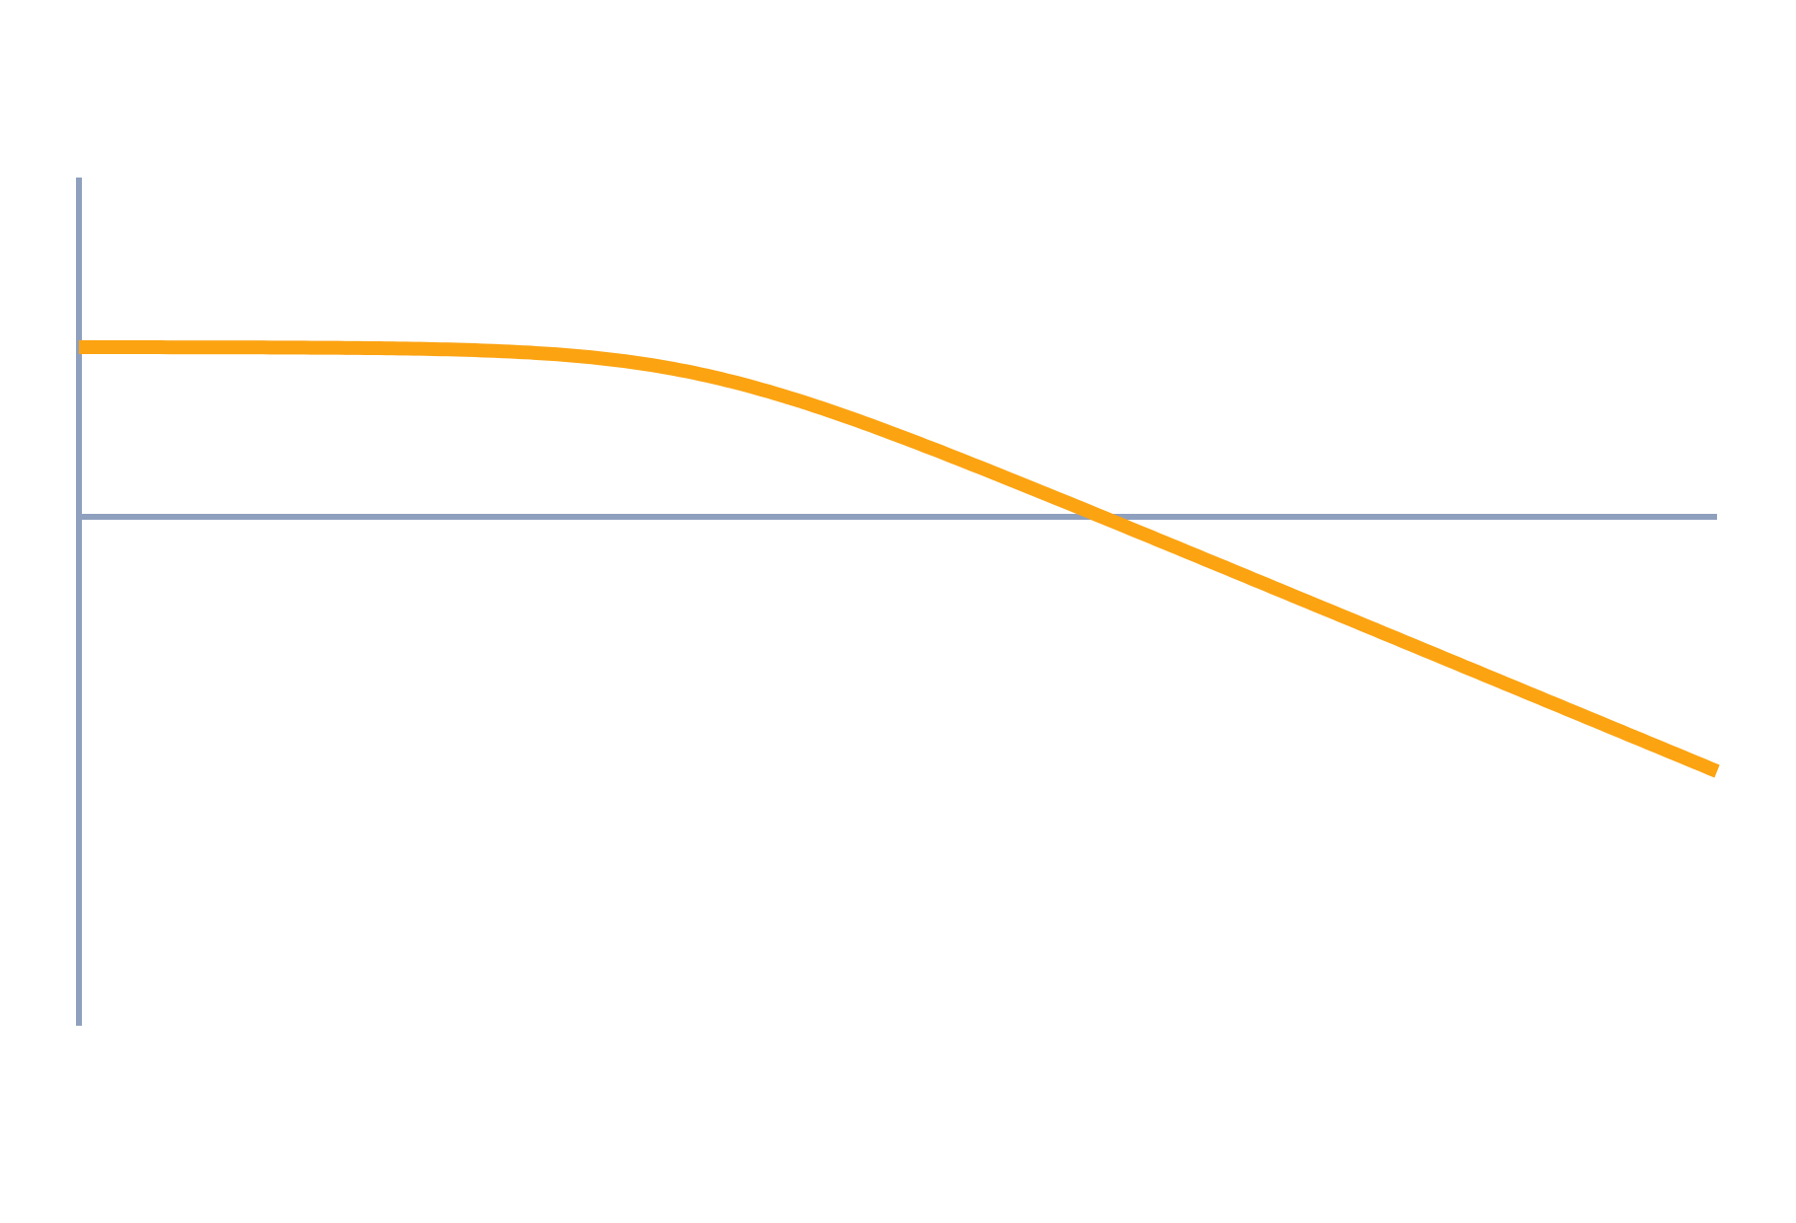
Frequency-Domain Specifications
Control Systems (22EEG53)
Unit 3: Frequency Domain Analysis
Topic: Peak resonance, resonant frequency, bandwidth, cut-off rate; correlation with time response
Prof. Mitesh Astik
Notes:
Welcome everyone. Today's topic is Peak resonance, resonant frequency, bandwidth, cut-off rate; correlation with time response. It belongs to Unit 3: Frequency Domain Analysis. By the end of this session you will be able to use it in numerical problems. Keep your notebooks ready because we will solve two examples.

Slide 2

Learning Outcomes
Define Mr, ωr, ωb and cut-off rate.
Derive Mr, ωr and ωb for a second-order system.
Relate frequency and time-domain specifications.
Find ζ and ωn from frequency-domain data.
Linked to CO3
Analyse the performance indices of a system in the frequency domain.
Notes:
Read the outcomes aloud. They map to CO3 of the syllabus. Tell students that these are examinable and that the two solved examples follow the same pattern. Ask them to tick off each outcome at the end of the lecture.

Slide 3
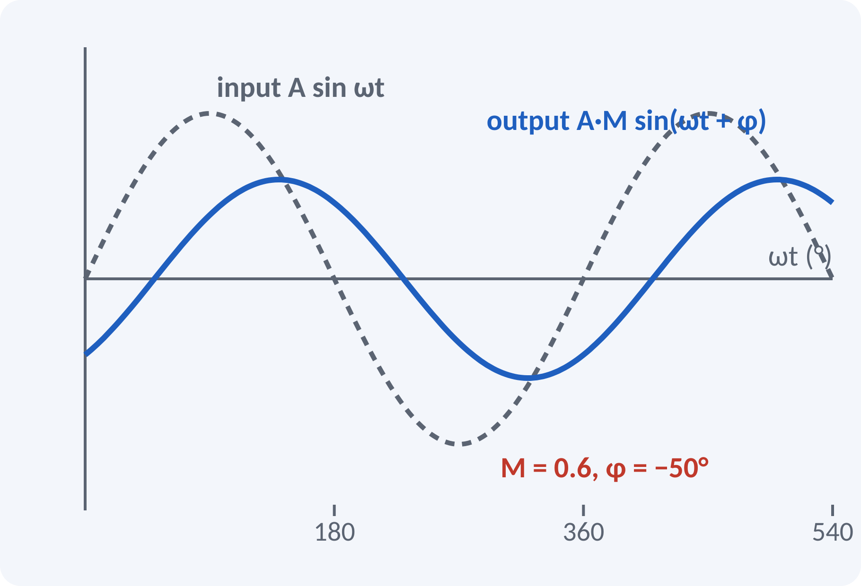
Recap: Sinusoidal Steady State
Apply r(t) = A sin ωt to a stable system.
Steady-state output is also sinusoidal.
Amplitude is scaled by M = |G(jω)|.
Phase is shifted by φ = ∠G(jω).
c(t) = A·M(ω)·sin(ωt + φ(ω)), M = |T(jω)|, φ = ∠T(jω)
T(s) closed-loop transfer function, ω in rad/s
Notes:
If we feed a sine wave into a stable linear system, the steady-state output is a sine wave of the same frequency. Its amplitude changes by the magnitude of the transfer function at jω and its phase shifts by the angle. Plotting M and φ against frequency gives the frequency response. This is the basis of the whole unit.

Slide 4
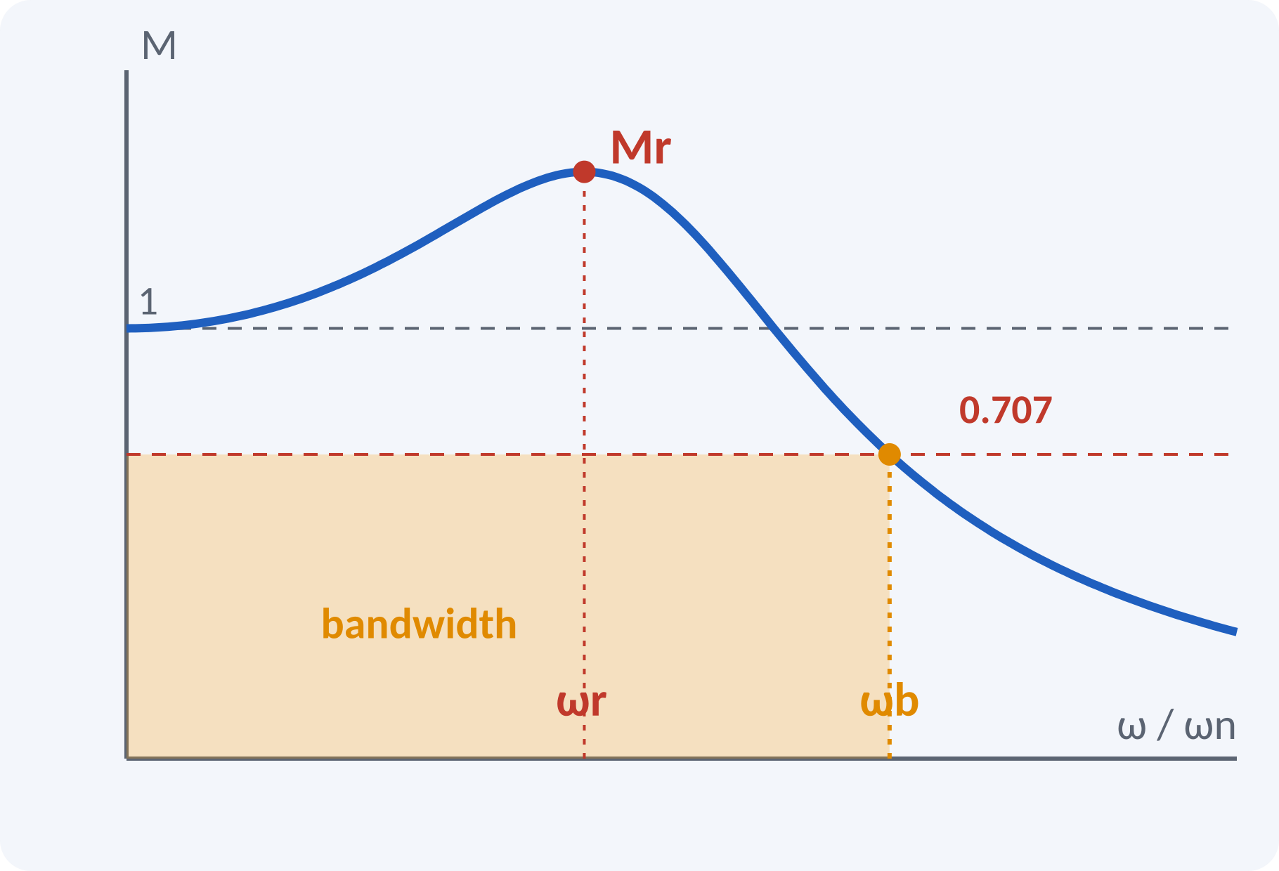
Motivation: Why Frequency Domain?
Audio amplifier: which frequencies pass?
Servo: how fast a command can it follow?
Measure response with a signal generator.
Design without solving differential equations.
Bandwidth indicates speed; resonant peak indicates damping
Notes:
Engineers often measure a plant by applying sine waves of different frequencies and reading the output amplitude. From the magnitude curve we can read how fast the system responds and how well damped it is. The specifications we define today are read directly from this curve.

Slide 5
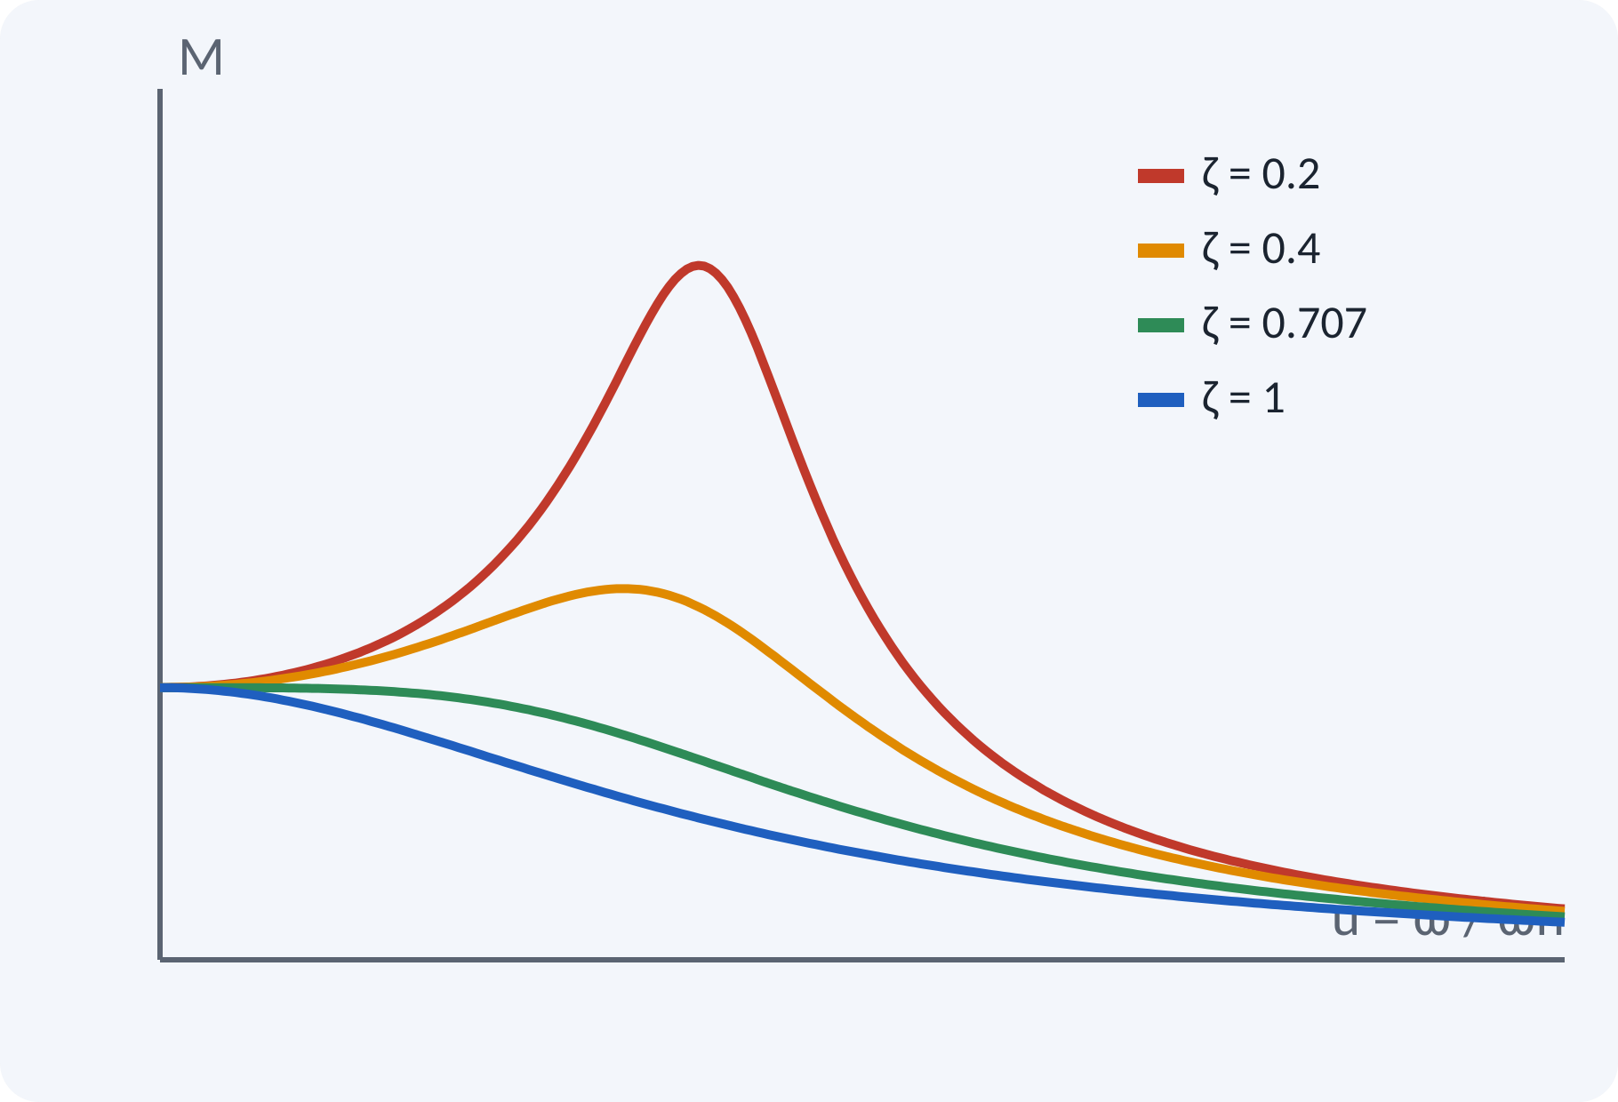
Frequency Response of a Second-Order System
Closed-loop T(s) = ωn²/(s² + 2ζωn s + ωn²).
Put s = jω and u = ω/ωn.
Magnitude depends on u and ζ only.
Low ζ gives a sharp peak near u = 1.
M(u) = 1/√[(1 − u²)² + (2ζu)²]; φ(u) = −tan⁻¹[2ζu/(1 − u²)]
u = ω/ωn normalised frequency
Notes:
Substitute s equal to j ω in the standard second-order function and normalise the frequency by ωn. The magnitude starts at one for u equal to zero and falls at high frequency. For small ζ there is a tall resonance peak close to u equal to one. For ζ of 0.707 or more the curve has no peak.

Slide 6
Frequency-Domain Specifications
Resonant peak Mr: maximum value of M.
Resonant frequency ωr: frequency at the peak.
Bandwidth ωb: where M falls to 0.707 (−3 dB).
Cut-off rate: slope of M at high frequency.
Gain margin, phase margin: next lecture.
Mr = Mmax/M(0); ωb: M(ωb) = 0.707·M(0)
Mr dimensionless (or dB), ωr and ωb in rad/s
Notes:
Mr tells us how lightly damped the system is. Omega r is where the peak occurs. Bandwidth is the frequency at which the magnitude has fallen to 0.707 of its low-frequency value, which is the minus 3 dB point. A larger bandwidth means a faster response. The cut-off rate describes how sharply the system rejects high frequencies.

Slide 7
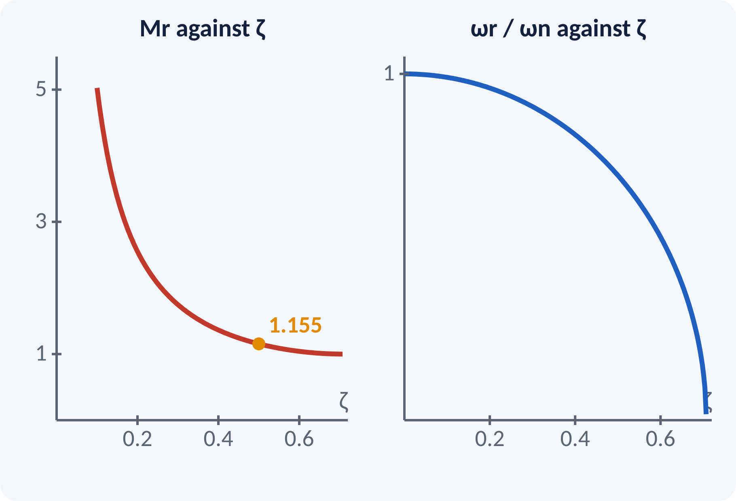
Resonant Peak and Frequency
Set dM/du = 0 to find the peak.
A peak exists only for ζ < 0.707.
Mr depends only on ζ.
ωr is always less than ωn.
ωr = ωn√(1 − 2ζ²); Mr = 1/(2ζ√(1 − ζ²)) (0 < ζ < 0.707)
For ζ ≥ 0.707: no peak, Mmax = 1 at ω = 0
Notes:
Differentiate the magnitude with respect to u and set the derivative to zero. This gives u r equal to the square root of one minus two zeta squared, which is real only for zeta below 0.707. Substituting back gives Mr as a function of ζ alone. Low damping means a large resonant peak.

Slide 8
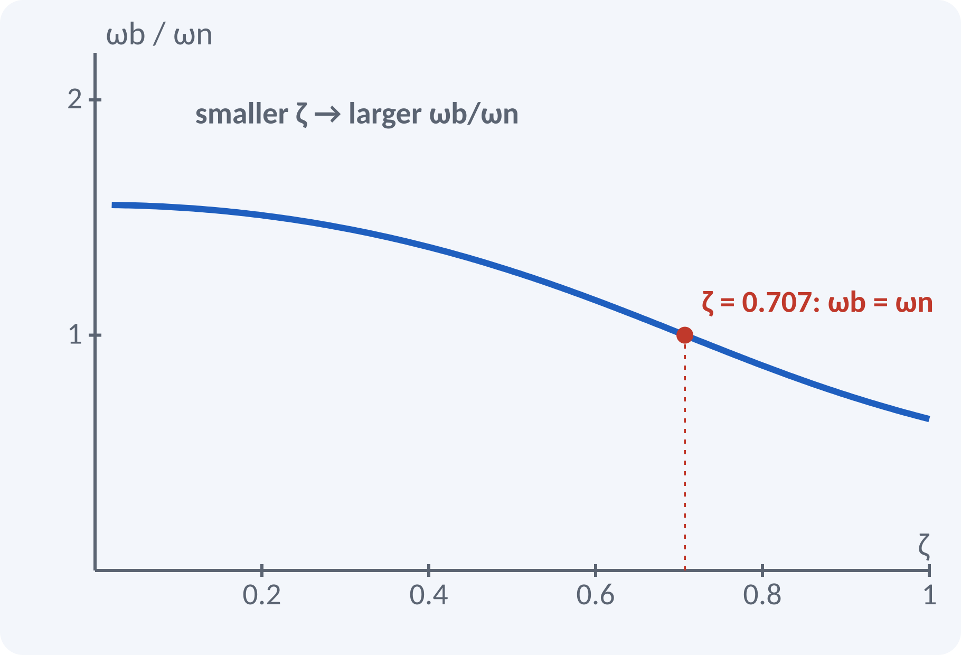
Bandwidth
Solve M(u) = 0.707 for u.
ωb/ωn depends only on ζ.
Larger bandwidth gives faster rise time.
For ζ = 0.707, ωb = ωn.
ωb = ωn·[(1 − 2ζ²) + √(4ζ⁴ − 4ζ² + 2)]^½
ωb in rad/s
Notes:
Set the magnitude equal to one over root two and solve the resulting quadratic in u squared. The positive root gives the bandwidth. For ζ equal to 0.707 the bracket equals one, so bandwidth equals natural frequency. A wide bandwidth passes faster signals, so the system is quicker but also more sensitive to noise.

Slide 9
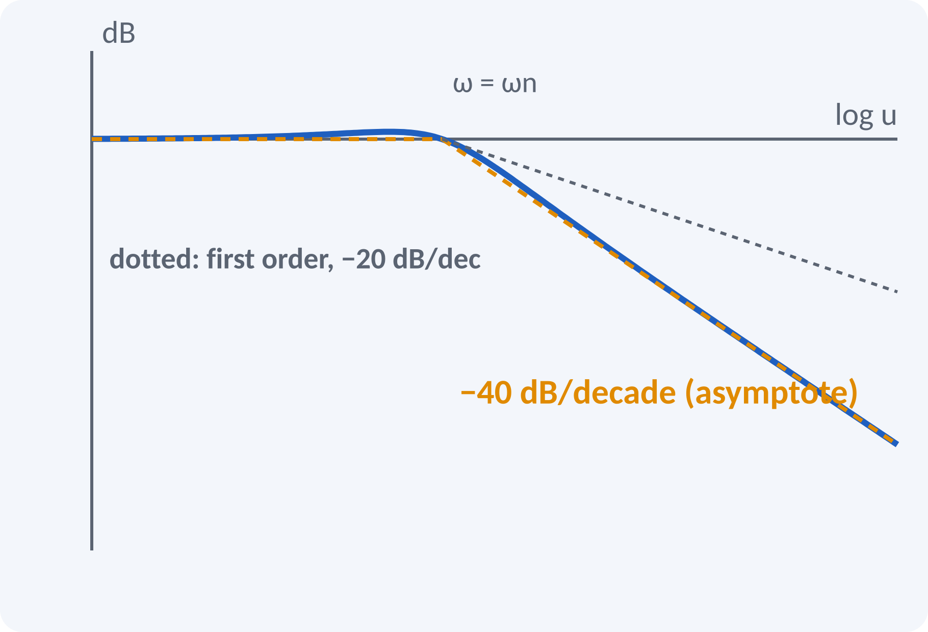
Cut-off Rate
Slope of the log-magnitude at high frequency.
Second order: −40 dB/decade.
First order: −20 dB/decade.
Steeper slope rejects noise better.
At high ω: |T| ≈ (ωn/ω)² → slope = −40 dB/decade
dB = 20 log₁₀ M
Notes:
At frequencies much higher than ωn the term u to the fourth dominates, so M behaves as one over u squared. On a log scale this is a straight line falling 40 dB for every tenfold increase in frequency. A first-order system falls at 20 dB per decade. The cut-off rate indicates how well the system discriminates between signal and noise.

Slide 10
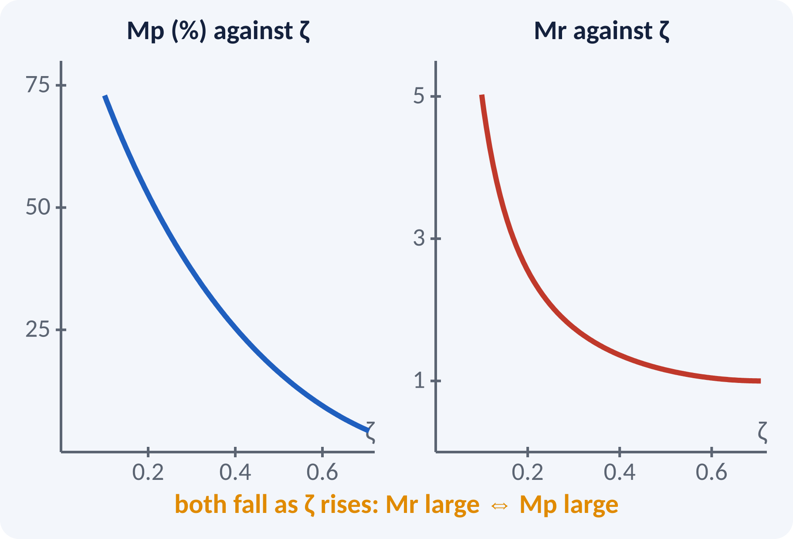
Correlation: Time and Frequency
Both Mp and Mr depend on ζ only.
Large Mr means large overshoot.
Bandwidth is inversely related to rise time.
High ωb gives short tr and ts.
ωd and ωr both scale with ωn.
Mr ↑ ⇔ Mp ↑ ; ωb ↑ ⇔ tr ↓; tr·ωb ≈ constant for fixed ζ
Notes:
Both the percent overshoot and the resonant peak are functions of damping ratio alone, so one can be read from the other. The bandwidth plays the role of speed: the larger the bandwidth, the shorter the rise time. This correlation is why a frequency test can predict transient behaviour without ever applying a step.

Slide 11
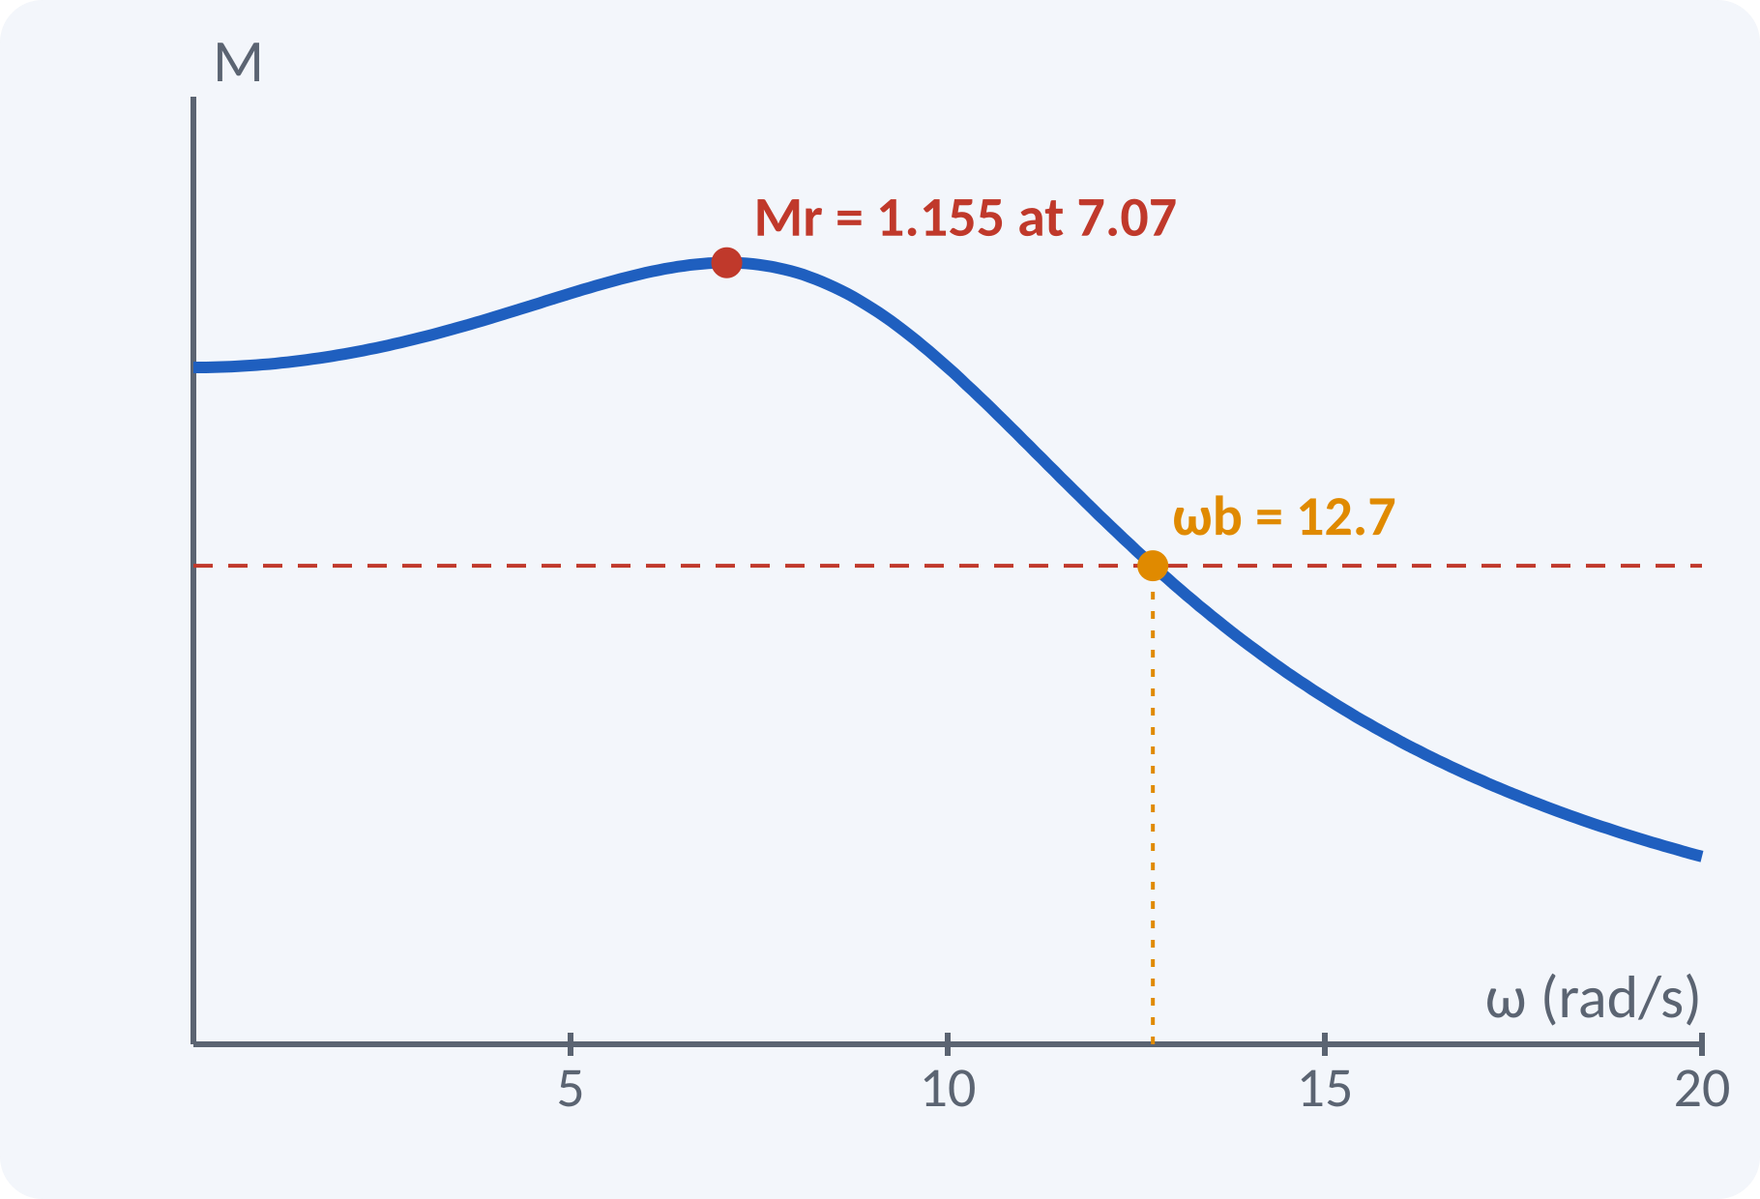
Solved Example 1: Find Mr, ωr, ωb
A system has ζ = 0.5 and ωn = 10 rad/s. Find Mr, ωr, ωb.
1. ζ < 0.707, so a peak exists.
2. Mr = 1/(2·0.5·√0.75) = 1.155 (1.25 dB).
3. ωr = 10√(1 − 0.5) = 7.07 rad/s.
4. ωb = 10[(0.5) + √(0.25 − 1 + 2)]^½ = 10 × 1.272 = 12.7 rad/s.
Answer: Mr = 1.155, ωr = 7.07 rad/s, ωb = 12.7 rad/s
Notes:
First check that zeta is less than 0.707, so the resonance formulas apply. Mr depends only on ζ, so substitute and get 1.155. Multiply the normalised ωr by ωn to get the actual frequency. For bandwidth compute the bracket: 1 minus 2 ζ squared is 0.5, and the square root term is root 1.25, so the bracket is 1.618 and the bandwidth is 12.7 rad/s.

Slide 12
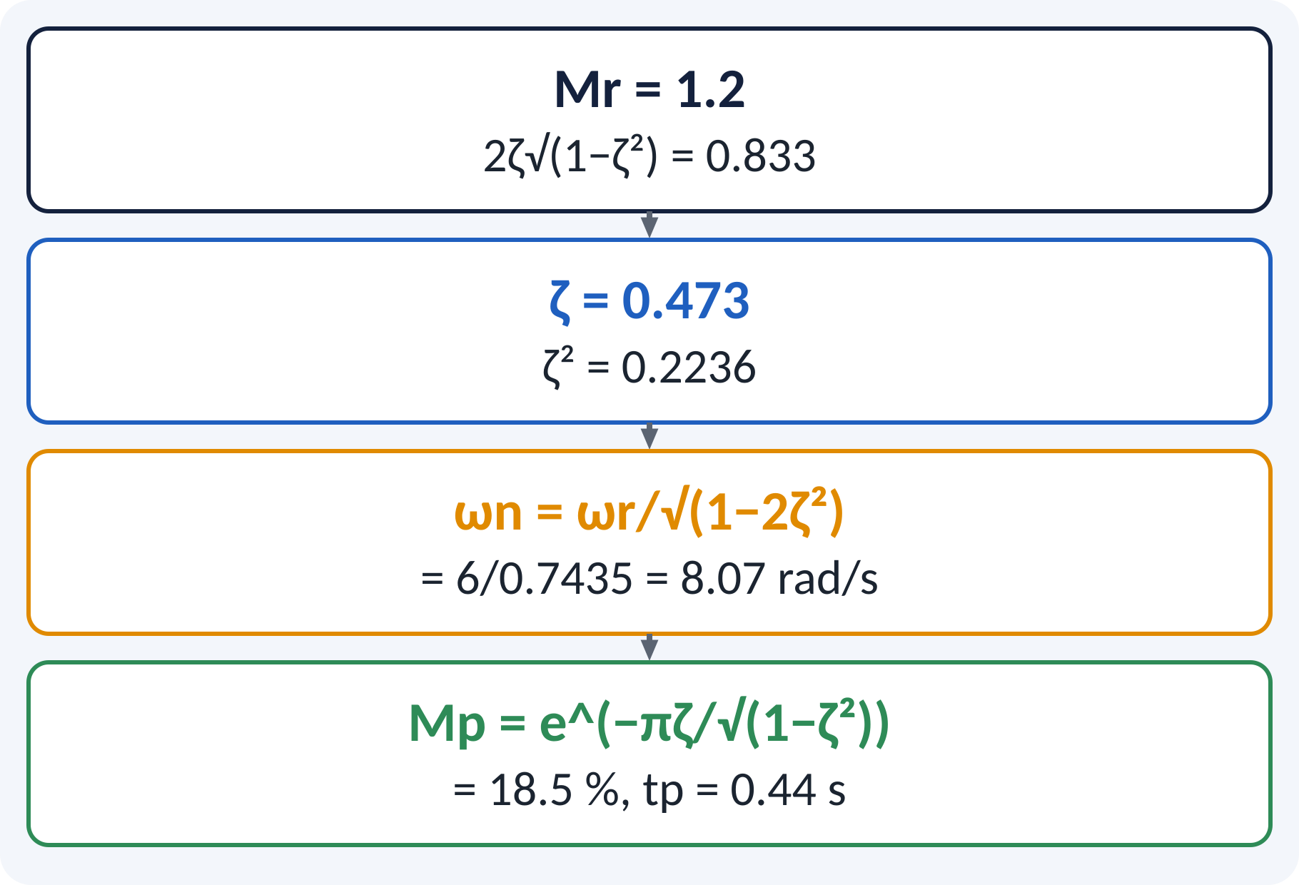
Solved Example 2: Specs from Data
A servo shows Mr = 1.2 at ωr = 6 rad/s. Find ζ, ωn, and the expected Mp and tp.
1. 2ζ√(1 − ζ²) = 1/1.2 = 0.833, so ζ²(1 − ζ²) = 0.1736.
2. ζ² = 0.2236 (root with ζ < 0.707), so ζ = 0.473.
3. ωn = ωr/√(1 − 2ζ²) = 6/0.7435 = 8.07 rad/s.
4. Mp = e^(−π·0.473/0.881) = 18.5 %.
5. ωd = 8.07 × 0.881 = 7.11, tp = π/7.11 = 0.44 s.
Answer: ζ = 0.473, ωn = 8.07 rad/s, Mp = 18.5 %, tp = 0.44 s
Notes:
This problem goes from frequency data to time-domain specifications. Solve the quadratic in zeta squared and choose the root below 0.5 so that zeta is less than 0.707. Then ω r and ζ give ω n. Finally use the time-domain formulas from the previous unit to predict overshoot and peak time. It shows the correlation in action.

Slide 13
Common Mistakes and Exam Tips
✕
Common mistakes
✓
Exam tips
Using the Mr formula for ζ ≥ 0.707.
Taking bandwidth at the peak instead of at 0.707.
Mixing dB and linear values of M.
Using ωr in place of ωn.
Forgetting that the cut-off rate is per decade.
Check ζ < 0.707 before using Mr and ωr.
Bandwidth: find where M = 0.707 M(0).
Convert: dB = 20 log₁₀ M.
Solve ζ² from the quadratic and choose the small root.
Notes:
These are the points where marks are lost most often in frequency-domain specifications. Give one quick example for each mistake. Remind students that writing the formula, substitution and the unit earns method marks even if the arithmetic slips. Encourage them to check the answer for reasonableness.

Slide 14
Summary
M = |T(jω)| and φ = ∠T(jω) describe frequency response.
Mr = 1/(2ζ√(1 − ζ²)) and ωr = ωn√(1 − 2ζ²) for ζ < 0.707.
Bandwidth is the −3 dB frequency; larger means faster.
Cut-off rate of a second-order system is −40 dB/decade.
Mr tracks overshoot; ωb tracks rise time.
Mr, Mp depend on ζ only; ωb, ωr scale with ωn
Notes:
Recap in one minute. Say each point and ask the class to recall the formula for it. If they remember these ideas, most numerical problems on frequency specifications are within reach. Next lecture: Bode plots, gain margin and phase margin. Revise the two solved examples tonight.

Slide 15
Quick Quiz
Q1. Mr for ζ = 0.5 is about:
(a) 0.5 (b) 1.0 (c) 1.155 (d) 2.0
Ans: (c)
Q2. A resonant peak exists only when:
(a) ζ > 1 (b) ζ < 0.707 (c) ζ = 1 (d) ζ > 0.707
Ans: (b)
Q3. Bandwidth is the frequency where M falls to:
(a) 0.5 (b) 0.707 (c) 0.9 (d) 0.1
Ans: (b)
Q4. Cut-off rate of a second-order system:
(a) −20 dB/dec (b) −40 dB/dec (c) −60 dB/dec (d) 0
Ans: (b)
Q5. For ζ = 0.707 the bandwidth equals:
(a) ωn/2 (b) ωn (c) 2ωn (d) ωr
Ans: (b)
Notes:
Give about one minute per question and take a show of hands. Discuss why the wrong options are tempting, especially the one that uses a wrong formula. Use the quiz as a quick check on frequency specifications before leaving.

Slide 16
References
1
Benjamin C. Kuo, Automatic Control Systems
7th Ed., PHI, 2007 (Units 3, 4, 5 textbook)
2
P. S. Satyanarayana, Concepts of Control Systems
2nd Ed., Dynaram Publishers, Bangalore, 2001 (reference)
3
K. Ogata, Modern Control Engineering
5th Ed., Pearson Education Asia / PHI, 2009 (reference)
Next lecture: Bode plots, gain margin and phase margin
Notes:
Point students to the textbooks listed in the syllabus for frequency specifications. Ask them to solve at least three textbook problems on this topic before the next class. Thank the class and preview the next lecture.

