Slide 1
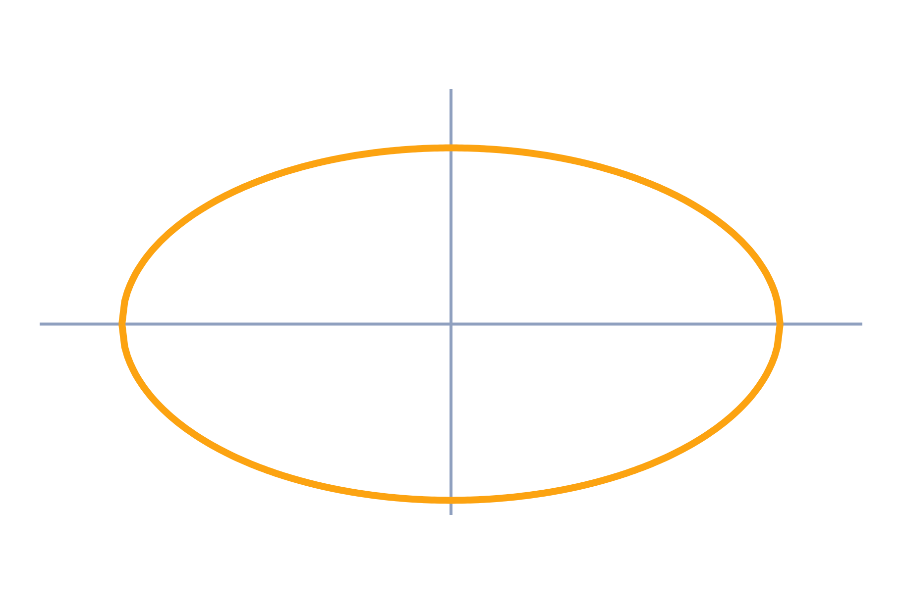
Stability and Routh–Hurwitz Criterion
Control Systems (22EEG53)
Unit 4: Stability of Systems
Topic: Characteristic equation, root locations, absolute and relative stability, Routh–Hurwitz criterion
Prof. Mitesh Astik
Notes:
Welcome everyone. Today's topic is Characteristic equation, root locations, absolute and relative stability, Routh–Hurwitz criterion. It belongs to Unit 4: Stability of Systems. By the end of this session you will be able to use it in numerical problems. Keep your notebooks ready because we will solve two examples.

Slide 2

Learning Outcomes
Relate root locations to stability.
Distinguish absolute and relative stability.
Build the Routh array and read stability from it.
Find the range of K for a stable loop.
Linked to CO4
Understand stability using Routh–Hurwitz and root locus.
Notes:
Read the outcomes aloud. They map to CO4 of the syllabus. Tell students that these are examinable and that the two solved examples follow the same pattern. Ask them to tick off each outcome at the end of the lecture.

Slide 3
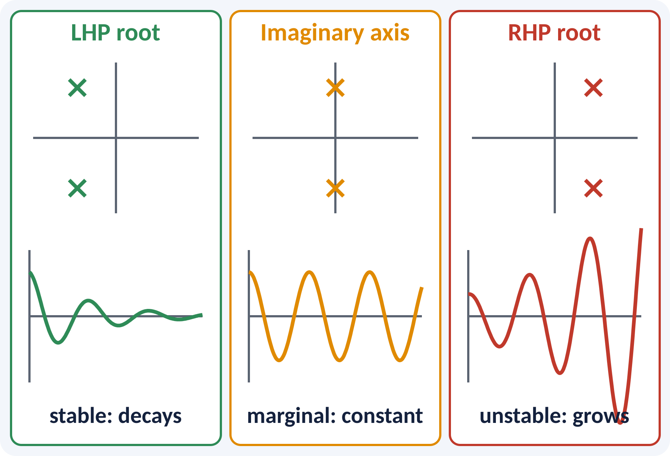
Recap: What You Already Know
Poles are roots of the denominator.
Pole location fixes the time response.
Real part σ gives decay or growth e^(σt).
Closed loop: T(s) = G/(1 + GH).
Closed-loop poles: roots of 1 + G(s)H(s) = 0 (characteristic equation)
Notes:
From earlier lectures, each pole contributes a term e to the power of sigma t. A negative real part means decay and a positive real part means growth. The closed-loop poles are the roots of the characteristic equation one plus G H equal to zero. So stability is a question about where these roots lie.

Slide 4
Motivation: Why Test Stability?
Unstable aircraft or robot: output grows without bound.
Feedback can turn a stable plant unstable.
High gain often causes oscillation.
Solving high-order polynomials is hard.
Routh's test tells stability without computing the roots
Notes:
An unstable control system does not just give a poor response, it may destroy itself. Raising the gain to reduce error is the usual way to cause instability. For a polynomial of degree five or more there is no closed formula for the roots. Routh's method gives a quick yes-or-no answer from the coefficients alone.

Slide 5
Characteristic Equation and Root Location
Stable: all roots in the left half-plane.
Marginally stable: simple roots on the jω axis.
Unstable: any root in the right half-plane.
Repeated jω roots also give instability.
Characteristic equation: a0 sⁿ + a1 sⁿ⁻¹ + … + an = 0
BIBO stable ⇔ all roots have negative real part
Notes:
The three possible root positions give three kinds of behaviour. Roots in the left half-plane decay, roots on the imaginary axis give sustained oscillation, and roots in the right half-plane grow. A system with a pair of simple roots on the axis is marginally stable. A repeated pair on the axis is unstable because the response grows like t times a sine.

Slide 6
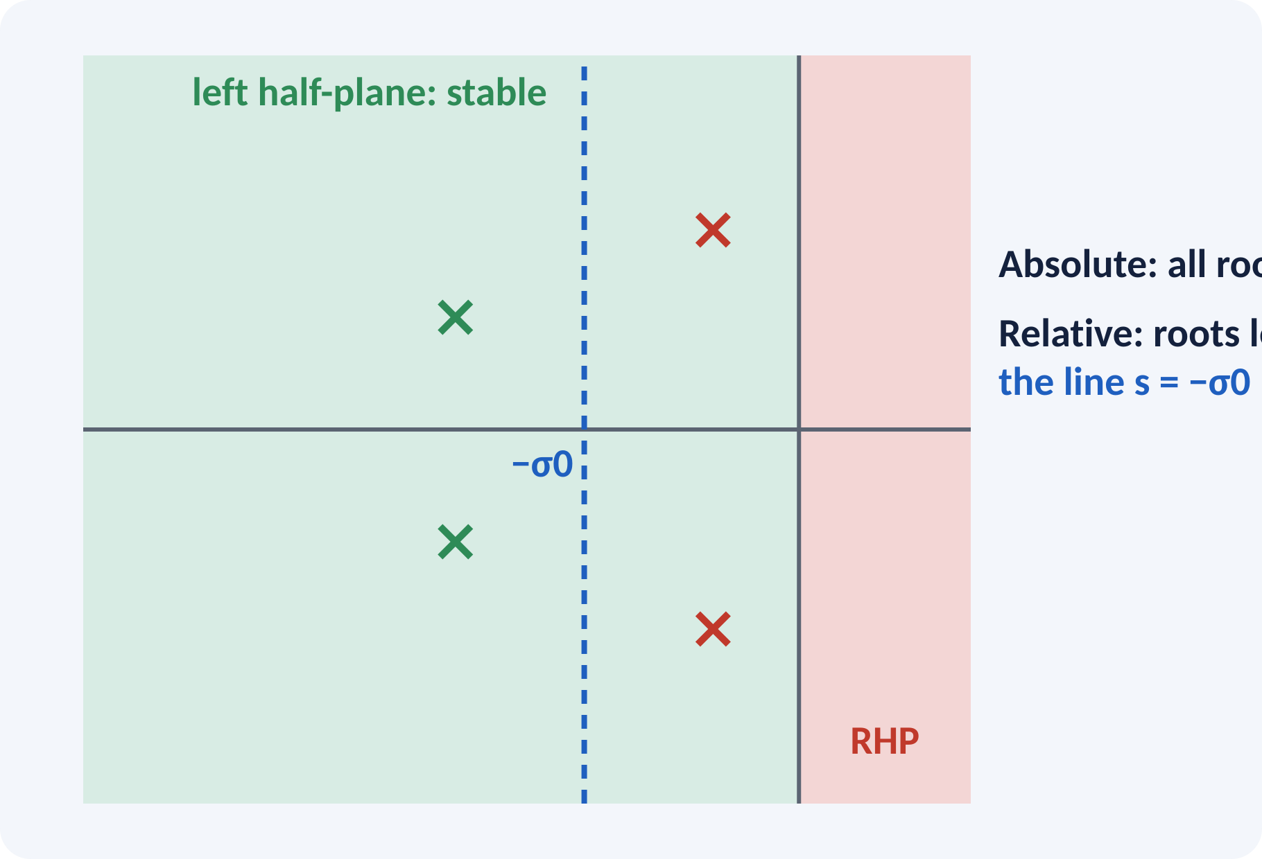
Absolute and Relative Stability
Absolute: are all roots in the LHP? yes or no.
Relative: how far are the roots from the jω axis?
Roots near the axis give poor damping.
Shift the axis by σ0 to test relative stability.
Substitute s = z − σ0 and apply Routh to the z polynomial
Notes:
Absolute stability only says whether the system is stable. Relative stability measures how stable it is, for example how far the nearest root is from the imaginary axis. Moving the imaginary axis to the left by σ0 and repeating Routh's test shows whether all roots are to the left of minus σ0. Designers specify a minimum margin for good transient behaviour.

Slide 7
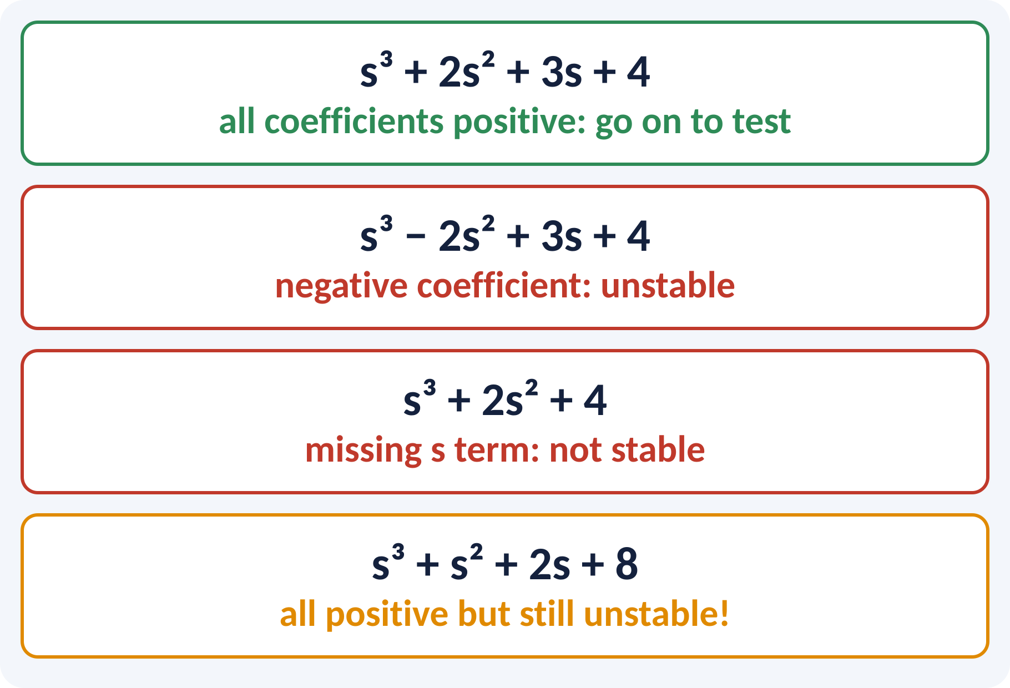
Necessary Condition for Stability
All coefficients must be present.
All coefficients must have the same sign.
If violated, the system is not stable.
If satisfied, it is still not enough.
Necessary, not sufficient: s³ + s² + 2s + 8 has positive coefficients but is unstable
Notes:
The quickest test is to look at the coefficients. A missing term or a coefficient with a different sign guarantees at least one root in the right half-plane or on the axis. But positive coefficients alone do not prove stability, and the last example on the slide shows that. For a sufficient test we need the Routh array.

Slide 8
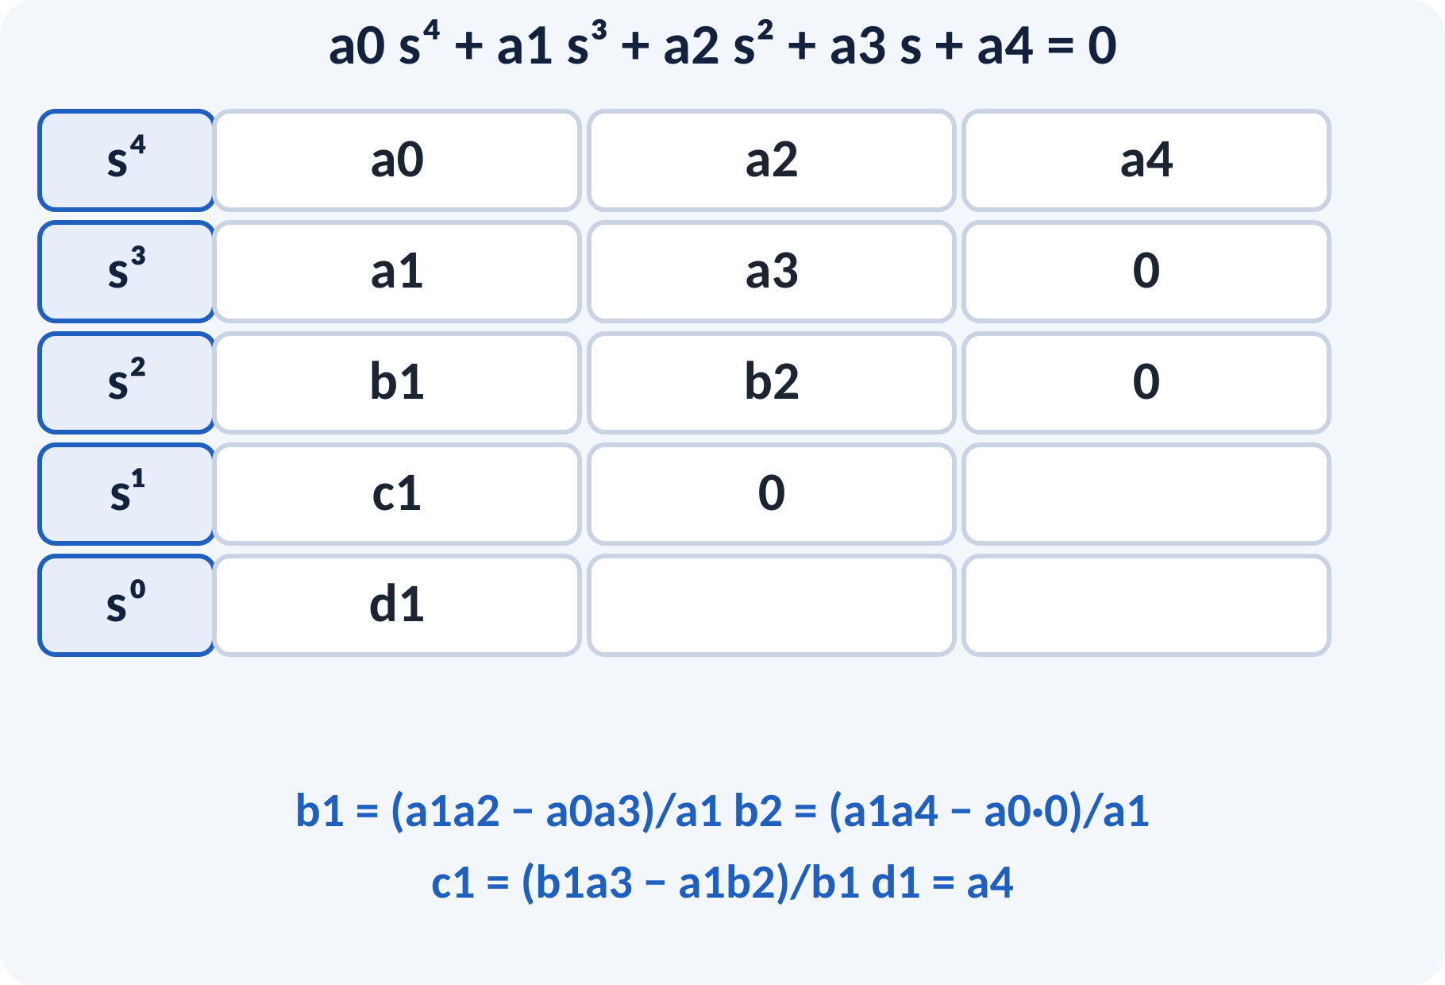
Routh Array Construction
Write coefficients in two rows: s⁴, s³.
Each next row from the two rows above.
Cross-multiply, subtract, divide by the pivot.
Continue down to the sⁿ⁰ row.
First column carries the information.
b1 = (a1a2 − a0a3)/a1; c1 = (b1a3 − a1b2)/b1
Number of rows = degree n + 1
Notes:
Arrange the coefficients alternately in the first two rows. Each element of the next row is obtained by cross multiplying the two entries above and to the right of the pivot, subtracting, and dividing by the pivot in the row above. Continue until the last row has one element. Take care to put zeros where a row is shorter.

Slide 9
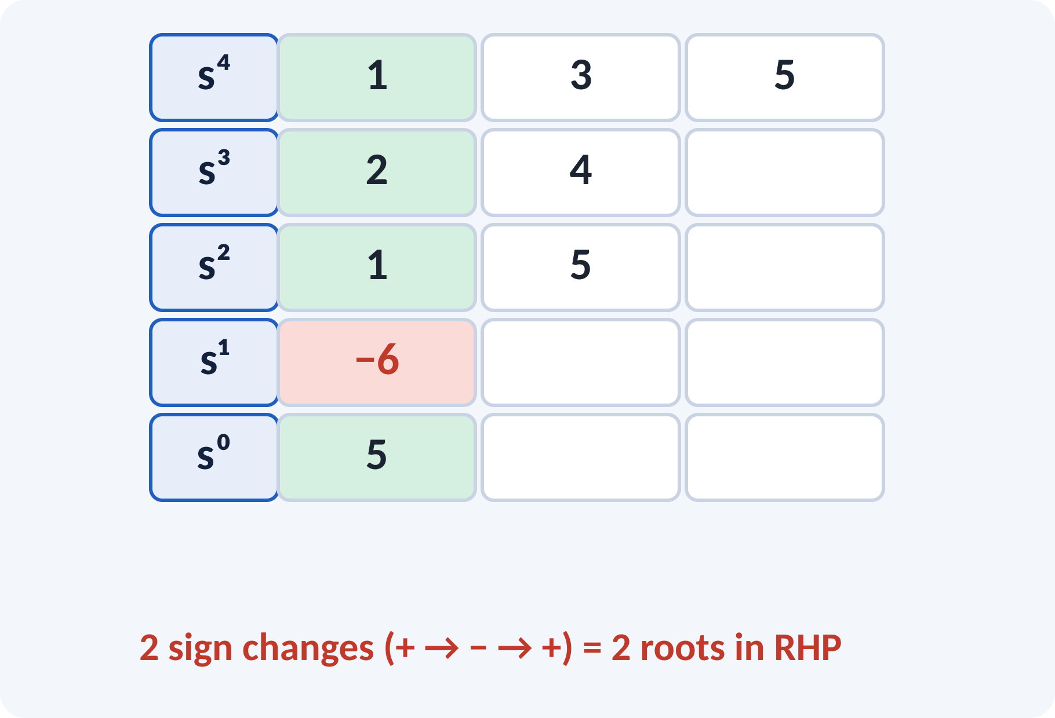
Reading the Routh Table
Look only at the first column.
All same sign: all roots in LHP.
Each sign change: one root in RHP.
Number of sign changes counts RHP roots.
Routh–Hurwitz: stable ⇔ first column has no sign change
Example s⁴ + 2s³ + 3s² + 4s + 5: column 1, 2, 1, −6, 5 → 2 changes
Notes:
The Routh–Hurwitz criterion says the number of roots with positive real part equals the number of sign changes in the first column. In the example the column goes plus, plus, plus, minus, plus, which has two sign changes, so there are two right-half-plane roots and the system is unstable. Always scan the whole column, not just the first two entries.

Slide 10
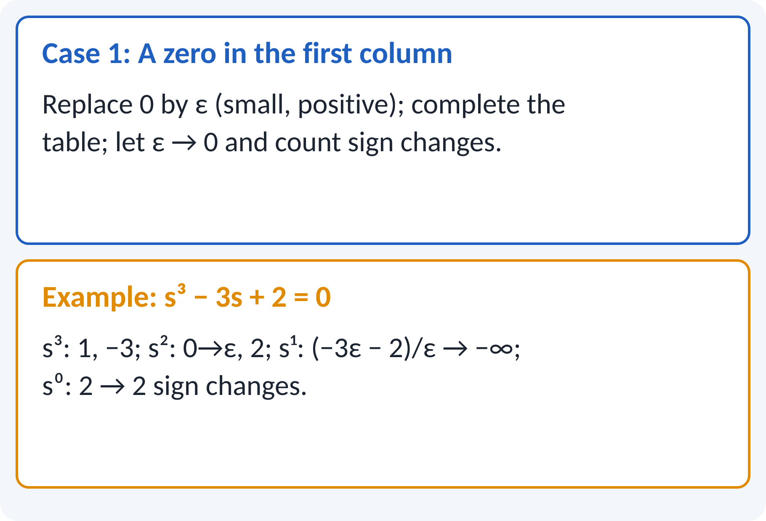
Special Case 1: Zero in First Column
A zero as pivot stops the calculation.
Replace 0 by a small positive ε.
Finish the table in terms of ε.
Let ε → 0 and count sign changes.
Alternative: substitute s = 1/z.
Example: s³ − 3s + 2: s² row (ε, 2) → s¹ = −∞ → 2 sign changes
Notes:
If a zero appears alone in the first column we cannot divide by it. We replace it by a tiny positive number epsilon, continue, and finally let epsilon go to zero while watching the signs. In the example the s squared row has a zero pivot and the sign of the next entry is negative, giving two sign changes. The other method is to invert the polynomial using s equal to one over z.

Slide 11
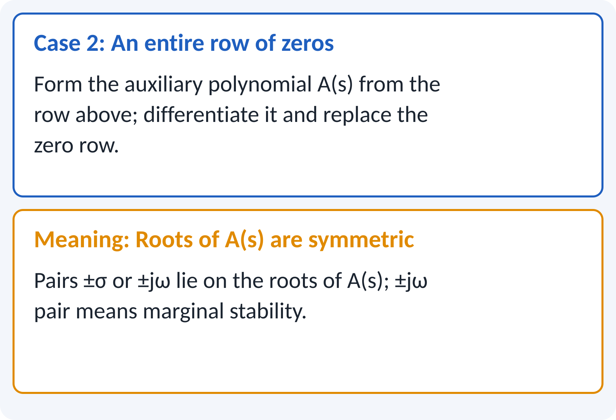
Special Case 2: Row of Zeros
A whole row becomes zero.
Form auxiliary polynomial A(s) from the row above.
Differentiate A(s); use its coefficients as the new row.
Roots of A(s) are roots of the system too.
A pair on jω: marginally stable.
Row of zeros ⇒ roots symmetric about the origin (±σ or ±jω)
Notes:
A row of zeros means the polynomial has roots that are symmetrical about the origin. Take the row just above, form an even polynomial called the auxiliary polynomial, and differentiate it to replace the zero row. The roots of the auxiliary polynomial are exact roots of the characteristic equation. If they are a pure imaginary pair the system is marginally stable.

Slide 12
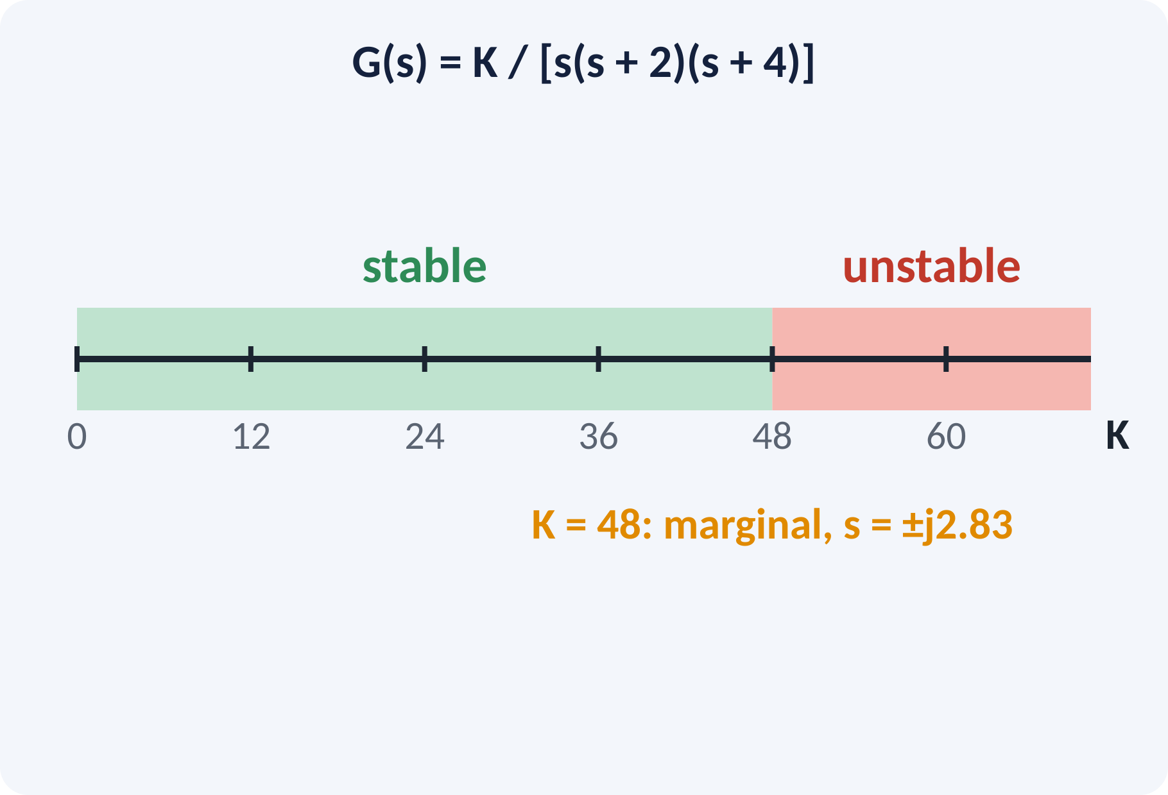
Range of Gain for Stability
Put K in the characteristic equation.
Build the array with K as a symbol.
Every first-column term must be positive.
Solve the inequalities for K.
Boundary values give marginal stability.
Example: s³ + 6s² + 8s + K = 0 → 0 < K < 48
At K = 48 the roots are s = ±j√8 = ±j2.83
Notes:
This is the most common use of Routh's test. Treat the gain K as an unknown and impose that every entry in the first column is positive. Each inequality gives a bound on K, and the stable range is their intersection. At the upper bound a row of zeros appears and the auxiliary polynomial gives the frequency of sustained oscillation.

Slide 13
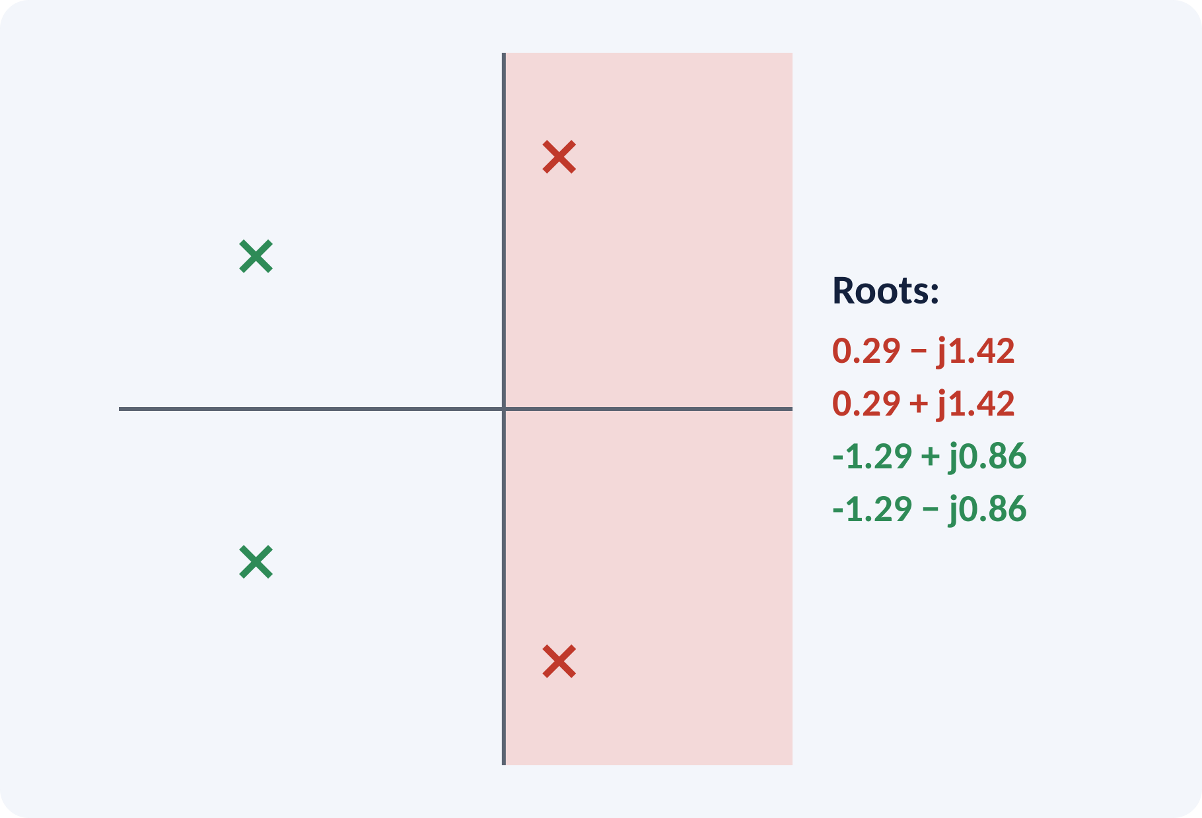
Solved Example 1: Routh Array
Test s⁴ + 2s³ + 3s² + 4s + 5 = 0 for stability.
1. All coefficients positive: continue.
2. s⁴: 1, 3, 5; s³: 2, 4.
3. s²: (2×3 − 1×4)/2 = 1; (2×5 − 0)/2 = 5.
4. s¹: (1×4 − 2×5)/1 = −6.
5. s⁰: 5.
6. Column: 1, 2, 1, −6, 5 → two sign changes.
Answer: unstable; two roots in the RHP (≈ 0.29 ± j1.42)
Notes:
Build the table row by row and double-check each cross product. The s one row gives minus six, which is the only negative entry, but it creates two sign changes: from plus one to minus six, and from minus six to plus five. So two roots lie in the right half-plane. The plot on the right shows the actual roots, which confirms the conclusion.

Slide 14
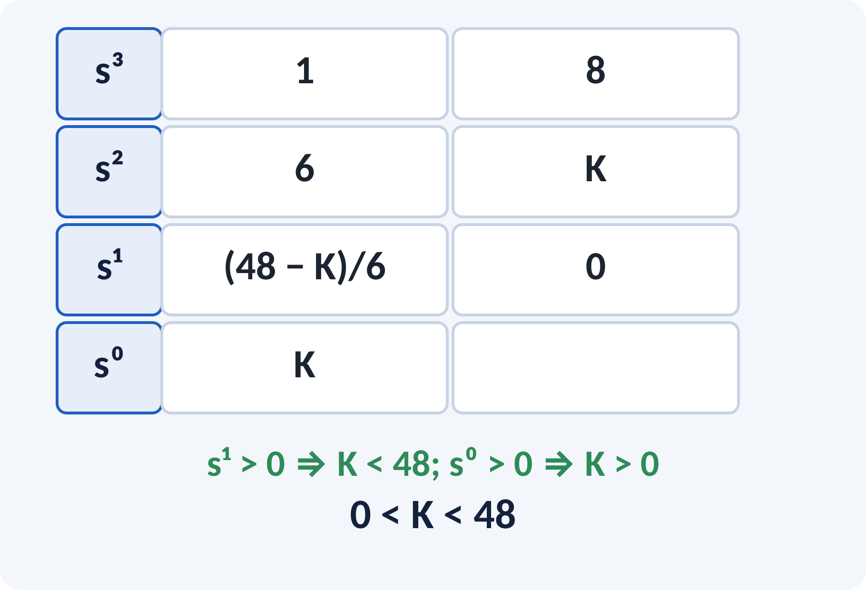
Solved Example 2: Range of K
Unity feedback, G = K/[s(s + 2)(s + 4)]. Find K for stability and the frequency at marginal stability.
1. Characteristic eq.: s³ + 6s² + 8s + K = 0.
2. Array: s³: 1, 8; s²: 6, K; s¹: (48 − K)/6; s⁰: K.
3. s¹ > 0 → K < 48; s⁰ > 0 → K > 0.
4. At K = 48: 6s² + 48 = 0 → s = ±j2.83 rad/s.
Answer: stable for 0 < K < 48; sustained oscillation at 2.83 rad/s when K = 48
Notes:
Multiply out s times s plus two times s plus four and add K to get the characteristic polynomial. The s one entry is 48 minus K over six, so the system is stable only if K is below 48. At K equal to 48 the s one row is zero, the auxiliary polynomial is 6 s squared plus 48, and its roots are plus and minus j root eight. This frequency also appears on the root locus and Bode plot.

Slide 15
Common Mistakes and Exam Tips
✕
Common mistakes
✓
Exam tips
Concluding stability from positive coefficients alone.
Arithmetic error in the cross products.
Counting sign changes in the whole row instead of the first column.
Ignoring special cases (zero pivot, zero row).
Forgetting to include K in the s⁰ term.
Check necessary condition first.
Divide each row by a positive number to simplify.
Count first-column sign changes only.
Write the stable range as an inequality in K.
Notes:
These are the points where marks are lost most often in Routh–Hurwitz. Give one quick example for each mistake. Remind students that writing the formula, substitution and the unit earns method marks even if the arithmetic slips. Encourage them to check the answer for reasonableness.

Slide 16
Summary
Stable ⇔ all roots of 1 + GH = 0 in the LHP.
Necessary: all coefficients present and same sign.
Routh array: sign changes in column 1 = RHP roots.
Zero pivot → ε; zero row → auxiliary polynomial.
Use Routh to find the K range for stability.
Stability range of K from the first column: all entries > 0
Notes:
Recap in one minute. Say each point and ask the class to recall the formula for it. If they remember these ideas, most numerical problems on Routh–Hurwitz are within reach. Next lecture: root locus concept and construction rules. Revise the two solved examples tonight.

Slide 17
Quick Quiz
Q1. A system with a root in the RHP is:
(a) stable (b) marginally stable (c) unstable (d) critically damped
Ans: (c)
Q2. s³ + 2s² + 3s + 4 = 0 first column of Routh array has:
(a) 1, 2, 1, 4 (b) 1, 2, −1, 4 (c) 1, 2, 0, 4 (d) 1, −2, 1, 4
Ans: (a)
Q3. Sign changes in the first column give:
(a) poles on jω (b) RHP roots (c) LHP roots (d) zeros
Ans: (b)
Q4. A row of zeros means:
(a) always unstable (b) symmetric roots, use auxiliary polynomial (c) always stable (d) type 2
Ans: (b)
Q5. s³ + 6s² + 8s + K: stable for:
(a) K < 6 (b) 0 < K < 48 (c) K > 48 (d) any K
Ans: (b)
Notes:
Give about one minute per question and take a show of hands. Discuss why the wrong options are tempting, especially the one that uses a wrong formula. Use the quiz as a quick check on Routh–Hurwitz before leaving.

Slide 18
References
1
Benjamin C. Kuo, Automatic Control Systems
7th Ed., PHI, 2007 (Units 3, 4, 5 textbook)
2
M. Gopal, Control Systems Principles and Design
4th Ed., TMH, 1999 (reference, Units 4, 5)
3
P. S. Satyanarayana, Concepts of Control Systems
2nd Ed., Dynaram Publishers, Bangalore, 2001 (reference)
Next lecture: root locus concept and construction rules
Notes:
Point students to the textbooks listed in the syllabus for Routh–Hurwitz. Ask them to solve at least three textbook problems on this topic before the next class. Thank the class and preview the next lecture.

