Slide 1
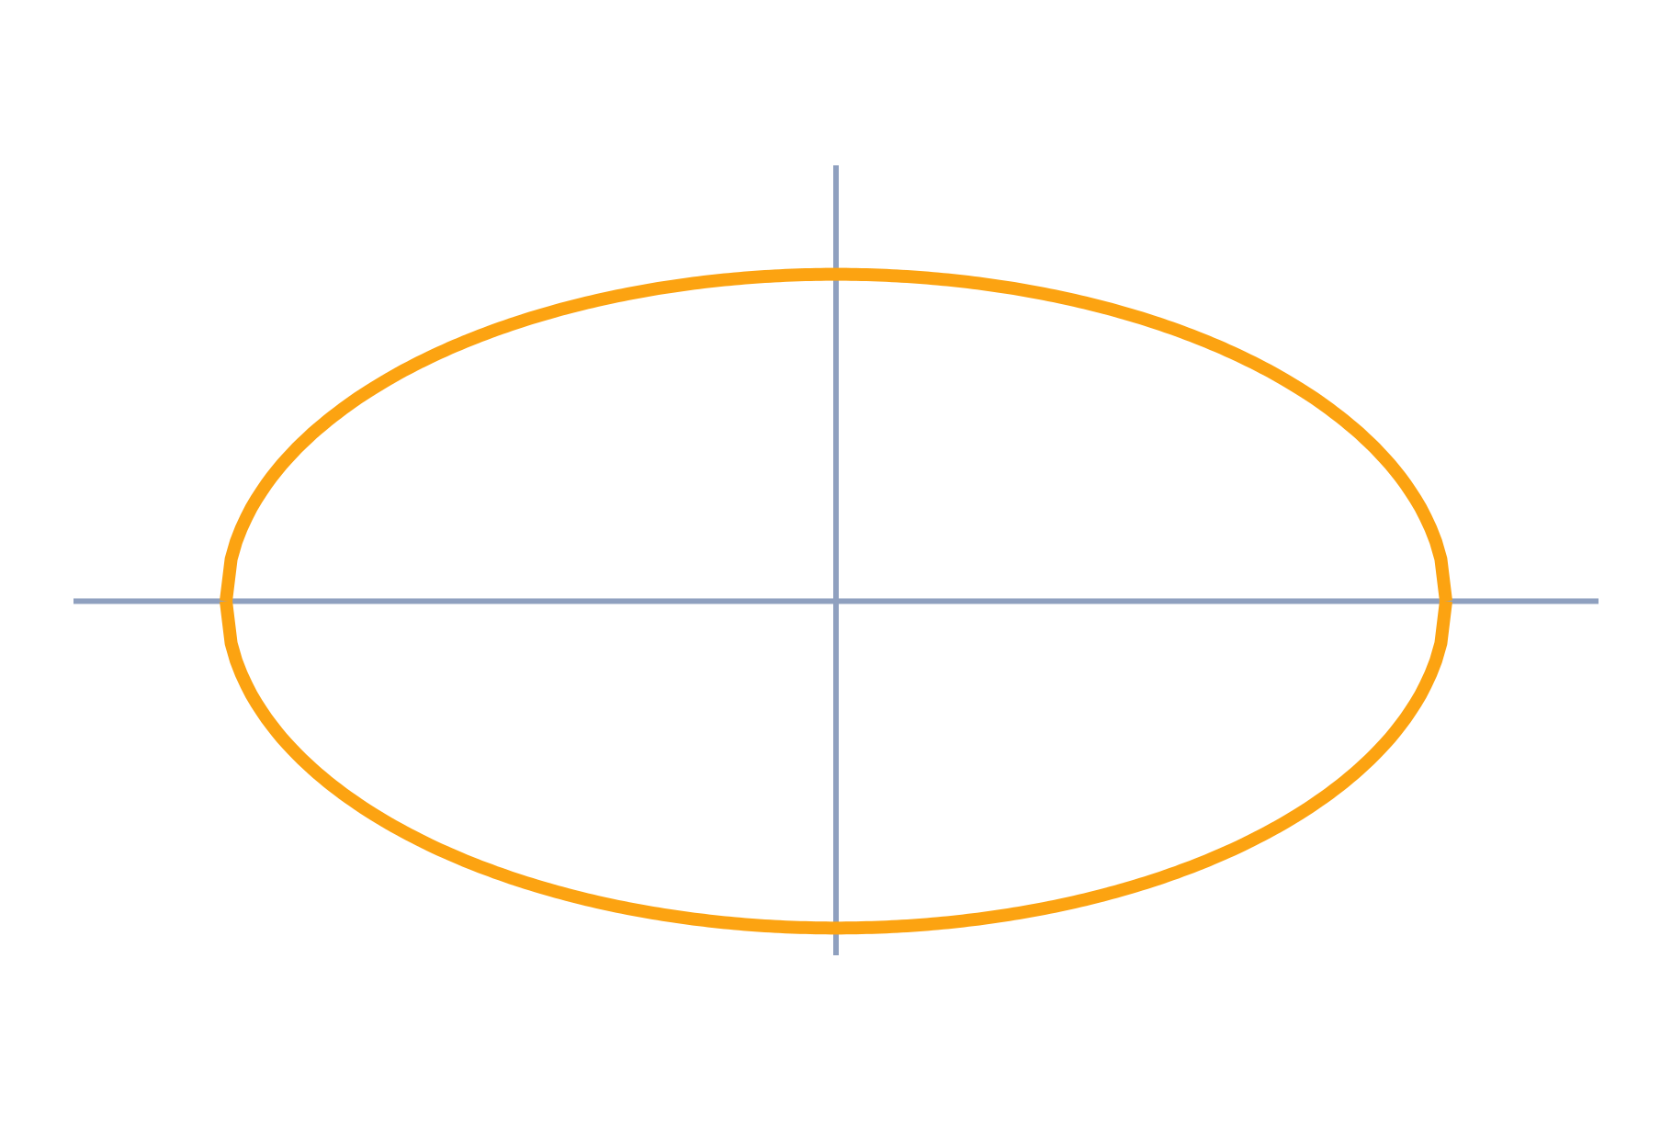
Root Locus Technique
Control Systems (22EEG53)
Unit 4: Stability of Systems
Topic: Root locus concept and rules for construction
Prof. Mitesh Astik
Notes:
Welcome everyone. Today's topic is Root locus concept and rules for construction. It belongs to Unit 4: Stability of Systems. By the end of this session you will be able to use it in numerical problems. Keep your notebooks ready because we will solve two examples.

Slide 2

Learning Outcomes
State the root-locus idea and its conditions.
Apply the construction rules step by step.
Find breakaway points and the jω-axis crossing.
Pick the gain K for a desired damping ratio.
Linked to CO4
Understand stability using Routh–Hurwitz and root locus.
Notes:
Read the outcomes aloud. They map to CO4 of the syllabus. Tell students that these are examinable and that the two solved examples follow the same pattern. Ask them to tick off each outcome at the end of the lecture.

Slide 3
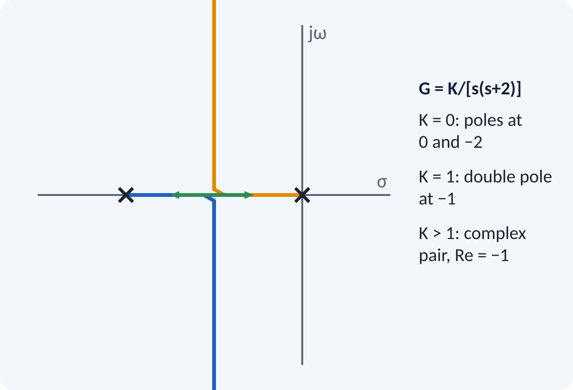
Recap: What You Already Know
Closed-loop poles solve 1 + GH = 0.
Pole position sets the transient response.
Gain K changes the pole positions.
Routh gives the stable range of K.
Closed-loop poles: roots of 1 + K·G(s)H(s) = 0, with K ≥ 0
Notes:
The poles of the closed loop are the roots of one plus K G H. Routh's test told us for which K all roots are in the left half-plane, but not where they are. The root locus shows the path of every closed-loop pole as K goes from zero to infinity, so we see ζ, ωn and stability at once.

Slide 4
Motivation: Tuning the Gain
Gain sets speed, overshoot and stability.
Trial and error with step tests is slow.
The locus shows all designs in one picture.
Choose K to put poles where specs need them.
Root locus = plot of closed-loop poles as K varies from 0 to ∞
Notes:
A designer may want a damping ratio of 0.5 and a given settling time. Rather than solving the characteristic equation for many values of K, we draw the root locus once. Then we pick the point on the locus that meets the specification and read the gain from it. This is the standard method used with MATLAB's rlocus.

Slide 5
Root Locus Concept
Poles of G(s)H(s) are the starting points (K = 0).
Zeros of G(s)H(s) are the end points (K → ∞).
Each pole traces a branch as K increases.
A branch leaving to ∞ follows an asymptote.
1 + K·G(s)H(s) = 0 ⇒ K·G(s)H(s) = −1
G(s)H(s) = N(s)/D(s), K gain, K ≥ 0
Notes:
For K equal to zero the closed-loop poles are the open-loop poles. As K grows, they move along branches. For the example, the poles at zero and minus two move toward each other, meet at minus one when K is one, then split into a complex pair with constant real part minus one. All design information is on this picture.

Slide 6
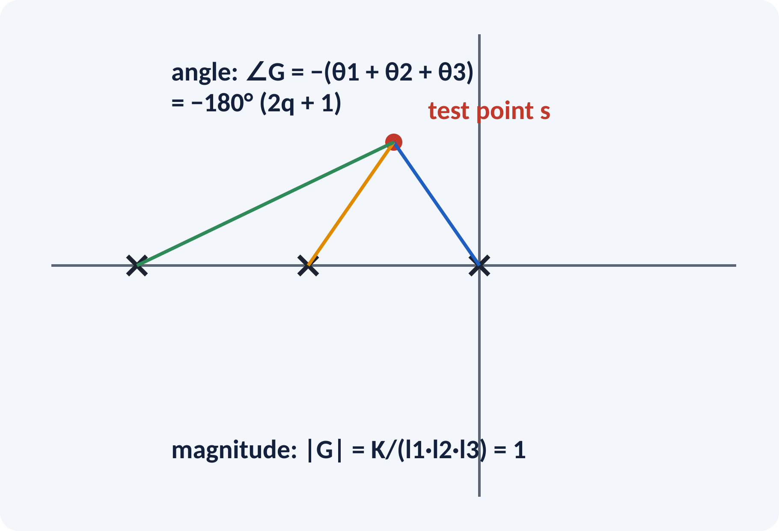
Magnitude and Angle Conditions
A point s is on the locus if it satisfies both.
Angle condition: ∠GH = ±180°(2q + 1).
Magnitude condition gives the gain K at s.
Measure with vectors from poles and zeros.
∠G(s)H(s) = ±180°(2q + 1); K = 1/|G(s)H(s)| = (product of pole distances)/(product of zero distances)
Notes:
From K G H equal to minus one we get two conditions. The angle of G H must be an odd multiple of 180 degrees, which tests whether the point is on the locus. The magnitude of K G H must equal one, which gives the value of K at that point. The magnitude is the ratio of products of distances measured from the point to the poles and zeros.

Slide 7
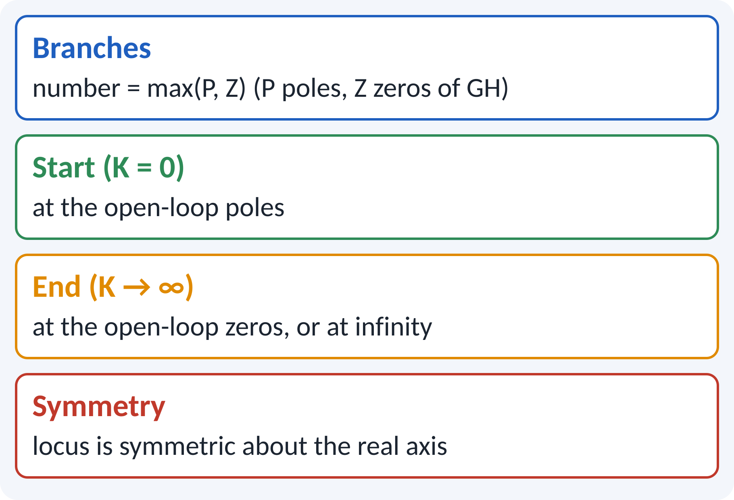
Rules 1–2: Branches, Start, End, Symmetry
Number of branches = number of poles (if P ≥ Z).
Branches start at poles, end at zeros or ∞.
P − Z branches go to infinity.
The locus is symmetrical about the real axis.
P poles, Z zeros → P − Z asymptotic branches
Notes:
Count the poles and zeros of the open-loop transfer function. Each branch starts at a pole. P minus Z of the branches go to infinity, the others terminate at the zeros. Since complex roots occur in conjugate pairs, the locus is symmetric about the real axis, so we only need to draw one half.

Slide 8
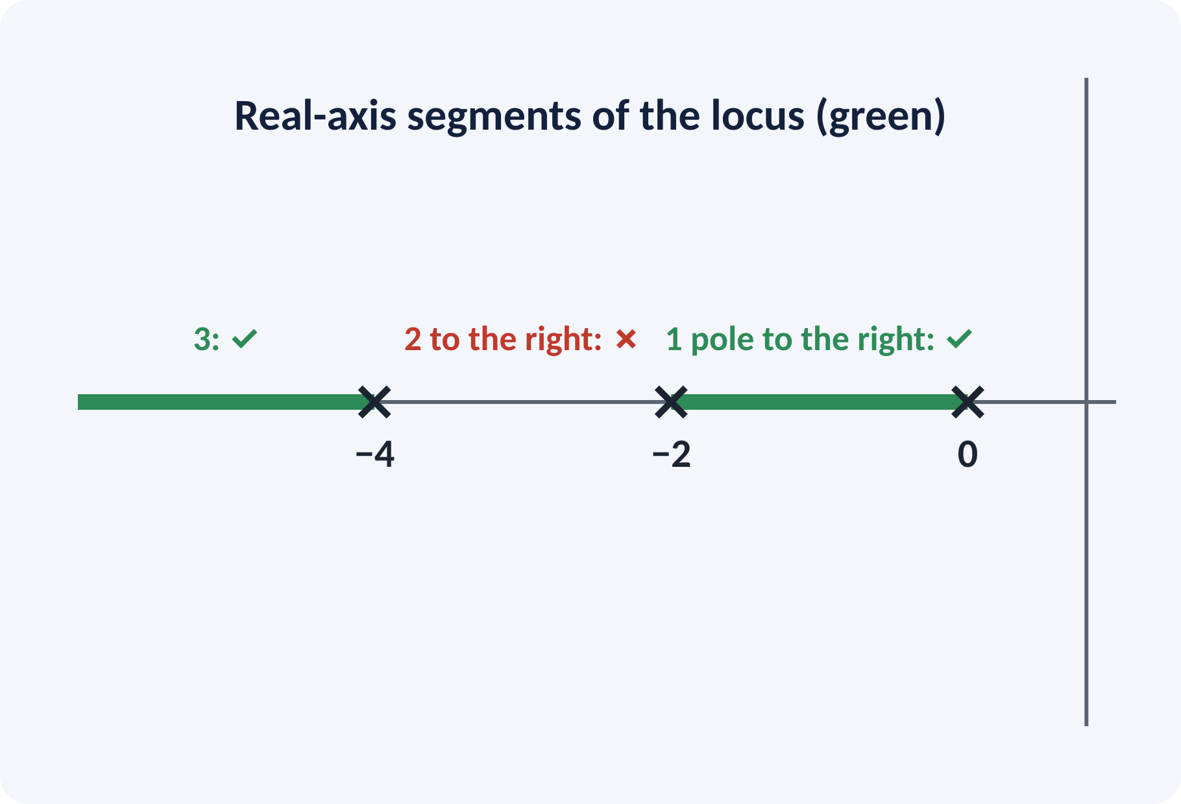
Rule 3: Real-Axis Segments
Take a test point on the real axis.
Count poles and zeros to its right.
Odd count: the point is on the locus.
Even count: not on the locus.
Example poles 0, −2, −4: locus on [−2, 0] and (−∞, −4]
Notes:
Pick any point on the real axis and count the poles and zeros to its right. Complex ones cancel in pairs, so only the real ones matter. If the total is odd, the angle condition is met and the point is on the locus. For our three poles, the intervals between 0 and minus 2, and to the left of minus 4 qualify.

Slide 9
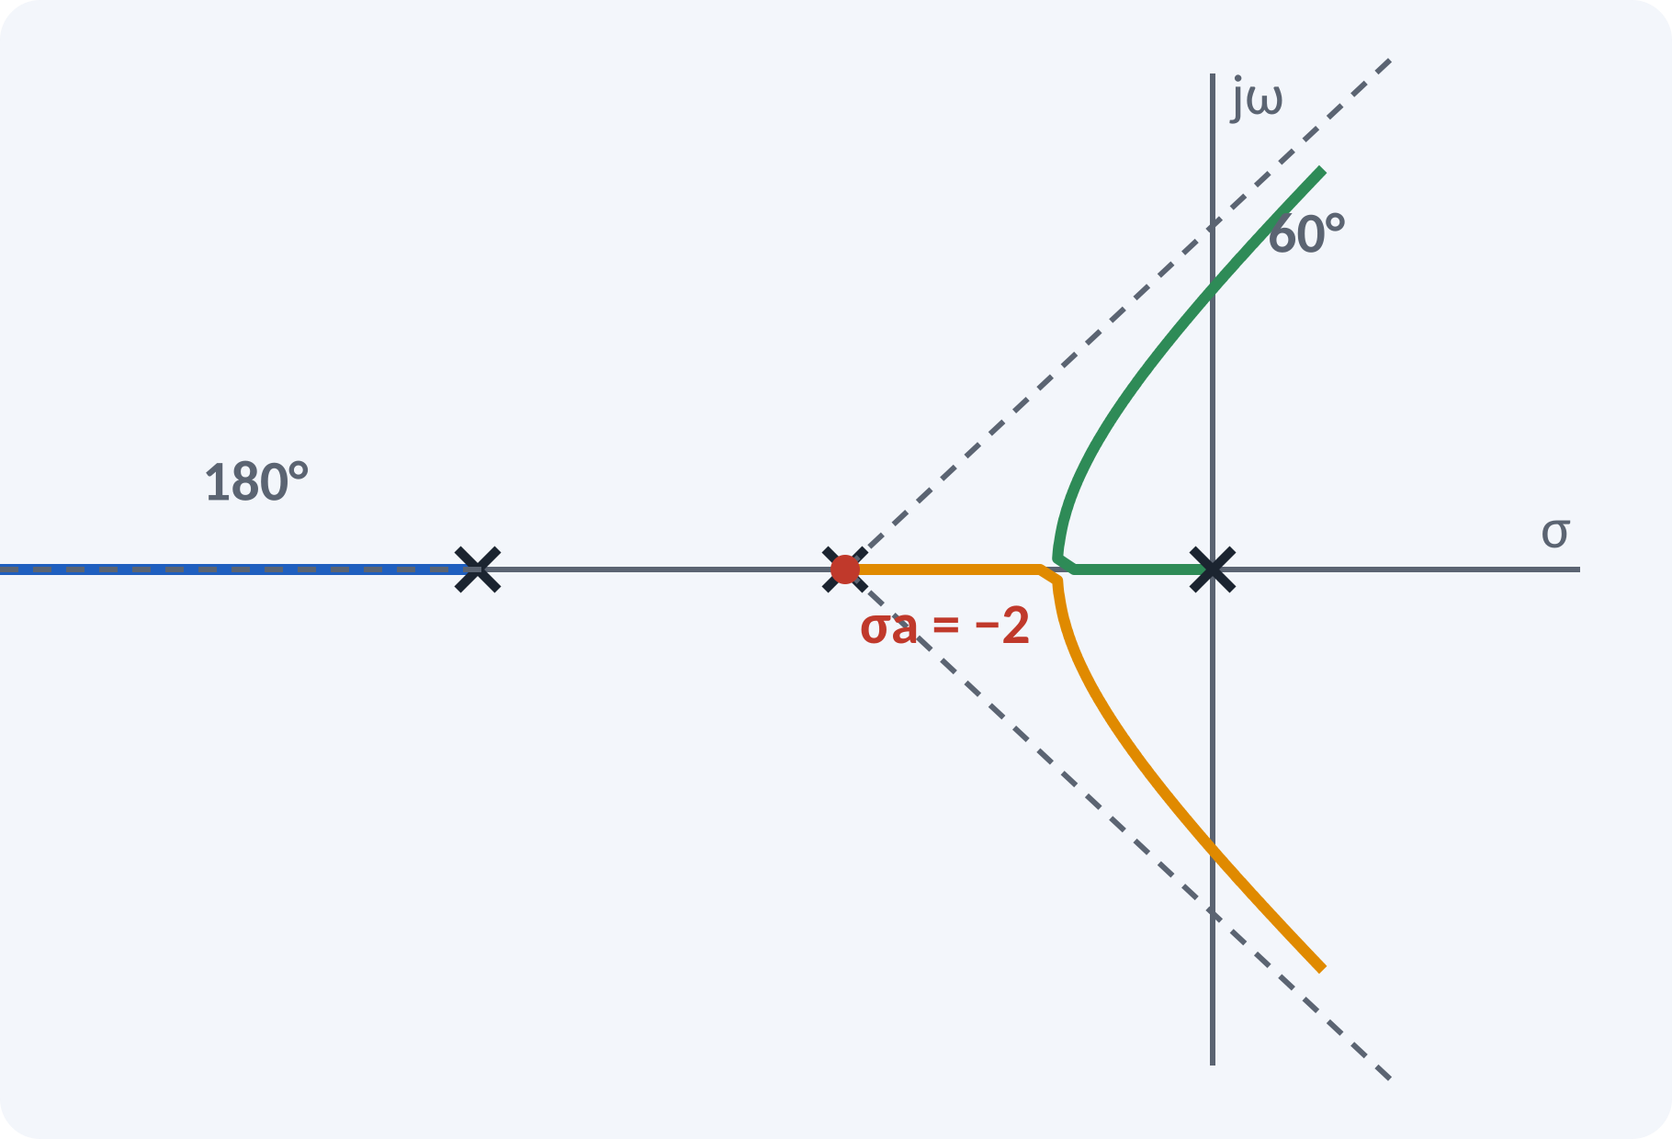
Rule 4: Asymptotes
P − Z branches approach straight lines.
Angles are equally spaced.
All asymptotes meet at the centroid σa on the real axis.
Example P = 3, Z = 0: 60°, 180°, 300°.
θq = ±180°(2q + 1)/(P − Z); σa = (Σ poles − Σ zeros)/(P − Z)
Example: σa = (0 − 2 − 4)/3 = −2
Notes:
For large K the branches that do not end at finite zeros become straight lines. Their angles are odd multiples of 180 degrees divided by P minus Z. They all radiate from the centroid, which is the sum of the poles minus the sum of the zeros divided by P minus Z. In the example the centroid is minus two and the angles are 60, 180 and 300 degrees.

Slide 10
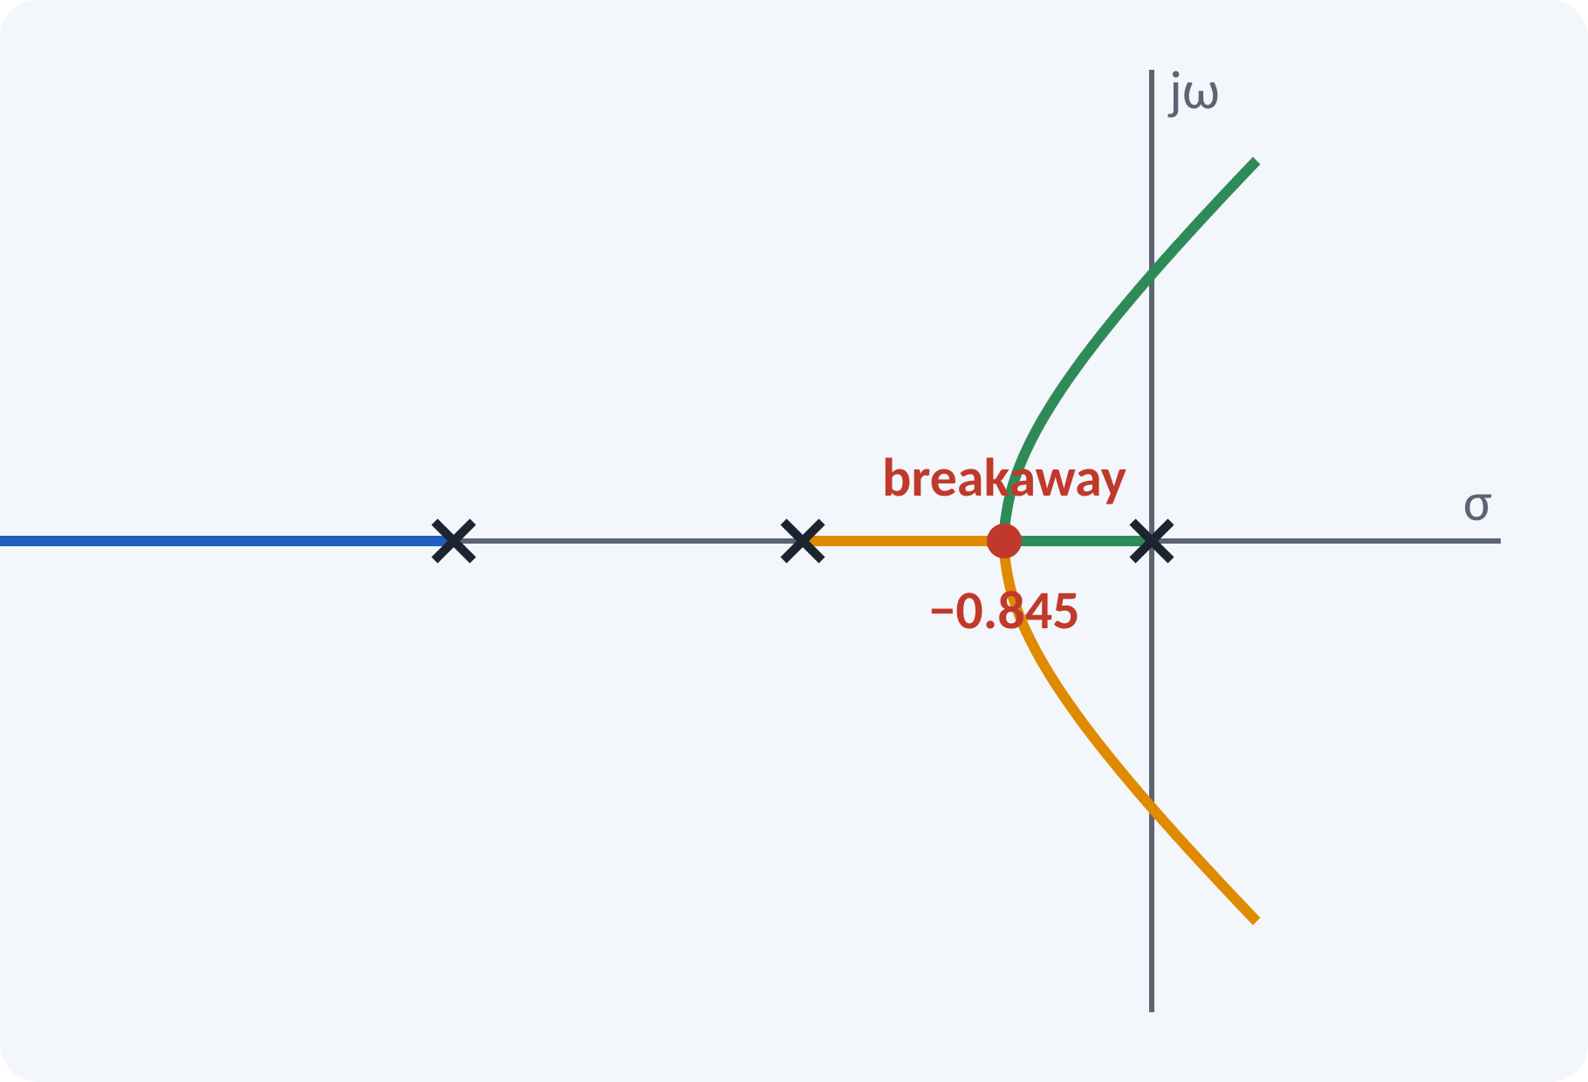
Rule 5: Breakaway and Break-in Points
Branches leave or join the real axis.
Write K = −1/(G H) as a function of s.
Solve dK/ds = 0.
Accept roots lying on the locus (rule 3).
Compute K at the point.
dK/ds = 0 with K = −D(s)/N(s)
Example: K = −(s³ + 6s² + 8s) → 3s² + 12s + 8 = 0 → s = −0.845 (valid), −3.155 (not on locus)
Notes:
Between two adjacent poles on the real axis the locus must break away into the complex plane. The break point is where K has a maximum along the real axis, so we set dK by ds to zero. Solve the quadratic, and keep only roots that lie on valid real-axis segments. Here minus 0.845 is on the locus, while minus 3.155 is not.

Slide 11
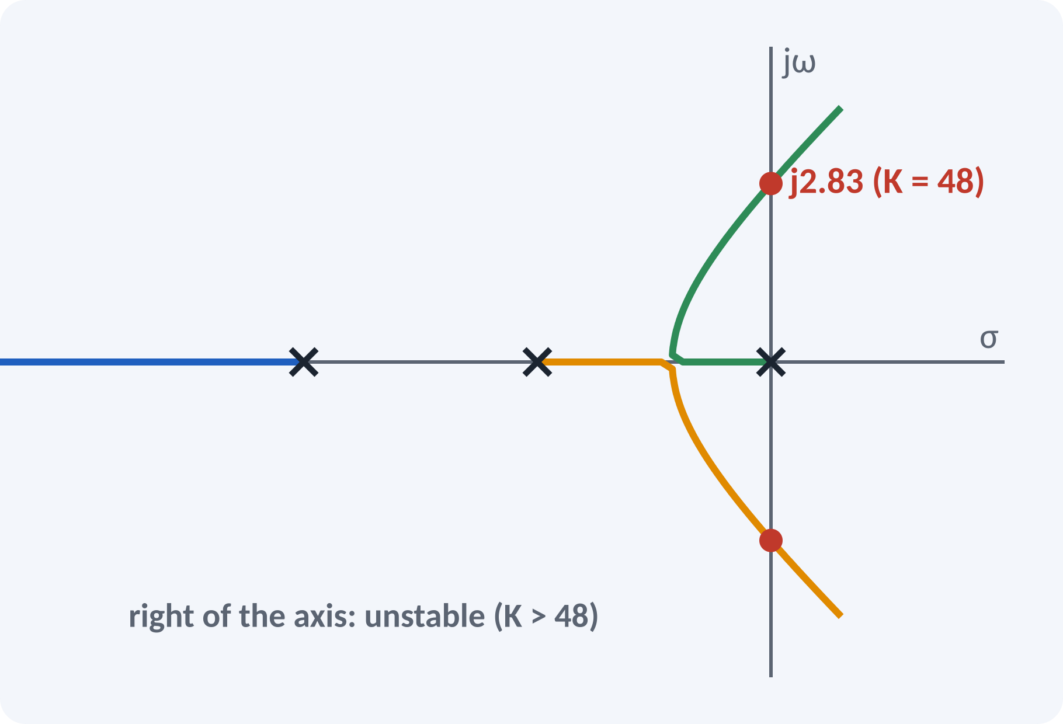
Rules 6–7: Departure Angle and jω Crossing
Departure angle from a complex pole: 180° − Σ(other angles).
Arrival angle at a complex zero: similar.
jω crossing: put s = jω or use Routh.
Crossing gives K for marginal stability.
Departure angle = 180° − Σ ∠(poles) + Σ ∠(zeros)
Crossing: Routh row of zeros → K = 48, ω = 2.83 rad/s
Notes:
If the poles are complex, the direction in which the branch leaves can be found from the angle condition at that pole. The imaginary-axis crossing is most easily found using Routh's test: at the critical gain a row of zeros appears and the auxiliary polynomial gives the frequency. For our example K equals 48 and the crossing is at j 2.83, as we found in the previous lecture.

Slide 12
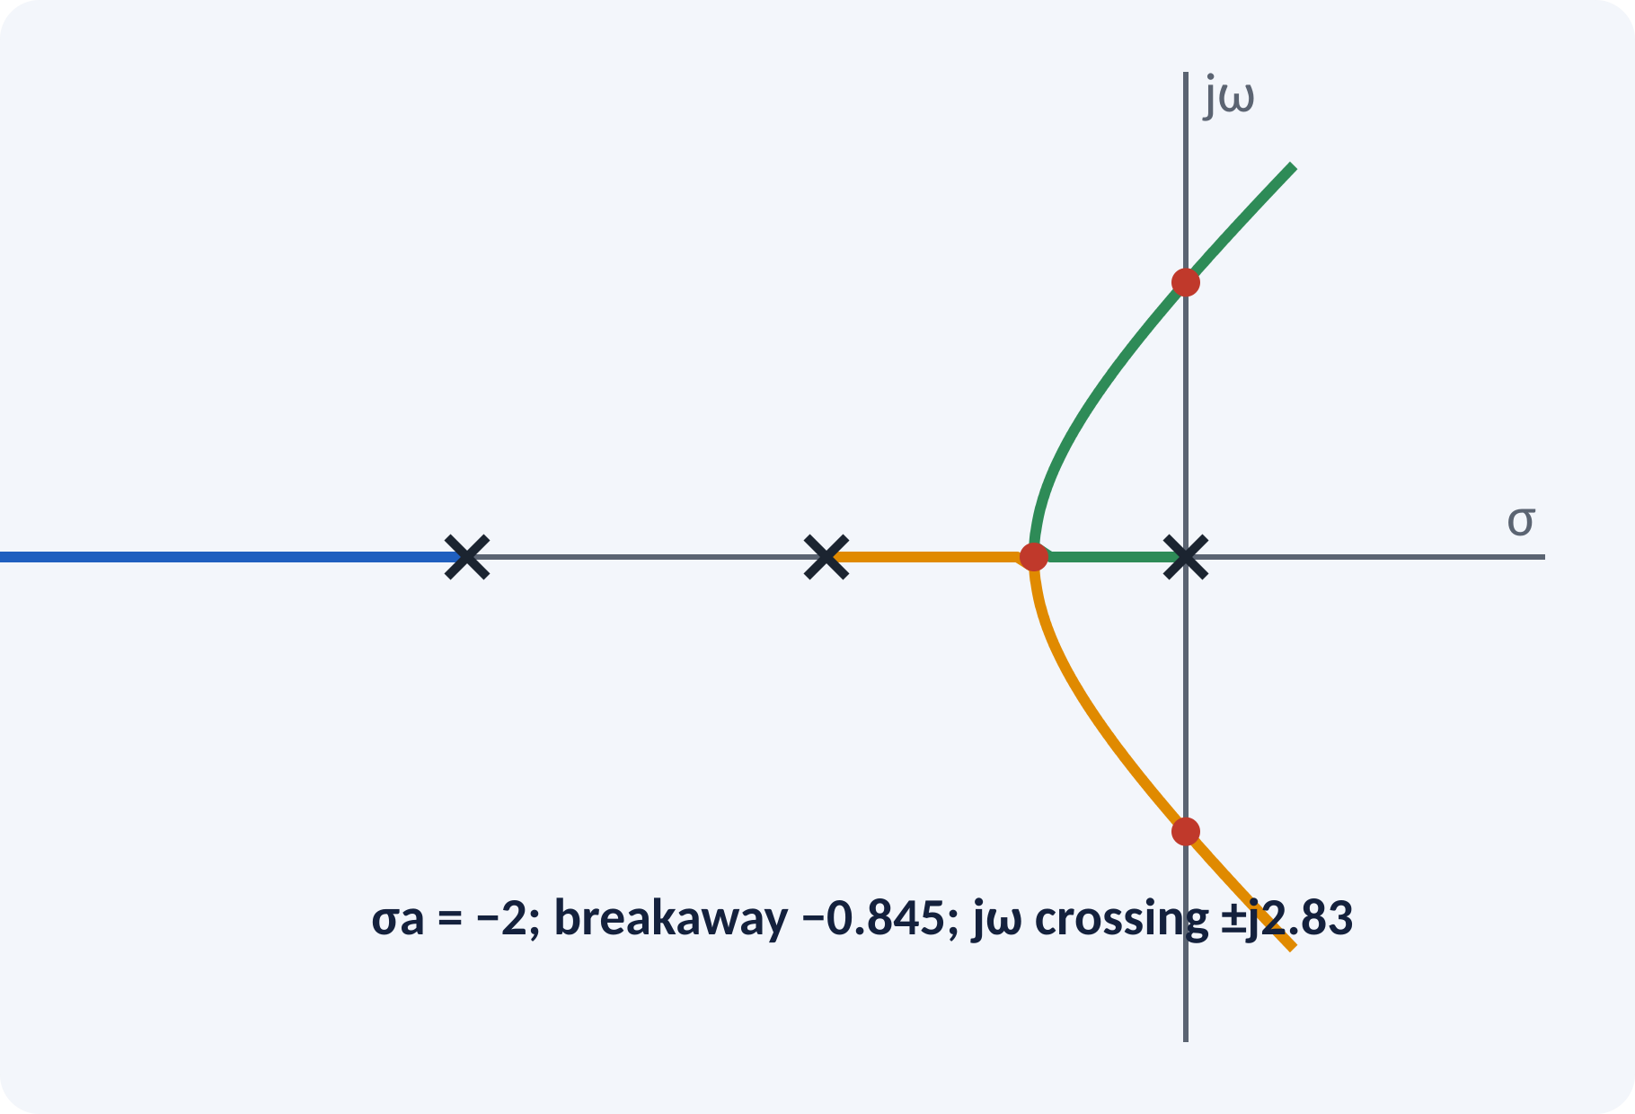
Solved Example 1: Sketch the Locus
Sketch the locus of G(s)H(s) = K/[s(s + 2)(s + 4)].
1. P = 3, Z = 0: three branches to ∞.
2. Real axis: [−2, 0] and (−∞, −4].
3. Asymptotes 60°, 180°, 300°; σa = −2.
4. Breakaway: 3s² + 12s + 8 = 0 → s = −0.845, K = 3.08.
5. jω crossing: K = 48, s = ±j2.83.
6. Complete the sketch.
Answer: breakaway −0.845 (K = 3.08); unstable for K > 48
Notes:
Go through the rules in order and collect numbers before sketching. The breakaway point gives K equal to the product of the distances, which is 0.845 times 1.155 times 3.155, about 3.08. The imaginary-axis crossing comes from Routh. With these points and the asymptotes, the sketch is almost automatic; verify with MATLAB in the lab.

Slide 13
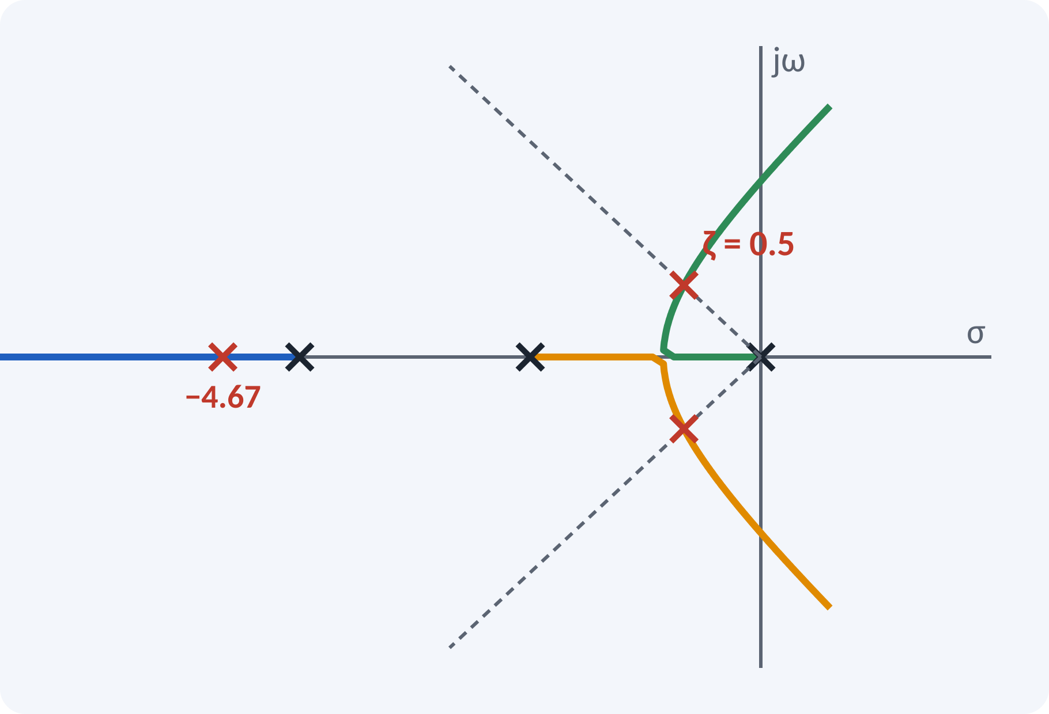
Solved Example 2: Gain for ζ = 0.5
For the same system find K for ζ = 0.5 and the closed-loop poles.
1. ζ = 0.5 → poles on the line at 60° from the negative real axis.
2. Intersection with the locus: s = −0.667 ± j1.155.
3. Third pole: sum of poles = −6 → −4.67.
4. K = |s||s + 2||s + 4| = 1.333 × 1.764 × 3.53 ≈ 8.3.
Answer: K ≈ 8.3; poles −0.667 ± j1.155 and −4.67
Notes:
A damping ratio of 0.5 means the pole lies on a radial line at 60 degrees from the negative real axis. Where this line crosses the locus gives the dominant pair of poles. The third pole follows from the fact that the sum of the roots is minus six. The magnitude condition then gives K of about 8.3. The dominant pair is slow, so the real pole at minus 4.67 is far away and can be neglected.

Slide 14
Common Mistakes and Exam Tips
✕
Common mistakes
✓
Exam tips
Counting only poles to the left for real-axis segments.
Accepting a breakaway root that is not on the locus.
Mixing up σa formula signs.
Taking asymptote angles from the positive axis only.
Drawing branches that cross each other.
Follow the rules in order.
Check each candidate point with the angle condition.
Verify K at the jω crossing with Routh.
Remember the locus is symmetric about the real axis.
Notes:
These are the points where marks are lost most often in root locus. Give one quick example for each mistake. Remind students that writing the formula, substitution and the unit earns method marks even if the arithmetic slips. Encourage them to check the answer for reasonableness.

Slide 15
Summary
Root locus = path of closed-loop poles for 0 ≤ K < ∞.
Angle condition finds the locus; magnitude gives K.
Real-axis segments: odd number of poles + zeros to the right.
Asymptotes: angles 180°(2q + 1)/(P − Z), centroid σa.
Breakaway: dK/ds = 0; jω crossing from Routh.
Choose K from the locus to meet ζ, ts and stability requirements
Notes:
Recap in one minute. Say each point and ask the class to recall the formula for it. If they remember these ideas, most numerical problems on root locus are within reach. Next lecture: compensators and controllers (lag, lead, PID). Revise the two solved examples tonight.

Slide 16
Quick Quiz
Q1. Root locus branches start at:
(a) zeros (b) poles of GH (c) origin (d) infinity
Ans: (b)
Q2. Number of asymptotes for P = 4, Z = 1:
(a) 1 (b) 3 (c) 4 (d) 5
Ans: (b)
Q3. A real-axis point is on the locus if poles + zeros to its right is:
(a) even (b) odd (c) zero (d) any
Ans: (b)
Q4. Centroid for poles 0, −2, −4 and no zeros:
(a) −6 (b) −3 (c) −2 (d) 0
Ans: (c)
Q5. Breakaway points satisfy:
(a) dK/ds = 0 (b) K = 0 (c) |GH| = 0 (d) s = jω
Ans: (a)
Notes:
Give about one minute per question and take a show of hands. Discuss why the wrong options are tempting, especially the one that uses a wrong formula. Use the quiz as a quick check on root locus before leaving.

Slide 17
References
1
Benjamin C. Kuo, Automatic Control Systems
7th Ed., PHI, 2007 (Units 3, 4, 5 textbook)
2
M. Gopal, Control Systems Principles and Design
4th Ed., TMH, 1999 (reference, Units 4, 5)
3
K. Ogata, Modern Control Engineering
5th Ed., Pearson Education Asia / PHI, 2009 (reference)
Next lecture: Unit 5: compensators and controllers
Notes:
Point students to the textbooks listed in the syllabus for root locus. Ask them to solve at least three textbook problems on this topic before the next class. Thank the class and preview the next lecture.

