Slide 1

UNIT 1 · 9 hours
Generation of Sinusoidal Voltage
Circuit Fundamentals
Basic Electrical and Electronics Engineering (EEE103)
Dr. Mitesh Astik · Dept. of Electrical and Electronics Engineering
NMAM Institute of Technology, Nitte · 2025-26
Notes:
Welcome. In this session we study "Generation of Sinusoidal Voltage", part of Unit 1 (Circuit Fundamentals) of Basic Electrical and Electronics Engineering.

Slide 2
Learning objectives
U1
Explain how a rotating coil generates a sinusoidal EMF
Define cycle, period, frequency, amplitude, phase
Write the instantaneous equation e = Em sin ωt
Relate ω, f and T
Syllabus context
Basic nodal and mesh analysis excited by independent DC voltage sources, Power and Energy. Generation of sinusoidal voltage, frequency, average value, RMS value, form factor and peak factor, phasor representation of alternating quantities.
Notes:
By the end of this topic you should be able to do the following. Explain how a rotating coil generates a sinusoidal EMF. Define cycle, period, frequency, amplitude, phase. Write the instantaneous equation e = Em sin ωt. Relate ω, f and T.

Slide 3
Why alternating current?
U1
Easy to generate at high voltage by rotating machines.
Transformers step voltage up for transmission and down for use, impossible with DC.
Motors such as the induction motor, run directly from AC.
Standard supply: 230 V (RMS), 50 Hz single-phase in India.
Notes:
Alternating current is the basis of nearly all power systems because transformers can change voltage levels efficiently.

Slide 4
Generating an EMF: coil in a field
U1
1
2
3
4
5
Coil
Flux cutting
Zero EMF
Peak EMF
Reversal
A coil AB rotates at uniform speed in a uniform magnetic field.
Sides of the coil cut flux; Faraday's law gives EMF e = B l v sin θ.
When the coil sides move parallel to the field (position 1), no flux is cut.
When sides move perpendicular to the field (position 3), cutting is maximum.
In the second half-cycle the polarity reverses; the cycle repeats.
One revolution of a two-pole machine = one complete cycle of EMF.
Notes:
At the instant the coil sides move along the flux lines no EMF is induced. At ninety degrees the cutting rate is maximum, so EMF is maximum.

Slide 5
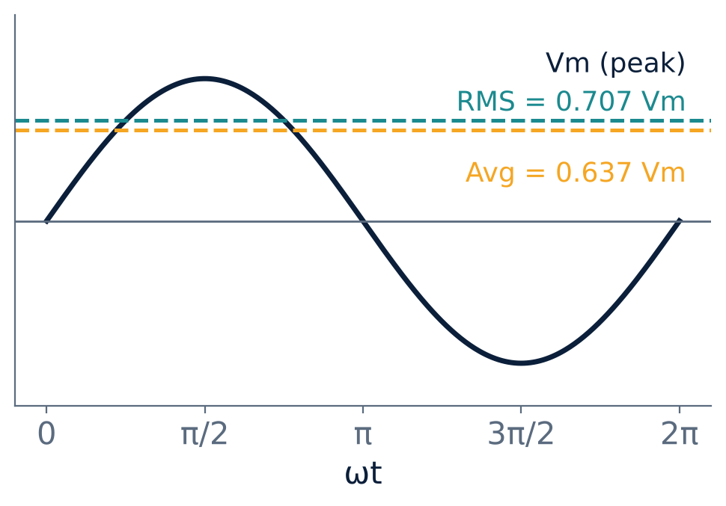
The sinusoidal waveform
U1
e = Em sin ωt = Em sin θ
θ = ωt (radians)
ω = 2πf = 2π/T rad/s
f = 1/T (hertz)
50 Hz → T = 20 ms, ω = 314 rad/s
Notes:
The voltage varies as a sine function of the angle turned by the coil.

Slide 6
Terms used with alternating quantities
U1
Term | Meaning
Waveform | Graph of the quantity against time or angle
Cycle | One complete repetition of the variation
Time period T | Duration of one cycle (s)
Frequency f | Number of cycles per second (Hz) = 1/T
Instantaneous value | Value at any instant: e, v, i
Peak (amplitude) Em | Maximum instantaneous value
Peak-to-peak | Maximum positive to maximum negative: 2Em for a sine
Phase | Fraction of the cycle advanced from the reference
Notes:
Learn these definitions. They are asked frequently.

Slide 7
Example: reading an equation
U1
Problem An alternating voltage is v = 141.4 sin 377t volts. Find peak value, frequency, period and v at t = 3 ms.
Peak Vm = 141.4 V
f = ω/2π = 377/2π = 60 Hz, T = 1/60 = 16.67 ms
v(3 ms) = 141.4 sin(377 × 0.003 rad) = 141.4 sin(1.131 rad = 64.8°)
Answer: Vm = 141.4 V, f = 60 Hz, v = 127.94 V
Notes:
Keep the calculator in radian mode if you use the argument directly, or convert to degrees as done in your notes.

Slide 8
Frequency of a multi-pole generator
U1
One pair of poles → one cycle per revolution.
P poles, speed N rpm: f = P N / 120 Hz.
Example: a 4-pole alternator at 1500 rpm gives f = 4 × 1500 / 120 = 50 Hz.
This is the same relation as the synchronous speed of an induction motor, Ns = 120 f / P.
Notes:
The frequency equals the number of pole pairs times revolutions per second.

Slide 9
Key takeaways
U1
A coil rotating in a magnetic field induces e = Em sin ωt
ω = 2πf and f = 1/T
Peak-to-peak value of a sine is twice the peak
f = PN/120 for a P-pole machine at N rpm
Notes:
To summarise this topic. A coil rotating in a magnetic field induces e = Em sin ωt. ω = 2πf and f = 1/T. Peak-to-peak value of a sine is twice the peak. f = PN/120 for a P-pole machine at N rpm.

Slide 10
Practice questions
U1
Q1. Find the period and angular frequency of a 50 Hz supply.
Q2. v = 325 sin 314t. Find Vm, f, and v at t = 5 ms.
Q3. A 6-pole alternator runs at 1000 rpm. Find its frequency.
Q4. Why does the EMF reverse polarity every half cycle?
Notes:
Attempt these on your own, then check your working against your notes and textbook. Find the period and angular frequency of a 50 Hz supply. v = 325 sin 314t. Find Vm, f, and v at t = 5 ms. A 6-pole alternator runs at 1000 rpm. Find its frequency. Why does the EMF reverse polarity every half cycle?

