Slide 1

UNIT 2 · 9 hours
Losses and Efficiency of a Transformer
Transformers and Electrical Machines
Basic Electrical and Electronics Engineering (EEE103)
Dr. Mitesh Astik · Dept. of Electrical and Electronics Engineering
NMAM Institute of Technology, Nitte · 2025-26
Notes:
Welcome. In this session we study "Losses and Efficiency of a Transformer", part of Unit 2 (Transformers and Electrical Machines) of Basic Electrical and Electronics Engineering.

Slide 2
Learning objectives
U2
Identify core and copper losses
Explain hysteresis and eddy-current loss
Calculate efficiency at any load and power factor
State the condition for maximum efficiency
Syllabus context
Transformers: necessity of transformers, principle of operation, types and construction of single-phase transformers, EMF equation, losses and efficiency.
Notes:
By the end of this topic you should be able to do the following. Identify core and copper losses. Explain hysteresis and eddy-current loss. Calculate efficiency at any load and power factor. State the condition for maximum efficiency.

Slide 3
Losses in a transformer
U2
Core (iron) loss Pi
Copper loss Pc
Others
Hysteresis + eddy current. Depends on voltage and frequency; practically constant from no load to full load.
I1²R1 + I2²R2 in the windings. Varies as the square of load current.
Stray load loss and dielectric loss: small.
Total loss = Pi + Pc; no rotating parts, so no friction loss.
Notes:
Because the supply voltage and frequency are constant, the maximum flux stays almost the same at all loads, so core loss is constant.

Slide 4
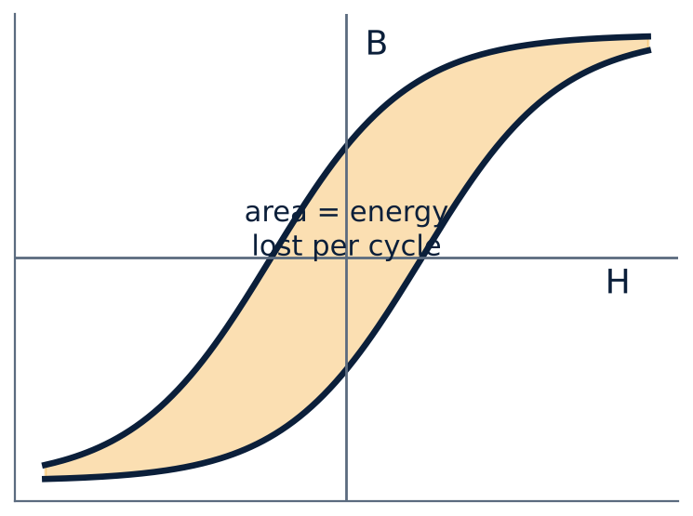
Hysteresis loss
U2
B lags H in iron: the B–H curve forms a loop.
Area of the loop = energy lost per cycle per unit volume.
Loss ∝ f × area: silicon steel has a thin loop.
Eddy-current loss ∝ f² Bm² t² (t = lamination thickness).
Notes:
The larger the hysteresis loop, the greater the energy required to magnetise the core on each cycle.

Slide 5
Efficiency
U2
η = Output / Input
η = x S cos φ / (x S cos φ + Pi + x² Pc)
= Output / (Output + losses)
x = fraction of full load, S = kVA rating
Typically 95–99 % for power transformers.
Maximum efficiency when copper loss = iron loss: x = √(Pi/Pc).
Distribution transformers are designed for maximum efficiency at ≈ 60–70 % load.
Notes:
Efficiency is output power over input power. Output is S times the load fraction times the power factor.

Slide 6
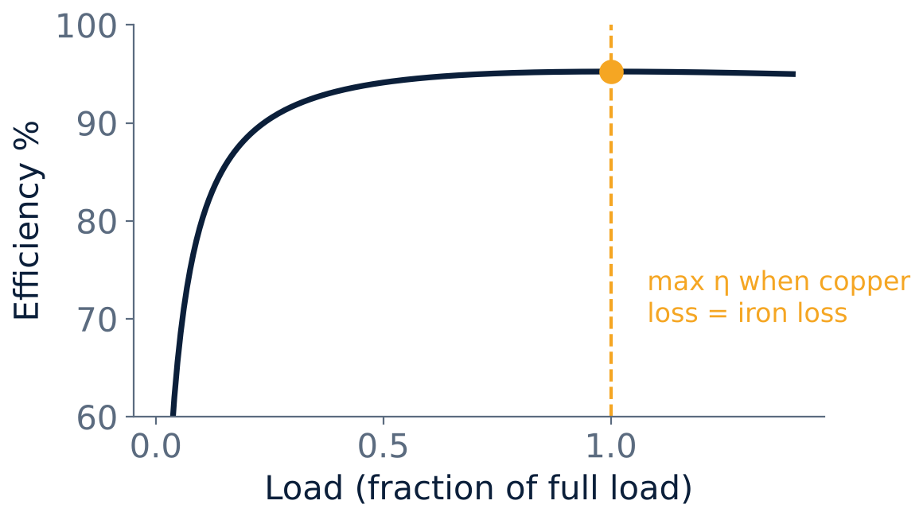
Efficiency versus load
U2
Efficiency rises quickly with load.
Peak occurs where Pc = Pi.
Falls slightly above that load as Pc grows with x².
Notes:
The curve is rather flat near its maximum, so the transformer remains efficient over a wide range of loads.

Slide 7
Numerical: full-load efficiency
U2
Problem A 25 kVA, 2000/200 V transformer has iron loss 350 W and full-load copper loss 400 W. Find efficiency at full load, 0.8 pf lagging.
Output = 25 × 0.8 = 20 kW
Total loss = 0.35 + 0.4 = 0.75 kW
η = 20/(20 + 0.75) × 100
Answer: η = 96.38 %
Notes:
Efficiency is the ratio of output to the sum of output and losses.

Slide 8
Numerical: maximum efficiency
U2
Problem For the same transformer find the load at which efficiency is maximum and the maximum efficiency at unity power factor.
x = √(Pi/Pc) = √(350/400) = 0.935
Output = 0.935 × 25 kVA × 1 = 23.4 kW
Losses = 2 × 350 W = 0.7 kW
η = 23.4/(23.4 + 0.7)
Answer: x = 0.935 (23.4 kVA), ηmax = 97.1 %
Notes:
At maximum efficiency the copper loss equals the iron loss.

Slide 9
Key takeaways
U2
Iron loss is constant; copper loss ∝ (load)²
Hysteresis loss depends on the B–H loop area; eddy loss on lamination thickness
η = output / (output + Pi + Pc)
Maximum η when Pc = Pi
Notes:
To summarise this topic. Iron loss is constant; copper loss ∝ (load)². Hysteresis loss depends on the B–H loop area; eddy loss on lamination thickness. η = output / (output + Pi + Pc). Maximum η when Pc = Pi.

Slide 10
Practice questions
U2
Q1. List the losses in a transformer and how each is reduced.
Q2. A 100 kVA transformer has Pi = 1 kW and Pc = 1.5 kW (full load). Find η at full load, unity pf.
Q3. Find the load fraction for maximum efficiency in question 2.
Q4. Why is the core loss assumed constant at all loads?
Notes:
Attempt these on your own, then check your working against your notes and textbook. List the losses in a transformer and how each is reduced. A 100 kVA transformer has Pi = 1 kW and Pc = 1.5 kW (full load). Find η at full load, unity pf. Find the load fraction for maximum efficiency in question 2. Why is the core loss assumed constant at all loads?

