Slide 1

UNIT 2 · 9 hours
DC Motor: Principle of Operation and Back EMF
Transformers and Electrical Machines
Basic Electrical and Electronics Engineering (EEE103)
Dr. Mitesh Astik · Dept. of Electrical and Electronics Engineering
NMAM Institute of Technology, Nitte · 2025-26
Notes:
Welcome. In this session we study "DC Motor: Principle of Operation and Back EMF", part of Unit 2 (Transformers and Electrical Machines) of Basic Electrical and Electronics Engineering.

Slide 2
Learning objectives
U2
Describe the construction of a DC machine
Explain the principle of the DC motor (Fleming's left-hand rule)
Derive the voltage equation and explain back EMF
Explain the significance of back EMF, including starting
Syllabus context
DC Motor: principle of operation, back EMF and its significance, torque equation, characteristics and speed control (armature and field) of DC shunt motor.
Notes:
By the end of this topic you should be able to do the following. Describe the construction of a DC machine. Explain the principle of the DC motor (Fleming's left-hand rule). Derive the voltage equation and explain back EMF. Explain the significance of back EMF, including starting.

Slide 3
Construction of a DC machine
U2
Stator
Rotor (armature)
Commutator + brushes
Yoke (cast steel frame), laminated pole cores with field coils, pole shoes to spread flux.
Laminated silicon-steel core with slots; armature winding (lap or wave).
Copper segments insulated by mica; carbon brushes carry current to the rotating armature.
Same construction serves as generator or motor. Lap winding: A = P; wave winding: A = 2.
Notes:
A DC generator and a DC motor are physically the same machine.

Slide 4
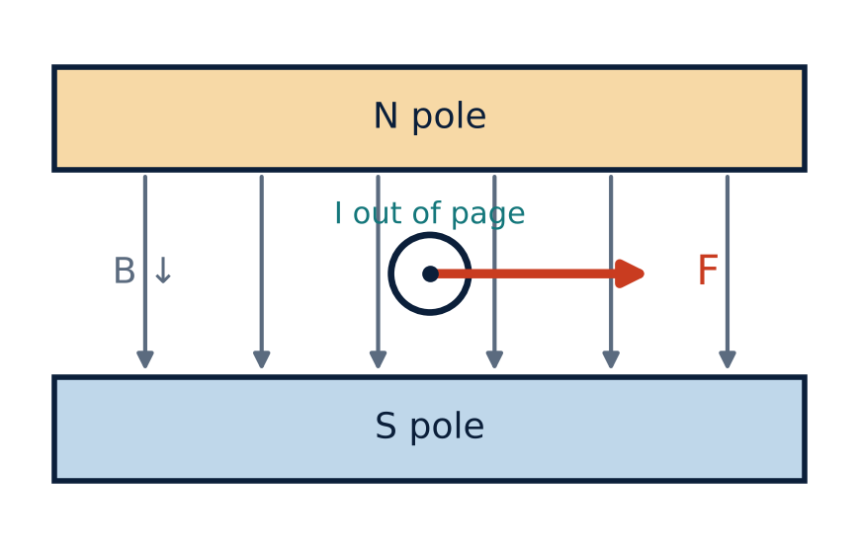
Principle of operation
U2
A current-carrying conductor in a magnetic field experiences a force.
Direction: Fleming's left-hand rule (field, current, force).
F = B I l.
Forces on the two sides of a coil give a turning moment; the commutator keeps the torque in one direction.
Notes:
Whenever a current carrying conductor is placed in a magnetic field it experiences a force. Coil sides A and B experience opposite forces, producing torque.

Slide 5
Back EMF and voltage equation
U2
Eb = Z N φ P / (60 A)
V = Eb + Ia Ra
Ia = (V − Eb) / Ra
back EMF (V)
voltage equation
armature current
Rotating conductors cut flux and induce an EMF opposing the applied voltage (Lenz's law): Eb.
Eb ∝ φ N and is always less than V in motoring.
Notes:
The voltage applied to a motor must overcome the back emf and supply the armature resistance drop.

Slide 6
Power relations
U2
V Ia = Eb Ia + Ia² Ra
Pin = V Ia
Pm = Eb Ia
multiply by Ia
electrical input to armature
mechanical power developed
Ia² Ra is the armature copper loss.
Efficiency of the armature conversion = Eb / V.
Notes:
Multiplying the voltage equation by I a shows how the input power is divided.

Slide 7
Significance of back EMF
U2
Self-regulation
Starting
Energy conversion
If load rises, speed falls, Eb falls, Ia rises and torque increases: motor adjusts itself.
At standstill Eb = 0, so Ia = V/Ra is very large (≈ 20× full-load). A starter resistance limits it.
Eb Ia is the electrical equivalent of mechanical power: Eb makes the conversion possible.
Notes:
Without back emf the armature current would be limited only by the tiny armature resistance.

Slide 8
Numerical: back EMF of a shunt motor
U2
Problem A 220 V DC shunt motor takes 10 kW. Rsh = 230 Ω, Ra = 0.28 Ω. Find line, field and armature currents and back EMF.
I = 10 000/220 = 45.45 A
Ish = 220/230 = 0.956 A
Ia = I − Ish = 44.49 A
Eb = V − Ia Ra = 220 − 44.49 × 0.28
Answer: Ia = 44.49 A, Eb = 207.54 V
Notes:
The shunt field current is small compared with the armature current.

Slide 9
Key takeaways
U2
Motor action: current-carrying conductor in a field experiences a force (Fleming's left hand)
V = Eb + Ia Ra; Eb = ZNφP/60A
Eb Ia = mechanical power developed
Back EMF limits armature current; a starter is needed
Notes:
To summarise this topic. Motor action: current-carrying conductor in a field experiences a force (Fleming's left hand). V = Eb + Ia Ra; Eb = ZNφP/60A. Eb Ia = mechanical power developed. Back EMF limits armature current; a starter is needed.

Slide 10
Practice questions
U2
Q1. Why is a starter necessary for a DC motor?
Q2. A 240 V motor has Ra = 0.5 Ω and Ia = 20 A. Find Eb and mechanical power.
Q3. State Fleming's left-hand rule.
Q4. How does back EMF make a DC motor self-regulating?
Notes:
Attempt these on your own, then check your working against your notes and textbook. Why is a starter necessary for a DC motor? A 240 V motor has Ra = 0.5 Ω and Ia = 20 A. Find Eb and mechanical power. State Fleming's left-hand rule. How does back EMF make a DC motor self-regulating?

