Slide 1

UNIT 3 · 9 hours
Zener Diode: Construction and Characteristics
Diodes, Transistors and their Applications
Basic Electrical and Electronics Engineering (EEE103)
Dr. Mitesh Astik · Dept. of Electrical and Electronics Engineering
NMAM Institute of Technology, Nitte · 2025-26
Notes:
Welcome. In this session we study "Zener Diode: Construction and Characteristics", part of Unit 3 (Diodes, Transistors and their Applications) of Basic Electrical and Electronics Engineering.

Slide 2
Learning objectives
U3
Describe the Zener diode and its symbol
Explain Zener and avalanche breakdown
Interpret the V-I characteristic
Compare Zener and ordinary PN diodes
Syllabus context
Semiconductor diode, diode equivalent circuits, half-wave rectifier, full-wave bridge rectifier. Zener diode and its use in voltage regulation.
Notes:
By the end of this topic you should be able to do the following. Describe the Zener diode and its symbol. Explain Zener and avalanche breakdown. Interpret the V-I characteristic. Compare Zener and ordinary PN diodes.

Slide 3
Zener diode
U3
Definition: heavily doped PN junction designed to operate in the reverse breakdown region.
Forward bias: behaves like an ordinary silicon diode.
Reverse bias: blocks until VZ, then conducts heavily while the voltage stays almost constant.
Symbol: diode with a bent cathode bar (Z shape).
VZ: set by doping level; commercial range ≈ 2.4 V to 200 V.
Notes:
Unlike a conventional diode, the Zener diode is intended to be operated in breakdown.

Slide 4
Breakdown mechanisms
U3
Zener breakdown (VZ < 5 V)
Avalanche breakdown (VZ > 8 V)
Between 5 V and 8 V
Heavy doping makes the depletion region very thin. A field of about 3×10⁵ V/cm pulls electrons from covalent bonds. VZ decreases as temperature rises.
Minority carriers accelerate and collide with atoms, creating electron–hole pairs in a cumulative multiplication. VZ increases with temperature.
Both mechanisms act; temperature coefficient nearly zero.
Notes:
Both types are loosely called Zener diodes. A series current limiting resistor is always needed to avoid overheating.

Slide 5
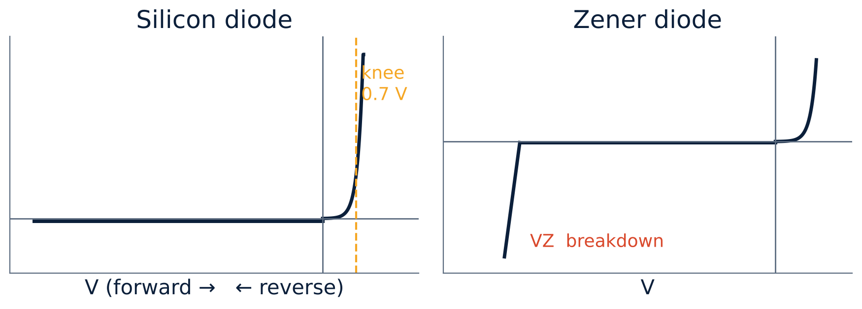
V-I characteristic
U3
Forward: like a silicon diode (0.7 V).
Reverse: tiny leakage until VZ.
Breakdown: current rises sharply; voltage nearly constant at VZ.
Operate between IZmin (knee) and IZmax (power limit).
Notes:
The Zener voltage depends on the amount of doping.

Slide 6
Zener diode versus ordinary PN diode
U3
Feature | PN diode | Zener diode
Doping | Light to moderate | Heavy
Depletion region | Wide | Narrow
Reverse operation | Avoided (damage) | Intended region of use
Breakdown | High, destructive | Sharp, reversible
Use | Rectification, switching | Regulation, reference
Notes:
The Zener is simply a PN diode optimised for breakdown operation.

Slide 7
Specifications and applications
U3
Key ratings
Applications
Maximum current
VZ (nominal), IZmin, IZmax, power rating PZ = VZ IZmax (0.25 W–5 W), dynamic resistance rz.
Voltage regulation, reference voltage source, over-voltage protection, clipping and wave shaping.
IZmax = PZ / VZ, e.g. 2 W, 5 V → 0.4 A.
Notes:
The power rating limits the maximum Zener current.

Slide 8
Key takeaways
U3
Zener = heavily doped diode used in reverse breakdown
Zener effect below ≈ 5 V; avalanche above ≈ 8 V
Output voltage ≈ VZ over a wide current range
A series resistor is always needed
Notes:
To summarise this topic. Zener = heavily doped diode used in reverse breakdown. Zener effect below ≈ 5 V; avalanche above ≈ 8 V. Output voltage ≈ VZ over a wide current range. A series resistor is always needed.

Slide 9
Practice questions
U3
Q1. Explain Zener and avalanche breakdown.
Q2. A 6.8 V, 1 W Zener: find IZmax.
Q3. Compare a Zener and a PN diode.
Q4. Why is the Zener diode heavily doped?
Notes:
Attempt these on your own, then check your working against your notes and textbook. Explain Zener and avalanche breakdown. A 6.8 V, 1 W Zener: find IZmax. Compare a Zener and a PN diode. Why is the Zener diode heavily doped?

