Slide 1

UNIT 4 · 9 hours
Common Source Amplifier
Transistors
Basic Electrical and Electronics Engineering (EEE103)
Dr. Mitesh Astik · Dept. of Electrical and Electronics Engineering
NMAM Institute of Technology, Nitte · 2025-26
Notes:
Welcome. In this session we study "Common Source Amplifier", part of Unit 4 (Transistors) of Basic Electrical and Electronics Engineering.

Slide 2
Learning objectives
U4
Draw the common-source (CS) amplifier with a MOSFET
Explain biasing and the role of each component
Define transconductance and voltage gain
Show that the CS stage inverts the signal
Syllabus context
Construction and operation, BJT as a switch, working and characteristics of n-channel enhancement type MOSFET, common source amplifier, DC load line analysis, MOS inverter.
Notes:
By the end of this topic you should be able to do the following. Draw the common-source (CS) amplifier with a MOSFET. Explain biasing and the role of each component. Define transconductance and voltage gain. Show that the CS stage inverts the signal.

Slide 3
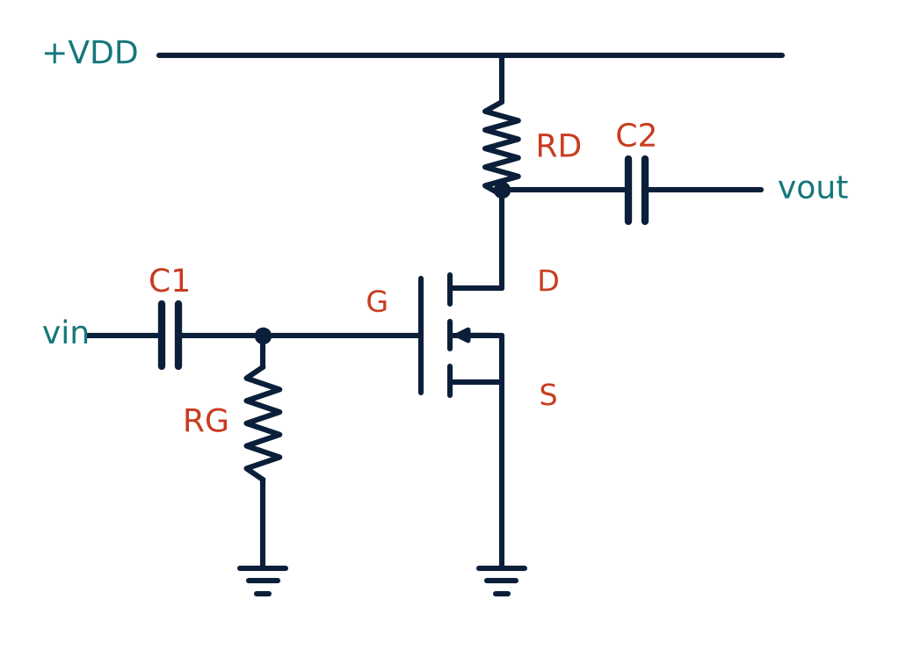
CS amplifier circuit
U4
Input at the gate (via C1), output at the drain (via C2).
Source is common to input and output (grounded).
RG sets the gate DC level; RD is the drain load.
MOSFET operated in saturation.
Notes:
The MOSFET must be biased in the saturation region for linear amplification.

Slide 4
How amplification occurs
U4
1
2
3
4
Bias
Signal
Current changes
Output
DC gate voltage sets ID and Q-point in saturation.
A small vin changes VGS by vgs.
id = gm vgs, where gm = ∂ID/∂VGS.
vout = −id RD: amplified and inverted.
Rising input → rising ID → larger drop across RD → falling drain voltage: 180° phase shift.
Notes:
A small change in gate voltage produces a larger change in drain voltage.

Slide 5
Small-signal gain
U4
gm = 2k (VGS − VT)
Av = vout/vin = − gm RD
Av = − gm (RD ∥ RL)
transconductance (S)
voltage gain (neglect ro)
with load RL
Negative sign: 180° phase inversion.
Higher gm or RD gives higher gain; gain limited by saturation of VDS.
Notes:
The gain is the product of transconductance and drain resistance, with a negative sign.

Slide 6
Numerical: gain of a CS stage
U4
Problem A MOSFET with k = 0.5 mA/V² is biased at VGS − VT = 2 V. RD = 5 kΩ. Find gm and Av.
gm = 2k(VGS − VT) = 2 × 0.5 mA/V² × 2 V = 2 mA/V
Av = −gm RD = −2 mS × 5 kΩ
Answer: gm = 2 mA/V, Av = −10
Notes:
A ten volts per volt gain with phase inversion.

Slide 7
Components and features
U4
C1, C2: coupling capacitors block DC, pass the signal.
RG: very large (MΩ) so the high input resistance is preserved.
Features: high input impedance, moderate-high voltage gain, 180° phase shift.
Uses: voltage amplifier stage in analog ICs, preamplifiers.
Notes:
The common source amplifier is the MOSFET counterpart of the common emitter BJT amplifier.

Slide 8
Key takeaways
U4
CS amplifier: input at gate, output at drain, source common
gm = 2k(VGS − VT); Av = −gm RD
Output is inverted (180° phase shift)
Bias in saturation for linear operation
Notes:
To summarise this topic. CS amplifier: input at gate, output at drain, source common. gm = 2k(VGS − VT); Av = −gm RD. Output is inverted (180° phase shift). Bias in saturation for linear operation.

Slide 9
Practice questions
U4
Q1. Draw a CS amplifier and label all components.
Q2. Find gain if gm = 3 mS and RD = 4.7 kΩ.
Q3. Why does the CS stage invert?
Q4. What is the function of the coupling capacitors?
Notes:
Attempt these on your own, then check your working against your notes and textbook. Draw a CS amplifier and label all components. Find gain if gm = 3 mS and RD = 4.7 kΩ. Why does the CS stage invert? What is the function of the coupling capacitors?

