Slide 1

UNIT 4 · 9 hours
DC Load Line Analysis and Q-Point
Transistors
Basic Electrical and Electronics Engineering (EEE103)
Dr. Mitesh Astik · Dept. of Electrical and Electronics Engineering
NMAM Institute of Technology, Nitte · 2025-26
Notes:
Welcome. In this session we study "DC Load Line Analysis and Q-Point", part of Unit 4 (Transistors) of Basic Electrical and Electronics Engineering.

Slide 2
Learning objectives
U4
Derive the DC load line for a BJT and a MOSFET stage
Locate the Q-point
Check the region of operation
Choose the Q-point for amplifier or switch operation
Syllabus context
Construction and operation, BJT as a switch, working and characteristics of n-channel enhancement type MOSFET, common source amplifier, DC load line analysis, MOS inverter.
Notes:
By the end of this topic you should be able to do the following. Derive the DC load line for a BJT and a MOSFET stage. Locate the Q-point. Check the region of operation. Choose the Q-point for amplifier or switch operation.

Slide 3
DC load line equations
U4
BJT: VCE = VCC − IC RC
MOSFET: VDS = VDD − ID RD
output loop KVL
output loop KVL
Endpoints: IC(max) = VCC/RC at VCE = 0, and VCE = VCC at IC = 0.
Line of all possible (VCE, IC) pairs allowed by the external circuit.
The device characteristic fixes the actual point on the line: the Q-point.
Notes:
Apply Kirchhoff's voltage law around the output loop to get the load line.

Slide 4
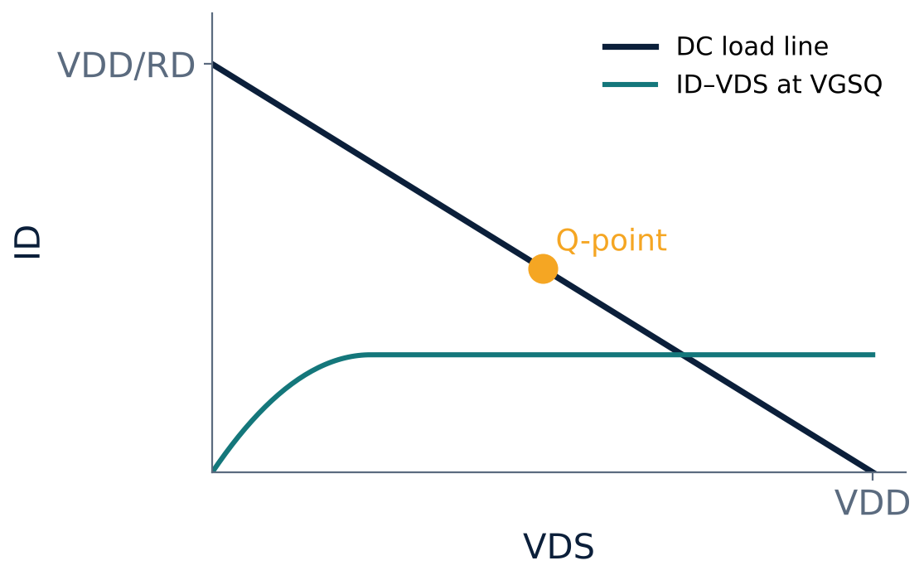
Q-point on the load line (MOSFET)
U4
Intersection of the DC load line with the device curve for VGSQ.
Q-point = (VDSQ, IDQ).
For an amplifier: put Q near the middle of the line to allow equal swing.
Too high: clipping in cut-off; too low: clipping in saturation.
Notes:
The quiescent point is the DC operating point in the absence of signal.

Slide 5
Where to place the Q-point
U4
Amplifier
Switch OFF
Switch ON
Middle of the active/saturation region: maximum undistorted swing.
At the cut-off end: IC ≈ 0, VCE ≈ VCC.
At the saturation end: IC ≈ VCC/RC, VCE ≈ 0.
Notes:
The same load line serves all three purposes; only the bias differs.

Slide 6
Numerical: MOSFET load line
U4
Problem VDD = 12 V, RD = 2 kΩ, n-MOSFET (k = 0.5 mA/V², VT = 2 V) with VGS = 4 V. Find the load line endpoints and the Q-point.
Endpoints: VDS = 12 V (ID = 0) and ID = 12/2k = 6 mA (VDS = 0)
Assume saturation: ID = k(VGS − VT)² = 0.5 × 4 = 2 mA
VDS = 12 − 2 mA × 2 kΩ = 8 V
Check: VDS = 8 V ≥ VGS − VT = 2 V → saturation ✓
Answer: Q-point: ID = 2 mA, VDS = 8 V
Notes:
Always verify the assumption of saturation after solving.

Slide 7
Numerical: BJT load line
U4
Problem VCC = 12 V, RC = 3 kΩ, β = 100, IB = 20 µA. Find Q-point and check region.
IC = β IB = 100 × 20 µA = 2 mA
VCE = 12 − 2 mA × 3 kΩ = 6 V
Endpoints: IC(max) = 4 mA, VCE(max) = 12 V → Q is at the middle
Answer: Q: IC = 2 mA, VCE = 6 V (active region)
Notes:
The Q point is half way along the load line, ideal for an amplifier.

Slide 8
Key takeaways
U4
Load line from KVL: VCE = VCC − IC RC (or VDS = VDD − ID RD)
Q-point = intersection of load line and device characteristic
Q mid-line for amplifiers; ends of the line for switches
Verify the region of operation
Notes:
To summarise this topic. Load line from KVL: VCE = VCC − IC RC (or VDS = VDD − ID RD). Q-point = intersection of load line and device characteristic. Q mid-line for amplifiers; ends of the line for switches. Verify the region of operation.

Slide 9
Practice questions
U4
Q1. Draw the DC load line for VCC = 10 V, RC = 2 kΩ.
Q2. Find the Q-point for VDD = 15 V, RD = 3 kΩ, ID = 2 mA.
Q3. What happens if the Q-point is too close to cut-off?
Q4. How does the load line differ for switch and amplifier use?
Notes:
Attempt these on your own, then check your working against your notes and textbook. Draw the DC load line for VCC = 10 V, RC = 2 kΩ. Find the Q-point for VDD = 15 V, RD = 3 kΩ, ID = 2 mA. What happens if the Q-point is too close to cut-off? How does the load line differ for switch and amplifier use?

