Slide 1

UNIT 5 · 9 hours
Operational Amplifier: Introduction and the Ideal Op-Amp
Op-Amp and Linear IC Applications
Basic Electrical and Electronics Engineering (EEE103)
Dr. Mitesh Astik · Dept. of Electrical and Electronics Engineering
NMAM Institute of Technology, Nitte · 2025-26
Notes:
Welcome. In this session we study "Operational Amplifier: Introduction and the Ideal Op-Amp", part of Unit 5 (Op-Amp and Linear IC Applications) of Basic Electrical and Electronics Engineering.

Slide 2
Learning objectives
U5
Describe the op-amp symbol and terminals
State the properties of an ideal op-amp
Explain why negative feedback is used
Compare ideal and practical (741) op-amps
Syllabus context
Introduction, op-amp specifications, differential and common-mode operation, op-amp applications: inverting/non-inverting amplifier, summing, integrator, differentiator, comparator, 555 timer IC in astable mode, 78XX series IC voltage regulators.
Notes:
By the end of this topic you should be able to do the following. Describe the op-amp symbol and terminals. State the properties of an ideal op-amp. Explain why negative feedback is used. Compare ideal and practical (741) op-amps.

Slide 3
What is an operational amplifier?
U5
High-gain DC-coupled amplifier with differential inputs and a single output.
Originally built to perform mathematical operations (sum, integrate, differentiate) in analog computers.
IC form (1965): low cost, small, reliable; the popular type is the 741.
Uses: amplifiers, filters, comparators, converters, oscillators, instrumentation.
Notes:
The term operational amplifier was originally used for D C amplifiers that perform mathematical operations.

Slide 4
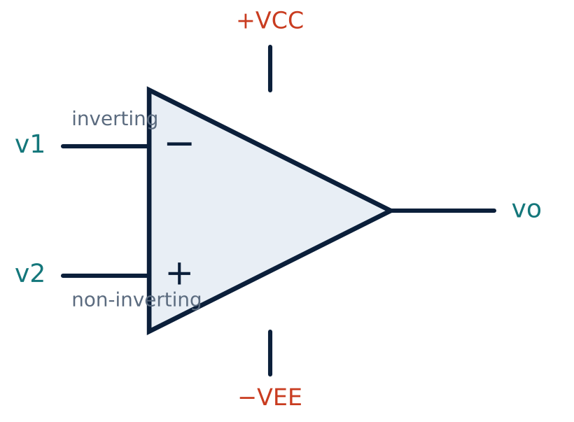
Symbol and terminals
U5
Inverting input (−), non-inverting input (+), output.
Power supply +VCC and −VEE (e.g. ±15 V).
Output: vo = A (v2 − v1).
A = open-loop gain (no feedback).
Notes:
The op amp is also known as a differential amplifier, because it amplifies the difference between its two inputs.

Slide 5
Ideal op-amp properties
U5
Infinite gain
Infinite input resistance
Zero output resistance
A → ∞ ; hence v1 ≈ v2 (virtual short).
No current enters the inputs: i1 = i2 = 0.
Output is an ideal voltage source.
Also: infinite bandwidth, infinite CMRR, zero offset voltage, infinite slew rate.
Notes:
These idealizations make analysis of op amp circuits very simple.

Slide 6
Ideal versus practical op-amp (741)
U5
Parameter | Ideal | Practical (741)
Open-loop gain | Infinite | ≈ 2 × 10⁵
Input impedance | Infinite | ≈ 2 MΩ
Output impedance | Zero | ≈ 75 Ω
Bandwidth (unity gain) | Infinite | ≈ 1 MHz
Slew rate | Infinite | 0.5 V/µs
CMRR | Infinite | 70–120 dB
Output swing | ±VCC | ≈ ±13 V for ±15 V
Notes:
A practical op amp approaches the ideal over a limited frequency range.

Slide 7
Negative feedback
U5
Feeds part of the output back to the inverting input.
Closed-loop gain depends only on external resistors, not on the op-amp's A.
Improves stability, bandwidth, linearity and input/output impedance.
Reduces the gain from A (~10⁵) to a controlled value.
Notes:
The reason for the widespread use of op amps is negative feedback.

Slide 8
Key takeaways
U5
Op-amp: high-gain differential amplifier, vo = A(v2 − v1)
Ideal: A = ∞, Rin = ∞, Ro = 0, no input current
Negative feedback makes gain depend on external resistors
741: A ≈ 2×10⁵, 1 MHz, 0.5 V/µs
Notes:
To summarise this topic. Op-amp: high-gain differential amplifier, vo = A(v2 − v1). Ideal: A = ∞, Rin = ∞, Ro = 0, no input current. Negative feedback makes gain depend on external resistors. 741: A ≈ 2×10⁵, 1 MHz, 0.5 V/µs.

Slide 9
Practice questions
U5
Q1. List the properties of an ideal op-amp.
Q2. Why is negative feedback used?
Q3. What are the five terminals of an op-amp IC?
Q4. Compare ideal and practical op-amps.
Notes:
Attempt these on your own, then check your working against your notes and textbook. List the properties of an ideal op-amp. Why is negative feedback used? What are the five terminals of an op-amp IC? Compare ideal and practical op-amps.

