Slide 1

UNIT 5 · 9 hours
Inverting and Non-Inverting Amplifiers
Op-Amp and Linear IC Applications
Basic Electrical and Electronics Engineering (EEE103)
Dr. Mitesh Astik · Dept. of Electrical and Electronics Engineering
NMAM Institute of Technology, Nitte · 2025-26
Notes:
Welcome. In this session we study "Inverting and Non-Inverting Amplifiers", part of Unit 5 (Op-Amp and Linear IC Applications) of Basic Electrical and Electronics Engineering.

Slide 2
Learning objectives
U5
Derive the gain of the inverting amplifier
Derive the gain of the non-inverting amplifier
Compare input resistance and phase of both
Design amplifiers for a required gain
Syllabus context
Introduction, op-amp specifications, differential and common-mode operation, op-amp applications: inverting/non-inverting amplifier, summing, integrator, differentiator, comparator, 555 timer IC in astable mode, 78XX series IC voltage regulators.
Notes:
By the end of this topic you should be able to do the following. Derive the gain of the inverting amplifier. Derive the gain of the non-inverting amplifier. Compare input resistance and phase of both. Design amplifiers for a required gain.

Slide 3
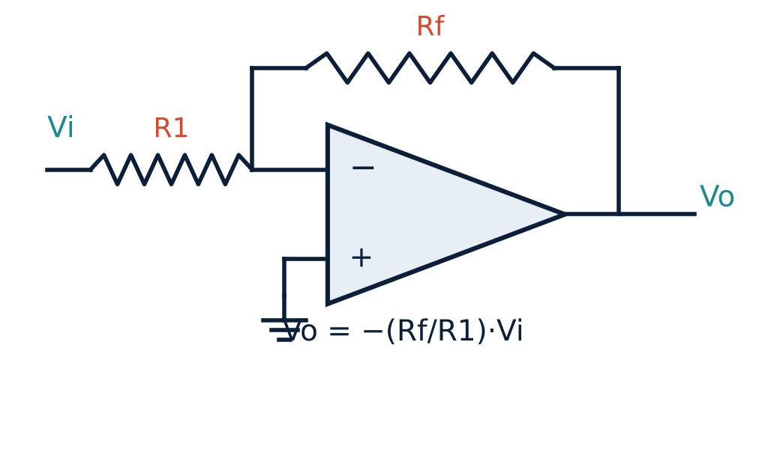
Inverting amplifier
U5
Input via R1 to the inverting terminal; + terminal grounded.
Rf feeds output back to the − input.
Virtual ground at the − terminal.
Output is 180° out of phase.
Notes:
G is called the virtual ground, since it is not directly connected to ground.

Slide 4
Deriving the inverting gain
U5
1
2
3
4
Input current
No input current
Feedback
Equate
i = (vi − 0)/R1 (virtual ground at 0 V).
No current enters the op-amp, so the same i flows through Rf.
i = (0 − vo)/Rf.
vi/R1 = −vo/Rf ⇒ vo/vi = −Rf/R1.
ACL = −Rf / R1, input resistance Rin = R1
Notes:
The closed loop gain depends only on the external resistors R1 and Rf.

Slide 5
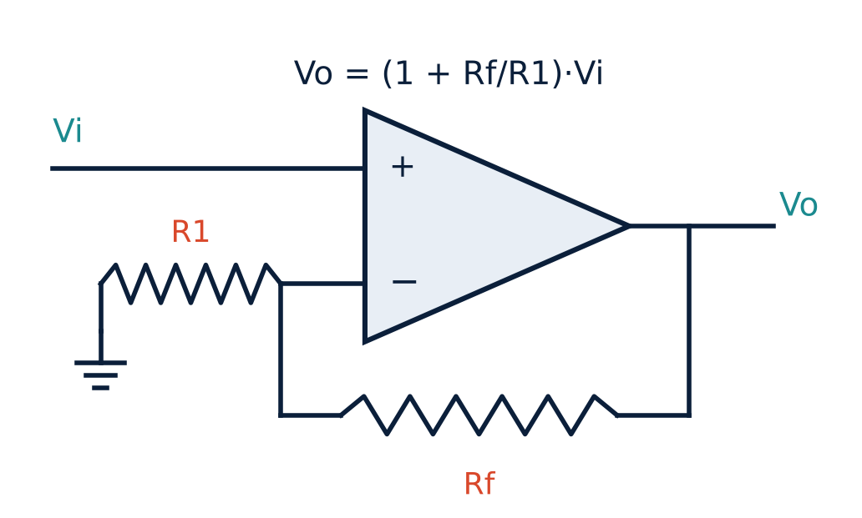
Non-inverting amplifier
U5
Input applied to the + terminal.
R1 from − terminal to ground; Rf from output to −.
The voltage at − equals vi (virtual short).
i = vi/R1 = (vo − vi)/Rf ⇒ vo/vi = 1 + Rf/R1.
Output in phase; Rin very high.
Notes:
The gain is positive, so no phase change occurs.

Slide 6
Inverting versus non-inverting
U5
Inverting
Non-inverting
Gain = −Rf/R1 (can be < 1)
Phase shift 180°
Input resistance = R1
Virtual ground at the input
Gain = 1 + Rf/R1 (≥ 1)
No phase shift
Input resistance very high
Voltage follower: Rf = 0, R1 = ∞ → gain 1
Notes:
The voltage follower or buffer uses the non-inverting configuration with unity gain.

Slide 7
Numerical 1: inverting amplifier
U5
Problem R1 = 20 kΩ, Rf = 100 kΩ, vi = 1 V. Find vo, Rin and the input current.
vo = −(Rf/R1) vi = −(100/20)(1) = −5 V
Rin = R1 = 20 kΩ
iin = vi/Rin = 1 V/20 kΩ
Answer: vo = −5 V, Rin = 20 kΩ, iin = 0.05 mA
Notes:
These are the values from your notes.

Slide 8
Numerical 2: design
U5
Problem Design (a) an inverting amplifier with Rin = 30 kΩ and gain −10; (b) a non-inverting amplifier of gain 10 using R1 = 1 kΩ.
(a) R1 = 30 kΩ; Rf = 10 × 30 kΩ = 300 kΩ
(b) 1 + Rf/R1 = 10 ⇒ Rf = 9 R1 = 9 kΩ
Check (b) with vi = 0.5 V: vo = 10 × 0.5 = 5 V
Answer: (a) Rf = 300 kΩ; (b) Rf = 9 kΩ
Notes:
Make sure the output does not exceed the supply rails.

Slide 9
Key takeaways
U5
Inverting: vo = −(Rf/R1) vi; Rin = R1
Non-inverting: vo = (1 + Rf/R1) vi; high Rin
Virtual short gives both results with simple algebra
Voltage follower: unity gain buffer
Notes:
To summarise this topic. Inverting: vo = −(Rf/R1) vi; Rin = R1. Non-inverting: vo = (1 + Rf/R1) vi; high Rin. Virtual short gives both results with simple algebra. Voltage follower: unity gain buffer.

Slide 10
Practice questions
U5
Q1. Derive the gain of an inverting amplifier.
Q2. R1 = 10 kΩ, Rf = 47 kΩ: find the gain of both configurations.
Q3. Design a non-inverting amplifier of gain 5.
Q4. What is a voltage follower and why is it used?
Notes:
Attempt these on your own, then check your working against your notes and textbook. Derive the gain of an inverting amplifier. R1 = 10 kΩ, Rf = 47 kΩ: find the gain of both configurations. Design a non-inverting amplifier of gain 5. What is a voltage follower and why is it used?

