Slide 1

UNIT 5 · 9 hours
Op-Amp as a Comparator
Op-Amp and Linear IC Applications
Basic Electrical and Electronics Engineering (EEE103)
Dr. Mitesh Astik · Dept. of Electrical and Electronics Engineering
NMAM Institute of Technology, Nitte · 2025-26
Notes:
Welcome. In this session we study "Op-Amp as a Comparator", part of Unit 5 (Op-Amp and Linear IC Applications) of Basic Electrical and Electronics Engineering.

Slide 2
Learning objectives
U5
Explain the working of an op-amp comparator
Draw output waveforms for sine input and fixed reference
Describe a zero-crossing detector
Mention hysteresis (Schmitt trigger) and applications
Syllabus context
Introduction, op-amp specifications, differential and common-mode operation, op-amp applications: inverting/non-inverting amplifier, summing, integrator, differentiator, comparator, 555 timer IC in astable mode, 78XX series IC voltage regulators.
Notes:
By the end of this topic you should be able to do the following. Explain the working of an op-amp comparator. Draw output waveforms for sine input and fixed reference. Describe a zero-crossing detector. Mention hysteresis (Schmitt trigger) and applications.

Slide 3
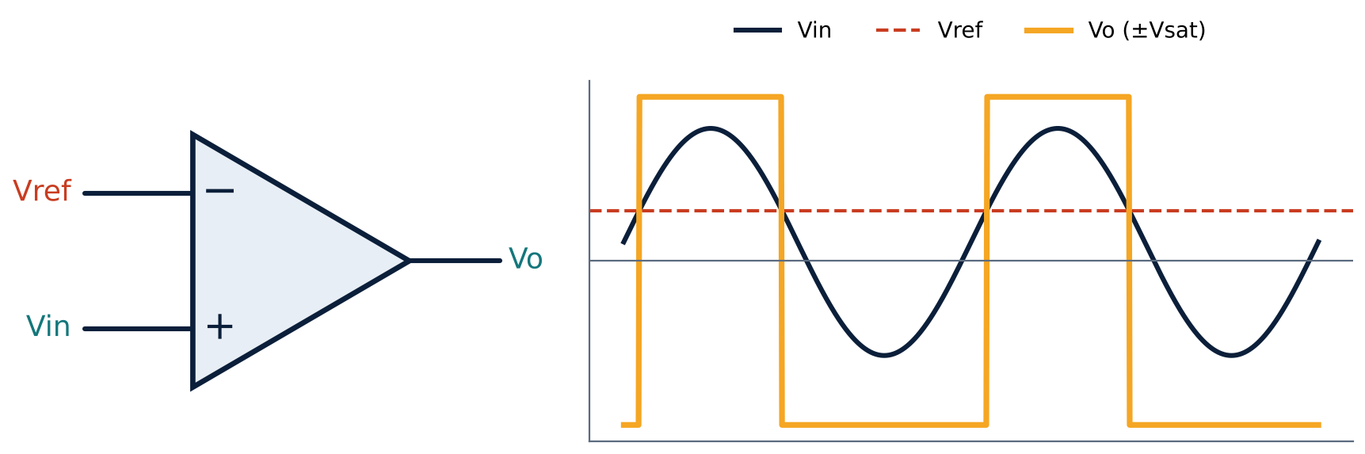
Comparator operation
U5
Op-amp used in open loop (no feedback).
Vin > Vref: output saturates at +Vsat.
Vin < Vref: output at −Vsat.
Compares two voltages and gives a digital-like output.
Notes:
A comparator compares an input voltage with a reference voltage and produces a high or low output.

Slide 4
Details
U5
Non-inverting comparator: Vin at +, Vref at −: output high when Vin > Vref.
Zero-crossing detector: Vref = 0 V; the output changes sign at each zero crossing of the input.
Output levels: about ±(VCC − 1.5 V), or 0 and +V with a single supply.
Limitations: noise near the threshold causes chatter; response limited by slew rate.
Notes:
With infinite gain, even a tiny difference drives the output to saturation.

Slide 5
Schmitt trigger (comparator with hysteresis)
U5
Positive feedback
Two thresholds
Benefit
A fraction of the output is fed back to the + input.
Upper VUT and lower VLT: the output switches at different levels for rising and falling input.
Immune to noise near the threshold; cleans slow or noisy signals.
Notes:
Hysteresis stops the output chattering when noise rides on the signal.

Slide 6
Numerical: comparator timing
U5
Problem Vref = 2 V, vin = 5 sin(100πt) V, saturation ±13 V. Find the fraction of the cycle for which the output is high and the high time.
vin = 2 V at sin θ = 0.4 → θ1 = 23.6°, θ2 = 180° − 23.6° = 156.4°
High for 156.4° − 23.6° = 132.8° of 360°
Fraction = 132.8/360 = 0.369; T = 20 ms
Answer: Output high for 36.9 % of the cycle = 7.4 ms
Notes:
The comparator converts a sine wave to a rectangular wave whose duty cycle depends on the reference.

Slide 7
Applications
U5
Zero-crossing and level detectors.
Analog-to-digital converters (flash and successive approximation).
Square-wave generation from sine waves.
Over-voltage / temperature alarms.
Notes:
Comparators are the interface between analog and digital circuits.

Slide 8
Key takeaways
U5
Comparator: open-loop op-amp output = ±Vsat
Vin > Vref: +Vsat; Vin < Vref: −Vsat
Zero-crossing detector: Vref = 0
Schmitt trigger adds hysteresis
Notes:
To summarise this topic. Comparator: open-loop op-amp output = ±Vsat. Vin > Vref: +Vsat; Vin < Vref: −Vsat. Zero-crossing detector: Vref = 0. Schmitt trigger adds hysteresis.

Slide 9
Practice questions
U5
Q1. Explain how an op-amp works as a comparator.
Q2. Vref = 1 V, vin = 3 sin ωt. Sketch the output.
Q3. Why is hysteresis needed in a noisy environment?
Q4. Name two applications of comparators.
Notes:
Attempt these on your own, then check your working against your notes and textbook. Explain how an op-amp works as a comparator. Vref = 1 V, vin = 3 sin ωt. Sketch the output. Why is hysteresis needed in a noisy environment? Name two applications of comparators.

