Slide 1

LABORATORY · Lab · 26 hours
Experiment 3: Time Domain Specifications of a Second-Order System
Control Systems Laboratory (22EEG53)
Control Systems (22EEG53)
Dr. Mitesh Astik · Dept. of Electrical and Electronics Engineering
NMAM Institute of Technology, Nitte · 2025-26
Notes:
Welcome. In this session we study "Experiment 3: Time Domain Specifications of a Second-Order System", part of Laboratory (Control Systems Laboratory (22EEG53)) of Control Systems.

Slide 2
Learning objectives
LAB
Determine tr, tp, Mp and ts from the simulated step response
Compare them with the theoretical values
Use stepinfo to extract specifications
Syllabus context
Laboratory component of 22EEG53 Control Systems (0:0:2 hours per week). CIE: record and observation 25, viva-voce 5, lab test 20 marks.
Notes:
By the end of this topic you should be able to do the following. Determine tr, tp, Mp and ts from the simulated step response. Compare them with the theoretical values. Use stepinfo to extract specifications.

Slide 3
Aim and requirements
LAB
Aim: to analyse the time-domain specifications of a second-order system using MATLAB.
Software: MATLAB with the Control System Toolbox (Simulink where required).
Hardware: Personal computer.
System: C/R = 25/(s² + 6s + 25): ωn = 5, ζ = 0.6.
Notes:
We compare simulated and theoretical specifications.

Slide 4
Theoretical formulas
LAB
tr = (π − φ)/ωd
tp = π/ωd
φ = cos⁻¹ζ
ωd = ωn√(1 − ζ²)
Mp = e^(−πζ/√(1−ζ²)) × 100
ts = 4/(ζωn)
overshoot
2 % band
Notes:
Theoretical values for ωn = 5 and ζ = 0.6: tr = 0.554 s, tp = 0.785 s, Mp = 9.48 %, ts = 1.33 s.

Slide 5
Procedure
LAB
1
2
3
4
Create system
Simulate
Extract
Compare
sys = tf(25,[1 6 25]).
Plot step(sys).
S = stepinfo(sys): RiseTime, PeakTime, Overshoot, SettlingTime.
Tabulate against theory and compute % error.
Notes:
Note that MATLAB defines rise time as 10 to 90 percent by default; the textbook formula is 0 to 100 percent.

Slide 6
MATLAB program
LAB
wn = 5; zeta = 0.6;
sys = tf(wn^2, [1 2*zeta*wn wn^2]);
S = stepinfo(sys, 'SettlingTimeThreshold', 0.02)
wd = wn*sqrt(1-zeta^2); phi = acos(zeta);
tr = (pi-phi)/wd; tp = pi/wd;
Mp = 100*exp(-pi*zeta/sqrt(1-zeta^2)); ts = 4/(zeta*wn);
fprintf('tp = %.3f s, Mp = %.2f %%, ts = %.3f s\n', tp, Mp, ts)
step(sys); grid on

Slide 7
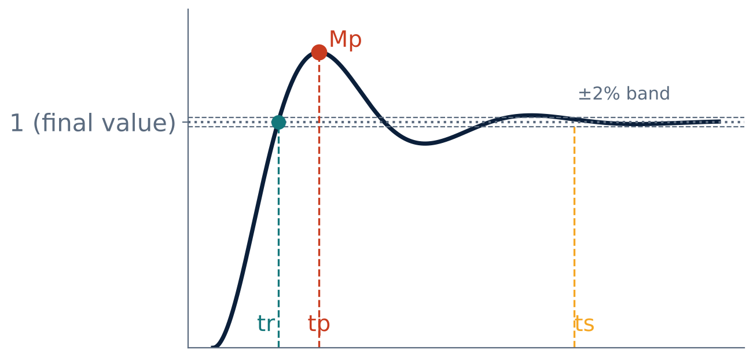
Annotated step response
LAB
Mark tr, tp, Mp and ts on the plot (right-click → Characteristics).
The ±2 % band defines ts.
Notes:
Use the plot characteristics menu in the figure window.

Slide 8
Observation table
LAB
Parameter | Theory | MATLAB | % error
Peak time tp (s) | 0.785
Peak overshoot Mp (%) | 9.48
Settling time ts (s) | 1.33
Rise time tr (s) | 0.554
Notes:
Differences arise because ts and tr are approximate in the theory.

Slide 9
Key takeaways
LAB
stepinfo returns rise, peak, overshoot and settling values
tp and Mp match theory closely; ts is approximate
Mp depends only on ζ
Specifications are read from the step response
Notes:
To summarise this topic. stepinfo returns rise, peak, overshoot and settling values. tp and Mp match theory closely; ts is approximate. Mp depends only on ζ. Specifications are read from the step response.

Slide 10
Practice questions
LAB
Q1. Find the specifications for ωn = 10, ζ = 0.4.
Q2. Why does MATLAB's rise time differ from the textbook value?
Q3. Write the stepinfo command with a 5 % band.
Q4. How do ts and Mp change if ωn doubles for fixed ζ?
Notes:
Attempt these on your own, then check your working against your notes and textbook. Find the specifications for ωn = 10, ζ = 0.4. Why does MATLAB's rise time differ from the textbook value? Write the stepinfo command with a 5 % band. How do ts and Mp change if ωn doubles for fixed ζ?

