Slide 1

LABORATORY · Lab · 26 hours
Experiment 9: Design and Implementation of an RC Lag Compensator
Control Systems Laboratory (22EEG53)
Control Systems (22EEG53)
Dr. Mitesh Astik · Dept. of Electrical and Electronics Engineering
NMAM Institute of Technology, Nitte · 2025-26
Notes:
Welcome. In this session we study "Experiment 9: Design and Implementation of an RC Lag Compensator", part of Laboratory (Control Systems Laboratory (22EEG53)) of Control Systems.

Slide 2
Learning objectives
LAB
Design an RC lag network for a given β and T
Implement it on a bread board and measure the frequency response
Verify using MATLAB Bode plot
Determine the maximum phase lag
Syllabus context
Laboratory component of 22EEG53 Control Systems (0:0:2 hours per week). CIE: record and observation 25, viva-voce 5, lab test 20 marks.
Notes:
By the end of this topic you should be able to do the following. Design an RC lag network for a given β and T. Implement it on a bread board and measure the frequency response. Verify using MATLAB Bode plot. Determine the maximum phase lag.

Slide 3
Aim and apparatus
LAB
Aim: to design and implement an RC lag compensator and verify the result using MATLAB.
Apparatus: resistors, capacitor, function generator, CRO/DSO, bread board, MATLAB.
Design: β = 10, T = 10 ms.
Notes:
We build the lag network and measure its gain and phase.

Slide 4
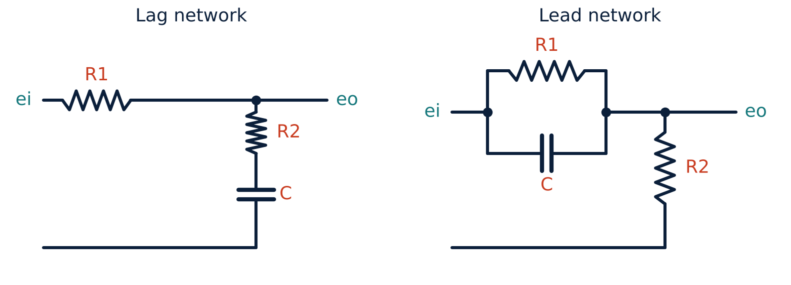
RC lag network
LAB
Left: lag network
Gc(s) = (1 + sR2C)/[1 + s(R1 + R2)C].
T = R2C; β = (R1 + R2)/R2.
Pole at 1/(βT), zero at 1/T.
High-frequency gain = 1/β.
Notes:
The network is a first order lag.

Slide 5
Design calculations
LAB
Problem Design a lag network with β = 10 and T = 10 ms. Choose C = 1 µF.
T = R2C ⇒ R2 = 10 ms/1 µF = 10 kΩ
β = (R1 + R2)/R2 = 10 ⇒ R1 = 9 R2 = 90 kΩ
Gc = (1 + 0.01s)/(1 + 0.1s); corners at 10 and 100 rad/s
φm = −sin⁻¹[(β − 1)/(β + 1)] = −54.9° at ωm = 1/(T√β) = 31.6 rad/s
Answer: R1 = 90 kΩ, R2 = 10 kΩ, C = 1 µF
Notes:
Use standard resistor values close to these.

Slide 6
Procedure
LAB
1
2
3
4
Build
Input
Measure
Plot and verify
Assemble the network on the bread board.
Apply a sine wave of 1 V peak from the function generator.
For 1–1000 rad/s measure output amplitude and phase (CRO).
Plot gain and phase; compare with MATLAB bode.
Gain = Vout/Vin (dB); phase = −360° × f × Δt.
Notes:
Use the Lissajous method or time shift to measure phase.

Slide 7
MATLAB verification
LAB
R1 = 90e3; R2 = 10e3; C = 1e-6;
T = R2*C; beta = (R1+R2)/R2;
Gc = tf([T 1], [beta*T 1])
bode(Gc), grid on
[mag, ph, w] = bode(Gc);
[phmin, i] = min(squeeze(ph));
fprintf('Max lag = %.1f deg at %.1f rad/s\n', phmin, w(i))

Slide 8
Observation table
LAB
f (Hz) | ω (rad/s) | Vo (V) | Gain (dB) | Phase (deg)
1 | 6.3
5 | 31.4
20 | 125.7
100 | 628
Notes:
Complete the table and plot the Bode diagram.

Slide 9
Key takeaways
LAB
Lag: Gc = (1 + sT)/(1 + sβT), β = (R1 + R2)/R2, T = R2C
High-frequency attenuation 20 log β dB (20 dB for β = 10)
Maximum lag −54.9° at 31.6 rad/s
Measured response agrees with MATLAB
Notes:
To summarise this topic. Lag: Gc = (1 + sT)/(1 + sβT), β = (R1 + R2)/R2, T = R2C. High-frequency attenuation 20 log β dB (20 dB for β = 10). Maximum lag −54.9° at 31.6 rad/s. Measured response agrees with MATLAB.

Slide 10
Practice questions
LAB
Q1. Design a lag network with β = 5, T = 20 ms.
Q2. Find the maximum phase lag of your design.
Q3. What is the high-frequency gain of the network?
Q4. Where is the compensator pole relative to the zero?
Notes:
Attempt these on your own, then check your working against your notes and textbook. Design a lag network with β = 5, T = 20 ms. Find the maximum phase lag of your design. What is the high-frequency gain of the network? Where is the compensator pole relative to the zero?

