Slide 1

UNIT 1 · 8 hours
Open-Loop and Closed-Loop Control Systems
Introduction and Mathematical Modelling of Physical Systems
Control Systems (22EEG53)
Dr. Mitesh Astik · Dept. of Electrical and Electronics Engineering
NMAM Institute of Technology, Nitte · 2025-26
Notes:
Welcome. In this session we study "Open-Loop and Closed-Loop Control Systems", part of Unit 1 (Introduction and Mathematical Modelling of Physical Systems) of Control Systems.

Slide 2
Learning objectives
U1
Define a control system and its basic terms
Distinguish open-loop from closed-loop systems with examples
Derive the closed-loop transfer function
Explain the effects of feedback on gain and sensitivity
Syllabus context
Introduction and mathematical modelling of physical systems: open loop and closed loop systems, examples, control system components. Transfer function of physical systems: mechanical systems (translational and rotational), electrical systems, analogous systems, block diagram reduction techniques, signal flow graphs.
Notes:
By the end of this topic you should be able to do the following. Define a control system and its basic terms. Distinguish open-loop from closed-loop systems with examples. Derive the closed-loop transfer function. Explain the effects of feedback on gain and sensitivity.

Slide 3
What is a control system?
U1
Definition: an interconnection of components that makes a plant (process) behave in a desired way.
Input (reference) r: desired value of the output.
Output (controlled variable) c: the quantity being controlled.
Plant: the system to be controlled; controller: the component that generates the actuating signal.
Disturbances: unwanted inputs that tend to move the output away from the desired value.
Notes:
A control system maintains an output at a desired value in spite of disturbances.

Slide 4
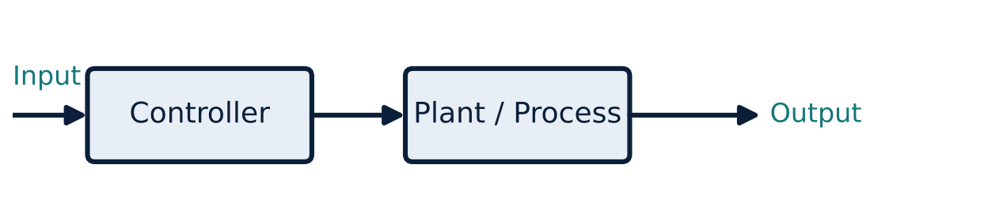
Open-loop system
U1
No feedback path
Output has no effect on the control action.
Accuracy depends on calibration of the controller.
Cannot compensate for disturbances or parameter drift.
Notes:
Examples: automatic washing machine timer, traffic light, electric toaster, hand dryer. Each is controlled by time, not by the result.

Slide 5
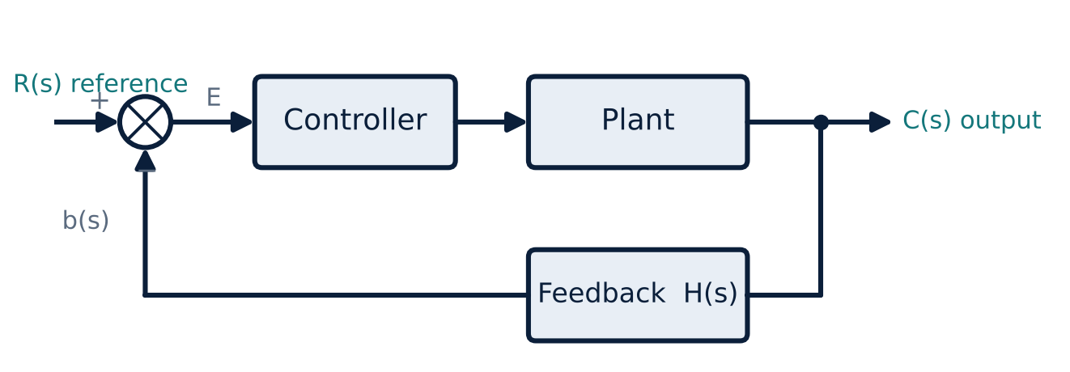
Closed-loop (feedback) system
U1
Negative feedback loop
Output is measured and fed back.
Error E = R − B = R − H·C drives the controller.
Disturbances are corrected automatically.
Examples: thermostat, cruise control, servo.
Notes:
In the closed loop system the actuating signal depends on the output.

Slide 6
Open loop versus closed loop
U1
Feature | Open loop | Closed loop
Feedback | None | Present
Accuracy | Depends on calibration | High; self-correcting
Response to disturbance | No correction | Reduces effect
Stability | No problem | Can become unstable
Complexity and cost | Simple, cheap | More components, costly
Examples | Toaster, traffic signal | Thermostat, servo, cruise control
Notes:
Closed loop control is preferred when accuracy matters and disturbances are present.

Slide 7
Deriving the closed-loop transfer function
U1
1
2
3
4
Forward path
Error
Feedback
Eliminate E and B
C(s) = G(s) E(s)
E(s) = R(s) − B(s)
B(s) = H(s) C(s)
C = G(R − HC) ⇒ C(1 + GH) = G R
C(s)/R(s) = G(s) / [1 + G(s)H(s)] (negative feedback); G/(1 − GH) for positive feedback
Notes:
Substituting the feedback signal into the error equation and rearranging gives the closed loop transfer function.

Slide 8
Effect of feedback on sensitivity
U1
Problem G = 100 and H = 0.1. Find the closed-loop gain; then find it if G falls by 10 % to 90.
T = G/(1 + GH) = 100/(1 + 10) = 9.09
With G = 90: T = 90/(1 + 9) = 9.00
Change in T = (9.09 − 9.00)/9.09 ≈ 1 % for a 10 % change in G
Answer: Feedback reduces sensitivity: 10 % change in G → ≈ 1 % in T
Notes:
The price paid is a reduction of overall gain by the factor one plus G H.

Slide 9
Effects of feedback
U1
Gain
Sensitivity and accuracy
Stability and bandwidth
Overall gain reduced by 1/(1 + GH) for negative feedback.
Less sensitive to parameter variations and disturbances; steady-state error reduced.
Bandwidth increases, but too much feedback can cause oscillation or instability.
Notes:
A designer trades off accuracy against stability.

Slide 10
Key takeaways
U1
Closed loop = feedback; open loop = no feedback
T(s) = G/(1 + GH) for negative feedback
Feedback reduces sensitivity to parameter changes and disturbances
Feedback can cause instability: stability analysis is essential
Notes:
To summarise this topic. Closed loop = feedback; open loop = no feedback. T(s) = G/(1 + GH) for negative feedback. Feedback reduces sensitivity to parameter changes and disturbances. Feedback can cause instability: stability analysis is essential.

Slide 11
Practice questions
U1
Q1. Differentiate open-loop and closed-loop systems with two examples each.
Q2. Derive C/R = G/(1 + GH).
Q3. G = 50, H = 0.2: find the closed-loop gain.
Q4. Why does feedback improve accuracy but risk instability?
Notes:
Attempt these on your own, then check your working against your notes and textbook. Differentiate open-loop and closed-loop systems with two examples each. Derive C/R = G/(1 + GH). G = 50, H = 0.2: find the closed-loop gain. Why does feedback improve accuracy but risk instability?

