Slide 1

UNIT 1 · 8 hours
Control System Components
Introduction and Mathematical Modelling of Physical Systems
Control Systems (22EEG53)
Dr. Mitesh Astik · Dept. of Electrical and Electronics Engineering
NMAM Institute of Technology, Nitte · 2025-26
Notes:
Welcome. In this session we study "Control System Components", part of Unit 1 (Introduction and Mathematical Modelling of Physical Systems) of Control Systems.

Slide 2
Learning objectives
U1
Name the main components of a servo system
Explain error detectors: potentiometer pair and synchros
Describe DC and AC servo motors and the tachogenerator
Identify the role of amplifiers and gear trains
Syllabus context
Introduction and mathematical modelling of physical systems: open loop and closed loop systems, examples, control system components. Transfer function of physical systems: mechanical systems (translational and rotational), electrical systems, analogous systems, block diagram reduction techniques, signal flow graphs.
Notes:
By the end of this topic you should be able to do the following. Name the main components of a servo system. Explain error detectors: potentiometer pair and synchros. Describe DC and AC servo motors and the tachogenerator. Identify the role of amplifiers and gear trains.

Slide 3
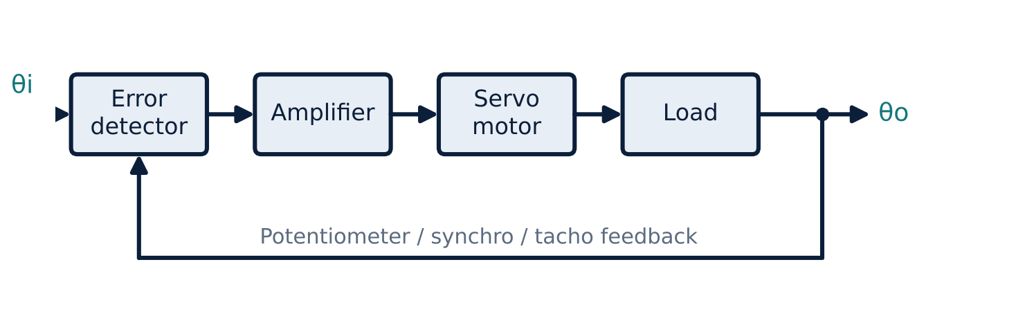
A typical position servo
U1
Error detector compares reference and output.
Amplifier boosts the small error signal.
Servo motor (actuator) drives the load.
Feedback element (potentiometer, synchro, tacho) measures the output.
Notes:
These blocks appear in almost every feedback control system.

Slide 4
Error detectors
U1
Potentiometer pair
Synchro pair
Others
Two potentiometers across the same supply; output voltage ∝ (θi − θo). Low-cost, DC systems.
Transmitter (CX) and control transformer (CT) give an AC error voltage ∝ sin(θi − θo); accurate, long-distance.
Optical encoders, LVDT, strain gauges, op-amp summers.
Notes:
An error detector produces a signal proportional to the difference between input and feedback.

Slide 5
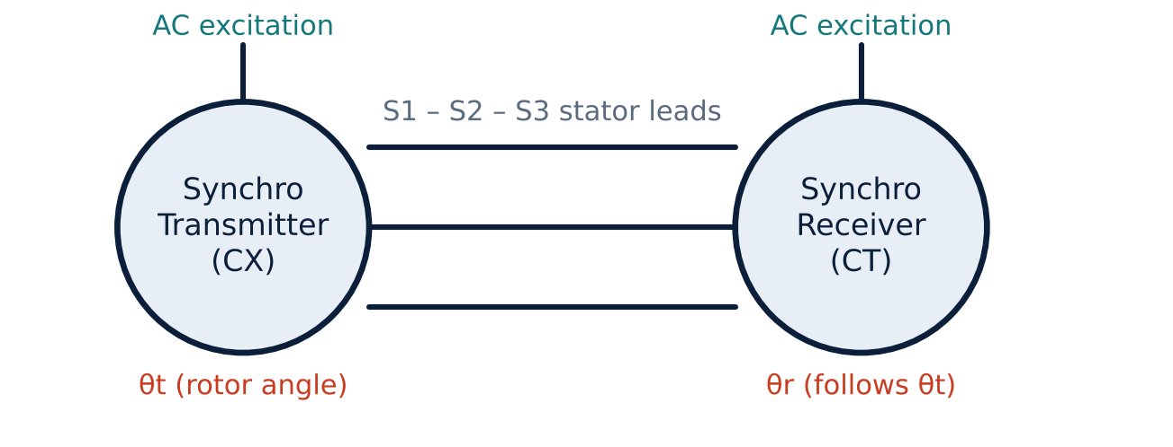
Synchro transmitter and receiver
U1
Synchro pair as an error detector
Rotor of the transmitter turned by θt.
Stator voltages induced in S1, S2, S3 depend on θt.
Receiver/CT rotor at θr: output ∝ sin(θt − θr).
Zero output when θt = θr (aligned).
Notes:
For small errors the output is nearly proportional to the angular difference.

Slide 6
Actuators: servo motors
U1
Feature | DC servo motor | AC servo motor
Supply | DC (armature or field controlled) | Two-phase AC: fixed phase + control phase
Torque–speed | Linear for armature control | Made linear by high rotor resistance
Typical size | High power | Low power (≤ ~100 W)
Maintenance | Brushes/commutator | Rugged, no brushes
Uses | Robots, machine tools | Instrument servos
Notes:
Servo motors have low inertia and high torque-to-inertia ratio for fast response.

Slide 7
Tachogenerator and other components
U1
eo = Kt ω = Kt dθ/dt
Eo(s)/Θ(s) = Kt s
Gear ratio N1/N2
tachogenerator output
transfer function
reflects J, B and torque
Tachogenerator: speed feedback gives damping (rate feedback).
Amplifier: electronic (op-amp), magnetic amplifier, amplidyne.
Gear train: matches motor speed to load, multiplies torque.
Notes:
A tachogenerator is a small DC generator whose output voltage is proportional to shaft speed.

Slide 8
Key takeaways
U1
Servo = error detector + amplifier + actuator + load + feedback element
Potentiometer pair and synchro pair give the error signal
AC and DC servo motors act as actuators
Tachogenerator provides velocity feedback: eo = Kt ω
Notes:
To summarise this topic. Servo = error detector + amplifier + actuator + load + feedback element. Potentiometer pair and synchro pair give the error signal. AC and DC servo motors act as actuators. Tachogenerator provides velocity feedback: eo = Kt ω.

Slide 9
Practice questions
U1
Q1. Draw and label the block diagram of a position servo system.
Q2. Explain how a synchro pair works as an error detector.
Q3. Compare AC and DC servo motors.
Q4. What is the function of a tachogenerator?
Notes:
Attempt these on your own, then check your working against your notes and textbook. Draw and label the block diagram of a position servo system. Explain how a synchro pair works as an error detector. Compare AC and DC servo motors. What is the function of a tachogenerator?

