Slide 1

UNIT 1 · 8 hours
Electrical Systems and Analogous Systems
Introduction and Mathematical Modelling of Physical Systems
Control Systems (22EEG53)
Dr. Mitesh Astik · Dept. of Electrical and Electronics Engineering
NMAM Institute of Technology, Nitte · 2025-26
Notes:
Welcome. In this session we study "Electrical Systems and Analogous Systems", part of Unit 1 (Introduction and Mathematical Modelling of Physical Systems) of Control Systems.

Slide 2
Learning objectives
U1
Derive transfer functions of RLC networks
Write the force–voltage and force–current analogies
Convert a mechanical system into an analogous electrical circuit
Use the analogy to transfer design insight
Syllabus context
Introduction and mathematical modelling of physical systems: open loop and closed loop systems, examples, control system components. Transfer function of physical systems: mechanical systems (translational and rotational), electrical systems, analogous systems, block diagram reduction techniques, signal flow graphs.
Notes:
By the end of this topic you should be able to do the following. Derive transfer functions of RLC networks. Write the force–voltage and force–current analogies. Convert a mechanical system into an analogous electrical circuit. Use the analogy to transfer design insight.

Slide 3
Electrical elements
U1
Element | v–i relation | Laplace
Resistor R | v = R i | R I(s)
Inductor L | v = L di/dt | L s I(s)
Capacitor C | v = (1/C)∫i dt | I(s)/(C s)
Kirchhoff's laws (KVL, KCL) give the differential equations of a network.
Notes:
These are the three passive elements.

Slide 4
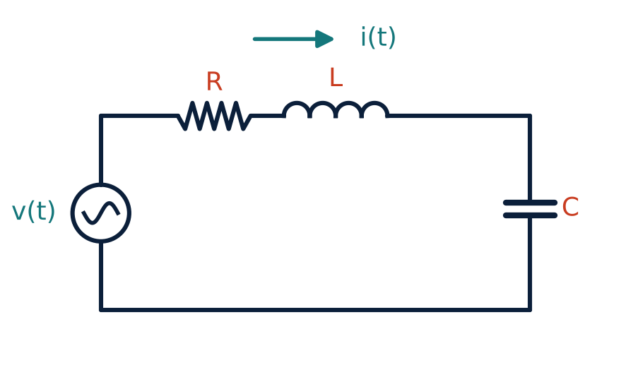
Series RLC network
U1
KVL: v = R i + L di/dt + (1/C)∫i dt.
Output across C: vc = (1/C)∫i dt.
Laplace: V(s) = (R + Ls + 1/Cs) I(s).
Vc(s)/V(s) = 1/(LC s² + RC s + 1).
Notes:
The output taken across the capacitor gives a second order low pass response.

Slide 5
RLC parameters
U1
Vc/V = 1/(LC s² + RC s + 1)
ωn = 1/√(LC)
ζ = (R/2)√(C/L)
transfer function
natural frequency
damping ratio
Compare with the mechanical system: M ↔ L, B ↔ R, K ↔ 1/C.
Notes:
Same mathematics, different physics.

Slide 6
Force–voltage analogy (F–V)
U1
Mechanical (translation) | Electrical | Equation
Force f | Voltage e | f ↔ e
Mass M | Inductance L | M ↔ L
Damper B | Resistance R | B ↔ R
Spring K | Reciprocal capacitance 1/C | K ↔ 1/C
Displacement x | Charge q | x ↔ q
Velocity v | Current i | v ↔ i
Notes:
In the F V analogy, the mechanical node equation becomes the series loop equation.

Slide 7
Force–current analogy (F–I)
U1
Mechanical (translation) | Electrical | Equation
Force f | Current i | f ↔ i
Mass M | Capacitance C | M ↔ C
Damper B | Conductance 1/R | B ↔ 1/R
Spring K | Reciprocal inductance 1/L | K ↔ 1/L
Displacement x | Flux linkage ψ | x ↔ ψ
Velocity v | Node voltage e | v ↔ e
Notes:
The force current analogy is also called the mass capacitance analogy; the circuit is a parallel RLC.

Slide 8
Numerical: analogous circuits
U1
Problem A system has M = 2 kg, B = 4 N·s/m, K = 8 N/m. Find the F–V and F–I analogous circuit values.
F–V (series RLC): L = M = 2 H; R = B = 4 Ω; C = 1/K = 0.125 F
F–I (parallel RLC): C = M = 2 F; 1/R = B → R = 0.25 Ω; 1/L = K → L = 0.125 H
Both give ωn = √(K/M) = 2 rad/s
Answer: F–V: L = 2 H, R = 4 Ω, C = 0.125 F. F–I: C = 2 F, R = 0.25 Ω, L = 0.125 H
Notes:
The analogous circuits have the same natural frequency and damping ratio.

Slide 9
Key takeaways
U1
RLC: Vc/V = 1/(LCs² + RCs + 1), ωn = 1/√(LC)
F–V analogy: M↔L, B↔R, K↔1/C, f↔e
F–I analogy: M↔C, B↔1/R, K↔1/L, f↔i
Analogies let us study mechanical systems with circuits
Notes:
To summarise this topic. RLC: Vc/V = 1/(LCs² + RCs + 1), ωn = 1/√(LC). F–V analogy: M↔L, B↔R, K↔1/C, f↔e. F–I analogy: M↔C, B↔1/R, K↔1/L, f↔i. Analogies let us study mechanical systems with circuits.

Slide 10
Practice questions
U1
Q1. Derive Vc/V for a series RLC network.
Q2. Draw the F–V analogue of a mass-spring-damper system.
Q3. M = 5, B = 10, K = 20: find F–I analogue parameters.
Q4. State the table of analogous quantities.
Notes:
Attempt these on your own, then check your working against your notes and textbook. Derive Vc/V for a series RLC network. Draw the F–V analogue of a mass-spring-damper system. M = 5, B = 10, K = 20: find F–I analogue parameters. State the table of analogous quantities.

