Slide 1

UNIT 1 · 8 hours
Block Diagram Algebra and Reduction Techniques
Introduction and Mathematical Modelling of Physical Systems
Control Systems (22EEG53)
Dr. Mitesh Astik · Dept. of Electrical and Electronics Engineering
NMAM Institute of Technology, Nitte · 2025-26
Notes:
Welcome. In this session we study "Block Diagram Algebra and Reduction Techniques", part of Unit 1 (Introduction and Mathematical Modelling of Physical Systems) of Control Systems.

Slide 2
Learning objectives
U1
Identify block, summing point and take-off point
Apply series, parallel and feedback reduction rules
Shift summing and take-off points
Reduce a multi-loop block diagram to a single transfer function
Syllabus context
Introduction and mathematical modelling of physical systems: open loop and closed loop systems, examples, control system components. Transfer function of physical systems: mechanical systems (translational and rotational), electrical systems, analogous systems, block diagram reduction techniques, signal flow graphs.
Notes:
By the end of this topic you should be able to do the following. Identify block, summing point and take-off point. Apply series, parallel and feedback reduction rules. Shift summing and take-off points. Reduce a multi-loop block diagram to a single transfer function.

Slide 3
Elements of a block diagram
U1
Block: rectangle containing the transfer function; output = G × input.
Summing point: circle with ± signs; algebraic sum of signals.
Take-off point: dot: the same signal is branched off without loading.
Arrows: direction of signal flow.
Why reduce? to get one overall transfer function C(s)/R(s).
Notes:
A block diagram gives a pictorial representation of the functional relationships among components.

Slide 4
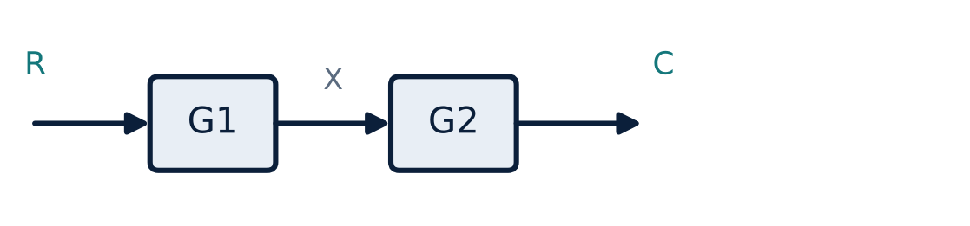
Rule 1: blocks in series (cascade)
U1
C/R = G1 · G2
Valid when blocks do not load each other.
Any number of blocks: multiply all.
Notes:
The output of the first block is the input of the second.

Slide 5
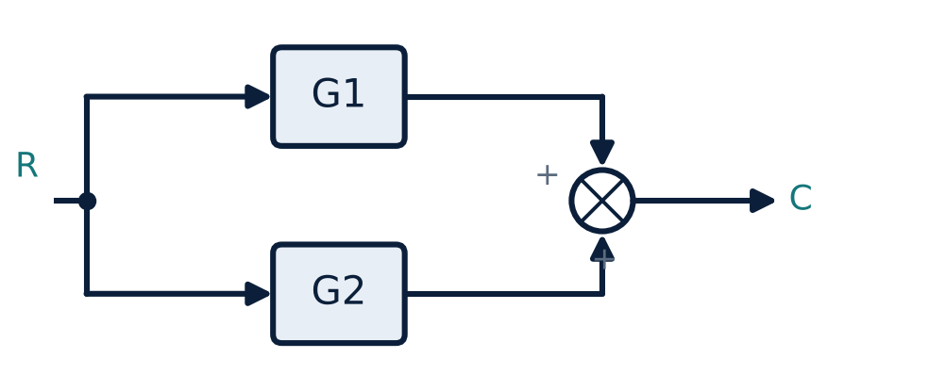
Rule 2: blocks in parallel
U1
C/R = G1 ± G2
Signs follow the summing point.
Same input to both blocks.
Notes:
Outputs are added or subtracted at the summing point.

Slide 6
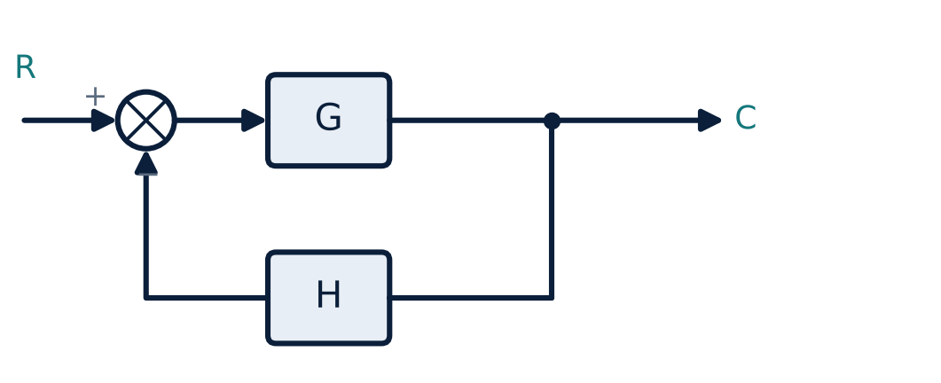
Rule 3: feedback loop
U1
C/R = G / (1 ± GH)
Negative feedback: 1 + GH; positive: 1 − GH.
Unity feedback: H = 1 → G/(1 + G).
GH = open-loop transfer function.
Notes:
This is the most used reduction.

Slide 7
Moving summing and take-off points
U1
Operation | Rule
Move take-off point beyond a block G | Add a block G in the branch
Move take-off point before a block G | Add a block 1/G in the branch
Move summing point beyond a block G | Add G in the branch being moved
Move summing point before a block G | Add 1/G in the branch being moved
Interchange adjacent summing points | Allowed
Interchange summing and take-off points | Not allowed (shift across a block)
Notes:
The aim of moving points is to expose simple series, parallel or feedback combinations.

Slide 8
Reduction procedure
U1
1
2
3
4
5
Combine series
Combine parallel
Eliminate inner loops
Shift points
Repeat
Multiply cascade blocks.
Only when needed to untangle.
Until a single block remains.
Add/subtract blocks with common input and output.
Apply G/(1 ± GH) to the innermost feedback.
Rule of thumb: reduce inner loops first and keep the same input/output.
Notes:
Work from the inside out. Always check signs at the summing points.

Slide 9
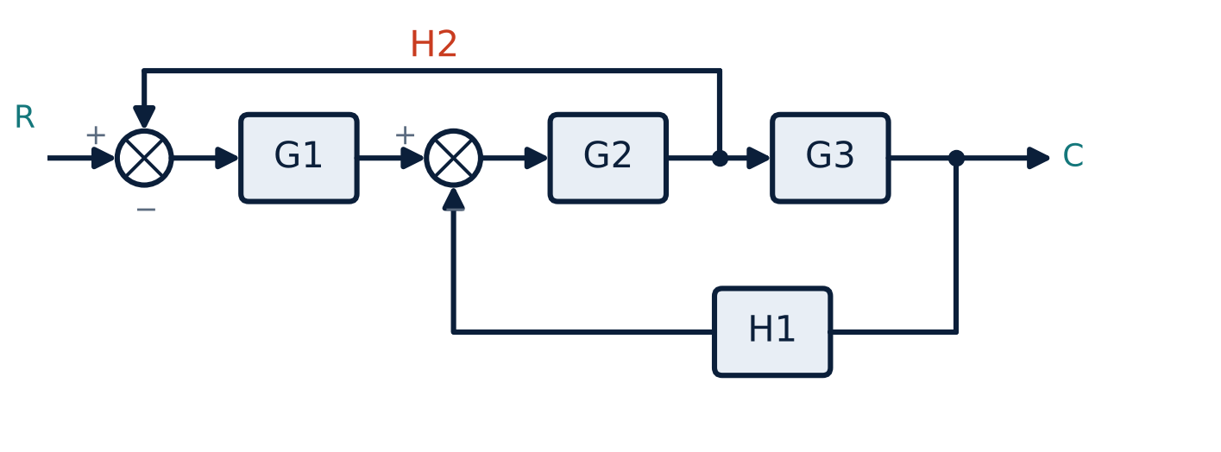
Example: multi-loop diagram
U1
Inner loop: G2 G3 with feedback H1.
Then outer loop: G1 with feedback H2 taken after G2.
Reduce step by step.
Notes:
Here H1 feeds back from the output to the second summing point, and H2 feeds back from the output of G2 to the first summing point.

Slide 10
Reducing the example
U1
Problem G1 = 10, G2 = 2, G3 = 5, H1 = 0.1, H2 = 0.2. Find C/R.
Inner loop (G2G3 with H1): G2G3/(1 + G2G3H1) = 10/(1 + 1) = 5
Path u1 → G2 output: G2/(1 + G2G3H1) = 2/2 = 1
Overall: C/R = G1G2G3 / (1 + G2G3H1 + G1G2H2)
= 100 / (1 + 1 + 4)
Answer: C/R = 100/6 = 16.67
Notes:
Verify by symbolic reduction: the denominator contains one term per loop.

Slide 11
Key takeaways
U1
Series: G1G2; parallel: G1 ± G2; feedback: G/(1 ± GH)
Move take-off points and summing points to expose simple forms
Reduce inner loops first
Check signs at every summing point
Notes:
To summarise this topic. Series: G1G2; parallel: G1 ± G2; feedback: G/(1 ± GH). Move take-off points and summing points to expose simple forms. Reduce inner loops first. Check signs at every summing point.

Slide 12
Practice questions
U1
Q1. Reduce a unity-feedback system with G = 10/(s(s+2)) to a single block.
Q2. State the rules for shifting a take-off point across a block.
Q3. G1 = 1/(s+1), G2 = 1/(s+2), H = 1: find C/R.
Q4. Why can't a summing point and a take-off point be interchanged directly?
Notes:
Attempt these on your own, then check your working against your notes and textbook. Reduce a unity-feedback system with G = 10/(s(s+2)) to a single block. State the rules for shifting a take-off point across a block. G1 = 1/(s+1), G2 = 1/(s+2), H = 1: find C/R. Why can't a summing point and a take-off point be interchanged directly?

