Slide 1

UNIT 3 · 7 hours
Frequency Response and Frequency Domain Specifications
Frequency Domain Analysis
Control Systems (22EEG53)
Dr. Mitesh Astik · Dept. of Electrical and Electronics Engineering
NMAM Institute of Technology, Nitte · 2025-26
Notes:
Welcome. In this session we study "Frequency Response and Frequency Domain Specifications", part of Unit 3 (Frequency Domain Analysis) of Control Systems.

Slide 2
Learning objectives
U3
Define the frequency response of a system
Define Mr, ωr, bandwidth and cut-off rate
Derive Mr and ωr for a second-order system
Compute the specifications from ωn and ζ
Syllabus context
Frequency domain analysis: frequency domain specifications peak resonance, resonant frequency, bandwidth and cut-off rate; correlation between time and frequency responses for second-order systems; Bode plot, gain margin and phase margin.
Notes:
By the end of this topic you should be able to do the following. Define the frequency response of a system. Define Mr, ωr, bandwidth and cut-off rate. Derive Mr and ωr for a second-order system. Compute the specifications from ωn and ζ.

Slide 3
Frequency response
U3
Definition: steady-state output of an LTI system for a sinusoidal input of varying frequency.
Obtain by putting s = jω in the transfer function: M(ω)∠φ(ω) = G(jω).
Magnitude M(ω) = |C/R(jω)| and phase φ(ω) are plotted against ω.
Advantages: easy to measure experimentally; stability and accuracy readable from plots; extends to systems whose transfer function is unknown.
Notes:
A sinusoidal input to an LTI system produces a sinusoidal output of the same frequency, with changed amplitude and phase.

Slide 4
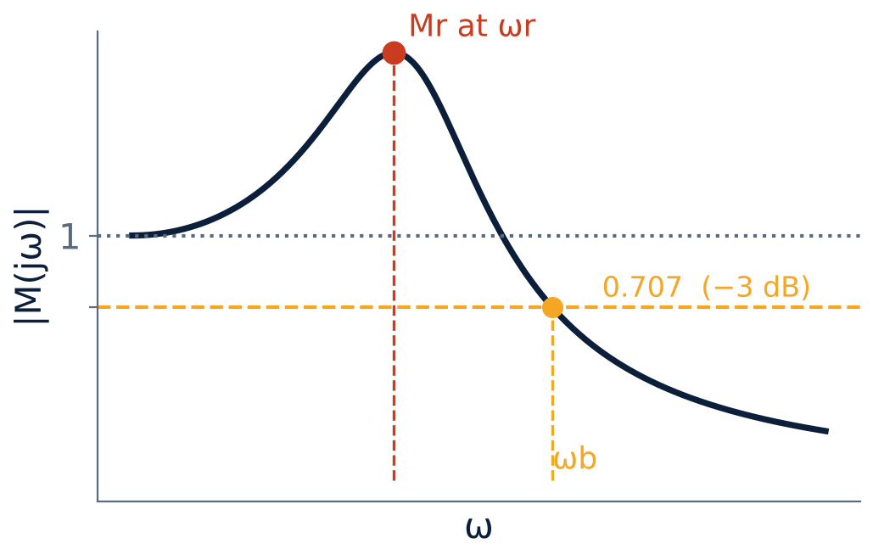
Frequency domain specifications
U3
Resonant peak Mr: maximum of |M(jω)|.
Resonant frequency ωr: frequency at which Mr occurs.
Bandwidth ωb: frequency where M falls to 0.707 (−3 dB) of its low-frequency value.
Cut-off rate: slope of the magnitude curve beyond ωb (dB/decade).
Notes:
A large peak means poor relative stability; a large bandwidth means fast response.

Slide 5
Second-order system
U3
M(jω) = 1/√[(1 − u²)² + (2ζu)²]
ωr = ωn √(1 − 2ζ²)
u = ω/ωn
ζ ≤ 0.707
Mr = 1/(2ζ√(1 − ζ²))
ωb = ωn[(1 − 2ζ²) + √(4ζ⁴ − 4ζ² + 2)]^½
ζ ≤ 0.707
bandwidth
Notes:
Differentiate M with respect to omega and set to zero to find the peak. For zeta greater than zero point seven oh seven there is no peak.

Slide 6
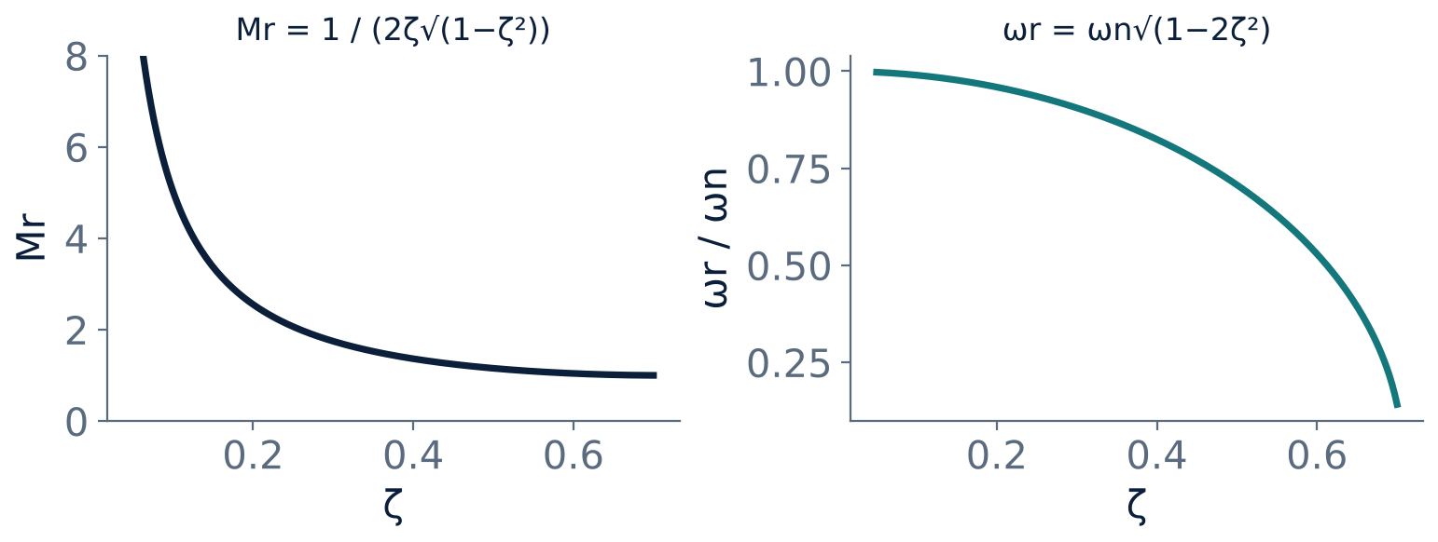
Mr and ωr versus ζ
U3
Mr rises sharply as ζ → 0.
Mr = 1 for ζ ≥ 0.707 (no peak).
ωr falls from ωn to 0 as ζ → 0.707.
Notes:
Small damping gives a tall narrow resonance peak.

Slide 7
Numerical: second-order specifications
U3
Problem ωn = 10 rad/s, ζ = 0.4. Find ωr, Mr and bandwidth.
ωr = 10√(1 − 2 × 0.16) = 10√0.68 = 8.25 rad/s
Mr = 1/(2 × 0.4 × √(1 − 0.16)) = 1/(0.8 × 0.9165) = 1.364
ωb = 10 [0.68 + √(0.1024 − 0.64 + 2)]^½ = 10 [0.68 + 1.2093]^½
Answer: ωr = 8.25 rad/s, Mr = 1.364 (2.7 dB), ωb = 13.75 rad/s
Notes:
The bandwidth is greater than the resonant frequency.

Slide 8
Cut-off rate and bandwidth
U3
Cut-off rate: slope of the high-frequency asymptote: −20 dB/dec for 1st order, −40 dB/dec for 2nd order.
Large bandwidth: fast rise time and good tracking, but also passes noise.
Bandwidth ∝ ωn: ωb·tr ≈ constant (≈ 2.2 for first order).
Specifications Mr and ωb are the frequency-domain equivalents of Mp and tr.
Notes:
A larger bandwidth gives a faster time response.

Slide 9
Key takeaways
U3
Frequency response: G(jω), magnitude and phase vs ω
ωr = ωn√(1 − 2ζ²), Mr = 1/(2ζ√(1 − ζ²))
Bandwidth: where M drops to 0.707 (−3 dB)
Larger bandwidth ⇒ faster response
Notes:
To summarise this topic. Frequency response: G(jω), magnitude and phase vs ω. ωr = ωn√(1 − 2ζ²), Mr = 1/(2ζ√(1 − ζ²)). Bandwidth: where M drops to 0.707 (−3 dB). Larger bandwidth ⇒ faster response.

Slide 10
Practice questions
U3
Q1. Define Mr, ωr, bandwidth and cut-off rate.
Q2. Derive Mr and ωr for a second-order system.
Q3. ωn = 5, ζ = 0.3: find Mr and ωr.
Q4. How is bandwidth related to rise time?
Notes:
Attempt these on your own, then check your working against your notes and textbook. Define Mr, ωr, bandwidth and cut-off rate. Derive Mr and ωr for a second-order system. ωn = 5, ζ = 0.3: find Mr and ωr. How is bandwidth related to rise time?

