Slide 1

UNIT 4 · 8 hours
Stability, Characteristic Equation and Root Location
Stability of Systems
Control Systems (22EEG53)
Dr. Mitesh Astik · Dept. of Electrical and Electronics Engineering
NMAM Institute of Technology, Nitte · 2025-26
Notes:
Welcome. In this session we study "Stability, Characteristic Equation and Root Location", part of Unit 4 (Stability of Systems) of Control Systems.

Slide 2
Learning objectives
U4
Define stability of an LTI system
Relate stability to the roots of the characteristic equation
Distinguish absolute and relative stability
Classify systems from root locations
Syllabus context
Stability of systems: characteristic equation, location of roots, absolute and relative stability, Routh–Hurwitz criterion (necessary and sufficient conditions), root locus concept, rules for construction of root locus.
Notes:
By the end of this topic you should be able to do the following. Define stability of an LTI system. Relate stability to the roots of the characteristic equation. Distinguish absolute and relative stability. Classify systems from root locations.

Slide 3
Stability
U4
Definition (BIBO): a system is stable if every bounded input gives a bounded output.
Equivalent: the natural (impulse) response decays to zero as t → ∞.
Unstable: the response grows without bound (e.g. an inverted pendulum without control).
Marginally stable: response neither decays nor grows: sustained oscillation.
Notes:
Stability is the first requirement of any control system.

Slide 4
Characteristic equation
U4
1 + G(s)H(s) = 0
Δ(s) = a0 sⁿ + a1 sⁿ⁻¹ + … + an = 0
characteristic equation
polynomial form
Roots are the closed-loop poles; each pole gives a term in the response: e^(pt).
A pole p = σ + jω gives e^(σt) × (oscillation): decays if σ < 0.
Notes:
The closed loop poles are the roots of the characteristic equation.

Slide 5
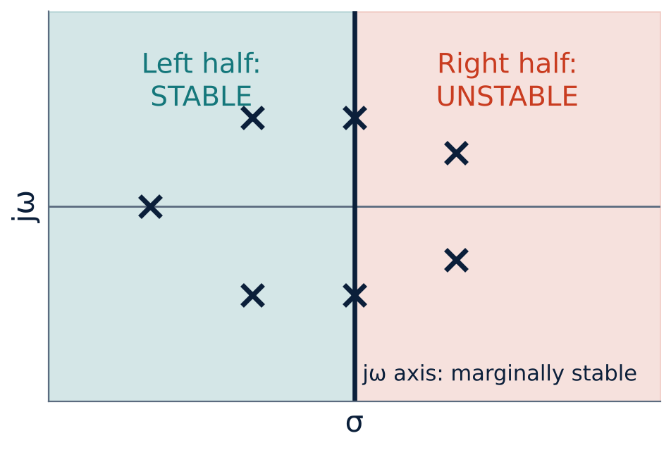
Root location and stability
U4
All roots in the left half-plane (LHP): stable.
Any root in the right half-plane (RHP): unstable.
Simple roots on the jω axis (and none in the RHP): marginally stable.
Repeated jω-axis roots: unstable.
Notes:
The imaginary axis is the stability boundary.

Slide 6
Examples of root locations
U4
Characteristic equation | Roots | Stability
s² + 3s + 2 | −1, −2 | Stable
s² + 4 | ± j2 | Marginally stable
s² − s + 2 | 0.5 ± j1.32 | Unstable
s² + 2s + 5 | −1 ± j2 | Stable (underdamped)
s³ + 2s² + s + 2 | −2, ± j1 | Marginally stable
Notes:
A root in the right half plane gives a growing exponential.

Slide 7
Absolute versus relative stability
U4
Absolute stability
Relative stability
Is the system stable or not?
Decided by sign of the real parts of roots
Tests: Routh–Hurwitz, root locus, Bode, Nyquist
Binary answer: stable / unstable
How stable? How close to the boundary?
Measured by distance of roots from the jω axis, damping ratio, GM and PM
Shifted-axis Routh test: s = z − σ
Determines transient quality
Notes:
A system can be stable but very oscillatory if its poles are close to the imaginary axis.

Slide 8
Necessary conditions
U4
For all roots to be in the LHP, all coefficients must be non-zero and have the same sign (necessary, not sufficient for n ≥ 3).
Missing term or sign change ⇒ certainly not stable.
For n = 1, 2 the condition is also sufficient.
For higher order: Routh–Hurwitz criterion (next topic).
Notes:
Checking coefficients is a quick first test.

Slide 9
Key takeaways
U4
Stable ⇔ all closed-loop poles in the LHP
Characteristic equation: 1 + GH = 0
jω-axis simple roots: marginal; RHP roots: unstable
Absolute stability: yes/no; relative stability: how far from the boundary
Notes:
To summarise this topic. Stable ⇔ all closed-loop poles in the LHP. Characteristic equation: 1 + GH = 0. jω-axis simple roots: marginal; RHP roots: unstable. Absolute stability: yes/no; relative stability: how far from the boundary.

Slide 10
Practice questions
U4
Q1. Define BIBO stability and relate it to pole locations.
Q2. Classify s³ + 4s² + 5s + 2 using the coefficient test.
Q3. Distinguish absolute and relative stability.
Q4. Find the roots and the stability of s² + 6s + 8.
Notes:
Attempt these on your own, then check your working against your notes and textbook. Define BIBO stability and relate it to pole locations. Classify s³ + 4s² + 5s + 2 using the coefficient test. Distinguish absolute and relative stability. Find the roots and the stability of s² + 6s + 8.

