Slide 1

UNIT 4 · 8 hours
Root Locus: Concept and Conditions
Stability of Systems
Control Systems (22EEG53)
Dr. Mitesh Astik · Dept. of Electrical and Electronics Engineering
NMAM Institute of Technology, Nitte · 2025-26
Notes:
Welcome. In this session we study "Root Locus: Concept and Conditions", part of Unit 4 (Stability of Systems) of Control Systems.

Slide 2
Learning objectives
U4
Define the root locus
State the magnitude and angle conditions
Relate poles and zeros of G(s)H(s) to the locus
Interpret the locus for a simple system
Syllabus context
Stability of systems: characteristic equation, location of roots, absolute and relative stability, Routh–Hurwitz criterion (necessary and sufficient conditions), root locus concept, rules for construction of root locus.
Notes:
By the end of this topic you should be able to do the following. Define the root locus. State the magnitude and angle conditions. Relate poles and zeros of G(s)H(s) to the locus. Interpret the locus for a simple system.

Slide 3
What is the root locus?
U4
Definition: the plot of closed-loop poles in the s-plane as a parameter K varies from 0 to ∞.
Proposed by W. R. Evans (1948).
Why? shows how the transient response (pole positions) changes with gain K, without solving the characteristic equation repeatedly.
Starts from open-loop poles (K = 0) and ends at open-loop zeros or infinity (K → ∞).
Notes:
The root locus is a graphical method to study the effect of gain on closed loop poles.

Slide 4
Conditions on the root locus
U4
1 + K G1(s) = 0
∠G1(s)H1(s) = ±180°(2q + 1)
|K G1(s)H1(s)| = 1
characteristic equation, G1 = Π(s + zi)/Π(s + pj)
angle condition
magnitude condition (gives K)
Angle condition decides whether a point lies on the locus.
Magnitude condition gives the gain K at that point: K = Π|s + pj| / Π|s + zi|.
Notes:
A point is on the root locus if the sum of the angles from the zeros minus the sum from the poles is an odd multiple of one hundred eighty degrees.

Slide 5
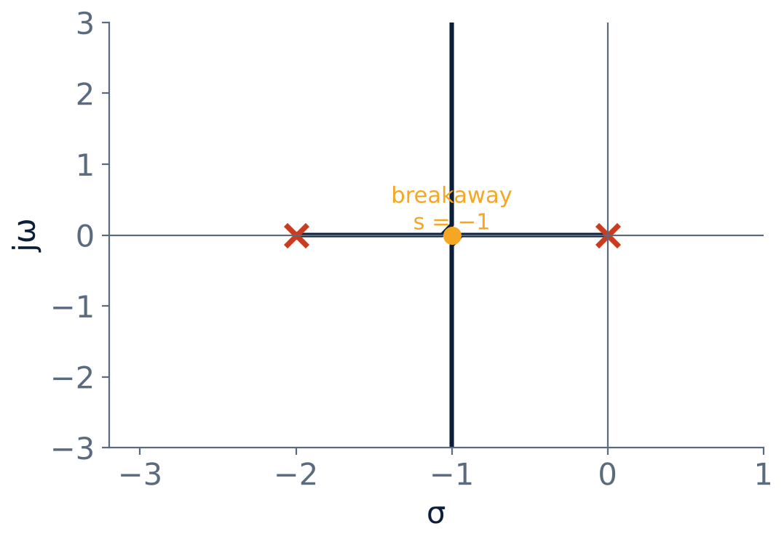
Example: G(s)H(s) = K/[s(s + 2)]
U4
Poles at 0 and −2 (K = 0).
Characteristic: s² + 2s + K = 0, s = −1 ± √(1 − K).
0 < K < 1: real roots, overdamped.
K = 1: breakaway at s = −1.
K > 1: complex roots on Re s = −1; ζ falls as K rises.
Notes:
The locus is the real axis between the poles and then vertical lines through minus one.

Slide 6
Numerical: finding K on the locus
U4
Problem For the locus above find K for ζ = 0.5.
s² + 2s + K = 0 ⇒ ωn = √K, 2ζωn = 2 ⇒ ωn = 2
K = ωn² = 4
Roots: s = −1 ± j√3 (on the 60° line)
Answer: K = 4, poles −1 ± j1.73
Notes:
Check with the magnitude condition: product of distances from the poles divided by one equals K: 2 times 2.

Slide 7
Effect of adding poles and zeros
U4
Adding a pole
Adding a zero
Use in design
Pushes the locus to the right: reduces stability and relative damping.
Pulls the locus to the left: improves stability and damping.
Lead compensator adds a zero (left), lag adds a pole-zero close to the origin.
Notes:
This is the basis of compensator design with the root locus.

Slide 8
Key takeaways
U4
Root locus: closed-loop poles vs K (0 → ∞)
Angle condition: ±180°(2q + 1); magnitude condition gives K
Starts at open-loop poles, ends at zeros or infinity
Adding poles destabilises; adding zeros stabilises
Notes:
To summarise this topic. Root locus: closed-loop poles vs K (0 → ∞). Angle condition: ±180°(2q + 1); magnitude condition gives K. Starts at open-loop poles, ends at zeros or infinity. Adding poles destabilises; adding zeros stabilises.

Slide 9
Practice questions
U4
Q1. State the angle and magnitude conditions.
Q2. Sketch the root locus of K/[s(s + 4)] and find K for critical damping.
Q3. What is the effect of adding a pole at −3 to K/[s(s+2)]?
Q4. Find the point on the real-axis locus where K = 1 for K/[s(s+2)].
Notes:
Attempt these on your own, then check your working against your notes and textbook. State the angle and magnitude conditions. Sketch the root locus of K/[s(s + 4)] and find K for critical damping. What is the effect of adding a pole at −3 to K/[s(s+2)]? Find the point on the real-axis locus where K = 1 for K/[s(s+2)].

