Slide 1

UNIT 5 · 8 hours
Lag Compensator
Compensators, Controllers and State-Space Analysis
Control Systems (22EEG53)
Dr. Mitesh Astik · Dept. of Electrical and Electronics Engineering
NMAM Institute of Technology, Nitte · 2025-26
Notes:
Welcome. In this session we study "Lag Compensator", part of Unit 5 (Compensators, Controllers and State-Space Analysis) of Control Systems.

Slide 2
Learning objectives
U5
Write the transfer function and Bode plot of a lag compensator
Explain its effect on steady-state error, bandwidth and margins
Design a lag compensator using the Bode plot
Verify the design
Syllabus context
Compensators and controllers: introduction to compensators, lag, lead and lag-lead compensators, P, PI and PID controllers.
Notes:
By the end of this topic you should be able to do the following. Write the transfer function and Bode plot of a lag compensator. Explain its effect on steady-state error, bandwidth and margins. Design a lag compensator using the Bode plot. Verify the design.

Slide 3
Lag compensator
U5
Gc(s) = (1 + Ts)/(1 + βTs), β > 1
φm = −sin⁻¹[(β − 1)/(β + 1)]
ωm = 1/(T√β)
zero at −1/T, pole at −1/(βT)
max phase lag
frequency of max lag
Pole is closer to the origin than the zero.
DC gain = 1; high-frequency gain = 1/β: attenuation 20 log β dB.
Notes:
The lag compensator is effectively a low pass filter.

Slide 4
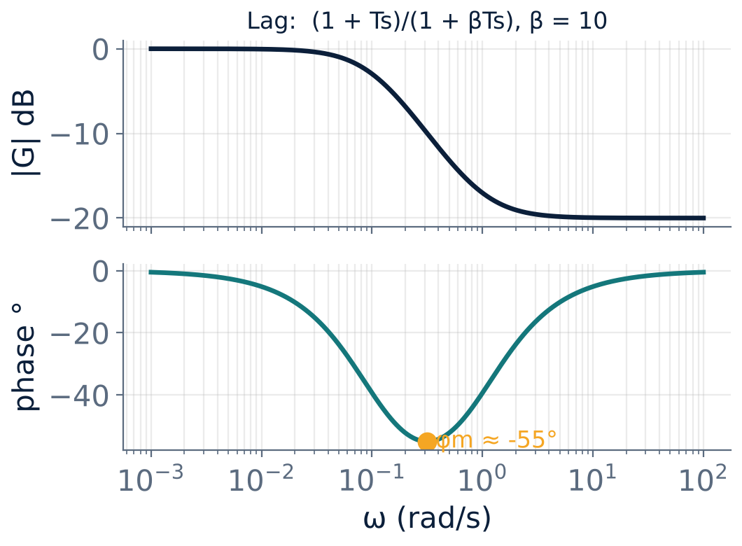
Bode plot of a lag network
U5
Gain falls by 20 log β dB between 1/(βT) and 1/T.
Phase negative with a minimum of −55° for β = 10.
Place the corners well below the gain crossover so the phase lag there is small.
Notes:
Do not put the maximum phase lag near the gain crossover.

Slide 5
Effect of lag compensation
U5
Steady-state accuracy
Stability / transient
Cautions
Allows higher low-frequency gain (Kv up by up to β) without changing high-frequency behaviour.
Reduces gain at crossover to restore PM; lowers bandwidth so response becomes slower.
Noise attenuation improves; the extra pole near the origin gives a slow tail in the step response.
Notes:
A lag compensator is used when the transient is acceptable but the steady state error is too large.

Slide 6
Bode design procedure (lag)
U5
1
2
3
4
5
Set K
Find new crossover
Choose β
Choose T
Check
Choose K to meet the steady-state error (Kv).
β = |G(jω)| at that frequency (attenuation needed).
Zero at 1/T = ωnew/10 (a decade below).
Verify PM, GM and steady-state error.
Find ω where phase = −180° + PM + 5°–12°.
Compensator: Gc(s) = (1 + Ts)/(1 + βTs) with β = |G(jωnew)| and 1/T = ωnew/10.
Notes:
The extra 5 to 12 degrees allows for the small phase lag the compensator adds at the new crossover.

Slide 7
Numerical: lag design
U5
Problem G(s) = K/[s(1 + s)(1 + 0.5s)], Kv = 5 required, PM ≥ 40°. Design a lag compensator.
K = Kv = 5. Uncompensated: ωgc ≈ 1.8 rad/s, PM ≈ −13° (unstable)
Need phase ≈ −180° + 40° + 5° = −135° at the new crossover ⇒ ω ≈ 0.56 rad/s
|G(j0.56)| = 7.5 ⇒ β = 7.5; 1/T = 0.056 ⇒ T = 17.9 s
Gc = (1 + 17.9s)/(1 + 134s); phase of Gc at 0.56 ≈ −4.9°
Answer: Compensated PM ≈ 40°, Kv = 5 retained
Notes:
The design restores positive phase margin while keeping the steady state error.

Slide 8
Key takeaways
U5
Lag: Gc = (1 + Ts)/(1 + βTs), β > 1
Improves steady-state accuracy; reduces bandwidth
Place the corner a decade below the new gain crossover
β = attenuation required at the new crossover
Notes:
To summarise this topic. Lag: Gc = (1 + Ts)/(1 + βTs), β > 1. Improves steady-state accuracy; reduces bandwidth. Place the corner a decade below the new gain crossover. β = attenuation required at the new crossover.

Slide 9
Practice questions
U5
Q1. Draw the pole-zero plot and Bode plot of a lag compensator.
Q2. State the effects of a lag compensator on time response.
Q3. Find φm and ωm for T = 1, β = 10.
Q4. Outline the Bode design procedure for a lag compensator.
Notes:
Attempt these on your own, then check your working against your notes and textbook. Draw the pole-zero plot and Bode plot of a lag compensator. State the effects of a lag compensator on time response. Find φm and ωm for T = 1, β = 10. Outline the Bode design procedure for a lag compensator.

