Slide 1

UNIT 5 · 8 hours
Lag–Lead Compensator
Compensators, Controllers and State-Space Analysis
Control Systems (22EEG53)
Dr. Mitesh Astik · Dept. of Electrical and Electronics Engineering
NMAM Institute of Technology, Nitte · 2025-26
Notes:
Welcome. In this session we study "Lag–Lead Compensator", part of Unit 5 (Compensators, Controllers and State-Space Analysis) of Control Systems.

Slide 2
Learning objectives
U5
Write the lag-lead compensator transfer function
Explain why it combines the benefits of lag and lead
Interpret its Bode plot
Outline the design procedure
Syllabus context
Compensators and controllers: introduction to compensators, lag, lead and lag-lead compensators, P, PI and PID controllers.
Notes:
By the end of this topic you should be able to do the following. Write the lag-lead compensator transfer function. Explain why it combines the benefits of lag and lead. Interpret its Bode plot. Outline the design procedure.

Slide 3
Why lag–lead?
U5
Lead alone: good transient but little help with steady-state error.
Lag alone: good steady-state accuracy but a slower response.
When both transient and steady-state specifications must be improved, use lag–lead.
A single network provides phase lag at low frequency and phase lead at high frequency.
Notes:
Lag lead compensation gives both fast response and high accuracy.

Slide 4
Transfer function
U5
Gc(s) = [(1 + aT1 s)/(1 + T1 s)] · [(1 + T2 s)/(1 + βT2 s)]
lead × lag, a > 1, β > 1
Lead part: zero at −1/(aT1), pole at −1/T1 (higher frequencies).
Lag part: zero at −1/T2, pole at −1/(βT2) (low frequencies).
Often a = β for a single passive network.
Notes:
The compensator is the product of the lead and the lag sections.

Slide 5
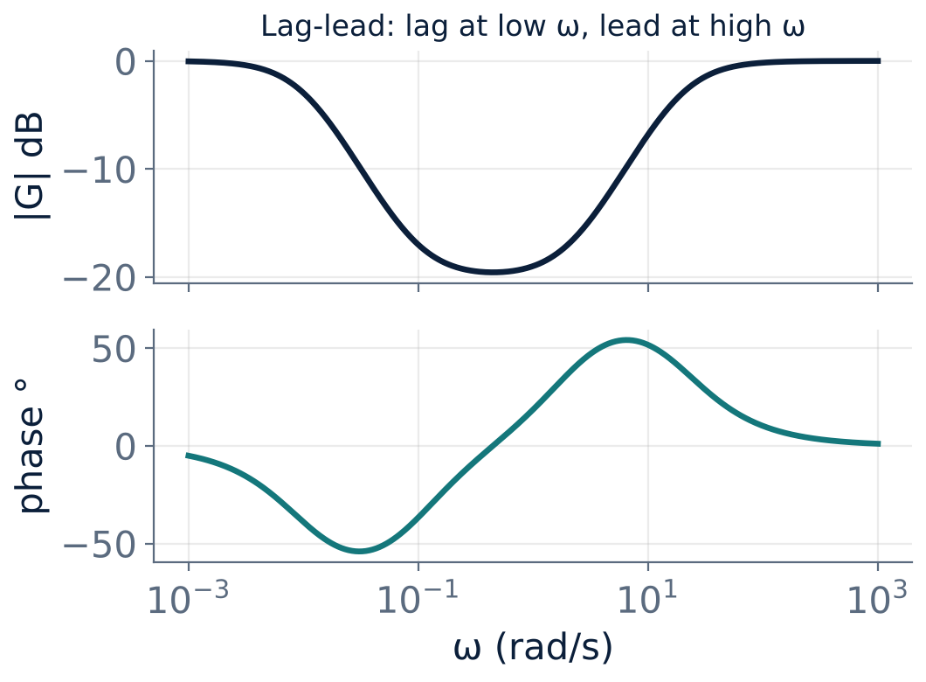
Bode plot of a lag–lead network
U5
Low ω: negative phase (lag).
High ω: positive phase (lead).
Gain dips between the lag and lead corners.
Example: lag β = 10, T2 = 10 s; lead a = 10, T1 = 0.05 s.
Notes:
Notice the gain dip and the phase that changes sign.

Slide 6
Design outline
U5
1
2
3
4
Choose K
Lead section
Lag section
Check
Meet the steady-state error requirement.
Design the lead part to obtain the required PM at the new crossover ωc.
Place its corners at least a decade below ωc, so it does not disturb the phase margin.
Verify PM, GM, bandwidth and steady-state error; iterate.
Notes:
Design the lead section first for the transient, then the lag section for the steady state.

Slide 7
Comparison
U5
Lead / Lag / Lag-lead
Typical use
Lead: ↑ PM, ↑ bandwidth, noise up
Lag: ↑ Kv, ↓ bandwidth, slower
Lag-lead: both, more complex
Lead: fast servo, low-order plant
Lag: process control, precise tracking
Lag-lead: demanding systems with strict accuracy and speed
Notes:
Use the simplest compensator that meets the specifications.

Slide 8
Key takeaways
U5
Lag–lead = lag (low ω) × lead (high ω)
Improves both steady-state and transient response
Lead sets PM at the new crossover; lag sets Kv
More components and design effort
Notes:
To summarise this topic. Lag–lead = lag (low ω) × lead (high ω). Improves both steady-state and transient response. Lead sets PM at the new crossover; lag sets Kv. More components and design effort.

Slide 9
Practice questions
U5
Q1. Write the transfer function of a lag–lead compensator.
Q2. Why are the lag corners placed a decade below the crossover?
Q3. When would you choose lag–lead over lead?
Q4. Sketch the Bode plot of a lag–lead compensator.
Notes:
Attempt these on your own, then check your working against your notes and textbook. Write the transfer function of a lag–lead compensator. Why are the lag corners placed a decade below the crossover? When would you choose lag–lead over lead? Sketch the Bode plot of a lag–lead compensator.

