Slide 1

EEE103 · REVISION LECTURE
Basic Electrical and Electronics Engineering
Units 1 to 5: circuits, machines, semiconductors, transistors and op-amps
Instructor: Dr. Mitesh Astik
Department of Electrical and Electronics Engineering
NMAM Institute of Technology, Nitte · 2025-26
Notes:
Hello everyone, and welcome. I am Doctor Mitesh Astik from the Department of Electrical and Electronics Engineering at N M A M Institute of Technology, Nitte. In this video we revise the whole of Basic Electrical and Electronics Engineering, course code E E E one oh three, covering all five units from your notes. Keep your notes beside you, and pause the video whenever you want to try a numerical yourself.

Slide 2




Course roadmap
UNIT 1
UNIT 2
UNIT 3
UNIT 4
UNIT 5
Circuits and AC
Transformers and Machines
Diodes and Rectifiers
BJT and MOSFET
Operational Amplifiers
Mesh, nodal, RMS, phasors, R-L-C, power factor
EMF equation, DC motors, induction motor
PN diode, HWR, FWR, bridge, Zener regulator
Currents, gains, switch, CMOS inverter
Ideal op-amp, inverting, summing, integrator
Notes:
Here is the roadmap. Unit one covers circuit fundamentals and A C circuits. Unit two covers transformers and electrical machines, including D C motors and the three phase induction motor. Unit three is diodes and rectifiers, ending with the Zener regulator. Unit four is the bipolar junction transistor and the MOSFET. Unit five is operational amplifiers. Each unit has a short concept section followed by worked numericals, so you can connect theory with problem solving.

Slide 3
UNIT 1
Circuit Fundamentals and AC Circuits
Mesh and nodal analysis
Energy and power
Sinusoidal quantities: average, RMS, phasors
R, L, C circuits, impedance, power factor
Notes:
Let us begin with Unit one: circuit fundamentals and A C circuits. First we solve D C networks using mesh and nodal analysis. Then we move to alternating quantities, their average and R M S values, phasors, and the behaviour of resistors, inductors and capacitors, finishing with impedance and power factor.

Slide 4
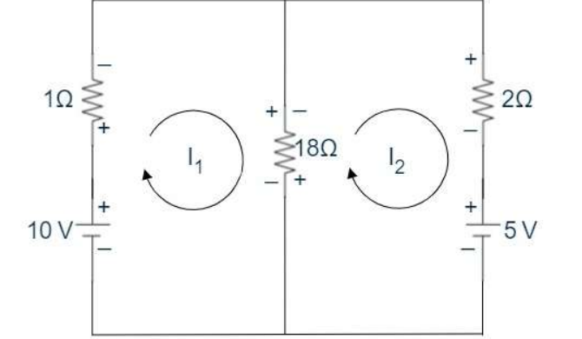
Mesh analysis
U1
Idea: assign a circulating current to every closed loop (mesh), not to every branch.
Write KVL around each mesh: sum of EMFs = sum of voltage drops.
Solve the simultaneous equations; branch current = algebraic sum of mesh currents.
Sign: a negative answer just means the real current flows opposite to the assumed direction.
KVL gives 19 I1 − 18 I2 = 10 and −18 I1 + 20 I2 = −5 → I1 = 1.964 A, I2 = 1.518 A; 18 Ω carries 0.446 A (3.59 W)
Notes:
Mesh analysis relies on Kirchhoff's voltage law. We give each closed loop its own circulating current, write one K V L equation per loop, and solve the equations together. In the example from your notes, a ten volt source with one ohm, an eighteen ohm shared resistor, and a two ohm resistor with a five volt source. The two equations give I one equals one point nine six four amps and I two equals one point five one eight amps. The eighteen ohm resistor carries the difference, about zero point four four six amps, and absorbs three point five nine watts. Remember, a negative current only tells you the direction is opposite to what you assumed.

Slide 5
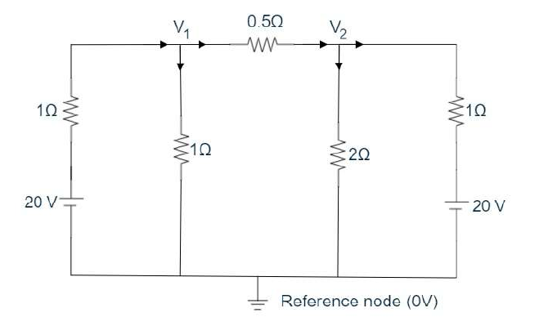
Nodal analysis
U1
Choose a reference node (0 V); label the others V1, V2, …
Apply KCL at each of the N − 1 remaining nodes, writing branch currents in terms of node voltages.
Solve the equations for the node voltages.
Node 1: 4V1 − 2V2 = 20 Node 2: 2V1 − 3.5V2 = −20 → V1 = 11 V, V2 = 12 V
Notes:
Nodal analysis is the dual of mesh analysis and uses Kirchhoff's current law. Pick a reference node as zero volts, label the other nodes, and write K C L at each one. In the example, node one gives four V one minus two V two equals twenty, and node two gives two V one minus three point five V two equals minus twenty. Solving, V one is eleven volts and V two is twelve volts. A network with N nodes needs only N minus one equations, so nodal analysis is attractive when there are fewer nodes than meshes.

Slide 6
Energy and power
U1
P = V I
P = I² R
P = V² / R
Definitions
Worked examples
Power: rate of doing work, 1 W = 1 J/s
Energy: capacity to do work, unit joule (J)
Electrical energy is billed in watt-hours: 1 Wh = 3600 J
24 V motor drawing 33.5 A: P = 24 × 33.5 = 804 W
60 W bulb for 365 days: E = 60 × 365 × 24 = 525 600 Wh = 525.6 kWh
Notes:
Power is the rate of doing work, measured in watts, where one watt is one joule per second. Substituting Ohm's law into P equals V I gives the other two forms, I squared R and V squared over R. Energy is power multiplied by time. Electrical energy is measured in watt hours, and one watt hour equals three thousand six hundred joules. Example: a twenty four volt D C motor drawing thirty three point five amps takes eight hundred and four watts. A sixty watt bulb burning for a whole year consumes five hundred twenty five point six kilowatt hours.

Slide 7
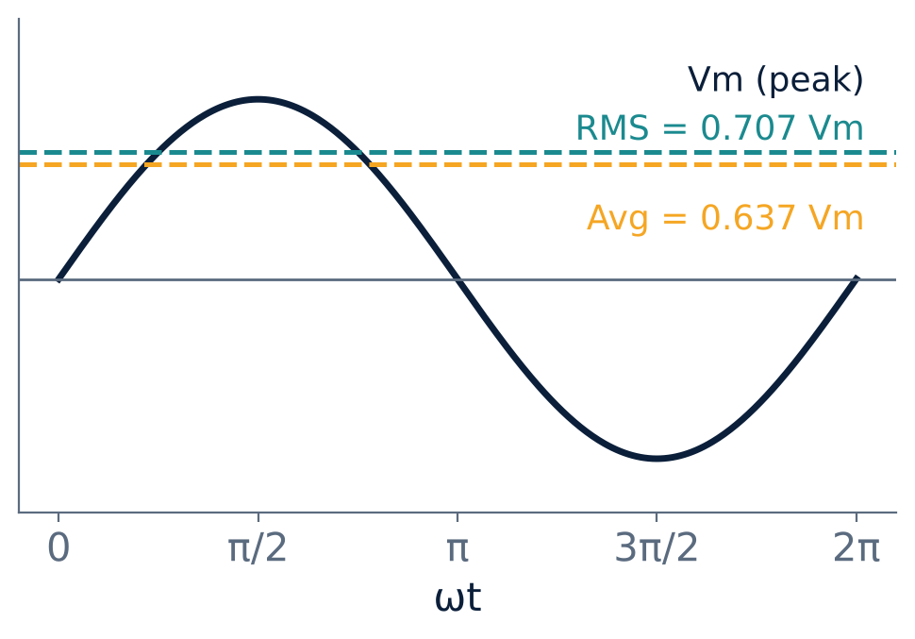
Generating a sinusoidal voltage
U1
Source: a coil rotating at uniform speed in a uniform magnetic field; EMF is induced by flux cutting.
Result: e = Em sin ωt, with ω = 2πf rad/s.
Cycle / period T: one full repetition and its duration; f = 1/T (Hz).
Peak, peak-to-peak: Vm, and 2Vm for a sine.
Phase: angular shift between two waves of the same frequency.
Instantaneous value: lower-case v, i, e
Notes:
An alternating voltage is generated by rotating a coil in a magnetic field. As the sides of the coil cut the flux, an E M F is induced that varies as the sine of the angle: e equals E m sine omega t, where omega equals two pi f. A few terms you must know: a cycle is one complete repetition, the time period T is its duration, and frequency f is one over T in hertz. The peak value is the maximum, peak to peak is twice that for a sine wave, and two waves of the same frequency that cross zero at different instants have a phase difference.

Slide 8
Average, RMS, form and peak factor
U1
0.637 Vm
0.707 Vm
1.11
1.414
Average
RMS
Form factor
Peak factor
2Vm/π, half cycle
Vm/√2
RMS / average
peak / RMS
Average: equal D C that transfers the same charge; over a full sine cycle it is zero, so take half a cycle.
RMS (effective): the D C value that produces the same heating in a resistor; mean of i²R over a cycle gives Im/√2.
Example: an RMS current of 10 A has peak 10/0.707 = 14.14 A.
Notes:
Two ways of describing the size of an alternating quantity. The average value is the D C that moves the same charge. Over a full sine cycle it is zero, so we average over a half cycle and get two I m over pi, which is zero point six three seven times the peak. The R M S value is the D C that gives the same heating effect. Integrating i squared R over a half cycle gives I m over root two, zero point seven zero seven times the peak. The ratio of R M S to average is the form factor, one point one one, and the ratio of peak to R M S is the peak factor, one point four one four. For instance, a ten amp R M S current has a peak of fourteen point one four amps.

Slide 9
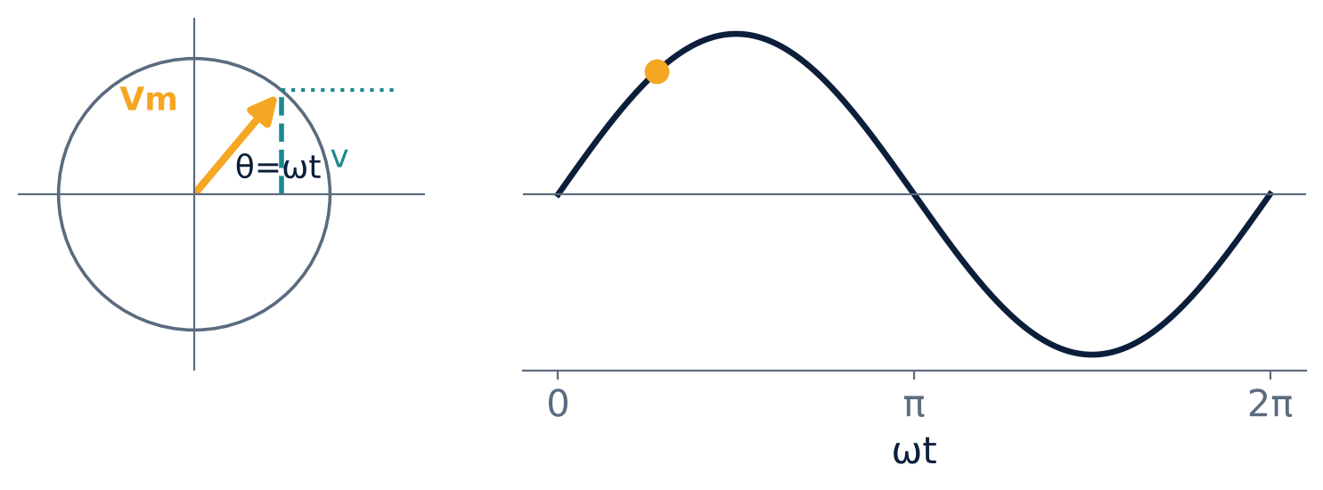
Phasor representation
U1
Check
v = 141.4 sin 377t
→ Vm = 141.4 V
→ f = 377 / 2π = 60 Hz
A phasor is a line of length Vm rotating anticlockwise at ω = 2πf.
Its vertical projection is the instantaneous value: v = Vm sin ωt.
One revolution = 2π radians = one cycle of the wave.
Same-frequency quantities are added as vectors, using RMS lengths.
Notes:
A phasor is a convenient way to picture a sine wave. Imagine a line of length V m rotating anticlockwise with angular velocity omega. Its projection on the vertical axis at any instant is the instantaneous value, V m sine omega t. One full revolution is one cycle. Phasors of the same frequency can be added like vectors, which is exactly how we analyse series circuits. For example, from v equals one hundred forty one point four sine three seventy seven t, we read the peak as one hundred forty one point four volts and the frequency as three seventy seven over two pi, which is sixty hertz.

Slide 10
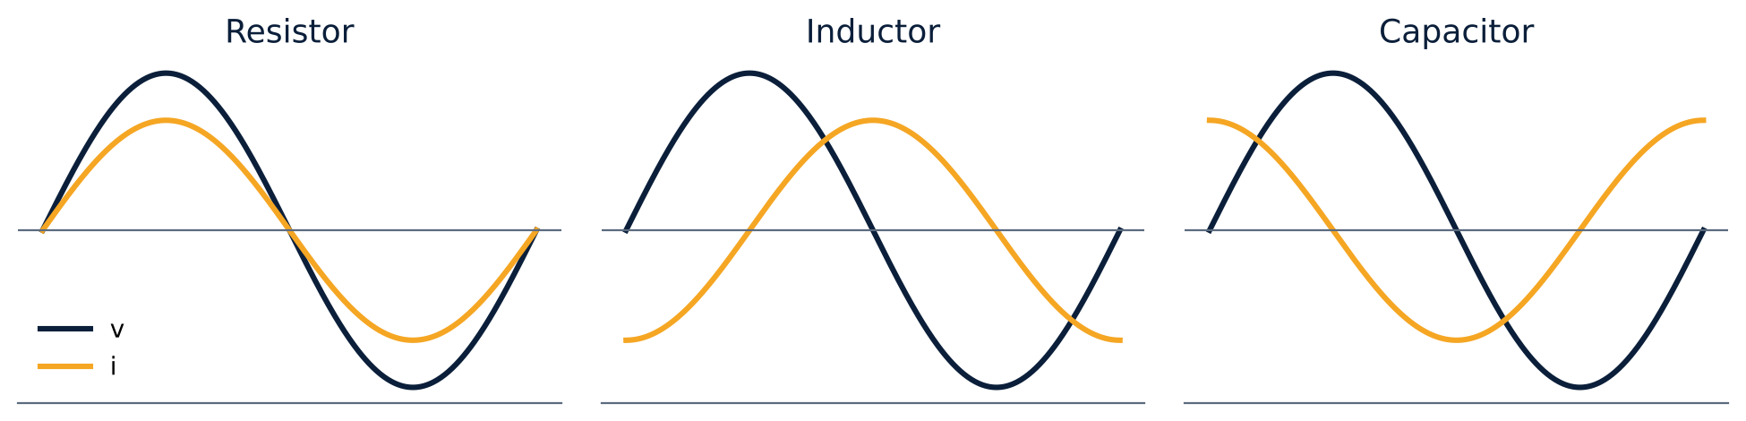
Pure R, pure L and pure C
U1
Resistor
Inductor
Capacitor
i in phase with v
P = V I
XL = 2πfL, i lags by 90°
P = 0 (stores magnetic energy)
XC = 1/(2πfC), i leads by 90°
P = 0 (stores electric energy)
Notes:
Now the three basic elements in an A C circuit. In a pure resistor the current is in phase with the voltage and the average power is V times I. In a pure inductor the current lags the voltage by ninety degrees; the opposition is the inductive reactance X L equals two pi f L, and the average power is zero, because energy is just stored in the magnetic field and returned. In a pure capacitor the current leads the voltage by ninety degrees; the capacitive reactance X C is one over two pi f C, and again the average power is zero. A handy memory aid: in an inductor the current lags, in a capacitor the current leads.

Slide 11
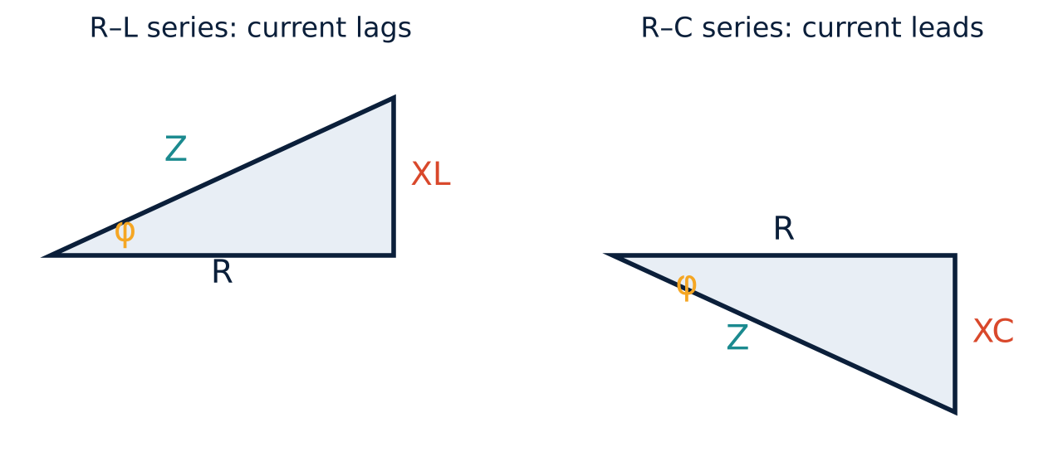
Series R-L, R-C and R-L-C circuits
U1
Impedance: Z = √(R² + X²), V = I Z.
Angle: φ = tan⁻¹(X/R); R-L: current lags, R-C: current leads.
R-L-C: Z = √(R² + (XL − XC)²); if XL = XC the circuit is purely resistive (resonance).
Phasor sum
Remember
VR = I R in phase with I
VL = I XL leads by 90°
VC = I XC lags by 90°
Take the current as the reference phasor in a series circuit. Voltages add as phasors, never arithmetically.
Notes:
In a series circuit the same current flows through every element, so we take the current as the reference phasor. The resistor voltage is in phase with it, the inductor voltage leads by ninety degrees and the capacitor voltage lags by ninety degrees. The supply voltage is the phasor sum, giving V equals I Z, where the impedance Z is the square root of R squared plus X squared. For R L, the current lags by angle phi; for R C, it leads. For the full R L C circuit, X is X L minus X C, and when they are equal the circuit behaves as a pure resistance, which is resonance.

Slide 12
Power and power factor
U1
P = VI cos φ
Q = VI sin φ
S = VI
Active power
Reactive power
Apparent power
watts (W)
VAR
VA
Power factor cos φ = R/Z = P/S; it lies between 0 and 1 (lagging for R-L, leading for R-C).
Why it matters: for the same real power, a low power factor means a larger current, more I²R loss and a larger supply rating.
Notes:
In an R L or R C circuit the instantaneous power has a constant part and a part that oscillates at twice the supply frequency with zero average. The useful, active power is V I cos phi, in watts. The power that shuttles to and fro in the reactive elements is V I sine phi, measured in V A R, and the product V I is the apparent power in volt amperes. The ratio of active to apparent power, cos phi, is the power factor. A low power factor forces the source to carry more current for the same useful power, which increases losses, so utilities prefer a power factor close to one.

Slide 13
Unit 1 numericals
U1
Resistor
Inductor
Capacitor
20 Ω across 230 V, 50 Hz
I = 230/20 = 11.5 A
P = 230 × 11.5 = 2645 W
Vm = 325.27 V, Im = 16.26 A
v = 325.27 sin 314t
i = 16.26 sin 314t
20 A from 230 V, 50 Hz
XL = 230/20 = 11.5 Ω
L = 11.5/(2π·50) = 0.036 H
P = 0
i = 28.28 sin(314t − π/2)
400 µF on 230 V, 50 Hz
XC = 1/(2π·50·400µ) = 7.95 Ω
I = 230/7.95 = 28.93 A
Im = 40.91 A
i = 40.91 sin(314t + π/2)
Notes:
Three quick numericals from your notes. First, a twenty ohm resistor on two thirty volts, fifty hertz: the current is eleven point five amps, the power two thousand six hundred forty five watts, and the current is in phase with voltage. Second, a pure inductor taking twenty amps from the same supply: the reactance is eleven point five ohms, the inductance zero point zero three six henry, the power is zero, and the current lags by ninety degrees. Third, a four hundred microfarad capacitor: the reactance is seven point nine five ohms, the current twenty eight point nine three amps R M S, and it leads the voltage by ninety degrees. Notice how we convert to peak values by multiplying with root two.

Slide 14
UNIT 2
Transformers and Electrical Machines
Single-phase transformer: construction, EMF, losses, efficiency
DC motor: back EMF, torque, types, speed control
Three-phase induction motor: rotating field and slip
Notes:
Unit two is about transformers and electrical machines. We study the single phase transformer, then D C motors, and finally the three phase induction motor, which is the workhorse of industry.

Slide 15
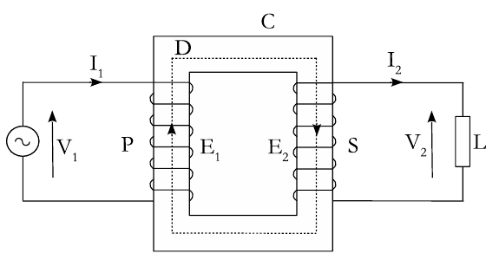
Single-phase transformer
U2
Static device that steps voltage up or down at the same frequency, using mutual induction.
Core: laminated silicon steel (0.35–0.7 mm) cuts eddy-current and hysteresis loss.
Types: core type and shell type; P connected to supply, S to load.
Ideal ratios: V2/V1 = N2/N1 = I1/I2.
Why use it? Power ∝ V I but loss ∝ I². Step the voltage up for transmission, current falls, losses fall.
Notes:
A transformer is a static device that receives power at one voltage and delivers it at another, at the same frequency. An alternating voltage on the primary creates an alternating flux in the laminated silicon steel core, which links the secondary and induces an E M F there by mutual induction. In an ideal transformer, V two over V one equals N two over N one, and I one over I two is the same ratio inverted, so the volt amperes balance. We need transformers because power is voltage times current while line loss goes as current squared. Raising the voltage for transmission cuts the current and the loss. The core can be core type, with windings around the limbs, or shell type, with the core surrounding the windings.

Slide 16
EMF equation, losses and efficiency
U2
E1 = 4.44 f φm N1
Losses
Core (iron) loss Pi = hysteresis + eddy current; practically constant
Copper loss Pc = I1²R1 + I2²R2; varies with load
E2 = 4.44 f φm N2
Average EMF per turn = 4 f φm (flux changes 2φm in 1/2f s); RMS = 1.11 × average.
η = Output / (Output + Pi + Pc)
Efficiency is typically 95–99 % for power transformers.
Notes:
To get the E M F equation, let the flux peak at phi m. The flux changes from plus phi m to minus phi m in half a cycle, one over two f seconds, so the average rate of change is four f phi m, and the average E M F per turn is four f phi m volts. Multiplying by the form factor one point one one gives R M S per turn, so E one equals four point four four f phi m N one, and E two equals four point four four f phi m N two. Losses are of two kinds: core loss, from hysteresis and eddy currents, which stays nearly constant, and copper loss, I squared R in the windings, which varies with load. Efficiency is output divided by output plus the losses.

Slide 17
Transformer numerical
U2
25 kVA, 50 Hz, 2000/200 V, iron loss 350 W, copper loss 400 W, φm = 0.045 Wb. Find the turns and the full-load efficiency at 0.8 pf lagging.
Step 1: N2
Step 2: N1
Step 3: η
N2 = E2 / (4.44 f φm)
= 200 / (4.44 × 50 × 0.045)
= 20.02 ≈ 20 turns
N1 = (E1/E2) × N2
= (2000/200) × 20
= 200 turns
Output = 25 × 0.8 = 20 kW
Pc = 0.4 kW, Pi = 0.35 kW
η = 20 / 20.75
= 96.38 %
Notes:
Let us solve this twenty five kilovolt ampere transformer. Using the E M F equation on the low voltage side, N two equals two hundred over four point four four times fifty times zero point zero four five, which is twenty turns. The primary turns follow from the voltage ratio, two thousand over two hundred times twenty, giving two hundred turns. For efficiency at full load and zero point eight power factor, the output is twenty five times zero point eight, twenty kilowatts. Adding copper loss zero point four and iron loss zero point three five kilowatts, the efficiency is twenty over twenty point seven five, ninety six point three eight percent.

Slide 18
DC motor: principle and back EMF
U2
Current
flows in armature conductors
Force
Fleming's left-hand rule
Torque
armature rotates
Back EMF
Eb opposes applied V
Eb = Z N φ P / 60 A
V = Eb + Ia Ra
Eb is always less than V; the difference drives armature current: Ia = (V − Eb) / Ra.
Multiply by Ia: V Ia = Eb Ia + Ia² Ra: input power = mechanical power developed + armature copper loss.
Notes:
A D C motor converts electrical energy into mechanical energy. When a current carrying conductor sits in a magnetic field, it experiences a force, with direction given by Fleming's left hand rule. The forces on the two sides of an armature coil give a turning moment. As the armature turns, its conductors cut flux and induce a back E M F, E b, which by Lenz's law opposes the applied voltage. So V equals E b plus I a R a. Multiplying by I a, input power equals E b I a, the mechanical power developed, plus I a squared R a, the armature copper loss. Back E M F is what automatically regulates the current drawn by a motor.

Slide 19
Torque and types of DC motors
U2
Ta = 0.159 φ Z Ia (P/A) N·m
Tsh = (Eb Ia − Pi) / (2πN/60)
Armature torque is the gross torque; shaft torque is what is left after iron and friction losses.
Shunt
Series
Compound
Field in parallel with armature.
Ia = IL − Ish
Eb = V − Ia Ra
Field in series; same current.
Eb = V − Ia(Ra + Rse)
Both fields; long or short shunt.
Cumulative: fluxes add
Differential: fluxes oppose
Notes:
The torque developed by the armature is T a equals zero point one five nine times phi Z I a times P over A newton metres. Part of it is lost to iron and friction, so the useful shaft torque is E b I a minus the iron and friction loss, divided by two pi N over sixty. D C motors are classified by how the field is connected. In a shunt motor the field is in parallel with the armature, so armature current is line current minus field current. In a series motor the field carries the armature current. A compound motor has both; if the series flux aids the shunt flux it is cumulative, if it opposes, differential.

Slide 20
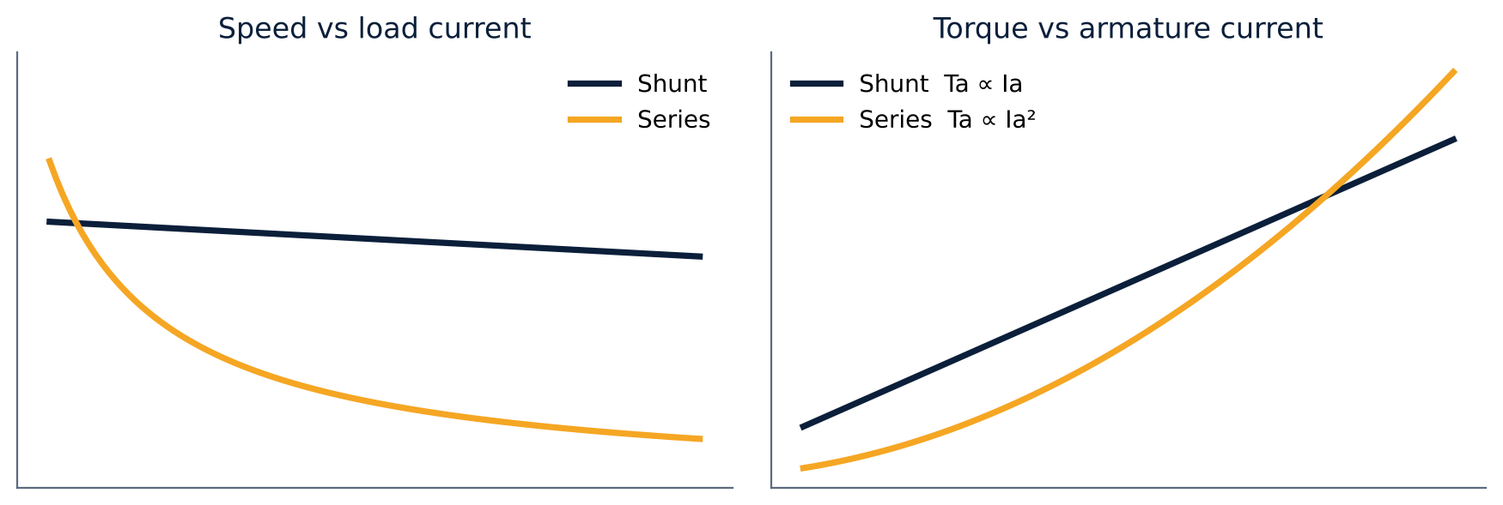
DC motor characteristics and uses
U2
Shunt: nearly constant speed; T ∝ Ia.
Series: T ∝ Ia², very high starting torque; speed ∝ 1/Ia, so never run it unloaded.
Motor | Behaviour | Applications
Shunt | Constant speed | Lathes, pumps, fans, machine tools
Series | High starting torque | Cranes, hoists, traction, conveyors
Cumulative compound | High torque, fairly steady speed | Punches, elevators, rolling mills
Differential compound | Wide speed variation | Variable-speed drives
Notes:
The shunt motor has an almost constant flux, so torque is proportional to armature current and speed falls only slightly with load; it is called a constant speed motor, used in lathes, pumps and fans. In the series motor, flux is proportional to the armature current, so torque goes as current squared, giving a very high starting torque, which suits cranes, hoists and traction. Its speed varies inversely with current, so at light load it can race dangerously high. Never start a series motor without a mechanical load. Cumulative compound motors give high torque with fairly steady speed, used in punches, elevators and rolling mills; differential compound motors suit wide speed variation.

Slide 21
DC motor numerical and speed control
U2
220 V shunt motor, 10 kW input
N = (V − Ia Ra) / (K φ)
Rsh = 230 Ω, Ra = 0.28 Ω
Input current I = 10 000/220 = 45.45 A
Field current Ish = 220/230 = 0.956 A
Armature current Ia = 44.49 A
Back EMF Eb = 220 − 44.49 × 0.28
= 207.54 V
Armature resistance control: extra series resistance lowers Ia, so speed falls (wasteful).
Field (flux) control: rheostat in the shunt field; weaker flux gives higher speed and the loss is small.
Notes:
A quick numerical. A two twenty volt shunt motor takes ten kilowatts. The input current is ten thousand over two twenty, forty five point four five amps. The field current is two twenty over two thirty, point nine five six amps, so the armature current is forty four point four nine amps. Back E M F is two twenty minus forty four point four nine times point two eight, two hundred seven point five four volts. For speed control, N is V minus I a R a over K phi. We can reduce speed by adding resistance in the armature circuit, which is wasteful, or increase speed by weakening the field with a rheostat in the shunt field, which is efficient because the field current is small.

Slide 22
Three-phase induction motor
U2
Stator
Squirrel-cage rotor
Slip-ring rotor
Stationary. Slotted silicon-steel laminations carrying a balanced three-phase winding (star or delta).
Bars short-circuited by end rings. Robust, low starting torque, no external resistance.
Three-phase wound, brought to slip rings and brushes; external resistance can be added.
About 50 % of electric power is used by induction motors: robust, self-starting, reliable and economical.
Notes:
The three phase induction motor is the most widely used A C motor, accounting for about half of all electric power consumption. It has two main parts separated by a small air gap. The stator carries a balanced three phase winding in slots of laminated silicon steel. The rotor is either a squirrel cage, with bars short circuited by end rings, which is rugged but has low starting torque, or a wound slip ring rotor, whose winding is brought out to slip rings so external resistance can be added.

Slide 23
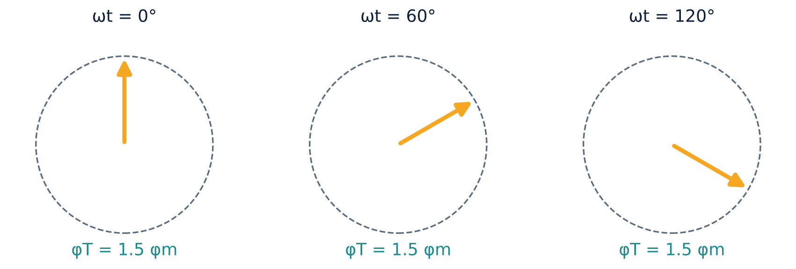
Rotating magnetic field and slip
U2
Example
4 poles, 50 Hz
Ns = 120 × 50 / 4 = 1500 rpm
At N = 1440 rpm, s = 4 %
Three fluxes 120° apart give a resultant of constant magnitude 1.5 φm that rotates at Ns = 120 f / P.
Rotor conductors cut this field, current flows, torque drags the rotor along.
Slip: s = (Ns − N)/Ns. The rotor cannot reach Ns, or no EMF would be induced.
Notes:
When three phase supply is applied to the stator, the three fluxes, displaced by one hundred twenty degrees in space and time, add up to a resultant of constant magnitude, one point five phi m, that rotates at synchronous speed, N s equals one twenty f over P. This rotating field cuts the rotor conductors and induces currents there; by Lenz's law the rotor is dragged in the direction of the field. The rotor can never quite reach synchronous speed, because then there would be no relative motion and no induced E M F. The fractional difference is the slip: s equals N s minus N over N s. For example, a four pole, fifty hertz machine has a synchronous speed of fifteen hundred r p m, and at fourteen forty r p m the slip is four percent.

Slide 24
UNIT 3
Diodes, Rectifiers and the Zener Regulator
PN junction diode: bias and V-I characteristics
Half-wave, full-wave and bridge rectifiers
Zener diode as a voltage regulator
Notes:
Unit three moves to electronics. We start with the PN junction diode, build rectifiers that convert A C to D C, and finish with the Zener diode, used for voltage regulation.

Slide 25


The PN junction diode
U3
P side: holes are majority carriers. N side: electrons.
Depletion region: at the junction, recombination leaves no free carriers and a barrier potential.
Function: conducts in one direction only, so it converts A C into D C.
Forward bias (P to +)
Barrier shrinks; carriers cross; current flows once V ≈ 0.7 V (Si).
Reverse bias (P to −)
Depletion region widens; only a tiny leakage current flows.
Anode (P) → Cathode (N): like a one-way valve for current.
Notes:
A semiconductor diode is a P N junction: P type with holes as majority carriers, N type with electrons. At the junction a depletion region forms, with no free carriers and a barrier potential. When we forward bias it, with the positive terminal on the P side, the external voltage opposes the barrier, the depletion region narrows, and once the applied voltage exceeds about zero point seven volts for silicon, a large current flows from anode to cathode. In reverse bias the depletion region widens and only a tiny leakage current flows. So a diode acts like a one way valve for current.

Slide 26
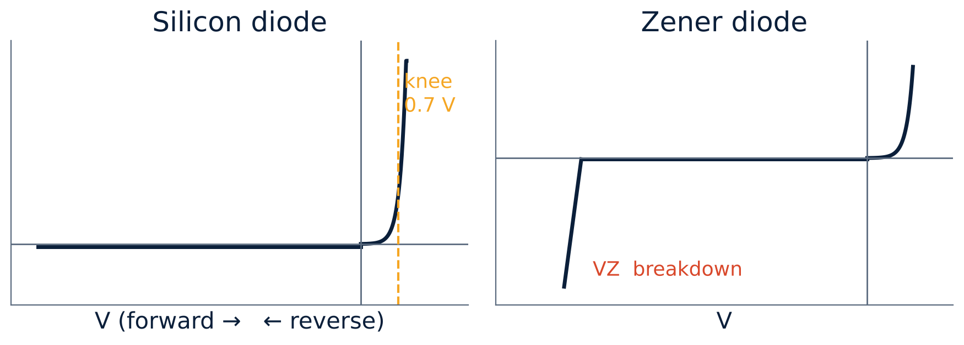
V-I characteristics and equivalent circuit
U3
I = Io (e^(V/VT) − 1)
Io: reverse saturation current
VT: thermal voltage (≈ 26 mV at room temp.)
Silicon diode: forward drop ≈ 0.7 V, high reverse breakdown, good temperature stability.
Equivalent circuit: forward current IF flows through the internal resistance rf; the applied voltage must overcome the knee voltage plus IF·rf.
Uses: rectification, switching, protection.
Notes:
The diode current equation relates current to voltage: I equals I zero times e to the V over V T, minus one, where I zero is the reverse saturation current and V T is the thermal voltage, about twenty six millivolts at room temperature. The characteristic is exponential in forward bias, with a knee near zero point seven volts for silicon, and almost flat in reverse bias until breakdown. For circuit analysis we replace the diode with an equivalent circuit: after the knee voltage is overcome, the forward current flows through a small internal resistance r f. The right hand plot shows the Zener characteristic, which we study shortly.

Slide 27
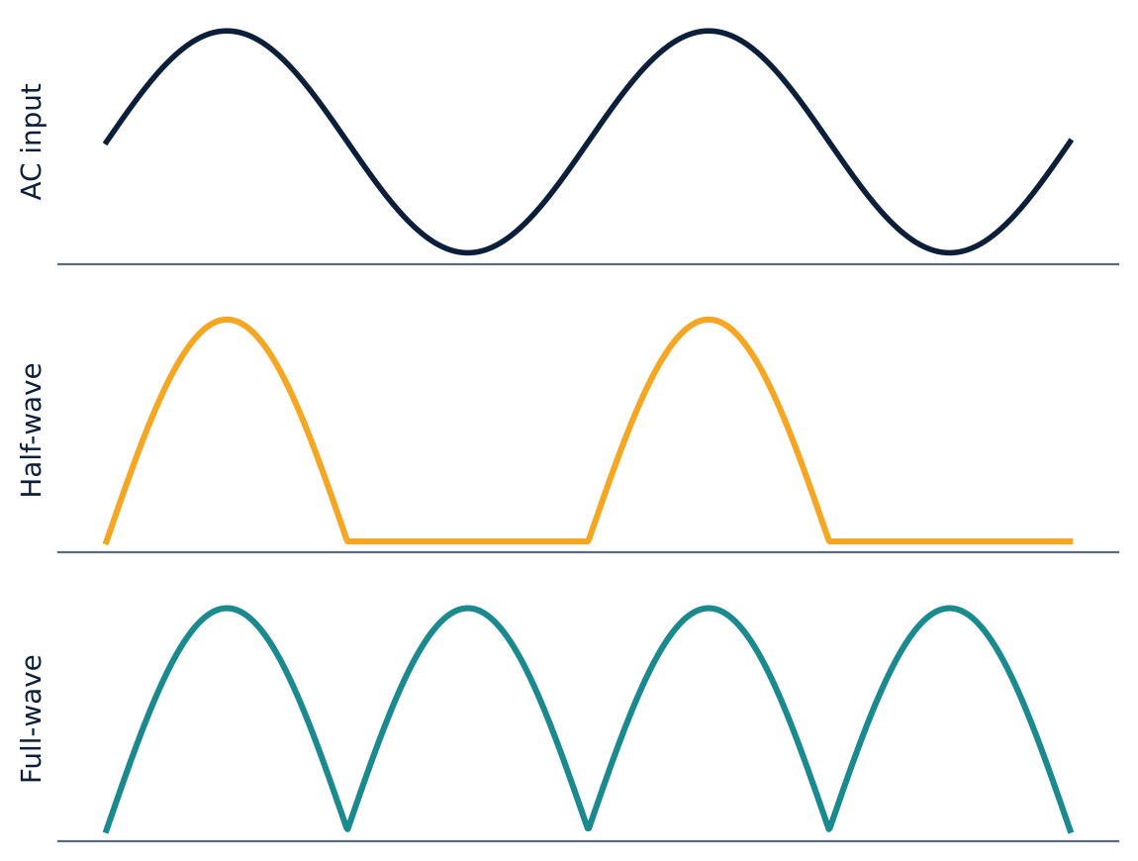
Rectifiers: HWR, FWR and bridge
U3
Half-wave
One diode passes one half-cycle: pulsating DC. Used in simple chargers, AM demodulation.
Full-wave (centre-tap)
Two diodes + centre-tapped transformer; each conducts on alternate half-cycles.
Bridge
Applications: power supplies, battery chargers, welding, renewable systems
Four diodes, two conduct per half-cycle, current through RL always in the same direction. No centre tap needed.
Notes:
A rectifier converts A C to D C. The half wave rectifier uses one diode and passes only one half of the input, giving pulsating D C. The full wave rectifier uses two diodes with a centre tapped transformer; during the positive half cycle one diode conducts, and during the negative half the other, so both half cycles reach the load in the same direction. The bridge rectifier uses four diodes and no centre tap; in each half cycle two diodes conduct, and the load current always flows from top to bottom. The waveforms on the right show the input, the half wave output and the full wave output.

Slide 28
Half-wave versus full-wave
U3
Parameter | Half-wave | Full-wave
DC (average) voltage | Vm / π | 2 Vm / π
DC (average) current | Im / π | 2 Im / π
RMS current | Im / 2 | Im / √2
Ripple factor | 1.21 | 0.482
Max. rectification efficiency | 40.6 % | 81.2 %
Output frequency | f | 2f
Ideal diodes, Im = Vm / (Rf + RL). Lower ripple means smoother DC.
Notes:
Comparing the two. For the half wave rectifier, the D C voltage is V m over pi, whereas for the full wave rectifier it is twice that. The R M S current is I m over two for half wave, and I m over root two for full wave. The ripple factor, a measure of how much A C is left in the output, is one point two one for half wave and zero point four eight two for full wave. The maximum rectification efficiency is forty point six percent against eighty one point two percent, and the full wave output ripples at twice the supply frequency, which makes filtering easier.

Slide 29
The Zener diode
U3
Heavily doped PN junction designed to operate in reverse breakdown.
Forward: behaves like an ordinary diode.
Reverse: blocks until VZ, then conducts heavily while the voltage stays almost constant.
Series resistor must limit the current to avoid overheating.
< 5 V
> 8 V
Zener effect
Avalanche
intense field pulls electrons from bonds
collisions multiply carriers
Applications
Voltage regulation, reference voltage, over-voltage protection, clipping circuits.
Notes:
A Zener diode is a heavily doped P N junction designed to work in the reverse breakdown region. In forward bias it behaves like a normal diode. In reverse bias it blocks until the reverse voltage reaches the Zener voltage V Z, then conducts heavily while the voltage across it stays almost constant. Two mechanisms cause this: the Zener effect, for breakdown below about five volts, where a very intense field pulls electrons out of covalent bonds, and avalanche breakdown above about eight volts, where accelerated carriers collide and multiply. A series resistor is always needed to limit the current. Applications include regulation, references and over voltage protection.

Slide 30
Zener diode as a voltage regulator
U3
Circuit: Zener reverse-connected across the load RL, with a series resistor Rs from the input VI. Choose VZ = VL.
Output Vo = VZ as long as the Zener stays in breakdown.
Line regulation: input varies, load fixed.
Load regulation: input fixed, load varies.
Example: 12 V → 5 V, Pz(max) = 2 W
Max Zener current
Iz(max) = Pz / Vz = 2 / 5 = 0.4 A
Minimum series resistor
Rs(min) = (12 − 5) / 0.4 = 17.5 Ω
Notes:
To regulate voltage, connect the Zener in reverse across the load, with a series resistor R s. Choose the Zener voltage equal to the load voltage. As long as the Zener remains in breakdown, the output stays at V Z. Line regulation means the output stays steady while the input varies; load regulation means it stays steady while the load resistance varies. Example from your notes: a five volt supply from a twelve volt source with a two watt Zener. The maximum Zener current is two over five, zero point four amps. The minimum series resistor is twelve minus five, over zero point four, seventeen point five ohms.

Slide 31
UNIT 4
BJT and MOSFET Applications
Bipolar junction transistor: construction, currents, gains
Configurations and the transistor as a switch
Enhancement MOSFET and the CMOS inverter
Notes:
Unit four covers transistors. First the bipolar junction transistor, with its currents, gains and use as a switch, and then the MOSFET and the CMOS inverter.

Slide 32
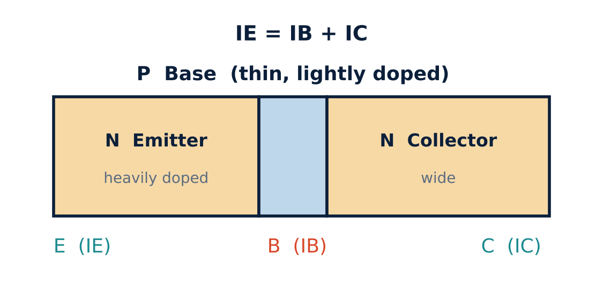
Bipolar junction transistor
U4
Three terminals: Emitter, Base, Collector; npn or pnp.
Emitter: heavily doped, emits carriers.
Base: thin, lightly doped, so little recombination.
Collector: widest region, collects carriers.
Active mode: emitter-base forward biased (VBE ≈ 0.7 V Si, 0.3 V Ge), collector-base reverse biased (VCC > VBB).
Notes:
The bipolar junction transistor has three differently doped regions and two P N junctions back to back, forming an N P N or P N P device. The emitter is heavily doped and emits carriers into the base. The base is thin and lightly doped, so few carriers recombine there. The collector is the widest region and collects the carriers. For normal amplifier action, the emitter base junction is forward biased, with V B E about zero point seven volts for silicon, and the collector base junction is reverse biased. Applications include amplification, oscillation and switching.

Slide 33
Transistor currents and gains
U4
IE = IB + IC
α = IC / IE
β = IC / IB
α is 0.95 to 0.99 (close to 1); β is typically 20 to 500.
Relation: β = α / (1 − α) and IE = (β + 1) IB.
Example: IB = 0.08 mA, IE = 9.60 mA
IC = IE − IB = 9.52 mA α = 9.52 / 9.60 = 0.9917 β = 9.52 / 0.08 = 119
Notes:
Applying Kirchhoff's current law to the transistor, the emitter current equals base current plus collector current. The ratio of collector current to emitter current is alpha, the common base current gain, between zero point nine five and zero point nine nine. The ratio of collector current to base current is beta, the common emitter current gain, typically twenty to five hundred, and beta equals alpha over one minus alpha. Example: base current zero point zero eight milliamp, emitter current nine point six milliamp. Collector current is nine point five two milliamps, alpha is zero point nine nine one seven, and beta is one hundred nineteen.

Slide 34
Configurations and the transistor switch
U4
Common base
Common emitter
Common collector
Voltage gain, no current gain
Both current and voltage gain
Current gain, no voltage gain
OFF: cut-off
ON: saturation
VBB = 0, IB = 0, IC = 0. Open switch. Operating point in cut-off.
VBB > 0, IB flows. Both junctions forward biased. Closed switch. Example: a 2 s square wave blinks an LED, 1 s on, 1 s off.
Notes:
A transistor can be connected in three ways, with one terminal common to input and output. The common base configuration has voltage gain but no current gain; common emitter has both current and voltage gain; and common collector has current gain but no voltage gain. As a switch, the transistor is driven between cut off and saturation. With V B B equal to zero there is no base current, the collector current is zero, and the transistor is off, like an open switch. With a positive base voltage, base current flows, the transistor saturates and acts like a closed switch. A square wave at the input can therefore blink an L E D, on for one second and off for one second.

Slide 35
Enhancement-type MOSFET
U4
Structure: p-type substrate, two n+ regions (source, drain); gate insulated by a thin SiO2 layer, so no gate current. Four terminals: G, D, S, SS.
1. VGS < VT
2. VGS > VT
3. VDS rises
No channel exists, so ID = 0 mA.
Electrons gather under the SiO2 and form an n-channel; ID rises with VGS.
Channel pinches off near the drain, ID saturates; VDS(sat) = VGS − VT.
Notes:
The enhancement mode M O S F E T is built on a p type substrate with two heavily doped n regions, the source and the drain. The gate is a metal contact separated from the channel by a thin silicon dioxide layer, so there is no direct electrical connection to the channel. With V G S below the threshold voltage there is no channel and the drain current is zero. When V G S exceeds the threshold, electrons are attracted under the oxide and form an n channel, and the drain current rises with V G S. As V D S increases the channel pinches off at the drain end and the current saturates, with V D S saturation equal to V G S minus V T.

Slide 36
CMOS inverter
U4
PMOS and NMOS share a common gate (Vin) and common drain (Vout).
Vin = 5 V → Vout = 0 V
Vin = 0 V → Vout = 5 V
Logic 1 in, logic 0 out
Logic 0 in, logic 1 out
NMOS ON (VGS = 5 V), PMOS OFF (VGS = 0 V)
PMOS ON (VGS = −5 V), NMOS OFF (VGS = 0 V)
The circuit inverts the logic level: a CMOS NOT gate, the building block of digital ICs.
Notes:
A very effective logic circuit is made by putting a p channel and an n channel enhancement M O S F E T on the same substrate. Their gates are tied together as the input, and their drains are tied together as the output. When the input is five volts, logic one, the N M O S has V G S of five volts and conducts, while the P M O S has zero V G S and is off, so the output is pulled to zero volts, logic zero. When the input is zero volts, the P M O S has minus five volts V G S and conducts, the N M O S is off, and the output is five volts. So the circuit is an inverter, a C M O S NOT gate.

Slide 37
UNIT 5
Operational Amplifiers
Ideal and practical op-amps
Modes of operation, CMRR, virtual ground
Inverting, non-inverting and summing amplifiers
Integrator and differentiator
Notes:
Unit five is operational amplifiers, the most versatile building block in analog electronics. We study the ideal op amp, its characteristics, and the important circuits built with feedback.

Slide 38
Ideal versus practical op-amp
U5
Two inputs, one output, powered from +VCC and −VEE. Output vo = A (v2 − v1).
Negative feedback makes circuit behaviour depend only on the external resistors.
Parameter | Ideal | Practical (e.g. 741)
Open-loop gain | Infinite | 10^5 – 10^6
Input impedance | Infinite | 10^6 – 10^12 Ω
Output impedance | Zero | 10 – 100 Ω
Bandwidth | Infinite | ≈ 1 MHz (unity gain)
Slew rate | Infinite | ≈ 0.5 V/µs
CMRR | Infinite | 70 – 120 dB
Notes:
An operational amplifier is a high gain differential amplifier with two inputs and one output, powered from a positive and a negative supply. The output is A times the difference of the two inputs. Its popularity comes from negative feedback: the closed loop behaviour is set by external resistors, not by the transistors inside. An ideal op amp has infinite open loop gain, infinite input impedance, zero output impedance, infinite bandwidth, slew rate and C M R R. A practical device such as the seven forty one has a gain of ten to the five or six, input impedance of megohms to teraohms, output impedance of tens of ohms, about one megahertz bandwidth and a slew rate near half a volt per microsecond.

Slide 39
Modes, CMRR and virtual ground
U5
Single-ended
Differential
Common mode
One input is zero: v1 = 0 or v2 = 0.
v1 = −v2. Output = Ad (V1 − V2).
v1 = v2 = VCM. Ideally the output is zero.
CMRR = Ad / Acm
Virtual ground
Vi = Vo / A is tiny (e.g. 5 V / 5000 = 1 mV), so the inverting input sits at ≈ 0 V, a virtual short, but no current flows into it.
CMRR(dB) = 20 log10(Ad / Acm). High CMRR rejects noise common to both inputs.
Notes:
An op amp can be operated in three modes. In single ended mode one input is grounded. In differential mode the two inputs are equal and opposite, and the output is the differential gain times the difference. In common mode the two inputs are identical and ideally the output is zero; in practice a small common mode gain remains. The common mode rejection ratio, differential gain divided by common mode gain, often quoted in decibels, tells us how well noise common to both inputs is rejected. The virtual ground idea follows from the huge gain: the input difference, output divided by gain, is only millivolts, so the two input terminals are at nearly the same potential, a virtual short, even though no current flows through it.

Slide 40
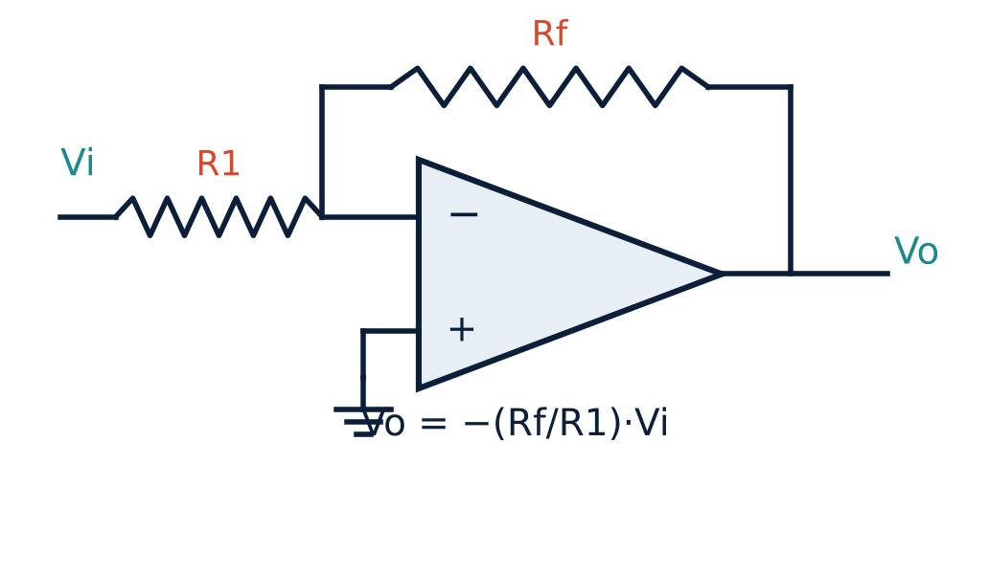
Inverting amplifier
U5
Virtual ground at the inverting input: i = Vi/R1 = −Vo/Rf.
Gain: ACL = −Rf/R1. The minus sign means a 180° phase shift.
Input resistance Rin = R1.
R1 = 20 kΩ, Rf = 100 kΩ, Vi = 1 V → Vo = −5 V, Rin = 20 kΩ, Iin = 0.05 mA
Notes:
In the inverting amplifier the signal goes to the inverting input through R one, the non inverting input is grounded, and R f feeds the output back. Because of the virtual ground, the current through R one is V i over R one, and since no current enters the op amp, the same current flows through R f, giving minus V o over R f. So the closed loop gain is minus R f over R one, depending only on the two resistors. The negative sign means the output is inverted. The input resistance is R one. Example: R one twenty kilohms, R f one hundred kilohms, one volt in gives minus five volts out, and the input current is zero point zero five milliamp.

Slide 41
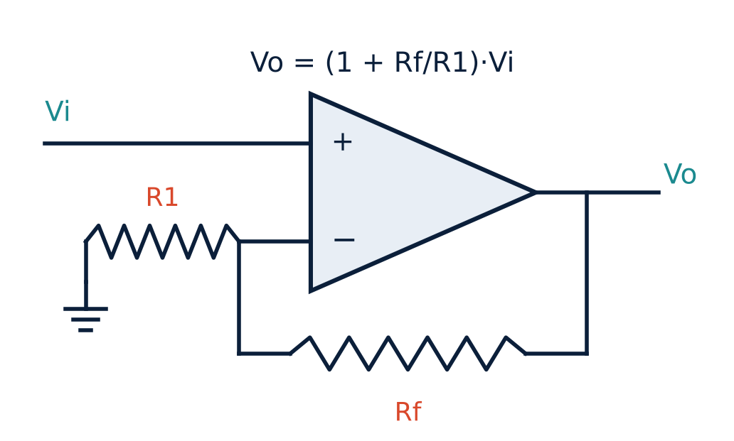
Non-inverting and summing amplifiers
U5
Summing amplifier
Inputs v1, v2, v3 enter the inverting node through R1, R2, R3, so if = i1 + i2 + i3.
vo = −[ (Rf/R1) v1 + (Rf/R2) v2 + (Rf/R3) v3 ]
If R1 = R2 = R3 = R and Rf = R/3, vo = −(v1 + v2 + v3)/3: an inverting averager.
Gain = 1 + Rf / R1
Output is in phase with the input.
Notes:
In the non inverting amplifier the input goes to the plus terminal and a divider R one and R f sets the feedback. Since the two inputs are at the same potential, the voltage across R one equals V i, and the gain is one plus R f over R one, always greater than or equal to one and with no phase inversion. The summing amplifier is an extension of the inverting amplifier: several inputs feed the same virtual ground through their own resistors, the currents add, and the output is minus the weighted sum of the inputs. With equal input resistors R and R f equal to R over three, the output is the negative of the average of the three inputs.

Slide 42
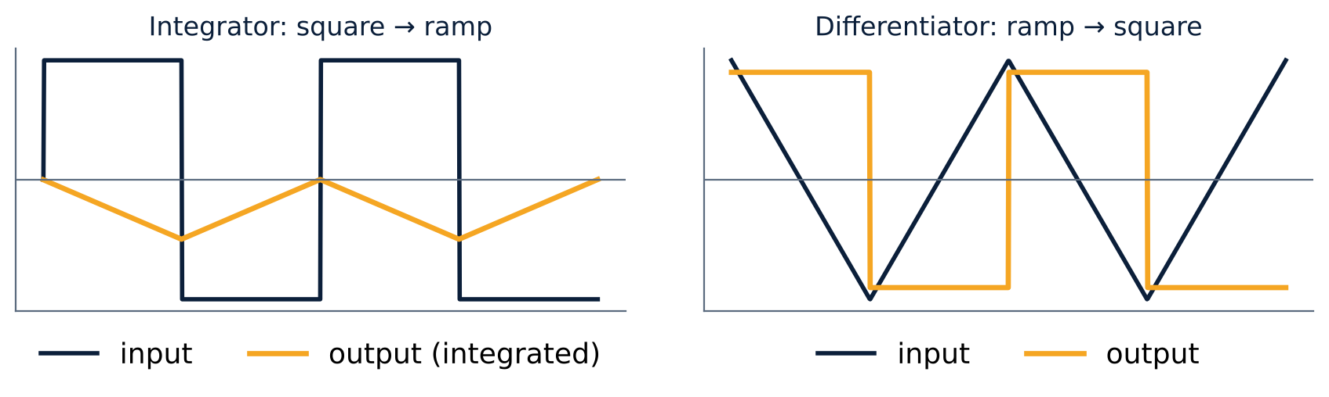
Integrator and differentiator
U5
vo = −(1/CR) ∫ vi dt
vo = −CR dvi/dt
Notes:
Replace the feedback resistor with a capacitor and we get an integrator. The input current v i over R charges the capacitor, and the output is minus one over C R times the integral of the input. A square wave input gives a triangular, ramp output. Swap the positions of the resistor and capacitor and we get a differentiator, whose output is minus C R times the derivative of the input. A ramp input gives a square wave. These two circuits are the basis of analog computers and filters.

Slide 43
Key results to remember
Unit 1
Vrms = 0.707 Vm, P = VI cos φ, Z = √(R² + X²)
Unit 2
E = 4.44 f φm N, V = Eb + Ia Ra, Ns = 120 f / P
Unit 3
Ripple: HWR 1.21, FWR 0.482; Zener Rs = (VI − VZ)/IZ
Unit 4
IE = IB + IC, β = α/(1 − α); CMOS inverts the input
Unit 5
Inverting −Rf/R1; non-inverting 1 + Rf/R1; virtual ground
Notes:
Let us quickly recap the key results. Unit one: the R M S value is zero point seven zero seven times the peak, active power is V I cos phi, and impedance is the square root of R squared plus X squared. Unit two: the transformer E M F is four point four four f phi m N, the motor voltage equation is V equals E b plus I a R a, and synchronous speed is one twenty f over P. Unit three: the ripple factor is one point two one for half wave and zero point four eight two for full wave, and the Zener regulator needs a series resistor. Unit four: I E equals I B plus I C, beta equals alpha over one minus alpha, and a C M O S pair inverts its input. Unit five: the inverting gain is minus R f over R one, the non inverting gain is one plus R f over R one, and the input terminals form a virtual ground.

Slide 44
Thank you
Practise the numericals in your unit notes, then attempt the exercise problems.
Dr. Mitesh Astik
Dept. of Electrical and Electronics Engineering, NMAMIT, Nitte
Notes:
That brings us to the end of this revision of Basic Electrical and Electronics Engineering. Revisit the numericals in your unit notes, and try the exercise problems on your own before checking the answers. Thank you for watching, and all the best for your studies.

