Slide 1

UNIT 1 · 9 hours
Average, RMS, Form and Peak Factor
Circuit Fundamentals
Basic Electrical and Electronics Engineering (EEE103)
Dr. Mitesh Astik · Dept. of Electrical and Electronics Engineering
NMAM Institute of Technology, Nitte · 2025-26
Notes:
Welcome. In this session we study "Average, RMS, Form and Peak Factor", part of Unit 1 (Circuit Fundamentals) of Basic Electrical and Electronics Engineering.

Slide 2
Learning objectives
U1
Derive average and RMS values of a sinusoid
Explain why RMS is the effective value
Calculate form factor and peak factor
Convert between peak, average and RMS
Syllabus context
Basic nodal and mesh analysis excited by independent DC voltage sources, Power and Energy. Generation of sinusoidal voltage, frequency, average value, RMS value, form factor and peak factor, phasor representation of alternating quantities.
Notes:
By the end of this topic you should be able to do the following. Derive average and RMS values of a sinusoid. Explain why RMS is the effective value. Calculate form factor and peak factor. Convert between peak, average and RMS.

Slide 3
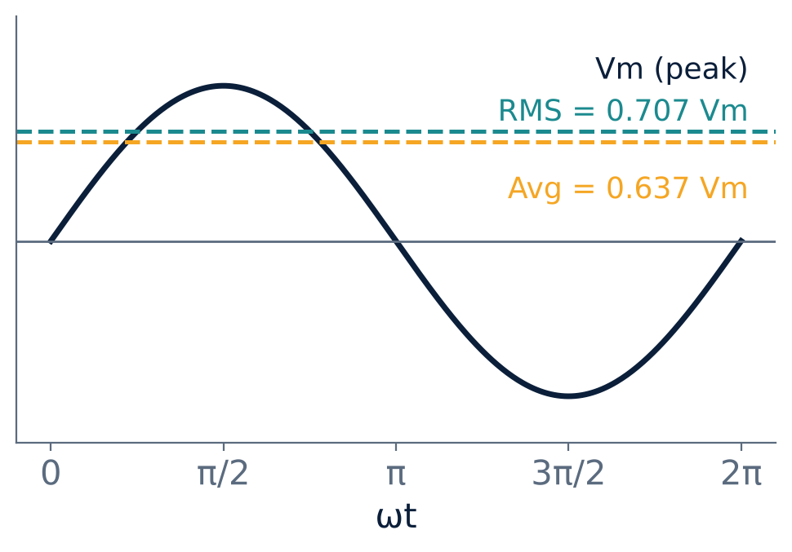
Average value
U1
Based on charge transferred (q = I × t).
Over a full sine cycle the average is zero.
So average is taken over a half cycle.
Iav = area / base = (1/π)∫ Im sin θ dθ
Iav = 2Im/π = 0.637 Im
Notes:
The average value of an alternating current is the steady DC that transfers the same charge in the same time.

Slide 4
Deriving the RMS value
U1
1
2
3
4
Heating
Square
Mean
Root
A current i through R produces heat i²R.
Square the instantaneous current: i² = Im² sin²θ.
Mean of i² over half cycle = (1/π)∫ Im² sin²θ dθ = Im²/2.
Take the square root to get the effective current.
I(rms) = Im / √2 = 0.707 Im and V(rms) = Vm / √2
Notes:
RMS stands for root mean square: root of the mean of the square. It is the DC value that gives the same heating effect.

Slide 5
Form factor and peak factor
U1
Kf = RMS / Average = 1.11
Kp = Peak / RMS = 1.414
for a sine wave
for a sine wave
Form factor indicates how peaked or flat the waveform is.
Peak factor matters for insulation and rating (peak voltage stress).
Moving-coil meters read average but are marked in RMS using Kf = 1.11.
Notes:
For a sine wave Kf equals pi over two root two, which is one point one one.

Slide 6
Summary of sinusoidal values
U1
Quantity | Formula | Value (Vm or Im = 1)
Average (half cycle) | 2 Vm / π | 0.637
RMS | Vm / √2 | 0.707
Form factor | RMS / Avg | 1.11
Peak factor | Peak / RMS | 1.414
Notes:
Memorise this table. It is used in all rectifier and AC problems.

Slide 7
Example 1: RMS to peak
U1
Problem A sinusoidal current has RMS value 10 A. Find its peak value and average value.
Im = I(rms) × √2 = 10 × 1.414 = 14.14 A
Average (half-cycle) = 0.637 × 14.14
Answer: Peak ±14.14 A, average 9.0 A
Notes:
Dividing 10 by zero point seven oh seven gives the same peak value.

Slide 8
Example 2: mains supply
U1
Problem 230 V RMS, 50 Hz mains. Find peak voltage and the voltage 2.5 ms after the zero crossing.
Vm = 230 × √2 = 325.27 V
ω = 2π × 50 = 314 rad/s; θ = 314 × 0.0025 = 0.785 rad = 45°
v = 325.27 sin 45°
Answer: Vm = 325.27 V; v = 230 V
Notes:
At forty five degrees the instantaneous value happens to equal the RMS value.

Slide 9
Key takeaways
U1
Average (half cycle) = 0.637 × peak
RMS = 0.707 × peak: effective heating value
Form factor 1.11 and peak factor 1.414 for a sine
AC ratings (230 V) are RMS values
Notes:
To summarise this topic. Average (half cycle) = 0.637 × peak. RMS = 0.707 × peak: effective heating value. Form factor 1.11 and peak factor 1.414 for a sine. AC ratings (230 V) are RMS values.

Slide 10
Practice questions
U1
Q1. Derive the RMS value of i = Im sin θ.
Q2. A voltage has RMS 110 V. Find its peak and average values.
Q3. A square wave of peak 10 V: what are its RMS and form factor?
Q4. Why is the average of a full sine cycle zero?
Notes:
Attempt these on your own, then check your working against your notes and textbook. Derive the RMS value of i = Im sin θ. A voltage has RMS 110 V. Find its peak and average values. A square wave of peak 10 V: what are its RMS and form factor? Why is the average of a full sine cycle zero?

