Slide 1

UNIT 1 · 9 hours
Phasor Representation of Alternating Quantities
Circuit Fundamentals
Basic Electrical and Electronics Engineering (EEE103)
Dr. Mitesh Astik · Dept. of Electrical and Electronics Engineering
NMAM Institute of Technology, Nitte · 2025-26
Notes:
Welcome. In this session we study "Phasor Representation of Alternating Quantities", part of Unit 1 (Circuit Fundamentals) of Basic Electrical and Electronics Engineering.

Slide 2
Learning objectives
U1
Represent a sinusoid as a rotating phasor
Define phase difference, lead and lag
Add sinusoids using phasors
Use the polar and rectangular forms
Syllabus context
Basic nodal and mesh analysis excited by independent DC voltage sources, Power and Energy. Generation of sinusoidal voltage, frequency, average value, RMS value, form factor and peak factor, phasor representation of alternating quantities.
Notes:
By the end of this topic you should be able to do the following. Represent a sinusoid as a rotating phasor. Define phase difference, lead and lag. Add sinusoids using phasors. Use the polar and rectangular forms.

Slide 3
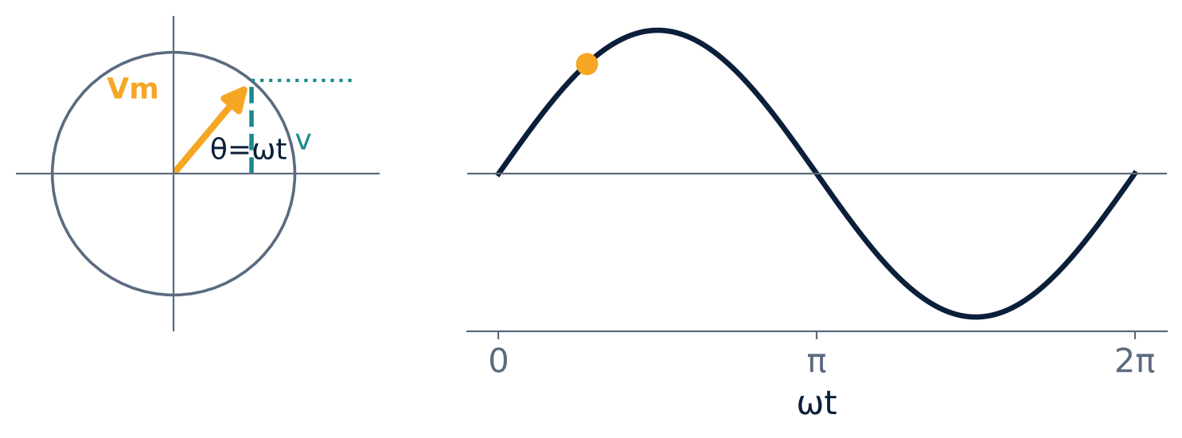
Rotating phasor and its projection
U1
Phasor OA of length Vm rotates anticlockwise at ω = 2πf.
Vertical projection = instantaneous value v = Vm sin ωt.
One revolution = 2π rad = one cycle.
All same-frequency phasors rotate together, so only their lengths and relative angles matter.
Notes:
Instead of drawing waves, we draw one arrow per quantity.

Slide 4
Phase difference
U1
In phase
Leading
Lagging
Two waves reach zero and peak together. Phase difference 0°.
Wave that reaches its peak earlier is leading, e.g. i = Im sin(ωt + φ) leads v.
Wave that reaches its peak later is lagging, e.g. i = Im sin(ωt − φ).
In phasor diagrams, anticlockwise from the reference is leading.
Notes:
Phase difference is the angle between phasors. Choose one quantity as reference at zero angle.

Slide 5
Forms of a phasor
U1
Form | Expression | Use
Polar | V∠θ | multiply / divide
Rectangular | a + jb | add / subtract
Conversion | a = V cos θ, b = V sin θ | V = √(a² + b²), θ = tan⁻¹(b/a)
Operator j | j = 90° rotation, j² = −1 | I∠90° = jI
Notes:
Use rectangular form for addition and polar form for multiplication or division.

Slide 6
Example: adding two voltages
U1
Problem v1 = 10 sin ωt and v2 = 5 sin(ωt + 90°). Find v1 + v2 (peak values).
Phasors: V1 = 10∠0° = 10 + j0, V2 = 5∠90° = 0 + j5
Sum = 10 + j5
|V| = √(10² + 5²) = 11.18, θ = tan⁻¹(5/10) = 26.57°
Answer: v = 11.18 sin(ωt + 26.57°)
Notes:
Adding sine waves of equal frequency gives another sine wave of the same frequency.

Slide 7
Why phasors are useful
U1
Reduce differential equations to algebra.
Voltages in a series circuit add as phasors, never arithmetically.
Phasor diagrams reveal lead/lag and power factor at a glance.
RMS values are normally used as phasor lengths.
Notes:
In a series R L circuit the voltages across R and L are ninety degrees apart, so the supply voltage is the phasor sum, not the sum of magnitudes.

Slide 8
Key takeaways
U1
A phasor rotates at ω; its vertical projection is the instantaneous value
Phase difference = angle between phasors
Add in rectangular, multiply in polar form
Series circuit voltages add as phasors
Notes:
To summarise this topic. A phasor rotates at ω; its vertical projection is the instantaneous value. Phase difference = angle between phasors. Add in rectangular, multiply in polar form. Series circuit voltages add as phasors.

Slide 9
Practice questions
U1
Q1. Express v = 100 sin(ωt − 30°) as a phasor in polar and rectangular form.
Q2. Add i1 = 4 sin ωt and i2 = 3 sin(ωt − 90°).
Q3. Which leads: v = sin(ωt + 20°) or i = sin(ωt − 40°)? By how much?
Q4. Why must all phasors in one diagram have the same frequency?
Notes:
Attempt these on your own, then check your working against your notes and textbook. Express v = 100 sin(ωt − 30°) as a phasor in polar and rectangular form. Add i1 = 4 sin ωt and i2 = 3 sin(ωt − 90°). Which leads: v = sin(ωt + 20°) or i = sin(ωt − 40°)? By how much? Why must all phasors in one diagram have the same frequency?

