Slide 1

UNIT 1 · 9 hours
Analysis of RL and RC Series Circuits
Circuit Fundamentals
Basic Electrical and Electronics Engineering (EEE103)
Dr. Mitesh Astik · Dept. of Electrical and Electronics Engineering
NMAM Institute of Technology, Nitte · 2025-26
Notes:
Welcome. In this session we study "Analysis of RL and RC Series Circuits", part of Unit 1 (Circuit Fundamentals) of Basic Electrical and Electronics Engineering.

Slide 2
Learning objectives
U1
Draw phasor and impedance diagrams for RL and RC series circuits
Compute impedance, current, phase angle and power
Decide whether current lags or leads
Solve numericals
Syllabus context
Analysis of R, L, C, RL, RC and RLC series circuits, real power, reactive power, apparent power and power factor.
Notes:
By the end of this topic you should be able to do the following. Draw phasor and impedance diagrams for RL and RC series circuits. Compute impedance, current, phase angle and power. Decide whether current lags or leads. Solve numericals.

Slide 3
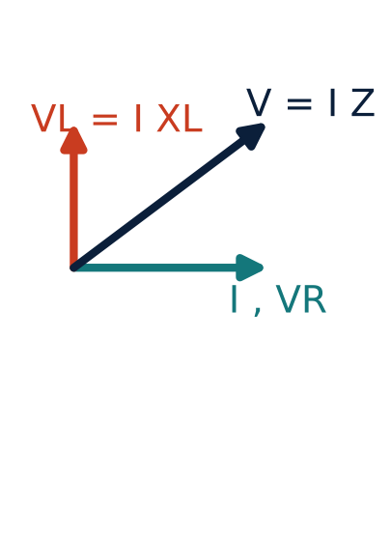
RL series circuit: impedance and phase
U1
Same current flows in R and L; use I as reference.
VR = IR in phase with I; VL = IXL leads by 90°.
V = √(VR² + VL²) = I Z
Z = √(R² + XL²), φ = tan⁻¹(XL/R)
Current lags the supply voltage by φ.
Notes:
Because voltage across the inductor leads the current by ninety degrees, the supply voltage leads the current. We say the circuit is inductive or lagging.

Slide 4
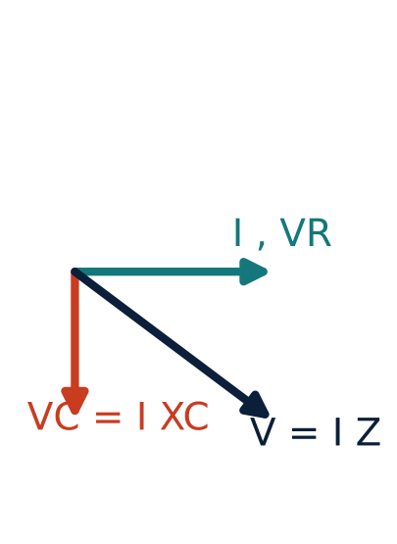
RC series circuit: impedance and phase
U1
VR = IR in phase with I; VC = IXC lags by 90°.
V = √(VR² + VC²) = I Z
Z = √(R² + XC²), φ = tan⁻¹(XC/R)
Current leads the supply voltage by φ.
Notes:
In the RC series circuit the supply voltage lags the current, a leading power factor.

Slide 5
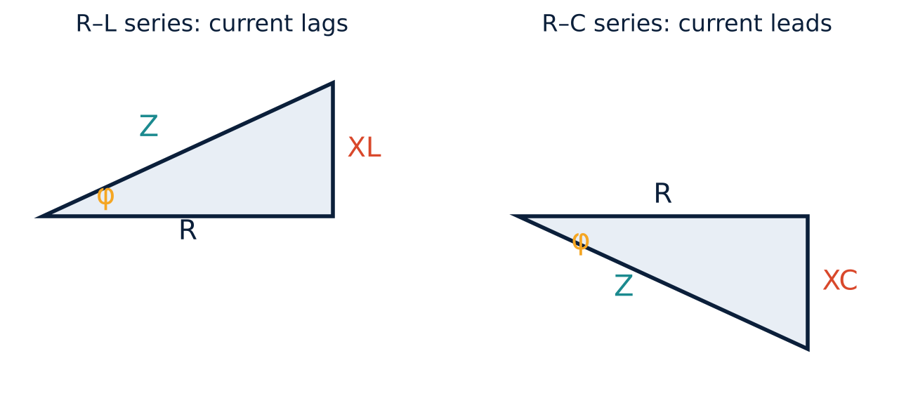
Impedance triangles
U1
Z is the phasor sum of R and X.
cos φ = R/Z = power factor.
tan φ = X/R.
Notes:
Divide the voltage triangle by the current and you get the impedance triangle.

Slide 6
Power in RL and RC circuits
U1
P = V I cos φ
P = I² R
active power (W)
only R dissipates
Instantaneous power p = ½VmIm cos φ − ½VmIm cos(2ωt − φ).
The second term averages to zero, so the average is VI cos φ.
Positive power lobes are larger than negative ones: net power is absorbed.
Notes:
Average power equals V I cos phi, which equals I squared R.

Slide 7
Numerical: RL series
U1
Problem R = 30 Ω and L = 0.1 H in series across 230 V, 50 Hz. Find Z, I, φ, power factor and P.
XL = 2π·50·0.1 = 31.42 Ω
Z = √(30² + 31.42²) = 43.44 Ω
I = 230/43.44 = 5.29 A; φ = tan⁻¹(31.42/30) = 46.3° (lagging)
cos φ = 30/43.44 = 0.69; P = I²R = 5.29² × 30
Answer: I = 5.29 A, pf = 0.69 lag, P = 840 W
Notes:
Power may also be computed as V I cos phi: two thirty times five point two nine times zero point six nine, about eight hundred forty watts.

Slide 8
Numerical: RC series
U1
Problem R = 50 Ω and C = 50 µF in series across 230 V, 50 Hz. Find Z, I and φ.
XC = 1/(2π·50·50×10⁻⁶) = 63.66 Ω
Z = √(50² + 63.66²) = 80.95 Ω
I = 230/80.95 = 2.84 A
φ = tan⁻¹(63.66/50) = 51.9° (current leads)
Answer: Z = 80.95 Ω, I = 2.84 A, φ = 51.9° leading
Notes:
Notice that the phase angle here is current leading the voltage.

Slide 9
Key takeaways
U1
Z = √(R² + X²), V = IZ
RL: current lags; RC: current leads
pf = cos φ = R/Z
Only the resistance dissipates power: P = I²R
Notes:
To summarise this topic. Z = √(R² + X²), V = IZ. RL: current lags; RC: current leads. pf = cos φ = R/Z. Only the resistance dissipates power: P = I²R.

Slide 10
Practice questions
U1
Q1. R = 10 Ω, L = 50 mH in series on 100 V, 50 Hz. Find I, φ, P.
Q2. R = 20 Ω, C = 100 µF on 230 V, 50 Hz. Find Z, I, pf.
Q3. A coil has R = 8 Ω, XL = 6 Ω. Find Z and pf.
Q4. Draw the phasor diagram for an RC circuit with I as reference.
Notes:
Attempt these on your own, then check your working against your notes and textbook. R = 10 Ω, L = 50 mH in series on 100 V, 50 Hz. Find I, φ, P. R = 20 Ω, C = 100 µF on 230 V, 50 Hz. Find Z, I, pf. A coil has R = 8 Ω, XL = 6 Ω. Find Z and pf. Draw the phasor diagram for an RC circuit with I as reference.

