Slide 1

UNIT 1 · 9 hours
Real, Reactive, Apparent Power and Power Factor
Circuit Fundamentals
Basic Electrical and Electronics Engineering (EEE103)
Dr. Mitesh Astik · Dept. of Electrical and Electronics Engineering
NMAM Institute of Technology, Nitte · 2025-26
Notes:
Welcome. In this session we study "Real, Reactive, Apparent Power and Power Factor", part of Unit 1 (Circuit Fundamentals) of Basic Electrical and Electronics Engineering.

Slide 2
Learning objectives
U1
Define P, Q and S and their units
Draw and use the power triangle
Define power factor, lagging and leading
Explain why a low power factor is undesirable
Syllabus context
Analysis of R, L, C, RL, RC and RLC series circuits, real power, reactive power, apparent power and power factor.
Notes:
By the end of this topic you should be able to do the following. Define P, Q and S and their units. Draw and use the power triangle. Define power factor, lagging and leading. Explain why a low power factor is undesirable.

Slide 3
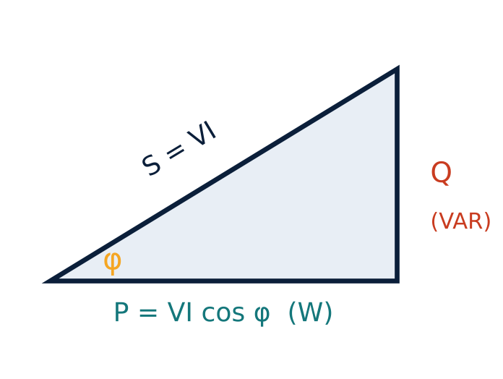
The power triangle
U1
Active (real) power P = VI cos φ (W)
Reactive power Q = VI sin φ (VAR)
Apparent power S = VI (VA)
S² = P² + Q²
Power factor cos φ = P/S
Notes:
Multiplying the impedance triangle by I squared gives the power triangle.

Slide 4
Meaning of each power
U1
Active power P
Reactive power Q
Apparent power S
Actual work done: heating, mechanical output. Measured by a wattmeter. Unit W or kW.
Power exchanged with L and C fields, no net work. Unit VAR. Q is positive for inductive loads.
Product of RMS V and I. Rating of equipment: transformers and cables are rated in kVA.
Notes:
Reactive power is needed to establish magnetic fields in motors and transformers but does no useful work.

Slide 5
Power factor
U1
Definition: cos φ = P/S = R/Z, where φ is the angle between V and I.
Lagging: inductive loads (motors, transformers); I lags V.
Leading: capacitive loads; I leads V.
Range: 0 to 1; unity for a pure resistor.
Low pf means the same real power needs a larger current.
Notes:
Power factor is dimensionless and always quoted as lagging or leading.

Slide 6
Why low power factor is bad
U1
Consequences
Improvement
Larger current for the same power: I = P/(V cos φ)
More I²R loss in cables and transformers
Larger kVA rating of generators and lines
Poor voltage regulation; utilities impose penalties
Connect capacitors in parallel with inductive loads
Use synchronous condensers
Avoid lightly loaded motors
Target pf ≥ 0.95
Notes:
A parallel capacitor supplies the reactive power locally so the line carries less current.

Slide 7
Numerical: power triangle
U1
Problem A load takes 5 A at 230 V with a power factor of 0.8 lagging. Find S, P and Q.
S = VI = 230 × 5 = 1150 VA
P = S cos φ = 1150 × 0.8 = 920 W
sin φ = √(1 − 0.8²) = 0.6; Q = S sin φ = 690 VAR
Answer: S = 1150 VA, P = 920 W, Q = 690 VAR
Notes:
Check using S squared equals P squared plus Q squared.

Slide 8
Numerical: effect of power factor
U1
Problem A 2 kW load on 230 V. Find the current at pf = 1 and at pf = 0.5.
I = P/(V cos φ)
pf = 1: I = 2000/230 = 8.70 A
pf = 0.5: I = 2000/(230 × 0.5) = 17.39 A
Answer: Current doubles at pf = 0.5, so loss rises 4×
Notes:
At half the power factor the current doubles, quadrupling I squared R loss.

Slide 9
Key takeaways
U1
P = VI cos φ (W), Q = VI sin φ (VAR), S = VI (VA)
S² = P² + Q²; pf = cos φ = P/S
Low pf increases current, losses and equipment rating
Capacitors in parallel improve a lagging pf
Notes:
To summarise this topic. P = VI cos φ (W), Q = VI sin φ (VAR), S = VI (VA). S² = P² + Q²; pf = cos φ = P/S. Low pf increases current, losses and equipment rating. Capacitors in parallel improve a lagging pf.

Slide 10
Practice questions
U1
Q1. A motor takes 10 A at 230 V, pf 0.7 lagging. Find P, Q and S.
Q2. Why are transformers rated in kVA and not kW?
Q3. Find the current of a 5 kW load at pf 0.8 on 230 V.
Q4. Draw the power triangle for a capacitive load.
Notes:
Attempt these on your own, then check your working against your notes and textbook. A motor takes 10 A at 230 V, pf 0.7 lagging. Find P, Q and S. Why are transformers rated in kVA and not kW? Find the current of a 5 kW load at pf 0.8 on 230 V. Draw the power triangle for a capacitive load.

