Slide 1

UNIT 2 · 9 hours
Types and Construction of Single-Phase Transformers
Transformers and Electrical Machines
Basic Electrical and Electronics Engineering (EEE103)
Dr. Mitesh Astik · Dept. of Electrical and Electronics Engineering
NMAM Institute of Technology, Nitte · 2025-26
Notes:
Welcome. In this session we study "Types and Construction of Single-Phase Transformers", part of Unit 2 (Transformers and Electrical Machines) of Basic Electrical and Electronics Engineering.

Slide 2
Learning objectives
U2
Name the main parts of a transformer
Distinguish core type from shell type
Explain the purpose of laminations and silicon steel
State common classifications of transformers
Syllabus context
Transformers: necessity of transformers, principle of operation, types and construction of single-phase transformers, EMF equation, losses and efficiency.
Notes:
By the end of this topic you should be able to do the following. Name the main parts of a transformer. Distinguish core type from shell type. Explain the purpose of laminations and silicon steel. State common classifications of transformers.

Slide 3
Main parts
U2
Core: stack of silicon-steel laminations (0.35–0.7 mm), each insulated, forms the magnetic path; limbs and yokes.
Windings: primary connected to supply, secondary to load; copper or aluminium, insulated.
Insulation: paper, varnish, press-board between turns and windings.
Tank and oil (large units): cooling and insulation. Bushings bring out terminals.
Notes:
The two main parts are the core and the windings.

Slide 4
Why laminate the core and use silicon steel?
U2
Eddy-current loss
Hysteresis loss
High permeability
Changing flux induces currents in the iron. Thin insulated laminations break their paths, reducing I²R loss.
Silicon steel has a narrow hysteresis loop (about 3–4 % Si), so less energy is lost per cycle.
Provides a low-reluctance path so little magnetising current is needed.
Notes:
Using a solid iron core would overheat because of eddy currents.

Slide 5
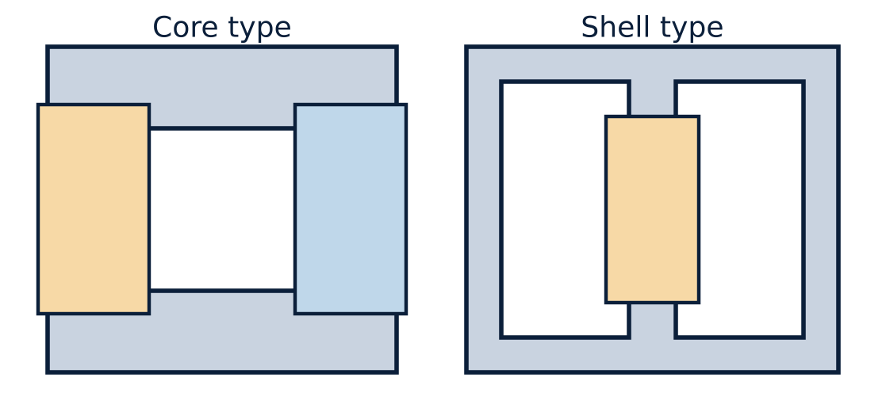
Core type and shell type
U2
Core type: windings surround the limbs; one magnetic path; half of each winding on each limb to cut leakage.
Shell type: windings on the central limb; core surrounds them; two parallel flux paths.
Notes:
Both constructions reduce leakage flux by placing primary and secondary close to each other.

Slide 6
Core type versus shell type
U2
Feature | Core type | Shell type
Magnetic circuit | Single path | Two parallel paths
Windings | On two limbs | On central limb
Leakage flux | Higher | Lower
Winding cooling / repair | Easy (exposed) | Harder (enclosed)
Typical use | High-voltage power transformers | Low-voltage, small and electronic
Notes:
Core type is the common choice for power transformers.

Slide 7
Classification of transformers
U2
By function: step-up and step-down.
By use: power, distribution, instrument (CT and PT), isolation, auto-transformer.
By cooling: dry (air) type and oil-immersed.
By phase: single-phase and three-phase.
Notes:
Auto-transformers use one common winding, saving copper, and are used for variacs and starters.

Slide 8
Key takeaways
U2
Core of insulated silicon-steel laminations reduces eddy and hysteresis loss
Core type: coils around limbs; shell type: core around coils
Primary is connected to the supply, secondary to the load
Large transformers are oil-cooled
Notes:
To summarise this topic. Core of insulated silicon-steel laminations reduces eddy and hysteresis loss. Core type: coils around limbs; shell type: core around coils. Primary is connected to the supply, secondary to the load. Large transformers are oil-cooled.

Slide 9
Practice questions
U2
Q1. Why is silicon steel used for the transformer core?
Q2. Compare core type and shell type transformers.
Q3. What is the thickness of a typical lamination and why?
Q4. Name three types of transformers by application.
Notes:
Attempt these on your own, then check your working against your notes and textbook. Why is silicon steel used for the transformer core? Compare core type and shell type transformers. What is the thickness of a typical lamination and why? Name three types of transformers by application.

