Slide 1

UNIT 2 · 9 hours
EMF Equation of a Transformer
Transformers and Electrical Machines
Basic Electrical and Electronics Engineering (EEE103)
Dr. Mitesh Astik · Dept. of Electrical and Electronics Engineering
NMAM Institute of Technology, Nitte · 2025-26
Notes:
Welcome. In this session we study "EMF Equation of a Transformer", part of Unit 2 (Transformers and Electrical Machines) of Basic Electrical and Electronics Engineering.

Slide 2
Learning objectives
U2
Derive the transformer EMF equation
Calculate turns and maximum flux
Find flux density from core area
Solve numericals on transformer EMF and ratio
Syllabus context
Transformers: necessity of transformers, principle of operation, types and construction of single-phase transformers, EMF equation, losses and efficiency.
Notes:
By the end of this topic you should be able to do the following. Derive the transformer EMF equation. Calculate turns and maximum flux. Find flux density from core area. Solve numericals on transformer EMF and ratio.

Slide 3
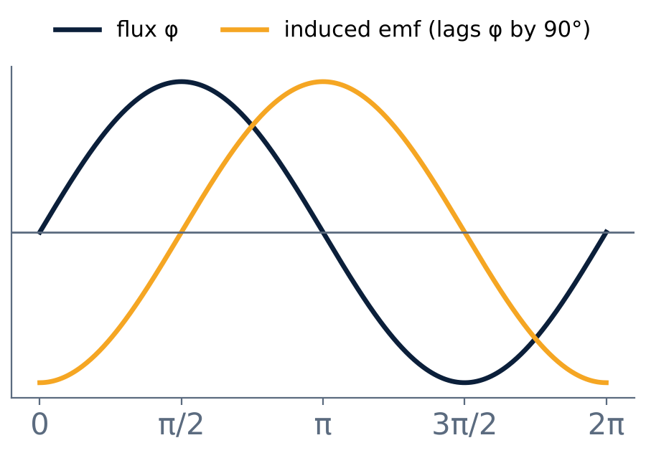
Flux and induced EMF
U2
Primary flux φ = φm sin ωt.
e = −N dφ/dt = −N ω φm cos ωt.
EMF lags the flux by 90°.
Peak EMF Em = 2π f N φm.
Notes:
The induced emf is the negative rate of change of flux linkage; it lags the flux by ninety degrees.

Slide 4
Deriving the EMF equation
U2
1
2
3
4
Flux change
Average rate
EMF per turn
RMS
Flux rises from 0 to φm in a quarter cycle and from +φm to −φm in 1/2f s.
2φm ÷ (1/2f) = 4 f φm weber per second.
Average EMF per turn = 4 f φm volts.
Multiply by form factor 1.11: 4.44 f φm per turn.
E1 = 4.44 f φm N1 and E2 = 4.44 f φm N2 (RMS volts)
Notes:
Because the form factor of a sine wave is one point one one, the R M S emf per turn is four point four four f phi m.

Slide 5
Using the EMF equation
U2
E1 = 4.44 f φm N1
E2 = 4.44 f φm N2
primary
secondary
E1/E2 = N1/N2
Bm = φm / A
ratio (flux and f cancel)
flux density (T) for core area A
Notes:
The emf depends on frequency, maximum flux and number of turns.

Slide 6
Numerical 1: 200 kVA transformer
U2
Problem 200 kVA, 3300/230 V, 50 Hz single-phase transformer has 80 turns on the secondary. Find the approximate primary and secondary currents, primary turns and maximum flux.
I1 = 200 × 1000/3300 = 60.6 A; I2 = 200 × 1000/230 = 869.6 A
N1 = N2 × (V1/V2) = 80 × 3300/230 = 1148 turns
φm = E2/(4.44 f N2) = 230/(4.44 × 50 × 80)
Answer: I1 = 60.6 A, I2 = 869.6 A, N1 = 1148, φm = 12.9 mWb
Notes:
Always use the low voltage side with its known turns for the flux calculation.

Slide 7
Numerical 2: flux density
U2
Problem A 50 Hz transformer has 80 primary and 400 secondary turns, net core area 200 cm². Primary is on 230 V. Find E2 and Bm.
K = 400/80 = 5; E2 = 5 × 230 = 1150 V
φm = 1150/(4.44 × 400 × 50) = 12.95 mWb
Bm = φm/A = 12.95×10⁻³ / (200×10⁻⁴)
Answer: E2 = 1150 V, Bm ≈ 0.65 T
Notes:
Typical maximum flux density in silicon steel is about one to one point five tesla.

Slide 8
Numerical 3: turns required
U2
Problem A 25 kVA, 50 Hz, 2000/200 V transformer has φm = 0.045 Wb. Find the turns on each winding.
N2 = E2/(4.44 f φm) = 200/(4.44 × 50 × 0.045) = 20.02 ≈ 20
N1 = N2 × E1/E2 = 20 × 2000/200
Answer: N2 = 20 turns, N1 = 200 turns
Notes:
Round the turns to whole numbers.

Slide 9
Key takeaways
U2
E = 4.44 f φm N (RMS)
Average emf per turn = 4 f φm; multiply by 1.11 for RMS
E1/E2 = N1/N2
Bm = φm / core area
Notes:
To summarise this topic. E = 4.44 f φm N (RMS). Average emf per turn = 4 f φm; multiply by 1.11 for RMS. E1/E2 = N1/N2. Bm = φm / core area.

Slide 10
Practice questions
U2
Q1. Derive E = 4.44 f φm N.
Q2. A 1100/220 V, 50 Hz transformer has 55 secondary turns. Find N1 and φm.
Q3. Core area 150 cm², Bm = 1.2 T, 50 Hz, 500 turns: find E.
Q4. Why does the same core flux serve both windings?
Notes:
Attempt these on your own, then check your working against your notes and textbook. Derive E = 4.44 f φm N. A 1100/220 V, 50 Hz transformer has 55 secondary turns. Find N1 and φm. Core area 150 cm², Bm = 1.2 T, 50 Hz, 500 turns: find E. Why does the same core flux serve both windings?

