Slide 1

UNIT 2 · 9 hours
Three-Phase Induction Motor: Principle, Construction and Types
Transformers and Electrical Machines
Basic Electrical and Electronics Engineering (EEE103)
Dr. Mitesh Astik · Dept. of Electrical and Electronics Engineering
NMAM Institute of Technology, Nitte · 2025-26
Notes:
Welcome. In this session we study "Three-Phase Induction Motor: Principle, Construction and Types", part of Unit 2 (Transformers and Electrical Machines) of Basic Electrical and Electronics Engineering.

Slide 2
Learning objectives
U2
Describe stator and rotor construction
Distinguish squirrel-cage and wound (slip-ring) rotors
Explain the principle of operation and slip
Solve numericals on slip and rotor frequency
Syllabus context
Three-phase induction motor: concept of rotating magnetic field, principle of operation, constructional features of motor, types: squirrel cage and wound rotor.
Notes:
By the end of this topic you should be able to do the following. Describe stator and rotor construction. Distinguish squirrel-cage and wound (slip-ring) rotors. Explain the principle of operation and slip. Solve numericals on slip and rotor frequency.

Slide 3
Why the induction motor?
U2
Most widely used AC motor: ~50 % of industrial electric power.
Robust, simple, low cost, self-starting, little maintenance.
No electrical connection to the rotor in the squirrel-cage type.
Constant-speed type: speed falls only 2–5 % from no load to full load.
Notes:
The three phase induction motor is the workhorse of industry.

Slide 4
Construction
U2
Stator
Rotor
Air gap
Hollow cylinder of laminated silicon steel with slots; balanced three-phase winding in star or delta; frame.
Laminated cylindrical core on the shaft with slots; squirrel-cage bars or three-phase winding.
Very small (0.3–1 mm) to keep magnetising current low.
Notes:
The stator and rotor are separated by a small air gap.

Slide 5
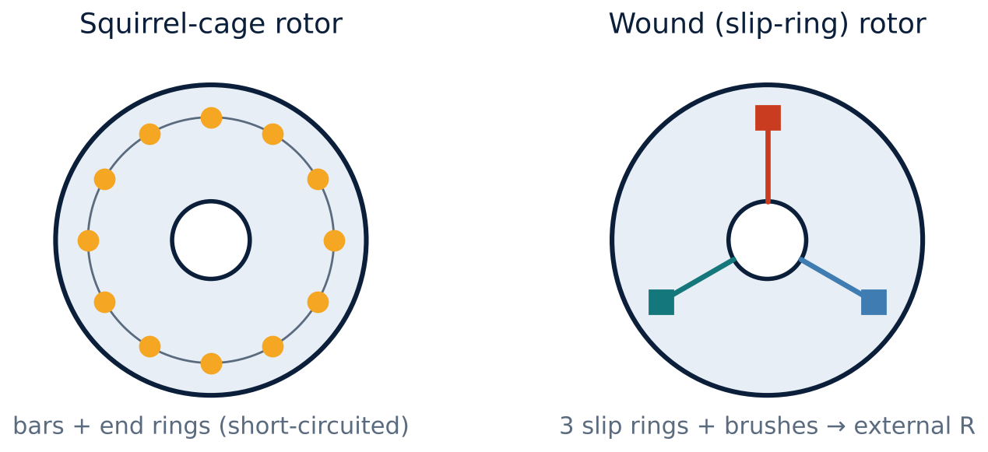
Rotor types
U2
Squirrel cage: aluminium/copper bars short-circuited by end rings.
Wound rotor: three-phase winding (star) brought out to slip rings; external resistance can be added.
Notes:
The motor with the cage rotor is the squirrel cage induction motor; with the wound rotor, slip ring induction motor.

Slide 6
Squirrel cage versus slip ring
U2
Feature | Squirrel cage | Slip ring (wound rotor)
Rotor | Bars + end rings | 3-phase winding, slip rings, brushes
External resistance | Not possible | Possible: high starting torque
Starting torque | Low–moderate | High
Cost / maintenance | Low / very little | Higher / brushes
Applications | Pumps, fans, machine tools | Cranes, hoists, crushers
Notes:
Wound rotor motors allow speed control and high starting torque by adding rotor resistance.

Slide 7
Principle of operation
U2
1
2
3
4
Rotating field
EMF induced
Rotor current
Torque
Stator currents produce a field of 1.5 φm rotating at Ns.
The field cuts rotor conductors: Faraday's law induces an EMF.
Short-circuited rotor carries current; by Lenz's law it opposes the relative motion.
Rotor is dragged in the direction of the field but never reaches Ns.
Slip s = (Ns − N)/Ns. Rotor speed N = Ns (1 − s). Rotor frequency fr = s f.
Notes:
If the rotor reached synchronous speed there would be no relative motion and no torque.

Slide 8
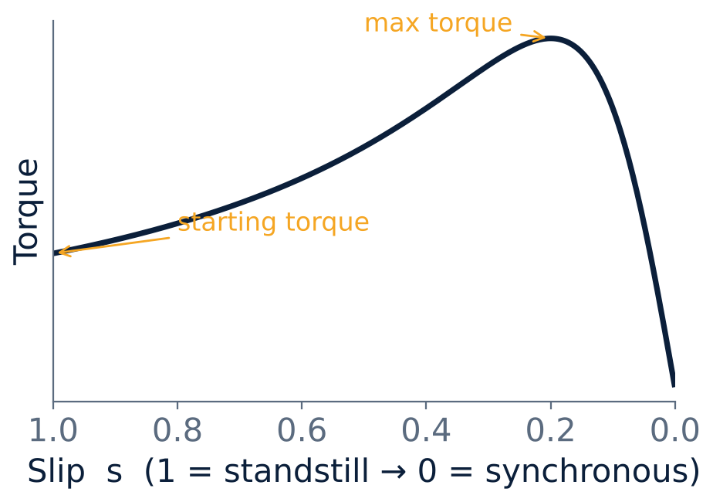
Torque–slip characteristic
U2
Starting torque at s = 1.
Maximum torque at about s = 0.15–0.25.
Full-load slip 2–5 %: stable operation on the right.
Notes:
A rotor with higher resistance has a larger starting torque but lower efficiency.

Slide 9
Numerical: slip and rotor frequency
U2
Problem A 4-pole, 50 Hz induction motor runs at 1440 rpm. Find Ns, slip, and rotor frequency.
Ns = 120 f/P = 120 × 50/4 = 1500 rpm
s = (Ns − N)/Ns = (1500 − 1440)/1500 = 0.04
fr = s f = 0.04 × 50
Answer: Ns = 1500 rpm, s = 4 %, fr = 2 Hz
Notes:
At standstill the rotor frequency equals the supply frequency; at full load it is only a few hertz.

Slide 10
Key takeaways
U2
Stator: 3-phase winding; rotor: squirrel cage or wound
Rotating field induces rotor current; torque follows Lenz's law
Slip s = (Ns − N)/Ns; N = Ns(1 − s); fr = s f
Wound rotor allows added resistance for high starting torque
Notes:
To summarise this topic. Stator: 3-phase winding; rotor: squirrel cage or wound. Rotating field induces rotor current; torque follows Lenz's law. Slip s = (Ns − N)/Ns; N = Ns(1 − s); fr = s f. Wound rotor allows added resistance for high starting torque.

Slide 11
Practice questions
U2
Q1. Compare squirrel-cage and slip-ring induction motors.
Q2. A 6-pole, 50 Hz motor runs at 960 rpm. Find slip.
Q3. Why can the rotor never reach synchronous speed?
Q4. What is the rotor frequency at standstill?
Notes:
Attempt these on your own, then check your working against your notes and textbook. Compare squirrel-cage and slip-ring induction motors. A 6-pole, 50 Hz motor runs at 960 rpm. Find slip. Why can the rotor never reach synchronous speed? What is the rotor frequency at standstill?

