Slide 1

UNIT 3 · 9 hours
Semiconductor Diode and the PN Junction
Diodes, Transistors and their Applications
Basic Electrical and Electronics Engineering (EEE103)
Dr. Mitesh Astik · Dept. of Electrical and Electronics Engineering
NMAM Institute of Technology, Nitte · 2025-26
Notes:
Welcome. In this session we study "Semiconductor Diode and the PN Junction", part of Unit 3 (Diodes, Transistors and their Applications) of Basic Electrical and Electronics Engineering.

Slide 2
Learning objectives
U3
Describe intrinsic and extrinsic semiconductors
Explain formation of the depletion region and barrier potential
Explain forward and reverse bias
State the diode symbol and its terminals
Syllabus context
Semiconductor diode, diode equivalent circuits, half-wave rectifier, full-wave bridge rectifier. Zener diode and its use in voltage regulation.
Notes:
By the end of this topic you should be able to do the following. Describe intrinsic and extrinsic semiconductors. Explain formation of the depletion region and barrier potential. Explain forward and reverse bias. State the diode symbol and its terminals.

Slide 3
Semiconductors
U3
Intrinsic
N-type
P-type
Pure silicon or germanium. Equal numbers of electrons and holes; low conductivity at room temperature.
Doped with pentavalent atoms (P, As). Electrons are majority carriers.
Doped with trivalent atoms (B, Ga). Holes are majority carriers.
Conductivity lies between conductors and insulators and rises with temperature and doping.
Notes:
Semiconductors such as silicon and germanium have conductivity between conductors and insulators.

Slide 4
Formation of the PN junction
U3
1
2
3
4
Join P and N
Recombination
Depletion region
Barrier potential
Majority carriers diffuse across the junction.
Electrons and holes recombine near the junction.
Fixed ions left behind: a region with no free carriers.
Electric field of the ions stops further diffusion: 0.7 V (Si), 0.3 V (Ge).
Notes:
The depletion region has positive donor ions on the N side and negative acceptor ions on the P side.

Slide 5
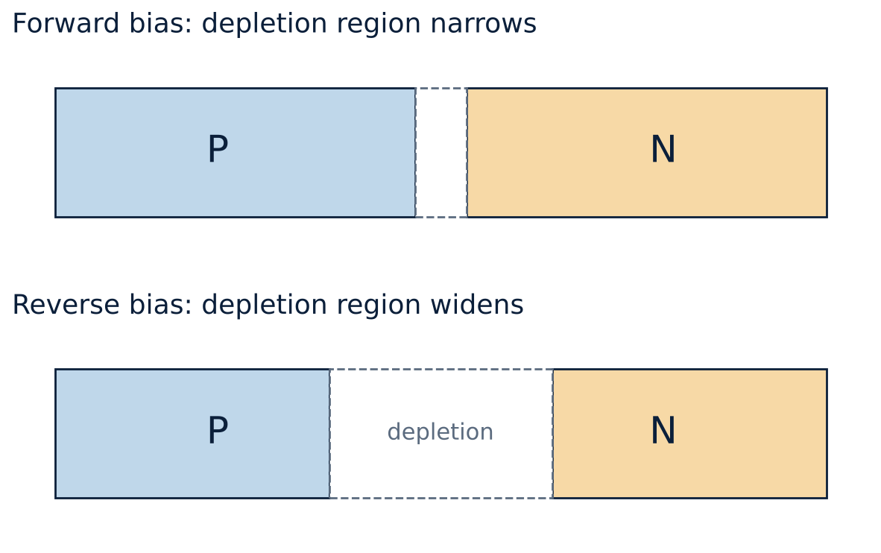
Forward and reverse bias
U3
Forward: P to +, N to −. Applied voltage opposes the barrier; depletion region narrows; current flows when V > 0.7 V.
Reverse: P to −, N to +. Barrier increases; depletion widens; only tiny leakage (minority carriers).
Notes:
In forward bias the applied potential acts in opposition to the internal potential barrier.

Slide 6
Forward bias versus reverse bias
U3
Forward bias
Reverse bias
Anode (P) positive
Depletion region narrow
Low resistance, large current
Diode acts as closed switch
Anode negative
Depletion region wide
High resistance, µA leakage
Diode acts as open switch
Notes:
Reverse leakage current doubles roughly for every ten degrees Celsius rise.

Slide 7
The diode
U3
Symbol: triangle (anode) with bar (cathode); current flows from anode to cathode.
Function: conducts in one direction only; converts AC to DC.
Types: rectifier, signal, Zener, LED, Schottky.
Applications: rectification, switching, clamping, protection, voltage regulation.
Notes:
A diode is essentially a one-way valve for electric current.

Slide 8
Key takeaways
U3
N-type: electrons majority; P-type: holes majority
Depletion region and barrier potential form at the junction
Forward bias reduces the barrier; reverse bias increases it
Si turns on near 0.7 V, Ge near 0.3 V
Notes:
To summarise this topic. N-type: electrons majority; P-type: holes majority. Depletion region and barrier potential form at the junction. Forward bias reduces the barrier; reverse bias increases it. Si turns on near 0.7 V, Ge near 0.3 V.

Slide 9
Practice questions
U3
Q1. Explain how the depletion region is formed.
Q2. What happens to the depletion width in forward and reverse bias?
Q3. Compare N-type and P-type semiconductors.
Q4. Why does a reverse-biased diode still carry a small current?
Notes:
Attempt these on your own, then check your working against your notes and textbook. Explain how the depletion region is formed. What happens to the depletion width in forward and reverse bias? Compare N-type and P-type semiconductors. Why does a reverse-biased diode still carry a small current?

