Slide 1

UNIT 3 · 9 hours
Diode V-I Characteristics and Equivalent Circuits
Diodes, Transistors and their Applications
Basic Electrical and Electronics Engineering (EEE103)
Dr. Mitesh Astik · Dept. of Electrical and Electronics Engineering
NMAM Institute of Technology, Nitte · 2025-26
Notes:
Welcome. In this session we study "Diode V-I Characteristics and Equivalent Circuits", part of Unit 3 (Diodes, Transistors and their Applications) of Basic Electrical and Electronics Engineering.

Slide 2
Learning objectives
U3
Sketch and explain the V-I characteristic of a silicon diode
Use the diode current equation
Draw ideal, constant-voltage and piecewise-linear equivalent circuits
Analyse simple diode circuits
Syllabus context
Semiconductor diode, diode equivalent circuits, half-wave rectifier, full-wave bridge rectifier. Zener diode and its use in voltage regulation.
Notes:
By the end of this topic you should be able to do the following. Sketch and explain the V-I characteristic of a silicon diode. Use the diode current equation. Draw ideal, constant-voltage and piecewise-linear equivalent circuits. Analyse simple diode circuits.

Slide 3
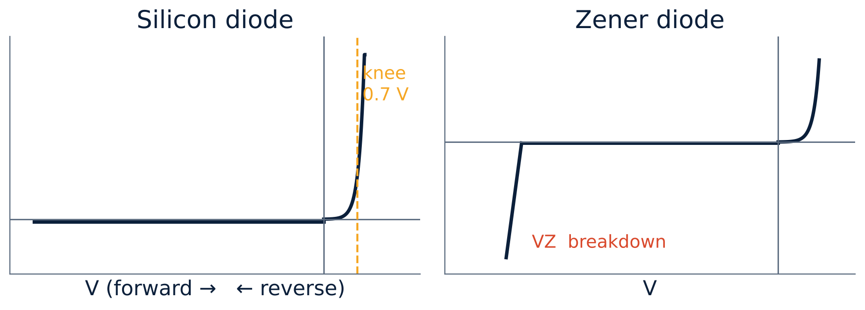
V-I characteristic of the silicon diode
U3
Forward: current negligible until the knee (≈ 0.7 V), then rises rapidly.
Reverse: tiny saturation current I0 up to the breakdown voltage.
Breakdown: large reverse current; the right plot shows the Zener case.
Notes:
The diode conducts easily in the forward direction when the anode is positive.

Slide 4
Diode current equation
U3
I = I0 (e^(V/ηVT) − 1)
VT = kT/q ≈ 26 mV
Shockley equation
at 300 K
I0 = reverse saturation current (nA–µA), η = 1 (Ge) to 2 (Si).
Forward (V ≫ VT): I ≈ I0 e^(V/ηVT), exponential.
Reverse (V negative): I ≈ −I0.
Notes:
I zero is the reverse saturation current, V T is the volt equivalent of temperature.

Slide 5
Silicon versus germanium
U3
Property | Silicon | Germanium
Cut-in (knee) voltage | 0.7 V | 0.3 V
Reverse saturation current | nA | µA
Temperature stability | Good | Poor
Max. junction temperature | ≈ 150 °C | ≈ 75 °C
Notes:
Silicon is far more common because of its low leakage and temperature stability.

Slide 6
Equivalent circuits of a forward-biased diode
U3
Ideal
Constant voltage
Piecewise linear
A switch with zero drop: V = 0 when ON, open when OFF.
Ideal diode in series with a battery of 0.7 V (Si).
Battery Vγ in series with forward resistance rf: V = Vγ + If rf.
Replace the diode by its equivalent circuit and use ordinary circuit analysis.
Notes:
Once the device is replaced by its equivalent circuit, the network can be solved by traditional methods.

Slide 7
Numerical: diode in series with a resistor
U3
Problem A silicon diode is in series with 1 kΩ across a 12 V DC source (forward). Find the current using the constant-voltage model, and the power in the diode.
VD = 0.7 V
I = (12 − 0.7)/1000
PD = VD × I = 0.7 × 11.3 mA
Answer: I = 11.3 mA, PD = 7.9 mW
Notes:
The ideal model would give twelve milliamps; the constant voltage model is more accurate.

Slide 8
Numerical: piecewise-linear model
U3
Problem Diode with Vγ = 0.7 V and rf = 10 Ω in series with R = 90 Ω across 10 V. Find the current.
Total resistance = 90 + 10 = 100 Ω
I = (10 − 0.7)/100
Answer: I = 93 mA
Notes:
The forward resistance is added to the circuit resistance.

Slide 9
Key takeaways
U3
Silicon knee ≈ 0.7 V; Germanium ≈ 0.3 V
I = I0 (e^(V/ηVT) − 1)
Equivalent circuits: ideal, constant-voltage, piecewise-linear
Forward current limited by the series resistor
Notes:
To summarise this topic. Silicon knee ≈ 0.7 V; Germanium ≈ 0.3 V. I = I0 (e^(V/ηVT) − 1). Equivalent circuits: ideal, constant-voltage, piecewise-linear. Forward current limited by the series resistor.

Slide 10
Practice questions
U3
Q1. Sketch the V-I curve of a silicon diode, marking knee and breakdown.
Q2. Find the current with 5 V, 470 Ω and a silicon diode.
Q3. Write the diode current equation and define each term.
Q4. What is VT at 27 °C?
Notes:
Attempt these on your own, then check your working against your notes and textbook. Sketch the V-I curve of a silicon diode, marking knee and breakdown. Find the current with 5 V, 470 Ω and a silicon diode. Write the diode current equation and define each term. What is VT at 27 °C?

