Slide 1

UNIT 4 · 9 hours
BJT: Construction and Operation
Transistors
Basic Electrical and Electronics Engineering (EEE103)
Dr. Mitesh Astik · Dept. of Electrical and Electronics Engineering
NMAM Institute of Technology, Nitte · 2025-26
Notes:
Welcome. In this session we study "BJT: Construction and Operation", part of Unit 4 (Transistors) of Basic Electrical and Electronics Engineering.

Slide 2
Learning objectives
U4
Describe the construction of npn and pnp transistors
Explain biasing for active-mode operation
Relate IE, IB, IC and the gains α and β
Distinguish CB, CE and CC configurations
Syllabus context
Construction and operation, BJT as a switch, working and characteristics of n-channel enhancement type MOSFET, common source amplifier, DC load line analysis, MOS inverter.
Notes:
By the end of this topic you should be able to do the following. Describe the construction of npn and pnp transistors. Explain biasing for active-mode operation. Relate IE, IB, IC and the gains α and β. Distinguish CB, CE and CC configurations.

Slide 3
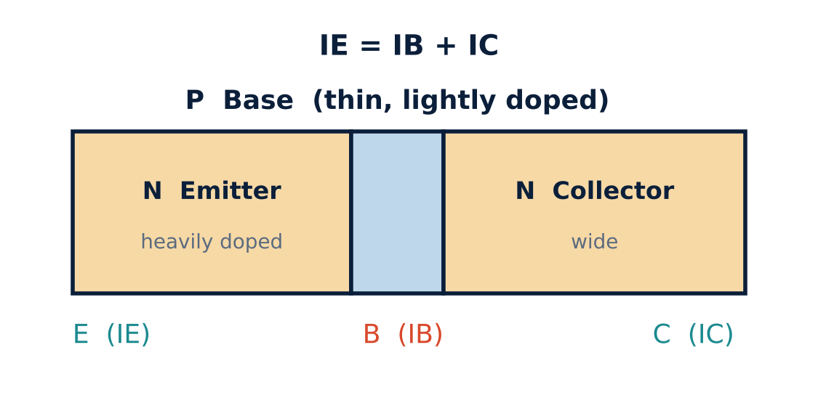
Construction
U4
Three regions, two PN junctions: npn or pnp.
Emitter: heavily doped; emits carriers.
Base: very thin, lightly doped.
Collector: widest region; collects carriers.
Invented by Bardeen, Shockley and Brattain (1948).
Notes:
The name bipolar is used because both electrons and holes take part in conduction.

Slide 4
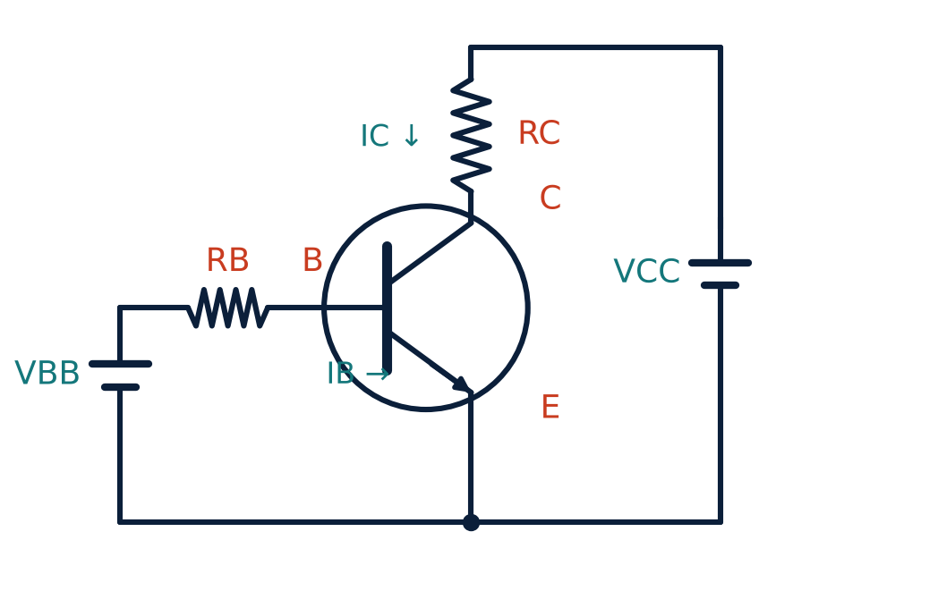
Biasing the npn transistor
U4
Emitter–base junction forward biased: VBE ≈ 0.7 V (Si), 0.3 V (Ge).
Collector–base junction reverse biased: VCC > VBB.
RB, RC are current-limiting resistors.
Collector voltage typically 3–20 V.
Notes:
For normal transistor action the base emitter junction is forward biased and the collector base junction is reverse biased.

Slide 5
What happens inside (npn, active mode)
U4
1
2
3
4
Injection
Thin base
Collection
Leakage
Forward-biased emitter junction injects electrons into the base.
Only a few (1–5 %) recombine with holes: this is the base current IB.
The rest are swept across the reverse-biased junction into the collector: IC.
Reverse minority-carrier current ICBO adds slightly to IC.
IE = IB + IC (Kirchhoff's current law)
Notes:
Most of the injected electrons diffuse through the thin base and are collected.

Slide 6
Current gains
U4
α = IC / IE
β = IC / IB
0.95 – 0.99
20 – 500
β = α / (1 − α)
IE = (β + 1) IB
relation
emitter current
Notes:
Alpha is the common base current gain; beta is the common emitter current gain.

Slide 7
Transistor configurations
U4
Configuration | Common terminal | Gain | Typical use
Common base (CB) | Base | Voltage gain, no current gain | High-frequency stages
Common emitter (CE) | Emitter | Both current and voltage gain | Amplifiers, switches
Common collector (CC) | Collector | Current gain, no voltage gain | Buffers (emitter follower)
Notes:
Each configuration has its own static characteristics.

Slide 8
Numerical: currents and gains
U4
Problem A transistor has IB = 0.08 mA and IE = 9.60 mA. Find IC, α and β.
IC = IE − IB = 9.60 − 0.08 = 9.52 mA
α = IC/IE = 9.52/9.60 = 0.9917
β = IC/IB = 9.52/0.08
Answer: IC = 9.52 mA, α = 0.9917, β = 119
Notes:
Check with β equals α over one minus α.

Slide 9
Key takeaways
U4
Emitter heavily doped, base thin, collector widest
Active mode: EB forward, CB reverse
IE = IB + IC; α = IC/IE; β = IC/IB
CE has both current and voltage gain
Notes:
To summarise this topic. Emitter heavily doped, base thin, collector widest. Active mode: EB forward, CB reverse. IE = IB + IC; α = IC/IE; β = IC/IB. CE has both current and voltage gain.

Slide 10
Practice questions
U4
Q1. Why is the base region made thin and lightly doped?
Q2. IC = 5 mA, β = 100. Find IB and IE.
Q3. Find β for α = 0.98.
Q4. Compare CB, CE and CC configurations.
Notes:
Attempt these on your own, then check your working against your notes and textbook. Why is the base region made thin and lightly doped? IC = 5 mA, β = 100. Find IB and IE. Find β for α = 0.98. Compare CB, CE and CC configurations.

