Slide 1

UNIT 5 · 9 hours
555 Timer IC in Astable Mode
Op-Amp and Linear IC Applications
Basic Electrical and Electronics Engineering (EEE103)
Dr. Mitesh Astik · Dept. of Electrical and Electronics Engineering
NMAM Institute of Technology, Nitte · 2025-26
Notes:
Welcome. In this session we study "555 Timer IC in Astable Mode", part of Unit 5 (Op-Amp and Linear IC Applications) of Basic Electrical and Electronics Engineering.

Slide 2
Learning objectives
U5
Describe the internal blocks of the 555 timer
Explain astable (free-running) operation
Derive/use the frequency and duty cycle equations
Design an astable multivibrator
Syllabus context
Introduction, op-amp specifications, differential and common-mode operation, op-amp applications: inverting/non-inverting amplifier, summing, integrator, differentiator, comparator, 555 timer IC in astable mode, 78XX series IC voltage regulators.
Notes:
By the end of this topic you should be able to do the following. Describe the internal blocks of the 555 timer. Explain astable (free-running) operation. Derive/use the frequency and duty cycle equations. Design an astable multivibrator.

Slide 3
555 timer: internal blocks
U5
Voltage divider
Two comparators
Flip-flop and discharge
Three equal 5 kΩ resistors set reference levels 2Vcc/3 and Vcc/3.
Threshold comparator (2Vcc/3) and trigger comparator (Vcc/3) drive the flip-flop.
Flip-flop sets the output; the discharge transistor discharges the timing capacitor.
8-pin IC: 1 GND, 2 TRIG, 3 OUT, 4 RESET, 5 CTRL, 6 THR, 7 DIS, 8 Vcc.
Notes:
The name comes from the three five kilohm resistors.

Slide 4
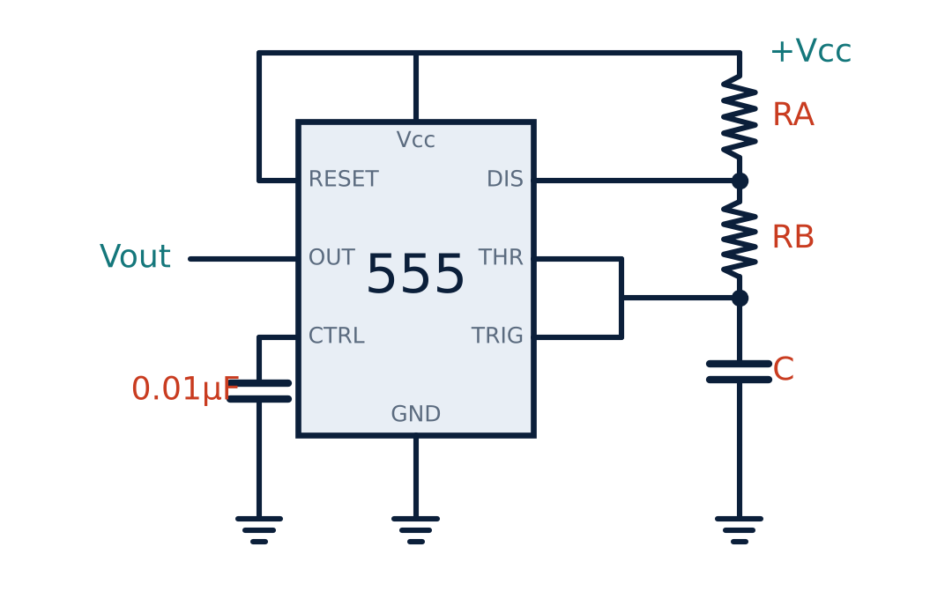
Astable circuit
U5
External: RA, RB, C.
Pins 2 and 6 tied together across C.
Pin 7 (discharge) between RA and RB.
Pin 4 to Vcc; pin 5 decoupled with 0.01 µF.
No external trigger needed: free-running.
Notes:
In the astable mode the 555 acts as a free running oscillator.

Slide 5
How it oscillates
U5
1
2
3
4
Charge
Reach 2Vcc/3
Discharge
Reach Vcc/3
Output HIGH; C charges through RA + RB toward Vcc.
Threshold comparator resets the flip-flop; output LOW; discharge transistor ON.
C discharges through RB toward ground.
Trigger comparator sets the flip-flop; output HIGH again. Repeats.
THIGH = 0.693 (RA + RB) C TLOW = 0.693 RB C
Notes:
The capacitor voltage swings between one third and two thirds of Vcc.

Slide 6
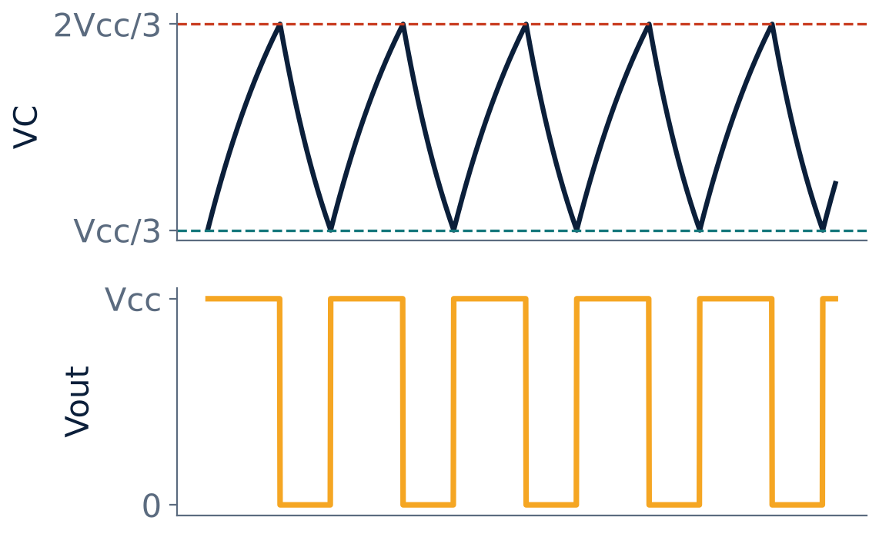
Capacitor voltage and output waveform
U5
VC rises and falls between Vcc/3 and 2Vcc/3.
Output is a rectangular wave.
HIGH time is always longer than LOW time (RA > 0).
Notes:
The output is a rectangular wave with duty cycle greater than fifty percent.

Slide 7
Frequency and duty cycle
U5
T = 0.693 (RA + 2RB) C
f = 1.44 / [(RA + 2RB) C]
D = (RA + RB)/(RA + 2RB)
period
frequency
duty cycle (> 50 %)
Notes:
To get a symmetrical wave, make RA much smaller than RB.

Slide 8
Numerical: astable design check
U5
Problem RA = 1 kΩ, RB = 10 kΩ, C = 0.1 µF. Find THIGH, TLOW, frequency and duty cycle.
THIGH = 0.693 × 11 kΩ × 0.1 µF = 0.762 ms
TLOW = 0.693 × 10 kΩ × 0.1 µF = 0.693 ms
T = 1.455 ms → f = 1.44/(21 kΩ × 0.1 µF) = 686 Hz
D = 11/21 = 52.4 %
Answer: f ≈ 687 Hz, duty cycle 52.4 %
Notes:
Applications include LED flashers, tone generators, clock pulses and PWM.

Slide 9
Key takeaways
U5
555: two comparators, SR flip-flop, discharge transistor, 3 × 5 kΩ divider
Astable: C charges to 2Vcc/3 and discharges to Vcc/3
THIGH = 0.693(RA + RB)C; TLOW = 0.693 RB C
f = 1.44/[(RA + 2RB)C]; D = (RA + RB)/(RA + 2RB)
Notes:
To summarise this topic. 555: two comparators, SR flip-flop, discharge transistor, 3 × 5 kΩ divider. Astable: C charges to 2Vcc/3 and discharges to Vcc/3. THIGH = 0.693(RA + RB)C; TLOW = 0.693 RB C. f = 1.44/[(RA + 2RB)C]; D = (RA + RB)/(RA + 2RB).

Slide 10
Practice questions
U5
Q1. Draw and explain the 555 astable multivibrator.
Q2. Find f and duty cycle for RA = 2.2 kΩ, RB = 4.7 kΩ, C = 10 nF.
Q3. How would you get an approximately 50 % duty cycle?
Q4. State the pin functions of the 555.
Notes:
Attempt these on your own, then check your working against your notes and textbook. Draw and explain the 555 astable multivibrator. Find f and duty cycle for RA = 2.2 kΩ, RB = 4.7 kΩ, C = 10 nF. How would you get an approximately 50 % duty cycle? State the pin functions of the 555.

