Slide 1

LABORATORY · Lab · 26 hours
Experiment 6: Frequency Domain Analysis Using Bode Plot
Control Systems Laboratory (22EEG53)
Control Systems (22EEG53)
Dr. Mitesh Astik · Dept. of Electrical and Electronics Engineering
NMAM Institute of Technology, Nitte · 2025-26
Notes:
Welcome. In this session we study "Experiment 6: Frequency Domain Analysis Using Bode Plot", part of Laboratory (Control Systems Laboratory (22EEG53)) of Control Systems.

Slide 2
Learning objectives
LAB
Plot the Bode magnitude and phase of a transfer function
Determine gain margin, phase margin and crossover frequencies
Assess stability from the margins
Syllabus context
Laboratory component of 22EEG53 Control Systems (0:0:2 hours per week). CIE: record and observation 25, viva-voce 5, lab test 20 marks.
Notes:
By the end of this topic you should be able to do the following. Plot the Bode magnitude and phase of a transfer function. Determine gain margin, phase margin and crossover frequencies. Assess stability from the margins.

Slide 3
Aim and requirements
LAB
Aim: to perform frequency domain analysis using the Bode plot in MATLAB and determine GM and PM.
Software: MATLAB with the Control System Toolbox (Simulink where required).
Hardware: Personal computer.
System: G(s) = 2/[s(s + 1)(s + 2)] (unity feedback).
Notes:
We obtain the stability margins both from the plot and the margin command.

Slide 4
Theory
LAB
Bode plot
Gain margin
Phase margin
Magnitude 20 log|G(jω)| and phase vs log ω.
GM = −20 log|G(jωpc)| at ∠G = −180°.
PM = 180° + ∠G(jωgc) at |G| = 1.
Stable if GM > 0 dB and PM > 0°.
Notes:
Hand calculation gave GM = 9.54 dB and PM = 32.7°.

Slide 5
Procedure
LAB
1
2
3
4
Define G
Bode plot
Margins
Interpret
G = tf(2, conv([1 0], conv([1 1],[1 2]))).
bode(G); grid on.
margin(G) marks GM, PM and the crossover frequencies.
Check the closed loop: step(feedback(G,1)).
Notes:
Try different gains K to see how the margins change.

Slide 6
MATLAB program
LAB
G = tf(2, conv([1 0], conv([1 1], [1 2])));
figure, bode(G), grid on
figure, margin(G)
[Gm, Pm, wpc, wgc] = margin(G);
fprintf('GM = %.2f dB at %.3f rad/s\n', 20*log10(Gm), wpc)
fprintf('PM = %.1f deg at %.3f rad/s\n', Pm, wgc)
figure, step(feedback(G, 1)) % closed loop response

Slide 7
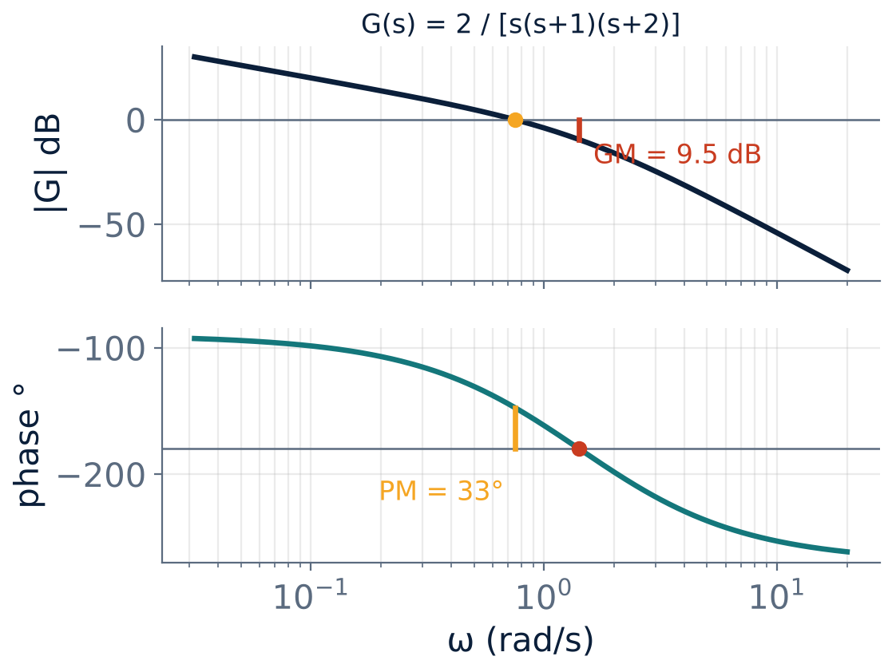
Expected result
LAB
GM ≈ 9.54 dB at ωpc = 1.414 rad/s.
PM ≈ 32.7° at ωgc = 0.748 rad/s.
Both positive: stable.
Notes:
Compare MATLAB output with the figure.

Slide 8
Observation table
LAB
Gain K | GM (dB) | PM (deg) | ωgc | Stability
1
2 | 9.54 | 32.7 | 0.748 | Stable
6 | 0 | 0 | 1.414 | Marginal
10
Notes:
Repeat for different K values.

Slide 9
Key takeaways
LAB
bode() and margin() give the frequency response and margins
GM = 9.54 dB, PM = 32.7° for K = 2
K = 6 gives GM = 0 dB: marginal stability
Larger K reduces the margins
Notes:
To summarise this topic. bode() and margin() give the frequency response and margins. GM = 9.54 dB, PM = 32.7° for K = 2. K = 6 gives GM = 0 dB: marginal stability. Larger K reduces the margins.

Slide 10
Practice questions
LAB
Q1. Define GM and PM.
Q2. What are the margins for K = 6?
Q3. Write the MATLAB commands used.
Q4. Predict the closed-loop overshoot from PM = 32.7°.
Notes:
Attempt these on your own, then check your working against your notes and textbook. Define GM and PM. What are the margins for K = 6? Write the MATLAB commands used. Predict the closed-loop overshoot from PM = 32.7°.

