Slide 1

LABORATORY · Lab · 26 hours
Experiment 8: DC Position Control System Using MATLAB/Simulink
Control Systems Laboratory (22EEG53)
Control Systems (22EEG53)
Dr. Mitesh Astik · Dept. of Electrical and Electronics Engineering
NMAM Institute of Technology, Nitte · 2025-26
Notes:
Welcome. In this session we study "Experiment 8: DC Position Control System Using MATLAB/Simulink", part of Laboratory (Control Systems Laboratory (22EEG53)) of Control Systems.

Slide 2
Learning objectives
LAB
Model a DC motor position control system
Obtain its step response for a given controller gain
Observe the effect of gain on overshoot and settling
Understand the role of feedback
Syllabus context
Laboratory component of 22EEG53 Control Systems (0:0:2 hours per week). CIE: record and observation 25, viva-voce 5, lab test 20 marks.
Notes:
By the end of this topic you should be able to do the following. Model a DC motor position control system. Obtain its step response for a given controller gain. Observe the effect of gain on overshoot and settling. Understand the role of feedback.

Slide 3
Aim and requirements
LAB
Aim: to simulate a DC position control system in MATLAB/Simulink and obtain its step response.
Software: MATLAB with the Control System Toolbox (Simulink where required).
Hardware: Personal computer.
Motor data (example): Ra = 1 Ω, La = 0.5 H, J = 0.01 kg·m², B = 0.1 N·m·s, Kt = Kb = 0.01.
Notes:
A DC servo motor drives a load; position is fed back.

Slide 4
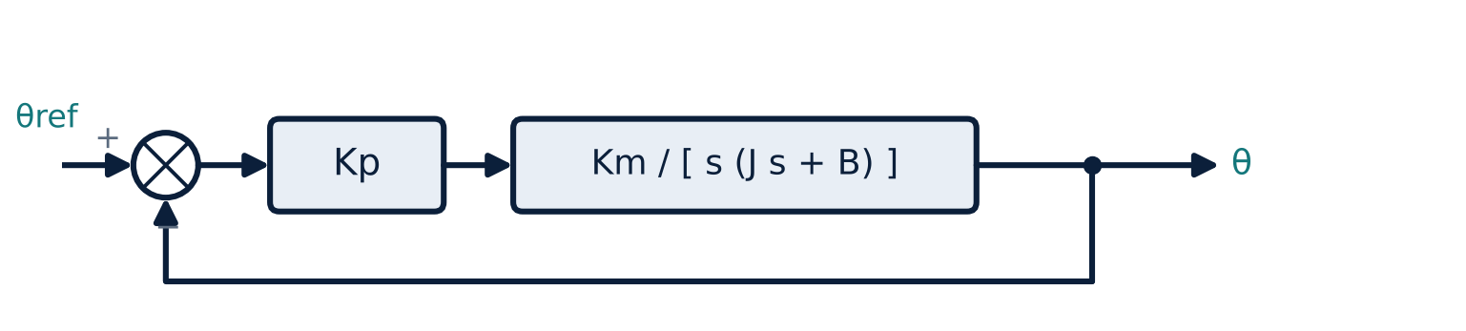
Block diagram
LAB
Unity feedback position loop with proportional controller Kp
Notes:
Armature controlled DC motor: input voltage, output shaft angle.

Slide 5
Motor transfer function
LAB
θ(s)/Va(s) = Kt / { s [ (La s + Ra)(J s + B) + Kt Kb ] }
Closed loop = Kp G/(1 + Kp G)
angle / armature voltage
unity feedback
Type 1 system: zero steady-state error for a step.
Increasing Kp reduces damping and increases overshoot.
Notes:
For the data, the denominator is 0.005s³ + 0.06 s² + 0.1001 s.

Slide 6
Procedure
LAB
1
2
3
4
5
Parameters
Plant
Closed loop
Simulate
Simulink
Enter Ra, La, J, B, Kt, Kb in the workspace.
G = tf(Kt, [La*J, La*B+Ra*J, Ra*B+Kt*Kb, 0]).
Add Kp and unity feedback.
Step response for several Kp; read Mp, ts.
Step → Sum → Gain → Transfer Fcn → Scope, with unity feedback.
Notes:
Both the MATLAB and Simulink versions should give identical responses.

Slide 7
MATLAB program
LAB
Ra=1; La=0.5; J=0.01; B=0.1; Kt=0.01; Kb=0.01;
G = tf(Kt, [La*J, La*B+Ra*J, Ra*B+Kt*Kb, 0]);
Kp = [1 5 20 50]; hold on
for k = 1:length(Kp)
step(feedback(Kp(k)*G, 1), 0:0.05:20)
end
legend('Kp=1','5','20','50'); grid on
stepinfo(feedback(20*G,1))

Slide 8
Observation table
LAB
Kp | Mp (%) | ts (s) | Steady-state error
1
5
20
50
Notes:
Observe zero steady state error and increasing overshoot with Kp.

Slide 9
Key takeaways
LAB
DC motor: θ/Va = Kt/{s[(Las + Ra)(Js + B) + KtKb]}
Position loop is type 1: zero step error
Higher Kp: faster but more overshoot
Simulink and MATLAB give the same result
Notes:
To summarise this topic. DC motor: θ/Va = Kt/{s[(Las + Ra)(Js + B) + KtKb]}. Position loop is type 1: zero step error. Higher Kp: faster but more overshoot. Simulink and MATLAB give the same result.

Slide 10
Practice questions
LAB
Q1. Derive the DC motor transfer function.
Q2. Why is the steady-state error zero for a step input?
Q3. What is the effect of Kp on damping?
Q4. Name the blocks needed in Simulink.
Notes:
Attempt these on your own, then check your working against your notes and textbook. Derive the DC motor transfer function. Why is the steady-state error zero for a step input? What is the effect of Kp on damping? Name the blocks needed in Simulink.

