Slide 1

LABORATORY · Lab · 26 hours
Experiment 10: Design and Implementation of an RC Lead Compensator
Control Systems Laboratory (22EEG53)
Control Systems (22EEG53)
Dr. Mitesh Astik · Dept. of Electrical and Electronics Engineering
NMAM Institute of Technology, Nitte · 2025-26
Notes:
Welcome. In this session we study "Experiment 10: Design and Implementation of an RC Lead Compensator", part of Laboratory (Control Systems Laboratory (22EEG53)) of Control Systems.

Slide 2
Learning objectives
LAB
Design an RC lead network for a required a and T
Implement it and measure its frequency response
Verify using MATLAB Bode plot
Find the maximum phase lead
Syllabus context
Laboratory component of 22EEG53 Control Systems (0:0:2 hours per week). CIE: record and observation 25, viva-voce 5, lab test 20 marks.
Notes:
By the end of this topic you should be able to do the following. Design an RC lead network for a required a and T. Implement it and measure its frequency response. Verify using MATLAB Bode plot. Find the maximum phase lead.

Slide 3
Aim and apparatus
LAB
Aim: to design and implement an RC lead compensator and verify the result using MATLAB.
Apparatus: resistors, capacitor, function generator, CRO/DSO, bread board, MATLAB.
Design: a = 10 (φm ≈ 55°).
Notes:
The lead network adds positive phase at mid frequencies.

Slide 4
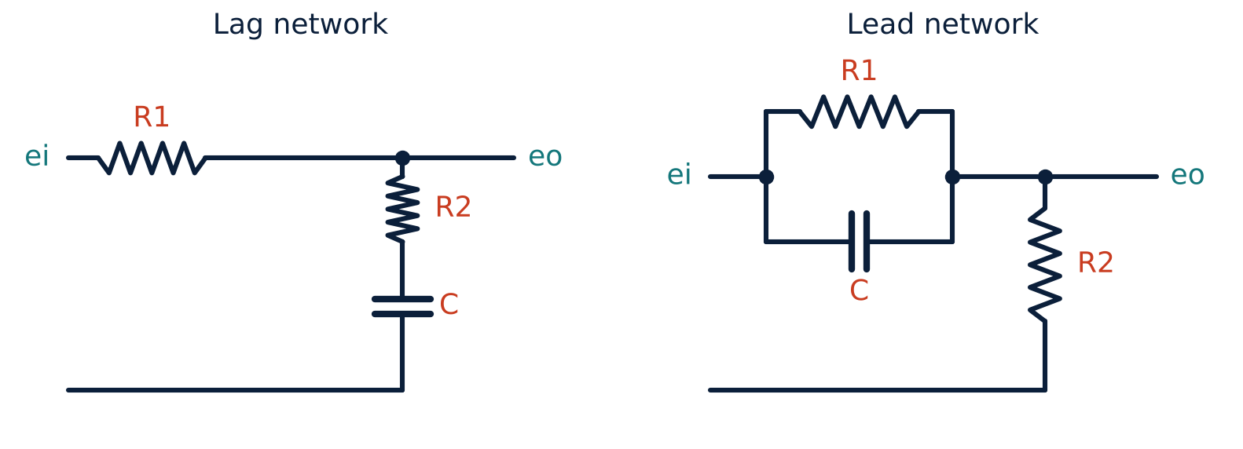
RC lead network
LAB
Right: lead network
Gc(s) = (1/a)(1 + aTs)/(1 + Ts).
a = (R1 + R2)/R2; T = R1R2C/(R1 + R2).
Zero at 1/(aT) = 1/(R1C); pole at 1/T.
DC gain = R2/(R1 + R2) = 1/a.
Notes:
The capacitor is in parallel with R1.

Slide 5
Design calculations
LAB
Problem Design a lead network with a = 10 using C = 0.1 µF and R2 = 10 kΩ.
a = (R1 + R2)/R2 = 10 ⇒ R1 = 9 R2 = 90 kΩ
T = R1R2C/(R1 + R2) = 9 kΩ × 0.1 µF = 0.9 ms; aT = R1C = 9 ms
Gc = 0.1 (1 + 0.009s)/(1 + 0.0009s)
φm = sin⁻¹(9/11) = 54.9° at ωm = 1/(T√a) = 351 rad/s
Answer: R1 = 90 kΩ, R2 = 10 kΩ, C = 0.1 µF
Notes:
The attenuation of 1/10 is restored using an amplifier of gain 10.

Slide 6
Procedure
LAB
1
2
3
4
Build
Excite
Measure
Plot
Assemble the lead network.
Sine input, 1 V peak.
Gain and phase from 100 to 5000 rad/s.
Bode plot; compare with MATLAB; verify φm and ωm.
Notes:
Phase lead is measured as the time by which the output leads the input.

Slide 7
MATLAB verification
LAB
R1 = 90e3; R2 = 10e3; C = 0.1e-6;
a = (R1+R2)/R2; T = R1*R2*C/(R1+R2);
Gc = (1/a)*tf([a*T 1], [T 1])
bode(Gc), grid on
[mag, ph, w] = bode(Gc);
[phmax, i] = max(squeeze(ph));
fprintf('Max lead = %.1f deg at %.0f rad/s\n', phmax, w(i))

Slide 8
Observation table
LAB
f (Hz) | ω (rad/s) | Vo (V) | Gain (dB) | Phase (deg)
20 | 126
56 | 351
200 | 1257
800 | 5026
Notes:
The phase should peak near 56 Hz.

Slide 9
Key takeaways
LAB
Lead: Gc = (1/a)(1 + aTs)/(1 + Ts), a = (R1 + R2)/R2, T = R1R2C/(R1 + R2)
Maximum lead 54.9° at 351 rad/s for a = 10
Passive network attenuates by 1/a: add gain a
Experimental Bode matches MATLAB
Notes:
To summarise this topic. Lead: Gc = (1/a)(1 + aTs)/(1 + Ts), a = (R1 + R2)/R2, T = R1R2C/(R1 + R2). Maximum lead 54.9° at 351 rad/s for a = 10. Passive network attenuates by 1/a: add gain a. Experimental Bode matches MATLAB.

Slide 10
Practice questions
LAB
Q1. Design a lead network with a = 4 using C = 0.1 µF.
Q2. Compute φm and ωm of your design.
Q3. Why must the amplifier gain a be added?
Q4. Compare lead and lag networks.
Notes:
Attempt these on your own, then check your working against your notes and textbook. Design a lead network with a = 4 using C = 0.1 µF. Compute φm and ωm of your design. Why must the amplifier gain a be added? Compare lead and lag networks.

