Slide 1

UNIT 1 · 8 hours
Transfer Function and Mechanical Translational Systems
Introduction and Mathematical Modelling of Physical Systems
Control Systems (22EEG53)
Dr. Mitesh Astik · Dept. of Electrical and Electronics Engineering
NMAM Institute of Technology, Nitte · 2025-26
Notes:
Welcome. In this session we study "Transfer Function and Mechanical Translational Systems", part of Unit 1 (Introduction and Mathematical Modelling of Physical Systems) of Control Systems.

Slide 2
Learning objectives
U1
Define the transfer function and state its properties
Write the differential equations of mass-spring-damper systems
Derive transfer functions of translational systems
Find natural frequency and damping ratio from the model
Syllabus context
Introduction and mathematical modelling of physical systems: open loop and closed loop systems, examples, control system components. Transfer function of physical systems: mechanical systems (translational and rotational), electrical systems, analogous systems, block diagram reduction techniques, signal flow graphs.
Notes:
By the end of this topic you should be able to do the following. Define the transfer function and state its properties. Write the differential equations of mass-spring-damper systems. Derive transfer functions of translational systems. Find natural frequency and damping ratio from the model.

Slide 3
Transfer function
U1
Definition: G(s) = L{output} / L{input} with all initial conditions zero.
Applies to linear time-invariant (LTI) systems.
Independent of input; depends only on system parameters.
Poles and zeros: roots of denominator / numerator; poles decide stability and response.
Characteristic equation: denominator of the closed-loop transfer function = 0.
Notes:
The Laplace transform converts differential equations into algebraic ones.

Slide 4
Translational elements
U1
Element | Force relation | Laplace
Mass M | f = M d²x/dt² | M s² X(s)
Viscous damper B | f = B dx/dt | B s X(s)
Spring K | f = K x | K X(s)
D'Alembert: the algebraic sum of forces on a mass (including inertia force) is zero.
Notes:
Each element resists motion with a force that depends on displacement, velocity or acceleration.

Slide 5
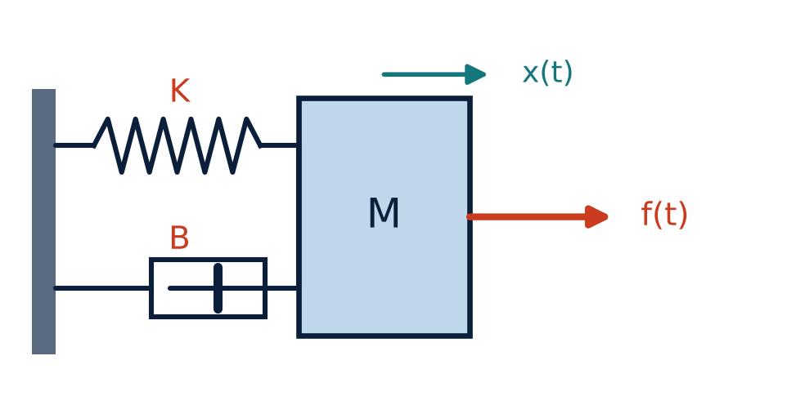
Mass–spring–damper system
U1
Free body diagram of M: f(t) − B ẋ − K x = M ẍ.
M ẍ + B ẋ + K x = f(t).
Laplace (zero initial conditions):
(M s² + B s + K) X(s) = F(s).
Notes:
Apply Newton's second law to the mass.

Slide 6
Transfer function and parameters
U1
X(s)/F(s) = 1/(M s² + B s + K)
ωn = √(K/M)
ζ = B / (2√(KM))
displacement/force
natural frequency
damping ratio
Standard form: X/F = (1/K) ωn² / (s² + 2ζωn s + ωn²).
Static deflection = 1/K for a unit step force.
Notes:
The system is a second order system whose behaviour depends on zeta.

Slide 7
Numerical: single mass
U1
Problem M = 1 kg, B = 3 N·s/m, K = 2 N/m. Find X(s)/F(s), the poles, ωn and ζ.
X/F = 1/(s² + 3s + 2) = 1/[(s + 1)(s + 2)]
Poles at s = −1, −2 (real, distinct)
ωn = √2 = 1.414 rad/s; ζ = 3/(2√2) = 1.06
Answer: Overdamped (ζ > 1); poles −1 and −2
Notes:
Real negative poles: no oscillation.

Slide 8
Procedure for multi-mass systems
U1
1
2
3
4
Mark displacements
Draw free-body diagram
Write equations
Laplace and solve
Assign x1, x2, … to each mass.
ΣF = M ẍ for each mass.
Solve simultaneous algebraic equations for the required ratio.
For each mass draw all forces: springs, dampers, external.
Two masses: (M1s² + B1s + K1 + K12) X1 − K12 X2 = F; −K12 X1 + (M2s² + B2s + K12) X2 = 0
Notes:
A spring or damper between two masses carries force proportional to the relative displacement.

Slide 9
Numerical: two-mass transfer function
U1
Problem Masses M1, M2 joined by spring K12; force F acts on M1; no walls or dampers. Find X2/F.
(M1 s² + K12) X1 − K12 X2 = F
−K12 X1 + (M2 s² + K12) X2 = 0 ⇒ X1 = (M2 s² + K12) X2/K12
Substitute: [(M1s² + K12)(M2s² + K12) − K12²] X2 / K12 = F
X2/F = K12 / [s²(M1M2 s² + K12(M1 + M2))]
Answer: X2/F = K12 / { s² [ M1M2 s² + K12 (M1 + M2) ] }
Notes:
The double pole at the origin shows the rigid-body mode.

Slide 10
Key takeaways
U1
Transfer function = L(output)/L(input) with zero initial conditions
Mass, damper, spring: f = Mẍ, Bẋ, Kx
M s² + B s + K gives ωn = √(K/M), ζ = B/(2√(KM))
Write one force equation per mass
Notes:
To summarise this topic. Transfer function = L(output)/L(input) with zero initial conditions. Mass, damper, spring: f = Mẍ, Bẋ, Kx. M s² + B s + K gives ωn = √(K/M), ζ = B/(2√(KM)). Write one force equation per mass.

Slide 11
Practice questions
U1
Q1. Derive X(s)/F(s) for a mass–spring–damper.
Q2. M = 2 kg, B = 4, K = 8: find ωn and ζ.
Q3. Write equations for two masses connected in series with springs.
Q4. What are the properties of a transfer function?
Notes:
Attempt these on your own, then check your working against your notes and textbook. Derive X(s)/F(s) for a mass–spring–damper. M = 2 kg, B = 4, K = 8: find ωn and ζ. Write equations for two masses connected in series with springs. What are the properties of a transfer function?

