Slide 1

UNIT 1 · 8 hours
Mechanical Rotational Systems and Gear Trains
Introduction and Mathematical Modelling of Physical Systems
Control Systems (22EEG53)
Dr. Mitesh Astik · Dept. of Electrical and Electronics Engineering
NMAM Institute of Technology, Nitte · 2025-26
Notes:
Welcome. In this session we study "Mechanical Rotational Systems and Gear Trains", part of Unit 1 (Introduction and Mathematical Modelling of Physical Systems) of Control Systems.

Slide 2
Learning objectives
U1
List rotational elements and their torque relations
Derive transfer functions for rotational systems
Reflect inertia, friction and torque through gear trains
Obtain ωn and ζ of a rotational system
Syllabus context
Introduction and mathematical modelling of physical systems: open loop and closed loop systems, examples, control system components. Transfer function of physical systems: mechanical systems (translational and rotational), electrical systems, analogous systems, block diagram reduction techniques, signal flow graphs.
Notes:
By the end of this topic you should be able to do the following. List rotational elements and their torque relations. Derive transfer functions for rotational systems. Reflect inertia, friction and torque through gear trains. Obtain ωn and ζ of a rotational system.

Slide 3
Rotational elements
U1
Element | Torque relation | Laplace
Moment of inertia J | T = J d²θ/dt² | J s² Θ(s)
Viscous friction B | T = B dθ/dt | B s Θ(s)
Torsional spring K | T = K θ | K Θ(s)
Same structure as translational elements with T ↔ f and θ ↔ x.
Notes:
Torque in newton metres, angle in radians.

Slide 4
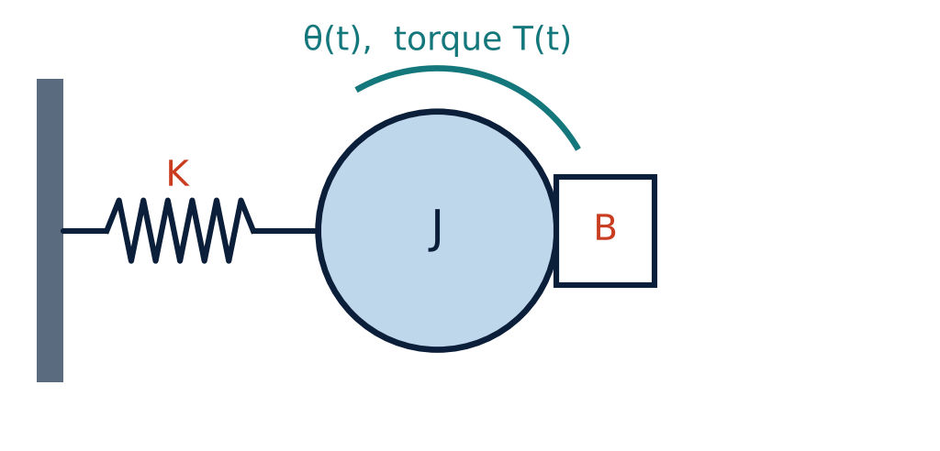
Rotational system
U1
Disc of inertia J on a shaft with torsional spring K and viscous friction B.
Applied torque T(t).
J θ̈ + B θ̇ + K θ = T(t).
Θ(s)/T(s) = 1/(J s² + B s + K).
Notes:
Apply the torque balance on the inertia.

Slide 5
Parameters
U1
Θ(s)/T(s) = 1/(J s² + B s + K)
ωn = √(K/J)
ζ = B / (2√(KJ))
transfer function
natural frequency
damping ratio
Notes:
The same second order standard form results.

Slide 6
Gear trains
U1
Gear ratio
Reflected inertia
Reflected friction
N1 θ1 = N2 θ2, so θ2/θ1 = N1/N2 and T2/T1 = N2/N1.
Referred to shaft 1: J_eq = J1 + (N1/N2)² J2.
B_eq = B1 + (N1/N2)² B2 (same factor).
Parameters are referred to the shaft where the equation is written, multiplied by (N1/N2)² when moved from the load to the motor side.
Notes:
Gears reduce speed and increase torque. A heavy load seen through a large step-down ratio looks light to the motor.

Slide 7
Numerical: rotational system
U1
Problem J = 0.5 kg·m², B = 0.2 N·m·s/rad, K = 2 N·m/rad. Find Θ/T, ωn, ζ and classify.
Θ/T = 1/(0.5 s² + 0.2 s + 2) = 2/(s² + 0.4 s + 4)
ωn = √(K/J) = √4 = 2 rad/s
ζ = B/(2√(KJ)) = 0.2/(2 × 1) = 0.1
Answer: ωn = 2 rad/s, ζ = 0.1: lightly damped (underdamped)
Notes:
Low damping: large oscillations after a disturbance.

Slide 8
Numerical: gear train
U1
Problem Motor shaft J1 = 0.01, gear ratio N1/N2 = 1/10 (load turns slower), load J2 = 4 kg·m². Find the equivalent inertia at the motor shaft.
(N1/N2)² = 0.01
J_eq = J1 + 0.01 × J2 = 0.01 + 0.04
Answer: J_eq = 0.05 kg·m² at the motor shaft
Notes:
The load inertia seen by the motor is reduced by the square of the gear ratio.

Slide 9
Key takeaways
U1
Rotational: T = Jθ̈, Bθ̇, Kθ
Θ/T = 1/(Js² + Bs + K); ωn = √(K/J), ζ = B/(2√(KJ))
Gear trains: θ2/θ1 = N1/N2, T2/T1 = N2/N1
Reflect parameters with (N1/N2)²
Notes:
To summarise this topic. Rotational: T = Jθ̈, Bθ̇, Kθ. Θ/T = 1/(Js² + Bs + K); ωn = √(K/J), ζ = B/(2√(KJ)). Gear trains: θ2/θ1 = N1/N2, T2/T1 = N2/N1. Reflect parameters with (N1/N2)².

Slide 10
Practice questions
U1
Q1. Derive Θ(s)/T(s) for a disc with spring and damper.
Q2. Find J_eq for J1 = 0.02, J2 = 2, N1/N2 = 1/5.
Q3. Why do we reflect inertia through gears?
Q4. J = 1, B = 4, K = 4: find ζ and ωn.
Notes:
Attempt these on your own, then check your working against your notes and textbook. Derive Θ(s)/T(s) for a disc with spring and damper. Find J_eq for J1 = 0.02, J2 = 2, N1/N2 = 1/5. Why do we reflect inertia through gears? J = 1, B = 4, K = 4: find ζ and ωn.

