Slide 1

UNIT 5 · 8 hours
Introduction to Compensators
Compensators, Controllers and State-Space Analysis
Control Systems (22EEG53)
Dr. Mitesh Astik · Dept. of Electrical and Electronics Engineering
NMAM Institute of Technology, Nitte · 2025-26
Notes:
Welcome. In this session we study "Introduction to Compensators", part of Unit 5 (Compensators, Controllers and State-Space Analysis) of Control Systems.

Slide 2
Learning objectives
U5
Explain why compensation is needed
Describe series, feedback and feed-forward compensation
Compare lead, lag and lag-lead compensators
Choose a compensator type for a given deficiency
Syllabus context
Compensators and controllers: introduction to compensators, lag, lead and lag-lead compensators, P, PI and PID controllers.
Notes:
By the end of this topic you should be able to do the following. Explain why compensation is needed. Describe series, feedback and feed-forward compensation. Compare lead, lag and lag-lead compensators. Choose a compensator type for a given deficiency.

Slide 3
Why adjust gain is not enough
U5
Problem Unity feedback G = K/[s(s + 2)]. Required Kv = 20. What are ζ and Mp with this gain?
Kv = K/2 = 20 ⇒ K = 40
ωn = √40 = 6.32 rad/s; ζ = 2/(2 × 6.32) = 0.158
Mp = exp(−π × 0.158/√(1 − 0.025)) = 60.5 %
Answer: Accuracy is met but overshoot ≈ 60 %: a compensator is needed
Notes:
Increasing gain to improve accuracy has reduced damping so much that the transient is unacceptable.

Slide 4
Compensation
U5
Definition: adding extra components (compensator) to reshape the system so that specifications are met.
Specifications: steady-state accuracy, transient response (Mp, ts), stability margins (GM, PM), bandwidth.
Reasons: gain adjustment alone cannot satisfy conflicting requirements.
Design domains: root locus (s-plane) or Bode (frequency domain).
Notes:
A compensator modifies the open loop transfer function to improve performance.

Slide 5
Types of compensation
U5
Series (cascade)
Feedback (parallel)
Feed-forward
Compensator Gc(s) placed in the forward path before the plant. Most common and simplest.
Compensator in the feedback path, e.g. tachometer (velocity) feedback; reduces effect of plant variations.
Compensator acts on the reference or disturbance ahead of the loop; improves tracking or rejects measurable disturbances.
Notes:
Most designs in this course use series compensation.

Slide 6
Lead, lag and lag-lead at a glance
U5
Compensator | Form | Effect
Lead | (1 + aTs)/(1 + Ts), a > 1 | Adds phase lead: ↑ PM, ↑ bandwidth, faster response
Lag | (1 + Ts)/(1 + βTs), β > 1 | Cuts high-frequency gain: ↑ steady-state accuracy, ↓ bandwidth
Lag-lead | Lead × lag | Both: better accuracy and transient
P, PI, PID | Kp, Kp(1 + 1/Tis), … | Controllers: proportional, integral, derivative action
Notes:
Choose the compensator that fixes the main deficiency.

Slide 7
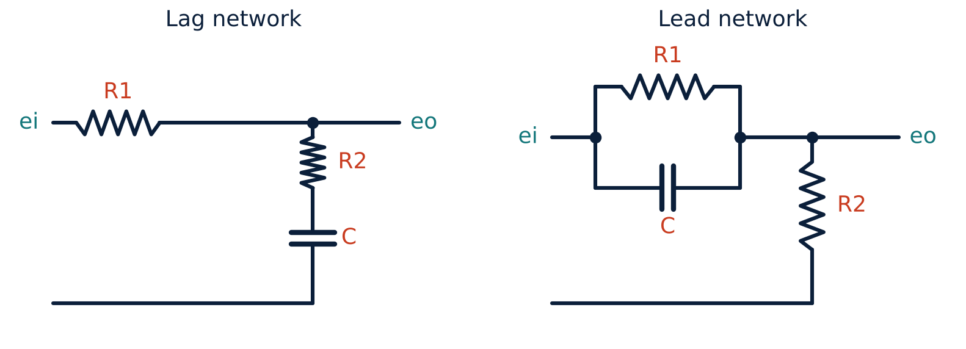
Lag and lead RC networks
U5
Lag network: Gc = (1 + sR2C)/[1 + s(R1 + R2)C].
Lead network: Gc = (1/a)(1 + aTs)/(1 + Ts), a = (R1 + R2)/R2, T = R1R2C/(R1 + R2).
Both are passive: attenuate at some frequencies.
Gain loss recovered by an amplifier.
Notes:
These are the networks you will build in the lab.

Slide 8
Key takeaways
U5
Compensators reshape the loop to meet specifications
Series, feedback and feed-forward compensation
Lead: transient; lag: steady-state accuracy; lag-lead: both
RC networks implement lead and lag
Notes:
To summarise this topic. Compensators reshape the loop to meet specifications. Series, feedback and feed-forward compensation. Lead: transient; lag: steady-state accuracy; lag-lead: both. RC networks implement lead and lag.

Slide 9
Practice questions
U5
Q1. Why is gain adjustment alone often inadequate?
Q2. Compare series and feedback compensation.
Q3. Which compensator improves steady-state error? Which improves PM?
Q4. Write the transfer functions of RC lag and lead networks.
Notes:
Attempt these on your own, then check your working against your notes and textbook. Why is gain adjustment alone often inadequate? Compare series and feedback compensation. Which compensator improves steady-state error? Which improves PM? Write the transfer functions of RC lag and lead networks.

