Slide 1

UNIT 5 · 8 hours
Lead Compensator
Compensators, Controllers and State-Space Analysis
Control Systems (22EEG53)
Dr. Mitesh Astik · Dept. of Electrical and Electronics Engineering
NMAM Institute of Technology, Nitte · 2025-26
Notes:
Welcome. In this session we study "Lead Compensator", part of Unit 5 (Compensators, Controllers and State-Space Analysis) of Control Systems.

Slide 2
Learning objectives
U5
Write the transfer function and frequency response of a lead compensator
Explain its effect on phase margin, bandwidth and transient response
Design a lead compensator using the Bode plot
Implement it with an RC network
Syllabus context
Compensators and controllers: introduction to compensators, lag, lead and lag-lead compensators, P, PI and PID controllers.
Notes:
By the end of this topic you should be able to do the following. Write the transfer function and frequency response of a lead compensator. Explain its effect on phase margin, bandwidth and transient response. Design a lead compensator using the Bode plot. Implement it with an RC network.

Slide 3
Lead compensator
U5
Gc(s) = (1 + aTs)/(1 + Ts), a > 1
φm = sin⁻¹[(a − 1)/(a + 1)]
ωm = 1/(T√a)
zero at −1/(aT), pole at −1/T
maximum phase lead
frequency of φm; gain boost 10 log a dB
Zero closer to the origin than the pole: adds phase lead (positive phase).
a = (1 + sin φm)/(1 − sin φm).
Notes:
The lead compensator is a high pass filter; it raises gain at high frequency.

Slide 4
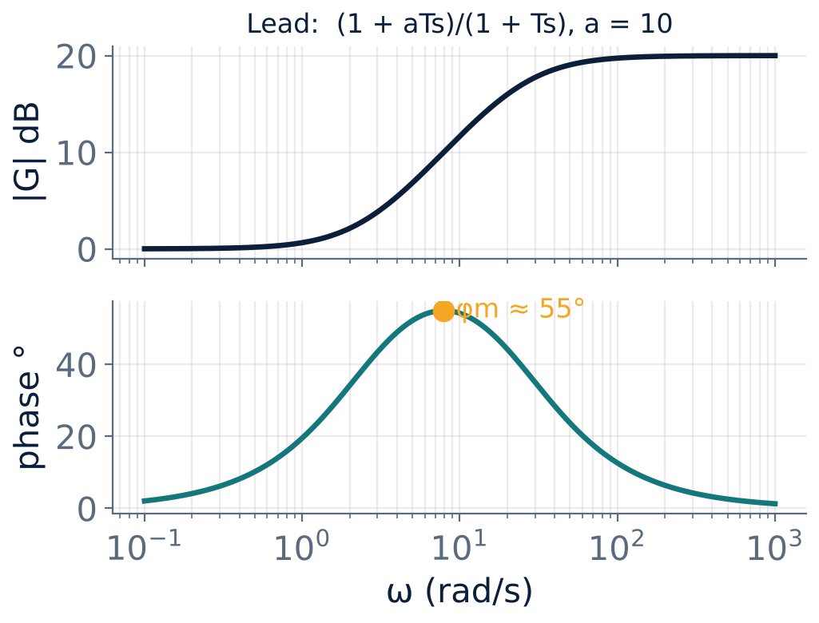
Bode plot of a lead network
U5
Gain rises by 20 log a dB between 1/(aT) and 1/T.
Phase lead peaks at ωm: 55° for a = 10.
Place ωm at the new gain crossover frequency.
Notes:
The lead compensator contributes positive phase near the crossover, increasing the phase margin.

Slide 5
Effect of lead compensation
U5
Transient response
Steady state
Cautions
Increases PM, damping and bandwidth: smaller overshoot and faster rise time.
Little effect (unless gain is raised to recover attenuation).
Increases high-frequency gain: amplifies noise; needs extra gain a if implemented with a passive network.
Notes:
Lead is used when the steady-state error is fine but the response is too oscillatory or slow.

Slide 6
Bode design procedure (lead)
U5
1
2
3
4
5
Set K
Find PM
Required lead
Compute a
Locate ωm
Choose K for the required steady-state error.
Draw Bode of KG; read PM.
φm = PM(required) − PM(existing) + 5°–12°.
a = (1 + sin φm)/(1 − sin φm).
Where |KG| = −10 log a dB; T = 1/(ωm√a). Check.
Gc(s) = (1 + aTs)/(1 + Ts) with an additional gain a if built from the passive network.
Notes:
The extra phase is added because the crossover moves right after compensation, where the plant phase is lower.

Slide 7
Numerical: lead design
U5
Problem G = K/[s(s + 2)], Kv = 20 and PM ≥ 50°. Design a lead compensator.
K = 40: ωgc = 6.17 rad/s, PM = 18°
Need φm = 50 − 18 + 5 ≈ 37° ⇒ a = (1 + sin37°)/(1 − sin37°) = 4
Boost 10 log 4 = 6 dB: place ωm where |G| = −6 dB ⇒ ωm = 8.83 rad/s
T = 1/(8.83 × 2) = 0.0566 s; aT = 0.226 s; Gc = (1 + 0.226s)/(1 + 0.0566s)
Answer: New ωgc = 8.83 rad/s, PM ≈ 50°, Kv = 20 retained
Notes:
Verify: the plant phase at the new crossover is minus 167 degrees; the lead adds 37 degrees, giving a 50 degree margin.

Slide 8
RC lead network
U5
Gc(s) = (1/a)(1 + aTs)/(1 + Ts) with a = (R1 + R2)/R2, T = R1R2C/(R1 + R2).
Attenuation 1/a is compensated by an amplifier of gain a.
Example: R1 = 90 kΩ, R2 = 10 kΩ ⇒ a = 10; C = 0.1 µF ⇒ T = 0.9 ms; φm = 54.9° at ωm = 351 rad/s.
Matches Experiment 10 of the laboratory.
Notes:
The lead network is built in the laboratory and its Bode plot is verified using MATLAB.

Slide 9
Key takeaways
U5
Lead: Gc = (1 + aTs)/(1 + Ts), a > 1; φm = sin⁻¹[(a − 1)/(a + 1)]
Increases phase margin and bandwidth: faster, less overshoot
ωm = 1/(T√a), placed at the new crossover
Amplifies high-frequency noise
Notes:
To summarise this topic. Lead: Gc = (1 + aTs)/(1 + Ts), a > 1; φm = sin⁻¹[(a − 1)/(a + 1)]. Increases phase margin and bandwidth: faster, less overshoot. ωm = 1/(T√a), placed at the new crossover. Amplifies high-frequency noise.

Slide 10
Practice questions
U5
Q1. Derive φm and ωm for the lead network.
Q2. G = 20/[s(s + 4)]: design a lead compensator for PM = 45°.
Q3. Compare lead and lag compensators.
Q4. Find T and a for φm = 45° at 10 rad/s.
Notes:
Attempt these on your own, then check your working against your notes and textbook. Derive φm and ωm for the lead network. G = 20/[s(s + 4)]: design a lead compensator for PM = 45°. Compare lead and lag compensators. Find T and a for φm = 45° at 10 rad/s.

