Slide 1

UNIT 5 · 8 hours
P, PI and PID Controllers
Compensators, Controllers and State-Space Analysis
Control Systems (22EEG53)
Dr. Mitesh Astik · Dept. of Electrical and Electronics Engineering
NMAM Institute of Technology, Nitte · 2025-26
Notes:
Welcome. In this session we study "P, PI and PID Controllers", part of Unit 5 (Compensators, Controllers and State-Space Analysis) of Control Systems.

Slide 2
Learning objectives
U5
Write the transfer functions of P, PI, PD and PID controllers
Explain the effect of each action on the response
Tune a PID controller by the Ziegler–Nichols method
Compare PID with lead/lag compensation
Syllabus context
Compensators and controllers: introduction to compensators, lag, lead and lag-lead compensators, P, PI and PID controllers.
Notes:
By the end of this topic you should be able to do the following. Write the transfer functions of P, PI, PD and PID controllers. Explain the effect of each action on the response. Tune a PID controller by the Ziegler–Nichols method. Compare PID with lead/lag compensation.

Slide 3
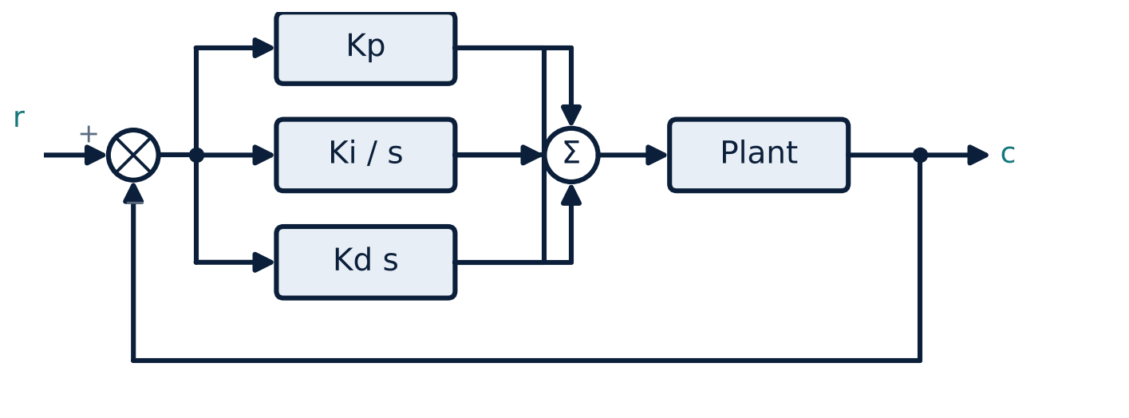
PID controller structure
U5
u(t) = Kp e + Ki ∫e dt + Kd de/dt.
Gc(s) = Kp + Ki/s + Kd s = Kp[1 + 1/(Ti s) + Td s].
Ki = Kp/Ti, Kd = Kp Td.
Parallel branches summed to drive the plant.
Notes:
PID is the most widely used industrial controller.

Slide 4
Controller actions
U5
Action | Gc(s) | Role
P | Kp | Reduces error and rise time; leaves a steady-state error
I (PI) | Kp(1 + 1/Tis) | Eliminates steady-state error; adds a pole at the origin (slower, less stable)
D (PD) | Kp(1 + Tds) | Anticipates; adds damping; speeds response; amplifies noise
PID | Kp(1 + 1/Tis + Tds) | Combines all three
Notes:
Proportional action responds to present error, integral to the accumulated error, derivative to the rate of change.

Slide 5
Effect of increasing each gain (typical)
U5
Gain increased | Rise time | Overshoot | Settling time | Steady-state error
Kp | Decrease | Increase | Small change | Decrease
Ki | Decrease | Increase | Increase | Eliminate
Kd | Small change | Decrease | Decrease | No change
Use as a guide for manual tuning; interactions exist.
Notes:
These trends are the standard guidelines for tuning.

Slide 6
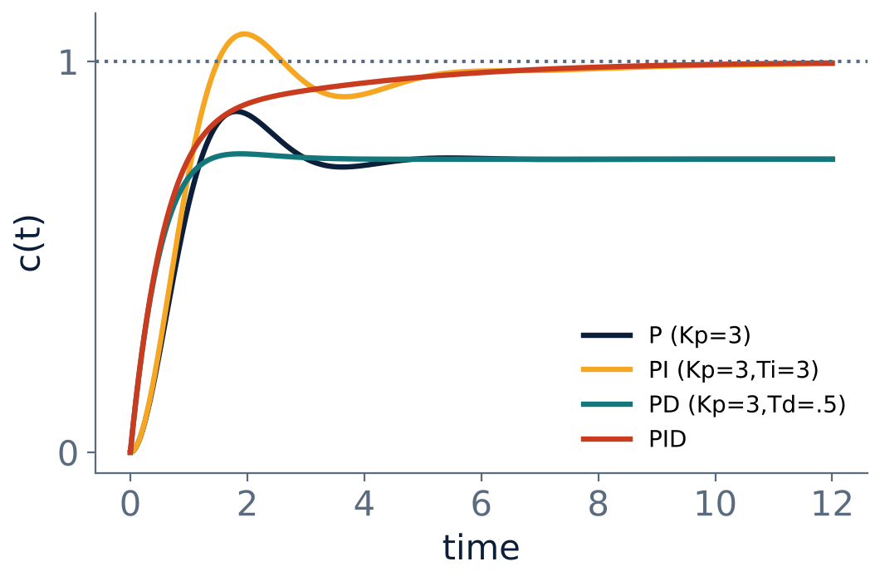
Step responses with P, PI, PD and PID
U5
P: fast but steady-state error remains.
PI: error eliminated, some overshoot.
PD: lower overshoot, faster, error remains.
PID: best compromise.
Notes:
Plant 1/(s+1)²: the PID response settles quickly with no steady-state error.

Slide 7
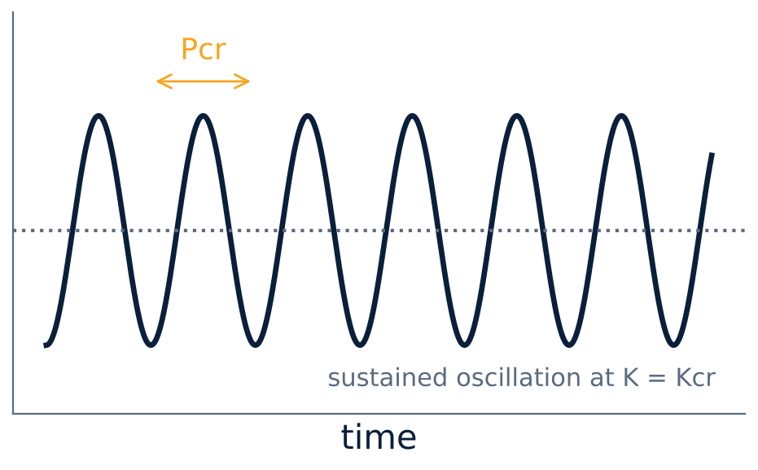
Ziegler–Nichols tuning (ultimate gain method)
U5
Set Ti = ∞, Td = 0; raise Kp until sustained oscillation: Kcr, period Pcr.
P: Kp = 0.5Kcr.
PI: Kp = 0.45Kcr, Ti = Pcr/1.2.
PID: Kp = 0.6Kcr, Ti = 0.5Pcr, Td = 0.125Pcr.
Notes:
These rules give a quarter amplitude decay response and a starting point for fine tuning.

Slide 8
Numerical: ZN tuning
U5
Problem For the plant K/[s(s+1)(s+2)] the loop oscillates at K = 6 with ω = √2 rad/s (Routh). Find PID settings.
Kcr = 6; Pcr = 2π/ω = 2π/1.414 = 4.44 s
Kp = 0.6 × 6 = 3.6
Ti = 0.5 × 4.44 = 2.22 s; Td = 0.125 × 4.44 = 0.555 s
Answer: Kp = 3.6, Ti = 2.22 s, Td = 0.555 s (Ki = 1.62, Kd = 2.0)
Notes:
This links the Routh-Hurwitz result to controller tuning.

Slide 9
Key takeaways
U5
PID: Kp + Ki/s + Kd s
P: speed; I: removes steady-state error; D: damping
ZN: PID Kp = 0.6Kcr, Ti = 0.5Pcr, Td = 0.125Pcr
PI ≈ lag action; PD ≈ lead action
Notes:
To summarise this topic. PID: Kp + Ki/s + Kd s. P: speed; I: removes steady-state error; D: damping. ZN: PID Kp = 0.6Kcr, Ti = 0.5Pcr, Td = 0.125Pcr. PI ≈ lag action; PD ≈ lead action.

Slide 10
Practice questions
U5
Q1. Write the transfer function of a PID controller.
Q2. Explain the effect of increasing Ki and Kd.
Q3. Kcr = 10, Pcr = 2 s: find ZN PID values.
Q4. Why does integral action eliminate steady-state error?
Notes:
Attempt these on your own, then check your working against your notes and textbook. Write the transfer function of a PID controller. Explain the effect of increasing Ki and Kd. Kcr = 10, Pcr = 2 s: find ZN PID values. Why does integral action eliminate steady-state error?

