Slide 1

UNIT 5 · 8 hours
Introduction to State-Variable Analysis
Compensators, Controllers and State-Space Analysis
Control Systems (22EEG53)
Dr. Mitesh Astik · Dept. of Electrical and Electronics Engineering
NMAM Institute of Technology, Nitte · 2025-26
Notes:
Welcome. In this session we study "Introduction to State-Variable Analysis", part of Unit 5 (Compensators, Controllers and State-Space Analysis) of Control Systems.

Slide 2
Learning objectives
U5
Define state, state variables and state space
Write the state and output equations
Draw the state-space block diagram
List advantages of the state-space approach over the transfer function
Syllabus context
Introduction to state variable analysis: modelling of physical systems using the state-space approach, advantages of state space over the transfer function approach, state-space model using the physical variable approach for SISO systems.
Notes:
By the end of this topic you should be able to do the following. Define state, state variables and state space. Write the state and output equations. Draw the state-space block diagram. List advantages of the state-space approach over the transfer function.

Slide 3
Basic definitions
U5
State
State variables x1…xn
State vector and space
The minimum set of variables whose values at t0 plus the input for t ≥ t0 determine the future behaviour.
The variables of that set; n = order of the system = number of independent energy storage elements.
x = [x1 … xn]ᵀ; the n-dimensional space of x is the state space.
Notes:
The state summarises all the past history needed to predict the future.

Slide 4
State-space model (LTI, SISO)
U5
ẋ = A x + B u
y = C x + D u
state equation
output equation
x: n×1 state; u: input; y: output.
A: n×n system matrix; B: n×1 input matrix; C: 1×n output matrix; D: direct transmission (often 0).
Transfer function: G(s) = C (sI − A)⁻¹ B + D; poles = eigenvalues of A (det(sI − A) = 0).
Notes:
The state equation is first order vector differential equation.

Slide 5
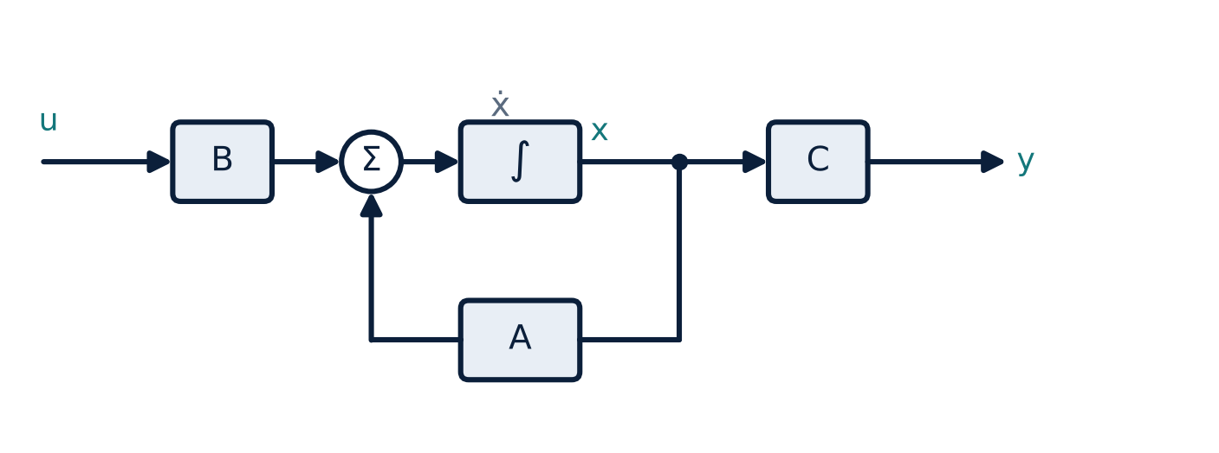
State-space block diagram
U5
Integrators hold the states.
A: state feedback; B: input matrix; C: output matrix.
Each state variable is the output of an integrator.
Notes:
The block diagram shows the vector flow of signals.

Slide 6
State space versus transfer function
U5
Transfer function
State space
Input–output only
Zero initial conditions
Single-input single-output (mainly)
Linear time-invariant systems only
Describes internal states
Includes initial conditions
Multi-input multi-output easily
Time-varying and non-linear systems
Suited to computers and modern/optimal control
Notes:
State space is the basis of modern control theory.

Slide 7
Advantages of state-space analysis
U5
Handles multiple inputs and outputs naturally (MIMO).
Includes initial conditions and internal behaviour.
Applicable to non-linear and time-varying systems (after linearisation).
Convenient for computer simulation (MATLAB ss, lsim).
Foundation for state feedback, observers and optimal control.
Controllability and observability tests possible.
Notes:
These advantages explain why state space is widely used in advanced control.

Slide 8
Key takeaways
U5
State: minimum set of variables describing the system's condition
ẋ = Ax + Bu, y = Cx + Du
G(s) = C(sI − A)⁻¹B + D; poles = eigenvalues of A
Advantages: MIMO, initial conditions, nonlinear/time-varying, computer friendly
Notes:
To summarise this topic. State: minimum set of variables describing the system's condition. ẋ = Ax + Bu, y = Cx + Du. G(s) = C(sI − A)⁻¹B + D; poles = eigenvalues of A. Advantages: MIMO, initial conditions, nonlinear/time-varying, computer friendly.

Slide 9
Practice questions
U5
Q1. Define state, state variable and state vector.
Q2. Write the standard state and output equations.
Q3. List four advantages of state space over transfer function.
Q4. How are poles related to A?
Notes:
Attempt these on your own, then check your working against your notes and textbook. Define state, state variable and state vector. Write the standard state and output equations. List four advantages of state space over transfer function. How are poles related to A?

