Slide 1

UNIT 1 · 9 hours
Mesh and Nodal Analysis
Circuit Fundamentals
Basic Electrical and Electronics Engineering (EEE103)
Dr. Mitesh Astik · Dept. of Electrical and Electronics Engineering
NMAM Institute of Technology, Nitte · 2025-26
Notes:
Welcome. In this session we study "Mesh and Nodal Analysis", part of Unit 1 (Circuit Fundamentals) of Basic Electrical and Electronics Engineering. We solve DC networks systematically using Kirchhoff's laws.

Slide 2
Learning objectives
U1
State Kirchhoff's current and voltage laws
Write mesh equations for a planar network with independent voltage sources
Write nodal equations using a reference node
Choose between mesh and nodal analysis for a given circuit
Solve for branch currents, node voltages and power
Syllabus context
Basic nodal and mesh analysis excited by independent DC voltage sources, Power and Energy. Generation of sinusoidal voltage, frequency, average value, RMS value, form factor and peak factor, phasor representation of alternating quantities.
Notes:
By the end of this topic you should be able to do the following. State Kirchhoff's current and voltage laws. Write mesh equations for a planar network with independent voltage sources. Write nodal equations using a reference node. Choose between mesh and nodal analysis for a given circuit. Solve for branch currents, node voltages and power.

Slide 3
Why systematic circuit analysis?
U1
Goal: find unknown voltages, currents and power in a network of sources and resistors.
Ohm's law alone is not enough once a circuit has several loops and sources.
Two systematic methods: mesh analysis (based on KVL) and nodal analysis (based on KCL).
Scope here: networks excited by independent DC voltage sources.
Same ideas model mechanical, thermal and hydraulic systems by analogy.
Notes:
Real circuits contain many elements. Instead of guessing, we use Kirchhoff's two laws to write a set of equations, then solve them. Mesh analysis uses voltage law around loops; nodal analysis uses current law at junctions.

Slide 4
Kirchhoff's laws recap
U1
KCL (current law)
KVL (voltage law)
Sign convention
The algebraic sum of currents at a node is zero.
Σ I(in) = Σ I(out)
The algebraic sum of voltages around any closed loop is zero.
Σ EMF = Σ IR drops
Current entering a resistor makes that end positive. Cross a source from − to + and the voltage rises.
Notes:
KCL expresses conservation of charge; KVL expresses conservation of energy. Both are used in every analysis technique.

Slide 5
Mesh analysis: procedure
U1
1
2
3
4
5
Mark meshes
Mark polarities
Apply KVL
Rearrange
Solve
Assign a clockwise loop current to each window of the network.
Sum of EMFs = sum of IR drops. A shared resistor carries (I1 − I2).
Write as simultaneous equations in the loop currents.
Branch current = algebraic sum of the loop currents through it.
Draw + and − on every resistor consistent with the loop current.
A negative loop current only means the real current opposes the assumed direction.
Notes:
The word mesh comes from the similarity of closed loops to a wire mesh fence. Remember that a shared branch carries the difference of the two loop currents when the loops circulate in the same direction.

Slide 6
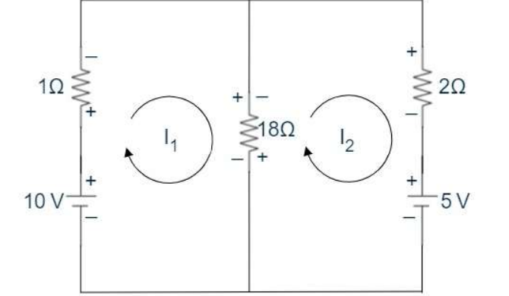
Mesh example: two-source network
U1
10 V source with 1 Ω; shared 18 Ω; 2 Ω with 5 V source.
Mesh 1: 10 − 1·I1 − 18(I1 − I2) = 0
Mesh 2: −18(I2 − I1) − 2·I2 − 5 = 0
Rearranged: −19 I1 + 18 I2 = −10 and 18 I1 − 20 I2 = 5
I1 = 1.964 A, I2 = 1.518 A; I(18 Ω) = 0.446 A
P(18 Ω) = I²R = 3.59 W, P(10 V source) = 19.64 W
Notes:
This is the example from your notes. Solving gives I one equals one point nine six four amps and I two equals one point five one eight amps.

Slide 7
Worked example: three-branch network
U1
Problem 20 V and 30 V sources with 5 Ω, 15 Ω and a shared 8 Ω. Find the current in the 8 Ω resistor.
Mesh 1: 20 = I1(5 + 8) − 8·I2 → 13 I1 − 8 I2 = 20
Mesh 2: −30 = I2(8 + 15) − 8·I1 → −8 I1 + 23 I2 = −30
Determinant Δ = 13·23 − 64 = 235
I1 = (20·23 − 240)/235 = 0.936 A; I2 = (13·(−30) + 160)/235 = −0.979 A
Current in 8 Ω = I1 − I2
Answer: 1.915 A in the 8 Ω resistor
Notes:
Eliminate by determinants or substitution. Always verify by substituting back: thirteen times zero point nine three six minus eight times minus zero point nine seven nine equals twenty.

Slide 8
Nodal analysis: procedure
U1
1
2
3
4
Choose reference
Label nodes
Apply KCL
Solve
Pick a node as 0 V (ground), usually the one with most branches.
Give the other N − 1 nodes voltages V1, V2, …
Write branch currents as (Va − Vb)/R and sum to zero at each node.
Solve N − 1 simultaneous equations for the node voltages.
Branch current = (voltage difference across the branch) / resistance.
Notes:
For a network of N nodes, only N minus one independent KCL equations exist.

Slide 9
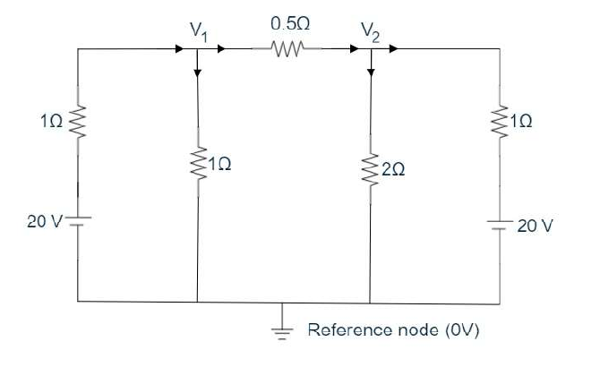
Nodal example
U1
Node 1: V1/1 + (V1 − V2)/0.5 = (20 − V1)/1
→ 4V1 − 2V2 = 20
Node 2: (V1 − V2)/0.5 = (V2 − 20)/1 + V2/2
→ 2V1 − 3.5V2 = −20
Solve: V1 = 11 V, V2 = 12 V
Notes:
Two unknown node voltages and two equations. Solving gives V one equals eleven volts and V two equals twelve volts.

Slide 10
Mesh versus nodal
U1
Mesh analysis
Nodal analysis
Uses KVL
Unknowns: loop currents
Equations = number of meshes
Best for many series elements and voltage sources
Uses KCL
Unknowns: node voltages
Equations = nodes − 1
Best for many parallel branches and current sources
Notes:
Choose the method that gives fewer equations.

Slide 11
Key takeaways
U1
KVL: sum of EMFs equals sum of voltage drops around a mesh
KCL: currents at a node sum to zero
Mesh analysis gives loop currents; branch current = algebraic sum of loop currents
Nodal analysis gives node voltages with one node as reference
Pick the method with fewer equations
Notes:
To summarise this topic. KVL: sum of EMFs equals sum of voltage drops around a mesh. KCL: currents at a node sum to zero. Mesh analysis gives loop currents; branch current = algebraic sum of loop currents. Nodal analysis gives node voltages with one node as reference. Pick the method with fewer equations.

Slide 12
Practice questions
U1
Q1. Using mesh analysis, find the current in each branch for 20 V and 30 V sources with 5 Ω, 8 Ω and 15 Ω resistors.
Q2. Find the node voltages V1 and V2 of the network in the nodal example.
Q3. A network has 5 nodes and 4 meshes. How many equations does each method need?
Q4. Why can a negative loop current appear in the solution?
Notes:
Attempt these on your own, then check your working against your notes and textbook. Using mesh analysis, find the current in each branch for 20 V and 30 V sources with 5 Ω, 8 Ω and 15 Ω resistors. Find the node voltages V1 and V2 of the network in the nodal example. A network has 5 nodes and 4 meshes. How many equations does each method need? Why can a negative loop current appear in the solution?

