Slide 1

UNIT 1 · 9 hours
Analysis of Pure R, L and C Circuits
Circuit Fundamentals
Basic Electrical and Electronics Engineering (EEE103)
Dr. Mitesh Astik · Dept. of Electrical and Electronics Engineering
NMAM Institute of Technology, Nitte · 2025-26
Notes:
Welcome. In this session we study "Analysis of Pure R, L and C Circuits", part of Unit 1 (Circuit Fundamentals) of Basic Electrical and Electronics Engineering.

Slide 2
Learning objectives
U1
Derive current and power in pure R, L and C
Define inductive and capacitive reactance
Draw phasor diagrams and waveforms
Solve numericals on each element
Syllabus context
Analysis of R, L, C, RL, RC and RLC series circuits, real power, reactive power, apparent power and power factor.
Notes:
By the end of this topic you should be able to do the following. Derive current and power in pure R, L and C. Define inductive and capacitive reactance. Draw phasor diagrams and waveforms. Solve numericals on each element.

Slide 3
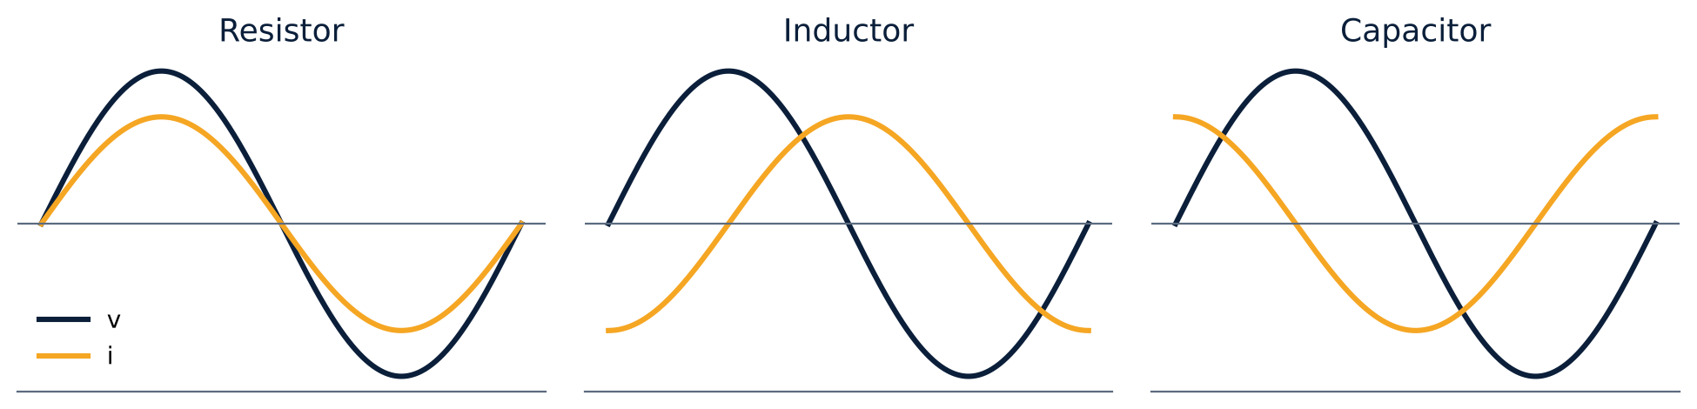
Overview: v and i in R, L and C
U1
R: i in phase with v.
L: i lags v by 90°.
C: i leads v by 90°.
Power: R consumes, L and C only store and return energy.
Notes:
The relationship between voltage and current differs for each element.

Slide 4
Pure resistor
U1
v = Vm sin ωt; i = v/R = Im sin ωt, Im = Vm/R
Current and voltage in phase (φ = 0°).
p = vi = Vm Im sin²ωt = (VmIm/2)(1 − cos 2ωt)
Average power P = VmIm/2 = V·I (RMS values)
Power factor = 1
Notes:
Instantaneous power is always positive in a resistor, so energy only flows in one direction: from source to load.

Slide 5
Pure inductor
U1
v = L di/dt, so i = (1/L)∫v dt = Im sin(ωt − 90°)
Inductive reactance XL = ωL = 2πfL (Ω); Im = Vm/XL
Current lags voltage by 90°.
p = −(VmIm/2) sin 2ωt: average power is zero.
Energy ½LI² is stored in the magnetic field and returned each quarter cycle.
Notes:
In an inductor the induced emf opposes the change of current, which makes the current lag. XL increases with frequency: at DC an inductor is a short circuit.

Slide 6
Pure capacitor
U1
i = C dv/dt = ωC Vm cos ωt = Im sin(ωt + 90°)
Capacitive reactance XC = 1/(ωC) = 1/(2πfC) (Ω)
Current leads voltage by 90°.
Average power is zero; energy ½CV² is stored in the electric field.
XC falls with frequency: at DC a capacitor is an open circuit.
Notes:
A capacitor passes high frequencies easily and blocks DC.

Slide 7
Comparison of the three elements
U1
 | R | L | C
Opposition | R (Ω) | XL = 2πfL | XC = 1/2πfC
Phase of i w.r.t. v | 0° | −90° (lags) | +90° (leads)
Average power | VI | 0 | 0
Energy | dissipated | magnetic field | electric field
Effect of f | none | XL ∝ f | XC ∝ 1/f
Notes:
ELI the ICE man: in an inductor E leads I; in a capacitor I leads E.

Slide 8
Numerical: inductor
U1
Problem A pure inductor takes 20 A from a 230 V, 50 Hz supply. Find XL, L, power and the equations of v and i.
XL = V/I = 230/20 = 11.5 Ω
L = XL/(2πf) = 11.5/314 = 0.0366 H
Vm = 325.27 V, Im = 28.28 A, ω = 314
P = 0
Answer: v = 325.27 sin314t V, i = 28.28 sin(314t − 90°) A
Notes:
Peak values are root two times the RMS values.

Slide 9
Numerical: capacitor
U1
Problem A 400 µF capacitor is connected to 230 V, 50 Hz. Find XC, the RMS current and the equations.
XC = 1/(2π·50·400×10⁻⁶) = 7.95 Ω
I = V/XC = 230/7.95 = 28.93 A; Im = 40.91 A
Answer: i = 40.91 sin(314t + 90°) A, P = 0
Notes:
Notice the large current drawn by even a modest capacitor on mains.

Slide 10
Key takeaways
U1
R: in phase; L: current lags 90°; C: current leads 90°
XL = 2πfL, XC = 1/(2πfC)
Average power in pure L or C is zero
Reactive elements store and return energy
Notes:
To summarise this topic. R: in phase; L: current lags 90°; C: current leads 90°. XL = 2πfL, XC = 1/(2πfC). Average power in pure L or C is zero. Reactive elements store and return energy.

Slide 11
Practice questions
U1
Q1. A 50 Ω resistor is on 230 V, 50 Hz. Find I, P and write i(t).
Q2. Find the reactance of a 0.1 H inductor at 50 Hz and 500 Hz.
Q3. A 100 µF capacitor on 230 V, 50 Hz: find current and reactive power.
Q4. At what frequency does a 10 mH inductor have a reactance of 100 Ω?
Notes:
Attempt these on your own, then check your working against your notes and textbook. A 50 Ω resistor is on 230 V, 50 Hz. Find I, P and write i(t). Find the reactance of a 0.1 H inductor at 50 Hz and 500 Hz. A 100 µF capacitor on 230 V, 50 Hz: find current and reactive power. At what frequency does a 10 mH inductor have a reactance of 100 Ω?

