Slide 1

UNIT 1 · 9 hours
Analysis of the RLC Series Circuit
Circuit Fundamentals
Basic Electrical and Electronics Engineering (EEE103)
Dr. Mitesh Astik · Dept. of Electrical and Electronics Engineering
NMAM Institute of Technology, Nitte · 2025-26
Notes:
Welcome. In this session we study "Analysis of the RLC Series Circuit", part of Unit 1 (Circuit Fundamentals) of Basic Electrical and Electronics Engineering.

Slide 2
Learning objectives
U1
Draw the phasor diagram for the series RLC circuit
Find Z, I, φ and voltages across each element
Classify as inductive, capacitive or resistive
Explain series resonance
Syllabus context
Analysis of R, L, C, RL, RC and RLC series circuits, real power, reactive power, apparent power and power factor.
Notes:
By the end of this topic you should be able to do the following. Draw the phasor diagram for the series RLC circuit. Find Z, I, φ and voltages across each element. Classify as inductive, capacitive or resistive. Explain series resonance.

Slide 3
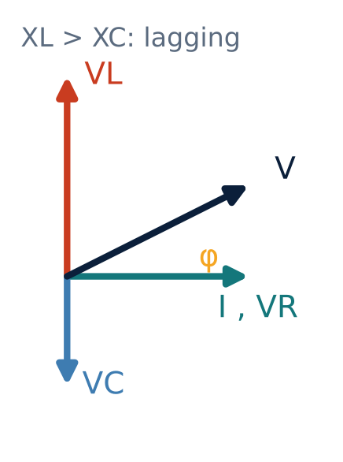
Series RLC phasor diagram
U1
Reference: current I.
VR in phase, VL leads by 90°, VC lags by 90°.
VL and VC are in opposition: net reactive voltage = VL − VC.
V = √(VR² + (VL − VC)²) = I Z
Notes:
In the series RLC circuit the inductive and capacitive reactive voltages are in opposition.

Slide 4
Impedance of the RLC series circuit
U1
X = XL − XC
Z = √(R² + (XL − XC)²)
φ = tan⁻¹[(XL − XC)/R]
net reactance
impedance (Ω)
phase angle
XL > XC: net inductive, current lags.
XL < XC: net capacitive, current leads.
XL = XC: purely resistive, φ = 0, Z = R (resonance).
Notes:
The net reactance is the difference of the inductive and capacitive reactance.

Slide 5
Three cases
U1
Condition | Nature | Current vs voltage | Power factor
XL > XC | Inductive | I lags V | Lagging
XL < XC | Capacitive | I leads V | Leading
XL = XC | Resistive | I in phase | Unity (resonance)
Notes:
Resonance occurs at f0 equals one over two pi root LC.

Slide 6
Numerical: RLC series
U1
Problem R = 10 Ω, L = 0.1 H, C = 100 µF in series across 230 V, 50 Hz. Find Z, I, φ, voltages and P.
XL = 31.42 Ω; XC = 31.83 Ω; X = −0.41 Ω
Z = √(10² + 0.41²) = 10.01 Ω
I = 230/10.01 = 22.98 A; φ ≈ 2.3° leading (almost resonance)
VR = 229.8 V, VL = 722 V, VC = 731 V
P = I²R = 22.98² × 10
Answer: I ≈ 23 A, P ≈ 5.28 kW, near-unity pf
Notes:
Near resonance the voltage across L and C can be several times the supply voltage.

Slide 7
Series resonance
U1
Condition: XL = XC, so ω0 = 1/√(LC) and f0 = 1/(2π√(LC)).
Impedance is minimum (Z = R); current is maximum (I = V/R).
Voltages VL and VC can far exceed the supply voltage: voltage magnification Q = XL/R.
Applications: radio tuning, filters.
Example: L = 0.1 H, C = 100 µF → f0 = 50.3 Hz.
Notes:
At resonance the reactive voltages cancel each other, leaving only the resistive drop.

Slide 8
Key takeaways
U1
X = XL − XC, Z = √(R² + X²)
XL > XC lagging; XL < XC leading; XL = XC resonance
At resonance Z = R, current is maximum, pf = 1
f0 = 1/(2π√LC)
Notes:
To summarise this topic. X = XL − XC, Z = √(R² + X²). XL > XC lagging; XL < XC leading; XL = XC resonance. At resonance Z = R, current is maximum, pf = 1. f0 = 1/(2π√LC).

Slide 9
Practice questions
U1
Q1. R = 5 Ω, XL = 12 Ω, XC = 7 Ω. Find Z and φ.
Q2. Find the resonant frequency for L = 20 mH, C = 10 µF.
Q3. A series RLC circuit has R = 20 Ω at resonance on 100 V. Find the current.
Q4. Why can VL exceed the supply voltage?
Notes:
Attempt these on your own, then check your working against your notes and textbook. R = 5 Ω, XL = 12 Ω, XC = 7 Ω. Find Z and φ. Find the resonant frequency for L = 20 mH, C = 10 µF. A series RLC circuit has R = 20 Ω at resonance on 100 V. Find the current. Why can VL exceed the supply voltage?

