Slide 1

UNIT 2 · 9 hours
Necessity and Principle of Operation of a Transformer
Transformers and Electrical Machines
Basic Electrical and Electronics Engineering (EEE103)
Dr. Mitesh Astik · Dept. of Electrical and Electronics Engineering
NMAM Institute of Technology, Nitte · 2025-26
Notes:
Welcome. In this session we study "Necessity and Principle of Operation of a Transformer", part of Unit 2 (Transformers and Electrical Machines) of Basic Electrical and Electronics Engineering.

Slide 2
Learning objectives
U2
Explain why transformers are necessary in power systems
State the principle of operation (mutual induction)
Derive the ideal voltage, current and turns ratios
Explain what happens when a load is connected
Syllabus context
Transformers: necessity of transformers, principle of operation, types and construction of single-phase transformers, EMF equation, losses and efficiency.
Notes:
By the end of this topic you should be able to do the following. Explain why transformers are necessary in power systems. State the principle of operation (mutual induction). Derive the ideal voltage, current and turns ratios. Explain what happens when a load is connected.

Slide 3
Necessity of a transformer
U2
Power ∝ V × I, but line loss ∝ I²R.
For the same power, raising the voltage lowers the current and the loss.
Generate at ~11 kV, step up to 132–400 kV for transmission, step down to 230/415 V for consumers.
This ability is the main reason AC replaced DC in power systems.
Other uses: isolation, impedance matching, measurement (CT, PT).
Notes:
A transformer receives power at one voltage and delivers it at another, at the same frequency and nearly the same power. Without it, long distance transmission would be hugely lossy.

Slide 4
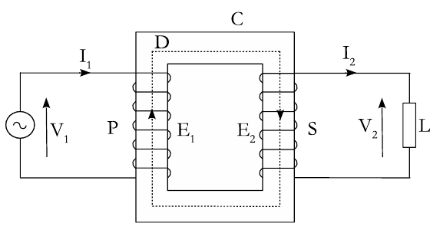
Working principle: mutual induction
U2
AC voltage V1 on primary P drives alternating current.
This produces alternating flux φ in the core.
Flux links the secondary S: EMF E2 induced (mutual induction).
Flux also induces E1 in the primary (self-induction).
Notes:
The primary and secondary have no electrical connection; energy is transferred magnetically through the core flux.

Slide 5
Ideal transformer relations
U2
E2/E1 = N2/N1 = K
V1 I1 = V2 I2
I1/I2 = N2/N1 = V2/V1
voltage (turns) ratio
volt-ampere balance
current ratio
K > 1: step-up; K < 1: step-down.
Ampere-turns balance: N1 I1 = N2 I2 (ideal).
Notes:
In an ideal transformer there are no losses and no leakage flux, so the induced emfs equal the terminal voltages.

Slide 6
Effect of loading
U2
1
2
3
4
No load
Load connected
Flux dips
Primary current rises
Primary draws a small magnetising current to set up the flux.
Secondary current I2 flows and by Lenz's law demagnetises the core.
Net flux and E1 fall slightly, so E1 < V1.
Extra primary current restores the flux until N1 I1 ≈ N2 I2.
Flux in a transformer stays almost constant from no load to full load.
Notes:
This self-regulating action explains why the primary current automatically follows the load.

Slide 7
Numerical: turns ratio
U2
Problem A single-phase transformer has 1000 primary turns and 200 secondary turns on 230 V. The secondary load is 5 A. Find V2 and I1 (ideal).
K = N2/N1 = 200/1000 = 0.2
V2 = K V1 = 0.2 × 230 = 46 V
I1 = K I2 = 0.2 × 5
Answer: V2 = 46 V, I1 = 1 A
Notes:
A step down transformer has low secondary voltage and high secondary current.

Slide 8
Key takeaways
U2
Transformers make efficient long-distance AC transmission possible
Principle: mutual induction between coupled windings
V2/V1 = N2/N1 = I1/I2 (ideal)
Load current is balanced by extra primary ampere-turns
Notes:
To summarise this topic. Transformers make efficient long-distance AC transmission possible. Principle: mutual induction between coupled windings. V2/V1 = N2/N1 = I1/I2 (ideal). Load current is balanced by extra primary ampere-turns.

Slide 9
Practice questions
U2
Q1. Why is power transmitted at high voltage?
Q2. A 2200/220 V transformer has 400 primary turns. Find secondary turns.
Q3. A 5 kVA, 230/115 V transformer: find full-load currents.
Q4. Explain why a transformer does not work on DC.
Notes:
Attempt these on your own, then check your working against your notes and textbook. Why is power transmitted at high voltage? A 2200/220 V transformer has 400 primary turns. Find secondary turns. A 5 kVA, 230/115 V transformer: find full-load currents. Explain why a transformer does not work on DC.

