Slide 1

UNIT 2 · 9 hours
Torque Equation and Characteristics of the DC Shunt Motor
Transformers and Electrical Machines
Basic Electrical and Electronics Engineering (EEE103)
Dr. Mitesh Astik · Dept. of Electrical and Electronics Engineering
NMAM Institute of Technology, Nitte · 2025-26
Notes:
Welcome. In this session we study "Torque Equation and Characteristics of the DC Shunt Motor", part of Unit 2 (Transformers and Electrical Machines) of Basic Electrical and Electronics Engineering.

Slide 2
Learning objectives
U2
Derive the armature torque equation
Distinguish armature torque from shaft torque
Draw and explain shunt motor characteristics
Summarise other motor types and applications
Syllabus context
DC Motor: principle of operation, back EMF and its significance, torque equation, characteristics and speed control (armature and field) of DC shunt motor.
Notes:
By the end of this topic you should be able to do the following. Derive the armature torque equation. Distinguish armature torque from shaft torque. Draw and explain shunt motor characteristics. Summarise other motor types and applications.

Slide 3
Deriving the torque equation
U2
1
2
3
4
Power
Equate
Substitute
Result
Mechanical power = Ta × ω = Ta (2πN/60).
Ta (2πN/60) = Eb Ia.
Eb = Z N φ P/(60A).
Ta = 0.159 φ Z Ia (P/A) N·m.
Ta ∝ φ Ia. For a shunt motor φ is constant, so Ta ∝ Ia.
Notes:
Equating mechanical power and the electrical equivalent gives the torque equation.

Slide 4
Armature and shaft torque
U2
Ta = Eb Ia / (2πN/60)
Ti = Pi / (2πN/60)
Tsh = Ta − Ti = (Eb Ia − Pi)/(2πN/60)
gross (armature) torque
lost in iron + friction
useful shaft torque
Output power = Tsh × 2πN/60.
BHP = Output / 735.5 (metric horsepower).
Notes:
Only the shaft torque is available to drive the load.

Slide 5
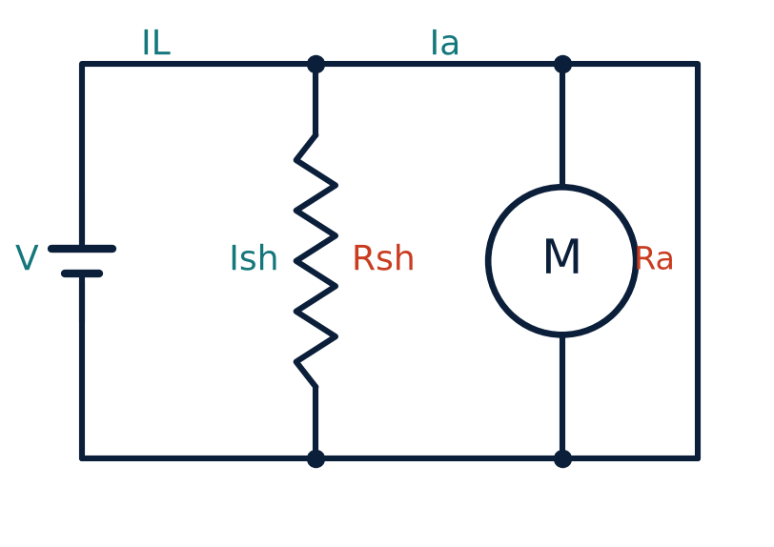
Shunt motor connection
U2
Field winding in parallel with the armature.
Field current Ish = V/Rsh is nearly constant, so flux is constant.
IL = Ia + Ish.
Eb = V − Ia Ra.
Notes:
In the shunt motor the field is connected across the supply.

Slide 6
Shunt motor characteristics
U2
Torque vs Ia
Speed vs Ia
Speed vs torque
Ta ∝ Ia: a straight line through the origin. Shaft torque is slightly lower.
N ∝ Eb/φ. Eb falls slightly with load, so speed drops only 3–5 %: constant-speed motor.
Same shape as speed vs Ia: nearly flat, slightly drooping.
Notes:
The shunt motor is practically a constant speed motor.

Slide 7
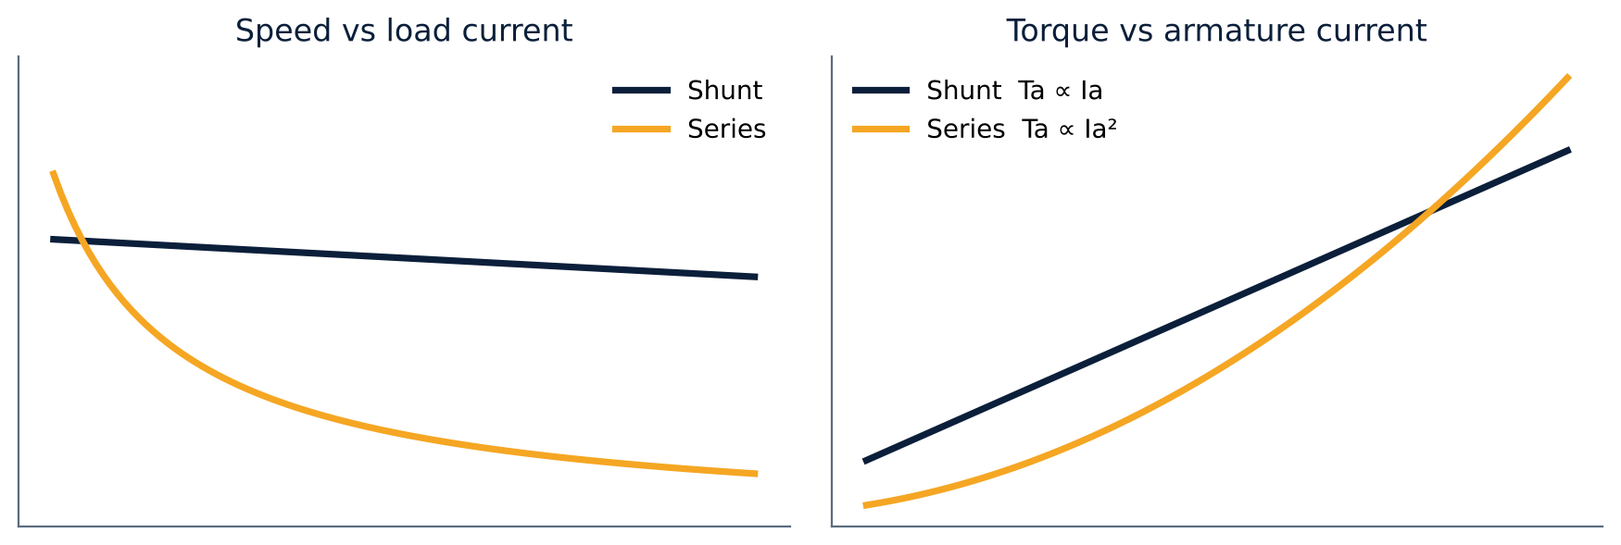
Shunt versus series characteristics
U2
Shunt: speed almost constant.
Series: Ta ∝ Ia², N ∝ 1/Ia: very high starting torque.
Never start a series motor without load.
Notes:
The series motor is used where high starting torque is needed.

Slide 8
Types of DC motors and applications
U2
Type | Characteristic | Applications
Shunt | Constant speed | Lathes, pumps, fans, machine tools
Series | High starting torque | Cranes, hoists, traction
Cumulative compound | High torque, fairly steady speed | Punches, elevators, rolling mills
Differential compound | Wide speed variation | Special drives
Notes:
Compound motors have both series and shunt field windings.

Slide 9
Numerical: series motor torque
U2
Problem A 6-pole lap-wound 400 V series motor: Z = 920, φ = 0.045 Wb, total resistance 0.6 Ω, iron + friction loss 2 kW, line current 90 A. Find Ta, speed, Tsh and output.
Ta = 0.159 × 0.045 × 920 × 90 × (6/6) = 592.4 N·m
Eb = 400 − 90 × 0.6 = 346 V; N = 60 A Eb/(Z φ P) = 501.5 rpm
Ti = 2000/(2π × 501.5/60) = 38.1 N·m; Tsh = 554.3 N·m
Output = Tsh × ω = 554.3 × 52.5
Answer: Ta = 592.4 N·m, Tsh = 554.3 N·m, output ≈ 29.1 kW
Notes:
The calculation follows the notes: first back emf, then speed, then the shaft torque.

Slide 10
Key takeaways
U2
Ta = 0.159 φ Z Ia (P/A) N·m
Shaft torque = armature torque − iron and friction torque
Shunt motor: Ta ∝ Ia, almost constant speed
Series motor: very high starting torque, never run unloaded
Notes:
To summarise this topic. Ta = 0.159 φ Z Ia (P/A) N·m. Shaft torque = armature torque − iron and friction torque. Shunt motor: Ta ∝ Ia, almost constant speed. Series motor: very high starting torque, never run unloaded.

Slide 11
Practice questions
U2
Q1. Derive the torque equation of a DC motor.
Q2. A shunt motor has Ta = 50 N·m at Ia = 20 A. Find Ta at Ia = 30 A (φ constant).
Q3. Why is the shunt motor called a constant-speed motor?
Q4. A motor delivers 7.5 kW at 1000 rpm. Find the shaft torque.
Notes:
Attempt these on your own, then check your working against your notes and textbook. Derive the torque equation of a DC motor. A shunt motor has Ta = 50 N·m at Ia = 20 A. Find Ta at Ia = 30 A (φ constant). Why is the shunt motor called a constant-speed motor? A motor delivers 7.5 kW at 1000 rpm. Find the shaft torque.

